Slide 1

MUREX:
A Mutable Replica Control Scheme for Structured
Peer-to-Peer Storage Systems
Presented by
Jehn-Ruey Jiang
National Central University
Taiwan, R. O. C.

Slide 2
Outline
P2P Storage Systems
The Problems
MUREX
Analysis and Simulation
Conclusion

Slide 3
Outline
P2P Storage Systems
The Problems
MUREX
Analysis and Simulation
Conclusion

Slide 4
P2P Storage Systems
To aggregate idle storage across the Internet to be a huge storage space
Towards Global Storage Systems
  Massive Nodes
  Massive Capacity

Slide 5
Unstructured vs. Structured
Unstructured:
  No restriction on the interconnection of nodes
  Easy to build but not scalable
Structured:
  Based on DHTs (Distributed Hash Tables)
  More scalable
Our Focus!!

Slide 6
Non-Mutable vs. Mutable
Non-Mutable (Read-only):
  CFS
  PAST
  Charles
Mutable:
  Ivy
  Eliot
  Oasis
  Om
Our Focus!!

Slide 7
Replication
Data objects are replicated for the purpose of fault-tolerance
Some DHTs have provided replication utilities, which are usually used to replicate routing states
The proposed protocol replicates data objects in the application layer so that it can be built on top of any DHT
➔high data availability

Slide 8
One-Copy Equivalence
Data consistency Criterion
The set of replicas must behave as if there were only a single copy
Conditions:
  no pair of write operations can proceed at the same time,
  no pair of a read operation and a write operation can proceed at the same time,
  a read operation always returns the replica that the last write operation writes.

Slide 9
Synchronous vs. Asynchronous
Our Focus
Synchronous Replication
  Each write operation should finish updating all replicas before the next write operation proceeds.
  Strict data consistency
  Long operation latency
Asynchronous Replication
  A write operation is written to the local replica; data object is then asynchronously written to other replicas.
  May violate data consistency
  Shorter latency
  Log-based mechanisms to roll back the system

Slide 10
Fault Models
Fail-Stop
  Nodes just stop functioning when they fail
Crash-Recovery
  Failures are detectable
  Nodes can recover and rejoin the system after state synchronization
Byzantine
  Nodes may act arbitrary

Slide 11
Outline
P2P Storage Systems
The Problems
MUREX
Analysis and Simulation
Conclusion

Slide 12
Three Problems
Replica migration
Replica acquisition
State synchronization

Slide 13

DHT – Node Joining
s
Data Object
Hash Function
k_{s}
Replica Migration
0
2¹²⁸-1
Hashed Key Space
Peer
Nodes
u
v
node joining

Slide 14
DHT – Node Leaving
r
Data Object
Hash Function
k_{r}
Replica Acquisition
0
2¹²⁸-1
Hashed Key Space
r
r
Data Object
State Synchronization
Peer
Nodes
p
q
node leaving

Slide 15
Outline
P2P Storage Systems
The Problems
MUREX
Analysis and Simulation
Conclusion

Slide 16
The Solution - MUREX
A mutable replica control scheme
  Keeping one-copy equivalence for synchronous P2P storage replication under the crash-recovery fault model
  Based on Multi-column read/write quorums

Slide 17
Operations
Publish(CON, DON)
  CON: Standing for CONtent
  DON: Standing for Data Object Name
Read(DON)
Write(CON, DON)

Slide 18
Synchronous Replication
n replicas for each data object
  K₁=HASH₁(Data Object Name), …, K_{n}=HASH_{n}(Data Object Name)
Using read/write quorums to maintain data consistency (one-copy equivalence)

Slide 19
Data Replication
Data Object
replica n
replica 2
replica 1
r
r
r
r
Hash Function 1
Hash Function 2
…
Hash Function n
k₂
k₁
k_{n}
0
2¹²⁸-1
Hashed Key Space
Peer
Nodes

Slide 20
Quorum-Based Schemes (1/2)
High data availability and low communication cost
n replicas with version numbers
Read operation
  Read-lock and access a read quorum
  Obtaining a largest-version-number replica
Write operation
  Write-lock and access a write quorum
  Updating all replicas with the new version number
the largest
+ 1

Slide 21
Quorum-Based Schemes (2/2)
One-copy equivalence is guaranteed If we restrict
  Write-write and write-read lock exclusion
  Intersection Property
    A non-empty intersection in any pair of
      A read quorum and a write quorum
      Two write quorums

Slide 22
Multi-Column Quorums
Smallest quorums: constant-sized quorums in the best case
  Smaller quorums imply lower communication cost
May achieve the highest data availability

Slide 23
Messages
LOCK (WLOCK/RLOCK)
OK
WAIT
MISS
UNLOCK

Slide 24
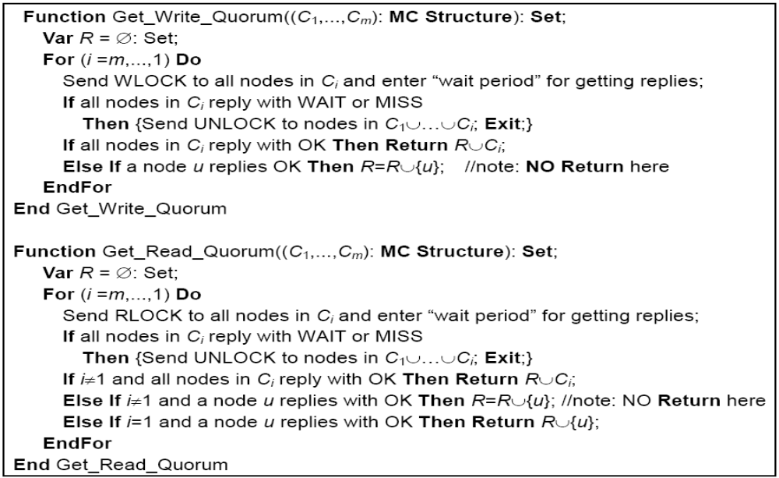
Algorithms for Quorum Construction

Slide 25
Three Mechanisms
Replica pointer
On-demand replica regeneration
Leased lock

Slide 26
Replica pointer
A lightweight mechanism to emigrate replicas
A five-tuple:
(hashed key, data object name, version number, lock state, actual storing location)
It is produced when a replica is first generated.
It is moved between nodes instead of the actual data object,

Slide 27
On-demand replica regeneration (1/2)
When node p receives LOCK from node u, it sends a MISS if it
  does not have the replica pointer
  has the replica pointer which indicates that v stores the replica, but v is not alive
After executing the desired read/write operation, node u will send the newest replica obtained/generated to node p

Slide 28
On-demand replica regeneration (2/2)
Acquiring replicas only when they are requested
Dummy read operation
  Performed periodically for rarely-accessed data object
  To check if replicas of data object are still alive
  To re-disseminate replicas to proper nodes to keep data persistency

Slide 29
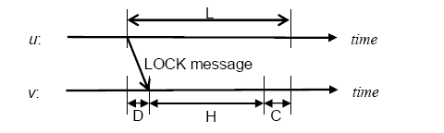
Leased lock (1/2)
A lock expires after a lease period of L
A node should release all locks if it is not in CS and H>L-C-D holds.
  H: The holding time of the lock
  D: The propagation delay
  C: time to be in CS

Slide 30
Leased lock (2/2)
When releasing all locks, a node starts over to request locks after a random backoff time
If a node starts to substitute another node at time T, a newly acquired replica can start to reply to LOCK requests at time T+L

Slide 31
Correctness
Theorem 1. (Safety Property)
  MUREX ensures the one-copy equivalence consistency criterion
Theorem 2. (Liveness Property)
  There is neither deadlock nor starvation in MUREX

Slide 32
Outline
P2P Storage Systems
The Problems
MUREX
Analysis and Simulation
Conclusion

Slide 33
Communication Cost
If no contention
  In the best case: 3s messages
    One LOCK
    One OK
    One UNLOCK
  When failures occur
    Communication cost increases gradually
  In the worst case: O(n) messages
    A node sends LOCK message to all n replicas
    (there are related UNLOCK, OK, WAIT messages)
s: the size of the last column of multi-column quorums

Slide 34
Simulation
Environment
  The underlying DHT is Tornado
  For quorums under four multi-column structures
    MC(5, 3), MC(4, 3), MC(5, 2) and MC(4, 2)
  For MC(m, s), the leased period is assumed to be m*(turn-around time)
  2000 nodes in the system
  Simulation for 3000 seconds
  10000 operations are requested
    Half for reading and half for writing
    Each request is assumed to be destined for a random file (data object)

Slide 35
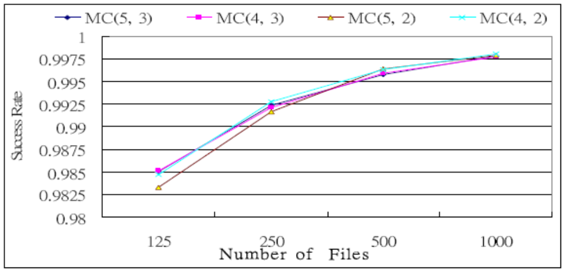
Simulation Result 1
The probability that a node succeeds to perform the desired operation before the leased lock expires
1st experiment: no node join or leave
Degree of Contention

Slide 36
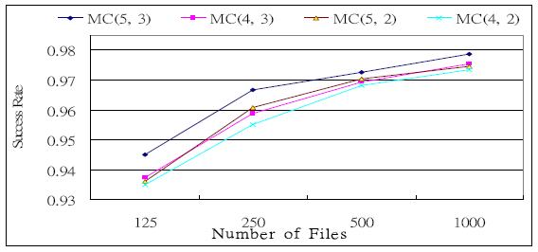
Simulation Result 2
2nd experiment: 200 out of 2000 nodes may join/leave at will

Slide 37
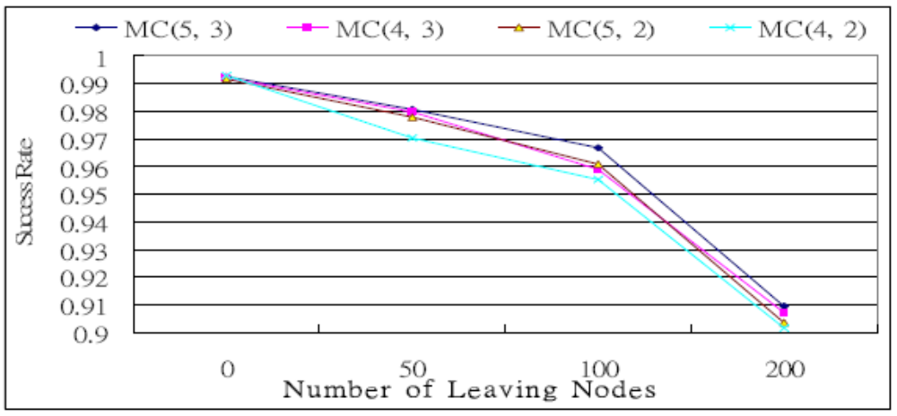
Simulation Result 3
3rd experiment: 0, 50, 100 or 200 out of 2000 nodes may leave

Slide 38
Outline
P2P Storage Systems
The Problems
MUREX
Analysis and Simulation
Conclusion

Slide 39
Conclusion
Identify three problems for synchronous replication in P2P mutable storage systems
  Replica migration
  Replica acquisition
  State synchronization
Propose MUREX to solve the problems by
  Multi-column read/write quorums
  Replica pointer
  On-demand replica regeneration
  Leased lock

Slide 40
Thanks!!

