Slide 1
OBJECT-ORIENTED TESTING
Dr. Durga Prasad Mohapatra
Professor
Department of Computer Science and Engineering
National Institute of Technology, Rourkela.

Slide 2
Introduction
More than 50% of development effort is being spent on testing.
Quality and effective reuse of software depend to a large extent on thorough testing.
The nature of OO programs changes both testing strategy and testing tactics.
Most research on OO paradigms focus on analysis and design
Binder argues that more testing is needed to obtain high reliability in OO systems, since each reuse is a new context of usage.

Slide 3
When should testing begin?
Analysis and Design:
  Testing begins by evaluating the OOA and OOD models
  How do we test OOA models (requirements and use cases)?
  How do we test OOD models (class and sequence diagrams)?
  Structured walk- through, prototypes
  Formal reviews of correctness, completeness and consistency

Slide 4
Contd…
Programming:
  How does OO makes testing different from procedural programming?
  Concept of a ‘unit’ broadens due to class encapsulation
  Integration focuses on classes and their execution across a ‘thread’
  or in the context of a use case scenario
  Validation may still use conventional black box methods

Slide 5
Strategic Issues
Issues to address for a successful software testing strategy:
  Specify product requirements long before testing commences
  For example: portability, maintainability, usability
  Do so in a manner that is unambiguous and quantifiable
  Understand the users of the software, with use cases
  Develop a testing plan that emphasizes “rapid cycle testing”
  Get quick feedback from a series of small incremental tests
  Build robust software that is designed to test itself
  Use assertions, exception handling and automated testing tools (Junit).
  Conduct formal technical reviews to assess test strategy & test cases.

Slide 6
Testing OOA and OOD Models
The review of OO analysis and design models is especially useful because the same semantic constructs (e.g., classes, attributes, operations, messages) appear at the analysis, design, and code level.
Therefore, a problem in the definition of class attributes that is uncovered during analysis will circumvent side effects that might occur if the problem was not discovered until design or code (or even the next iteration of analysis).
By fixing the number of attributes of a class during the first iteration of OOA, the following problems may be avoided:
  Creation of unnecessary subclasses.
  Incorrect class relationships.
  Improper behavior of the system or its classes.

Slide 7
Contd…
If the error is not uncovered during analysis and propagated further more efforts needed during design or coding stages.
Analysis and design models cannot be tested in the conventional sense, because they cannot be executed.
Formal technical review can be used to examine the correctness and consistency of both analysis and design models.

Slide 8
Contd…
Correctness:
  Syntax: Each model is reviewed to ensure that proper modeling conventions have been maintained.
  Semantic: Must be judged based on the model’s conformance to the real world problem domain by domain experts.
Consistency:
  May be judged by considering the relationship among entities in the model.
  Each class and its connections to other classes should be examined.
  The Class-responsibility-collaboration model and object-relationship diagram can be used.

Slide 9
Major Challenges in OO Testing
What is an appropriate unit for testing ?
Implications of OO Features:
  Encapsulation
  Inheritance
  Polymorphism & Dynamic Binding
State-based testing
Test coverage analysis
Integration strategies
Test process strategy

Slide 10
Object-Oriented Testing Strategies
Black Box Testing:
Black box testing treats the system as a "black-box", so it doesn't explicitly use Knowledge of the internal structure.
It focuses on the functionality part of the module. It is the testing based on an analysis of the specification of a piece of software without reference to its internal workings.
The goal is to test how well the component conforms to the published requirements for the component.
Specifically, this technique determines whether combinations of inputs and operations produce expected results.

Slide 11
Characteristics
It attempts to find:
Incorrect or missing functions
Interface errors
Errors in data structures or external database access
Performance errors
Initialization and termination errors

Slide 12
White Box Testing
White box testing involves looking at the structure of the code.
All internal components should be adequately exercised.
It is the testing based on an analysis of internal workings and structure of a piece of software.
It is also known as Structural Testing / Glass Box Testing / Clear Box Testing.

Slide 13
Characteristics
white box testing tends to involve the coverage of the specification in the code.
Aims to establish that the code works as designed.
Examines the internal structure and implementation of the program.
Target specific paths through the program.
Needs accurate knowledge of the design, implementation and code.

Slide 14
Object-Oriented Testing Levels
unit tests
integration
tests
system
tests
validation
tests

Slide 15
Unit Testing
Smallest testable unit is the encapsulated class or object
A single operation needs to be tested as part of a class hierarchy because its context of use may differ subtly
Class testing is the equivalent of unit testing in conventional software approach:
  Methods within the class are tested
  The state behavior of the class is examined
Class testing focuses on designing sequences of methods to exercise the states of a class

Slide 16
Class testing
In class testing, unit testing is applied for each class
Class testing uses a variety of methods :
  Fault-based testing
  Random testing
  Partition testing
Each method exercises the operations encapsulated by class
Test sequences are designed to ensure that relevant operations are used
The state of the class, represented by the values of its attributes, is examined to determine if errors exist

Slide 17
Fault-Based Testing
The main objective is to design tests that have a high likelihood of uncovering plausible faults (i.e. aspects of the implementation of the system that may result in defects).
Test cases are designed to exercise the design or code to determine whether these faults exists or not.
Fault-based testing can find significant number of errors with low expenditure of effort.
The three types of faults encountered are : unexpected result, wrong operation/message used , incorrect invocation.

Slide 18
Examples
Example 1: Boundary value error:
  When a SQRT operation that returns errors for negative value and zero itself.
  Zero itself checks whether the programmer made a mistake like
  “if (x>0) calculate_the_square_root();”
  Instead of the correct:
  “if (x>=0) calculate_the_square_root(); ”

Slide 19
Contd…
Example2: consider a Boolean expression:
  “ if (a && !b || c) ”
  Multiconditon testing and related techniques probe for certain plausible faults such as :
  “&& ” should be an “ || ”
  “! ” was left out where it was needed
  There should be a parentheses around “ !b || ”
Fault-based testing misses two types of errors : incorrect specifications and interactions among subsystems

Slide 20
Random Class Testing
Identify methods applicable to a class
Define constraints on their use – e.g. the class must always be initialized first
Identify a minimum test sequence – an operation sequence that defines the minimum life history of the class
Generate a variety of random (but valid) test sequences – this exercises more complex class instance life histories
Example:
An account class in a banking application has open, setup, deposit, withdraw, balance, summarize, creditLimit, and close methods.

Slide 21
Contd…
  The constraint of all operations is that the account must be opened first and closed on completion
Minimum behavior is
Open – setup – deposit – withdraw – close
Generate random test sequences using this template
Open – setup – deposit –* [deposit | withdraw | balance | summarize| creditLimit] – withdraw – close.
Test case 1:
Open – setup – deposit –deposit – balance- summarize– withdraw – close.
Test case 2:
Open – setup – deposit –withdraw -` deposit- balance-creditLimit- withdraw – close.

Slide 22
Partition Class Testing
Reduces the number of test cases required (similar to equivalence partitioning)
Input and output are categorized , and test cases are designed to exercise each category.

Slide 23
Contd…
State-based partitioning:
  Categorize and test methods separately based on their ability to change the state of a class
  Example: deposit and withdraw change state but balance does not
Test case 1:
Open – setup – deposit –deposit –withdraw– withdraw – close.
Test case 2:
Open – setup – deposit –summarize-creditLimit– withdraw – close.

Slide 24
Contd…
Attribute-based partitioning:
  Categorize and test operations based on the attributes that they use
  Example: attributes balance and creditLimit can define partitions
  Operations are divided into three partitions:
    Operations that use creditLimit
    Operations that modify creditLimit
    Operations that do not use or modify creditLimit

Slide 25
Contd…
Category-based partitioning:
  Categorize and test operations based on the generic function each performs
  Example: initialization (open, setup), computation (deposit, withdraw), queries (balance, summarize), termination (close)

Slide 26
Integration Testing
Object-Oriented software does not have a hierarchical control structure so conventional top-down and bottom-up integration tests have little meaning
Integration applied three different incremental strategies
  Thread-based testing: integrates the set of classes that collaborate to respond to one input or event
  Use-based testing: integrates classes required by one use case
  Cluster testing: integrates classes required to demonstrate one collaboration

Slide 27
Thread-based integration Strategies
A thread consists of all the classes needed to respond to a single external input.
Each thread is integrated and tested individually.
Regression testing is applied to ensure that no side effects occur.

Slide 28
Use-based integration Strategies
Use-based testing begins by testing classes that use few or no server classes
Next, dependent classes that use the independent group of classes are tested, followed by classes that use the dependent group, and so on.
Sequence of testing layers of dependent classes continues until the entire system is constructed.

Slide 29
Cluster Testing
A cluster is a collection of classes (possibly from different systems) cooperating with each other via messaging.
A cluster specification should include methods from each class that will be accessed
Cluster testing focuses on the interaction among the instances of the classes in the cluster
It assumes that each class has been tested individually
Cluster testing is considered a second level of integration testing

Slide 30
Scenario-Based Test Design
Scenario-based testing captures the tasks (via use cases) that the user has to perform ,then applying them and their variants as tests.
Scenarios uncover interaction errors
Test cases must be more complex and more realistic than fault-based tests
Scenario-based testing tends to exercise multiple subsystems in a single test

Slide 31
Contd…
Example:
Use Case 1: Fix the Final Draft
Background: It's not unusual to print the "final" draft, read it, and discover some annoying errors that weren't obvious from the on-screen image. This use-case describes the sequence of events that occurs when this happens
  Print the entire document
  Move around in the document, changing certain pages.
  As each page is changed, it’s printed.
  Sometimes a series of pages is printed.
This scenario describes two things : a test and specific user needs.

Slide 32
Contd…
Use Case 2: Print a New Copy
Background: Someone asks for a fresh copy of the document. It must be printed.
  Open the document.
  Print it.
  Close the document.
After the “Fix the Final Draft ” scenario, just selecting “Print ” in the menu will print the last corrected page again.

Slide 33
Contd…
So the correct scenario according to the editor is :
Use Case 2: Print a New Copy
  Open the document.
  Select “Print ” in the menu.
  Check if you’re printing a page range; if so, click to print the entire document.
  Click on the “Print ” button
  Close the document.

Slide 34
Random Integration Testing
Multiple Class Random Testing
  For each client class, use the list of class methods to generate a series of random test sequences. The methods will send messages to other server classes
  For each message that is generated, determine the collaborating class and the corresponding method in the server object
  For each method in the server object (that has been invoked by messages sent from the client object), determine the messages that it transmits
  For each of the messages, determine the next level of methods that are invoked and incorporate these into the test sequence

Slide 35
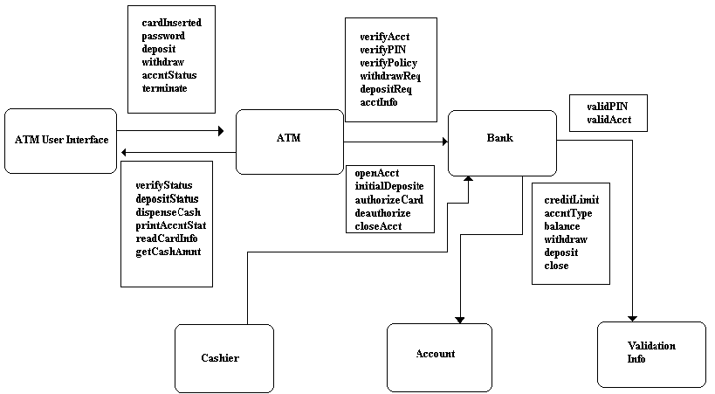
Class Collaboration Diagram for Banking Application

Slide 36
Example
Consider a sequence of operations for the BANK class relative to an ATM class
verifyAcct-verifyPIN- [[verifyPolicy -withdrawReq] | depositReq | acctInfoREQ ]^{n}
A random test case for the BANK class Test case 1:
verifyAcct-verifyPIN-depositReq

Slide 37
Contd …
In order to consider the collaborators involved in this test, the msgs. Associated with each of the operns noted in the above test case 1 are considered.
BANK must collaborate with validationInfo to execute the verifyAcct& verifyPin, with Acct. to execute depositRequest.
So, a new test case that exercises the above collaborations is
Test case 2: verifyAcct_{BANK} – [validAcct_{validationInfo}]- verifyPIN _{BANK}- [validPin_{validationInfo}]- depositReq _{BANK} – [deposit _{Account} ]

Slide 38
Contd…
Approach for multiple class partition testing is similar to the approach used for partition testing of individual classes.
A single class is partitioned as discussed earlier.
Here, the test sequence is expanded to include those operations that are invoked via messages to collaborating classes.

Slide 39
Contd…
An alternative approach
partitions the tests based on the interfaces to a particular class.
e. g. the bank class receives messages from ATM & Cashier classes.
The methods within the BANK can therefore be tested by partitioning them into those that serve ATM & those that serve Cashier.
The state based partitioning can be used to refine the partitions further.

Slide 40
Behavioral Integration Testing
Tests Derived from Behavioral Model:
Derive tests from the object-behavioral analysis model
Each state in a State diagram should be visited in a “breadth-first” fashion.
  Each test case should exercise a single transition
  When a new transition is being tested only previously tested transitions are used
  Each test case is designed around causing a specific transition

Slide 41
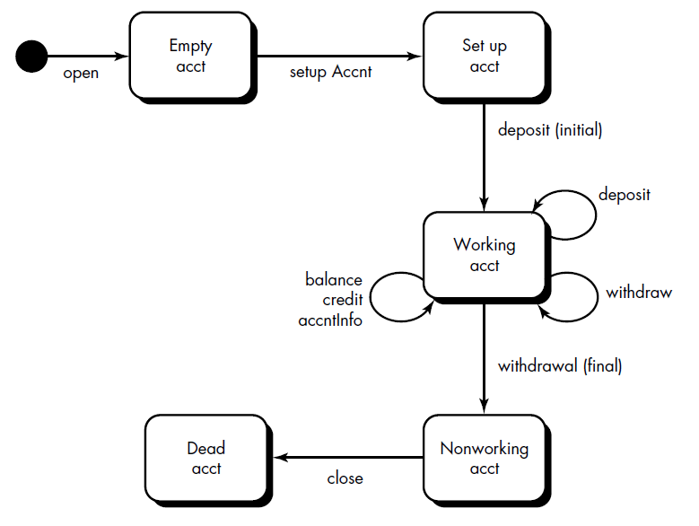

State transition diagram for account class

Slide 42
Contd…
Example:
  A credit card can move between undefined, defined, submitted and approved states
  The first test case must test the transition out of the start state undefined and not any of the other later transitions
  Initial transitions in account class move through the empty acct and setup acct states.
  The majority of all behavior for instances of the class occurs while in the working acct state.
  A final withdrawal and close cause the account class to make transitions to the nonworking acct and dead acct states, respectively

Slide 43
Contd…
Test case 1:
Open – setupAcct – deposit(initial)–withdraw(final)– close. (identical to the minimum test sequence)
Adding additional test sequences to it, we may get
Test case 2:
Open – setupAcct – deposit(initial)-deposit-balance-credit–withdraw(final)– close.
Test case 3:
Open – setupAcct – deposit(initial)-deposit-withdraw-accntInfo –withdraw(final)– close.

Slide 44
Generating Test cases from
State Chart Diagram (GeTeSC).
Step 1: Draw State chart diagram of the problems.
Step 2: Select predicates and draw state graph according to state chart diagram.
Step 3: Develop Java code for the state graph.
Step 4: Generate class file with the use of modelJunit.jar and JUnit.jar file.
Step 5: Generate the State coverage, Transition coverage, Transition pair coverage.
Step 6: Construction of EFSM from the source code
Step 7: Generate Test Sequences and Test Cases.
DEPT. OF CSE, NIT ROURKELA

Slide 45
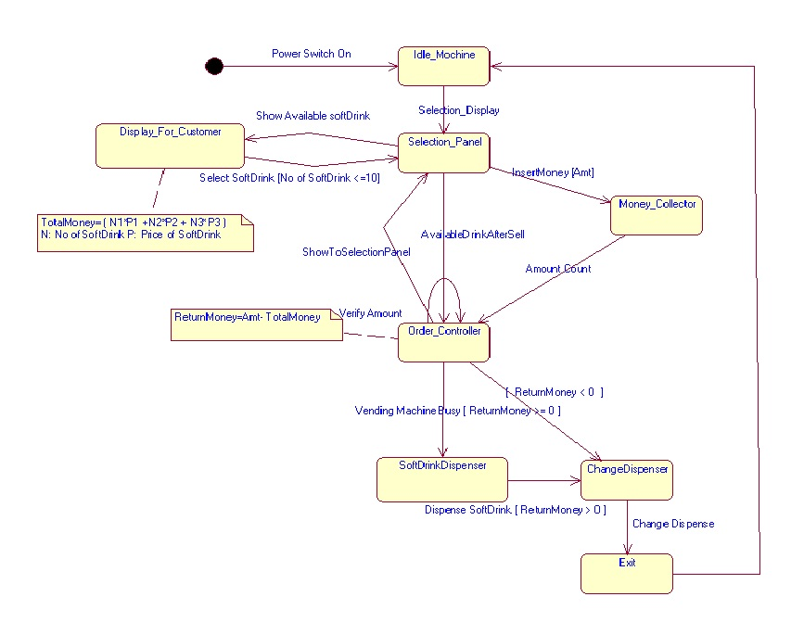
Case Study: SoftDrink Vending Machine
State Chart Diagram of SoftDrink Vending Machine

Slide 46
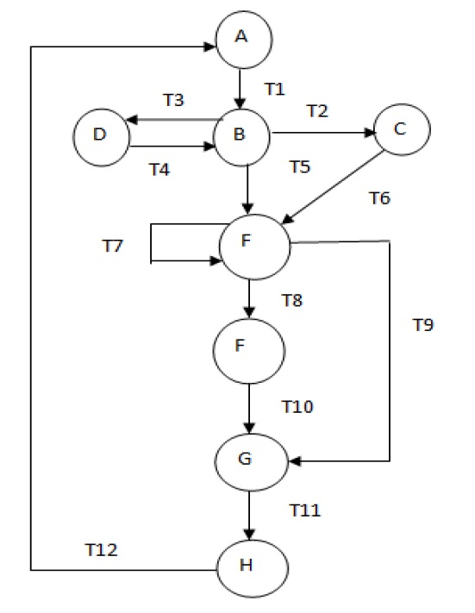
Cyclomatic Complexity of Our Case Study
McCabe cyclomatic complexity
The number of independent paths is given by
V (G) = e - n + 2
where n is the number of nodes and e is the number of arcs/edges
No of Edges = 12
No. Of Nodes = 8
V(G) = 12 - 8 + 2
V(G) = 6
State graph of SoftDrink Vending Machine
DEPT. OF CSE, NIT ROURKELA

Slide 47
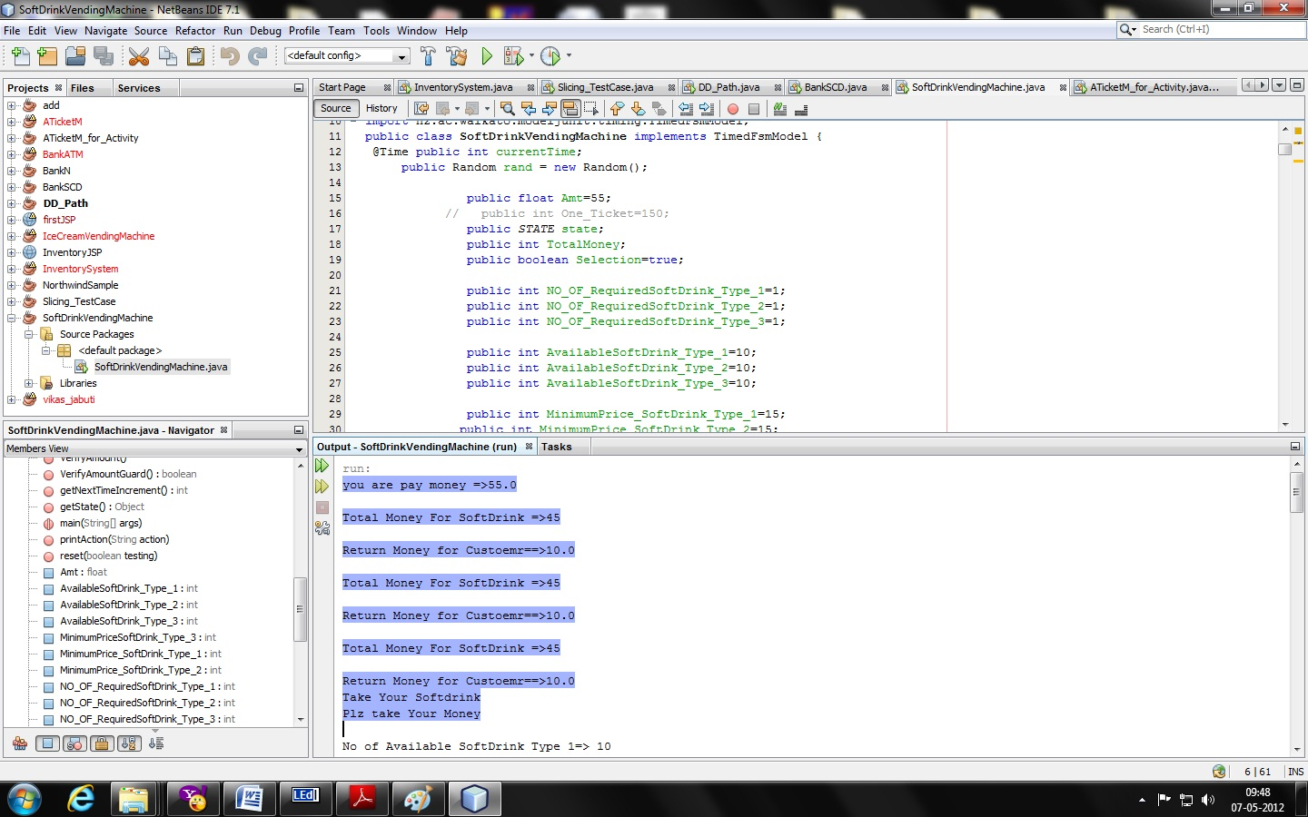
Source code for state graph
DEPT. OF CSE, NIT ROURKELA

Slide 48
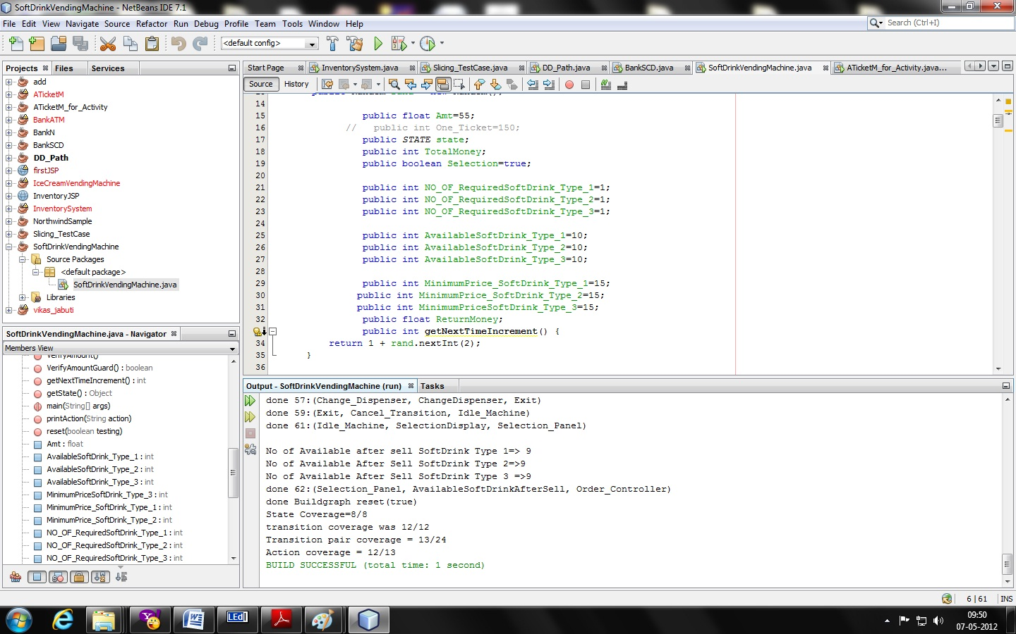
Coverage for state graph
DEPT. OF CSE, NIT ROURKELA

Slide 49
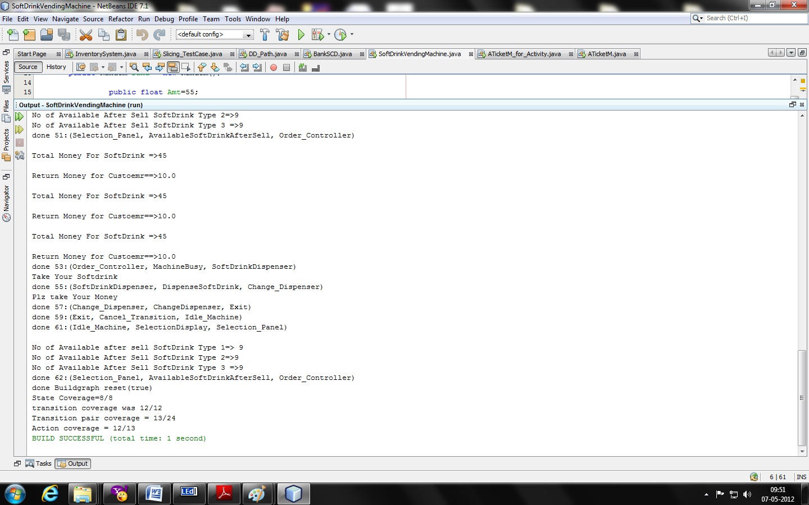
Output With Test Coverage & Test Sequence
DEPT. OF CSE, NIT ROURKELA

Slide 50
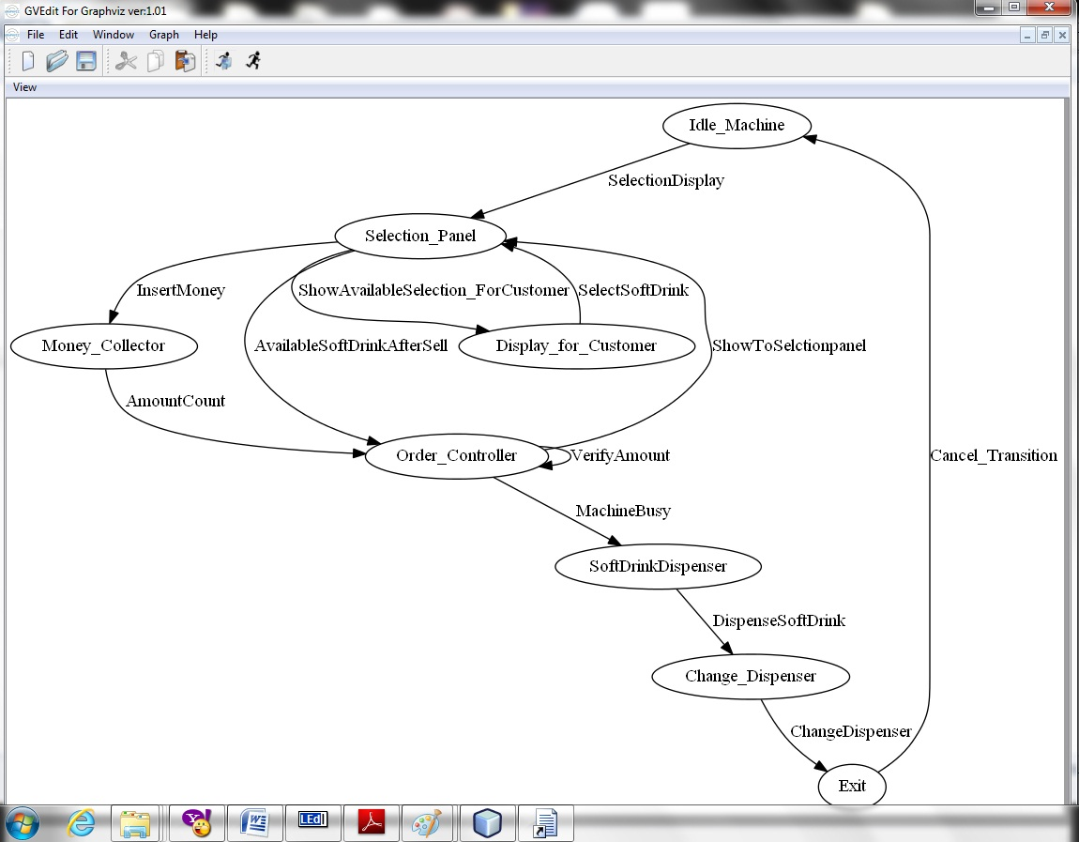
EFSM graph for State Graph
DEPT. OF CSE, NIT ROURKELA

Slide 51
Table 1: Table Showing Test Input with Expected Output & observed Output
TC_ID | INPUT |  |  |  |  | Expected | Observed
ID | Amt | Selection | N1 | N2 | N3 | Output | Output
1. | 50 | T | 1 | 1 | 1 | Issue Ticket, Return Money | Issue Ticket, Return Money
2. | 35 | T | 4 | 1 | 5 | Return Money | Return Money
3. | 45 | T | 1 | 1 | 1 | Issue Ticket | Issue Ticket
4. | 100 | F | 1 | 1 | 3 | Not Select Item | Not Select Item
5. | 500 | T | 10 | 10 | 10 | Return Money | Return Money
6. | 200 | T | 0 | 0 | 0 | Null Item Select | Null Item Select
7. | 500 | T | 11 | 1 | 1 | SD Not Available | SD Not Available
DEPT. OF CSE, NIT ROURKELA

Slide 52
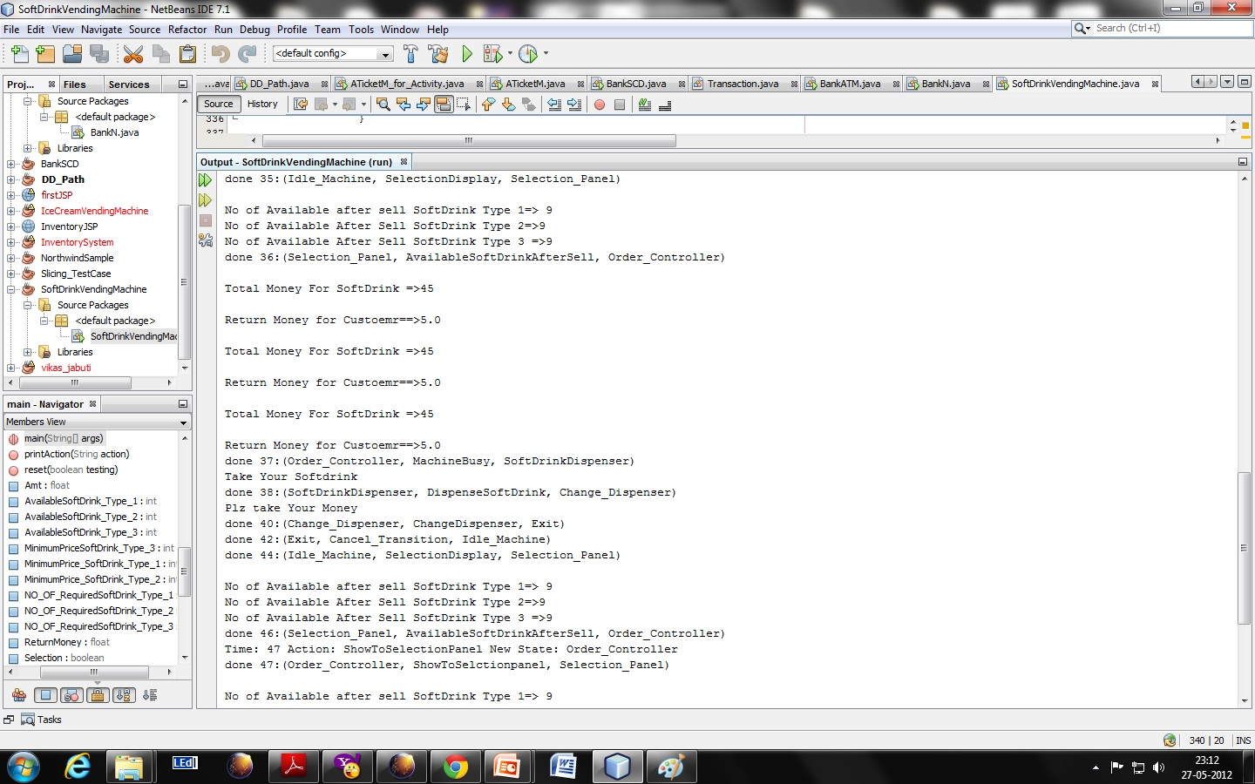
Test Sequence 1 for TC_ID 1 Output Snapshot:
DEPT. OF CSE, NIT ROURKELA

Slide 53
Test Sequence 1 for TC_ID I:
done :(Idle_Machine, SelectionDisplay, Selection_Panel)
done :(Selection_Panel, ShowAvailableSelection_ForCustomer, Display_for_Customer)
done :(Display_for_Customer, SelectSoftDrink, Selection_Panel)
done :(Selection_Panel, InsertMoney, Money_Collector)
done :(Money_Collector, AmountCount, Order_Controller)
done :(Order_Controller, VerifyAmount, Order_Controller)
done :(Order_Controller, ShowToSelctionpanel, Selection_Panel)
done :(Selection_Panel, AvailableSoftDrinkAfterSell, Order_Controller)
done :(Order_Controller, MachineBusy, SoftDrinkDispenser)
done :(SoftDrinkDispenser, DispenseSoftDrink, Change_Dispenser)
done :(Change_Dispenser, ChangeDispenser, Exit)
DEPT. OF CSE, NIT ROURKELA

Slide 54
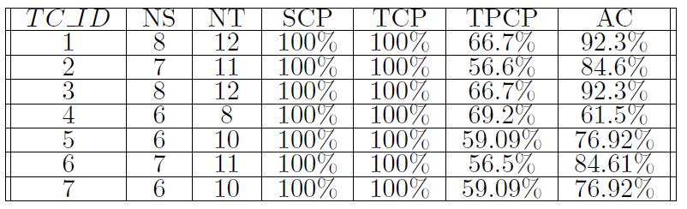
Table 2: TABLE Showing Test Coverage Achieved
DEPT. OF CSE, NIT ROURKELA

Slide 55
Validation Testing
Validation succeeds when software functions in a manner that can be reasonably expected by the customer.
Focus on user-visible actions and user-recognizable outputs
Details of class connections disappear at this level
Apply:
  Use-case scenarios from the software requirements specifications
  Black-box testing to create a deficiency list
  Acceptance tests through alpha (at developer’s site) and beta (at customer’s site) testing with actual customers

Slide 56
System Testing
Finally ,the system as a whole is tested to ensure that errors in requirements are uncovered .
Types of System Testing:
  Recovery testing: how well and quickly does the system recover from faults
  Security testing: verify that protection mechanisms built into the system will protect from unauthorized access (hackers, disgruntled employees, fraudsters)
  Stress testing: place abnormal load on the system
  Performance testing: investigate the run-time performance within the context of an integrated system

Slide 57
Testing Surface Structure
Surface structure refers to the externally observable structure of an OO program.
Here tests are based on user tasks, no matter whatever is the interface.
Capturing these tasks involves understanding watching, and talking with representative user ( also non-representative users)
Ex-In a conventional system with a command-oriented interface, the user might use the list of all commands as a testing checklist. If no test scenarios existed to exercise a command, testing has likely overlooked some user tasks (or the interface has useless commands).
Whatever the interface style, test case design that exercises the surface structure should use both objects and operations as clues leading to overlooked tasks.

Slide 58
Testing Deep Structure
Deep structure refers to the internal technical details of an OO program.
Deep structure testing is designed to exercise dependencies, behaviors, and communication mechanisms that have been established as part of the subsystem and object design of OO software.
Analysis and design models are used as the basis for deep structures testing.
Examples- the object-relationship diagram or the subsystem collaboration graph depicts collaborations between objects and subsystems that may not be externally visible. Test case designer checks whether some task exercises the collaboration noted on the object-relationship diagram or the sub system collaboration graph, if not then why not ?

Slide 59
Test Case Design For OO Software
Each test case should be uniquely identified and should be explicitly associated with the class to be tested
The purpose of the test should be stated
A list of testing steps should be developed for each test and should contain :
    A list of specified states for the object that is to be tested
    A list of messages and operations that will be exercised as a consequence of the test

Slide 60
Contd…
    A list of exceptions that may occur as the object is tested
    A list of external conditions (i.e., changes in the environment external to the software that must exist in order to properly conduct the test)
    Supplementary information that will aid in understanding or implementing the test

Slide 61
Challenges in Test Case Design
Encapsulation:
  Difficult to obtain a snapshot of a class without building extra methods which display the classes’ state
Inheritance:
  Each new context of use (subclass) requires re-testing because a method may be implemented differently (polymorphism).
  Other unaltered methods within the subclass may use the redefined method and need to be tested

Slide 62
Automated Testing Tools
Mercury Interactive
  Quick Test Professional: Regression testing
  WinRunner: UI testing
IBM Rational
  Rational Robot
  Functional Tester
Borland
  Silk Test
Compuware
  QA Run
AutomatedQA
  TestComplete

Slide 63
Automated Testing Tools
Mercury Interactive
  Quick Test Professional (QTP): Regression testing
  WinRunner: Functional / Regression / UI testing
  LoadRunner: Performance and Load testing of Client-Server applications
  TestDirector: Web based Test mgt tool;
  Advantage: can be used when 2 testing teams are located at
  different locations.
IBM Rational
  Rational Robot: Functional / Regression testing
  Rational Functional Tester (RFT): Functional / Regression testing
  Rational Quality Software: Test Suit Management
Segue Software
  Silk Test: Functional / Regression testing,
  Advantage: It has a provision for customized in-built recovery system

Slide 64
Automated Testing Tools
Compuware
  QA Run
AutomatedQA
  TestComplete: UI testing / Regression testing
Apache’s
  JMeter: an open source software used for performance and load testing .

Slide 65
Testing Summary
Testing is integrated with and affects all stages of the Software Engineering lifecycle
Strategies: a bottom-up approach – class, integration, validation and system level testing
Techniques:
  white box (look into technical internal details)
  black box (view the external behavior)

