Slide 1
Agile Based Software Development Models
Prof. Durga Prasad Mohapatra
Dept. of CSE, NIT Rourkela
India

Slide 2
Scrum

Slide 3
Introduction
Scrum is an Agile framework which concentrates on how team members should function to produce system flexibly in a constantly changing environment.
Scrum is concerned with the product owner, project lead, and the team working together in an intensive and interdependent manner.

Slide 4
Introduction cont …
Scrum process includes three phases:
Pre-game
Development
Post-game

Slide 5
Introduction cont …
There are six identifiable roles in Scrum that have different tasks and purposes during the process and its practices:
Scrum master
Product owner
Scrum team
Customer
User
Management

Slide 6
Scrum: Characteristics
Self-organizing teams
Product progresses in a series of month-long sprints (iterations or runs or development cycles)
Requirements are captured as items in a list, called product backlog
One of the agile processes

Slide 7
Scrum Life Cycle
Daily Scrum
Sprint
planning
Sprint
review
Scrum
Sprint
backlog
Product backlog
Product
increment
Daily Scrum Meeting
Design
Code
Test

Slide 8
Sprint
Scrum projects progress in a series of “sprints”
Analogous to XP iterations or time boxes
Target duration is one month
Software increment is designed, coded, and tested during the sprint
No changes are entertained during a sprint

Slide 9
Scrum Framework
Roles: Product Owner, Scrum Master, Scrum Team, Customer, End User, Management
Ceremonies: Sprint Planning, Sprint Review, Sprint Retrospective, and Daily Scrum Meeting
Artifacts: Product Backlog, Sprint Backlog, and Burndown Chart

Slide 10
Key Roles and Responsibilities in a Scrum Team
Product Owner
Represents customers’ views and interests.
Development Team
Team of 5 - 10 people with cross-functional skill sets.
Scrum Master (aka Project Manager)
Facilitates scrum process and resolves impediments at the team and organization level by acting as a buffer between the team and outside interference.

Slide 11
Product Owner
Defines the features of the product
Decides on release date and content
Prioritizes features according to usefullness
Adjusts features and priority every iteration, as needed
Accepts or reject work results.

Slide 12
The Scrum Master
Represents management in the project
Removes impediments
Ensures that the team is fully functional and productive
Enables close cooperation across all roles and functions
Shields the team from external interferences

Slide 13
Scrum Team
Typically 5-10 people
Cross-functional
Quality Assurance Engineers, Programmers, UI Designers, etc.
Teams are self-organizing
Membership can change only between sprints

Slide 14
Sprint
Fundamental process flow of Scrum
It is usually a month-long iteration:
during this time an incremental product functionality is completed
No outside influence is allowed to interfere with the Scrum team during the Sprint
Each day begins with the Daily Scrum Meeting

Slide 15
Ceremonies
Sprint Planning Meeting
Daily Scrum
Sprint Review Meeting

Slide 16
Sprint Planning
Goal is to produce Sprint Backlog
Product owner works with the Team to negotiate what Backlog Items
Scrum Master ensures that the Team agrees to the realistic goals

Slide 17
Daily Scrum
Daily
15-minutes
Stand-up meeting
Not for problem solving
Three questions:
What did you do yesterday?
What will you do today?
What obstacles are in your way?

Slide 18
Daily Scrum
Is NOT a problem solving session
Is NOT a way to collect information about WHO is behind the schedule
Is a meeting in which team members review what is done and make informal commitments to each other and to the Scrum Master
Is a good way for a Scrum Master to track the progress of the Team

Slide 19
Sprint Review Meeting
Team presents what it accomplished during the sprint
Typically takes the form of a demo of new features
Informal
2-hour prep time rule
Participants
Customers
Management
Product Owner
Other team members

Slide 20
Product Backlog
A list of all desired work on the project
Usually a combination of
story-based work (“let user search and replace”)
task-based work (“improve exception handling”)
List is prioritized by the Product Owner
Typically a Product Manager, Marketing, Internal Customer, etc.

Slide 21
Product Backlog
Requirements for a system, expressed as a prioritized list of Backlog Items
Managed and owned by Product Owner
Spreadsheet (typically)

Slide 22
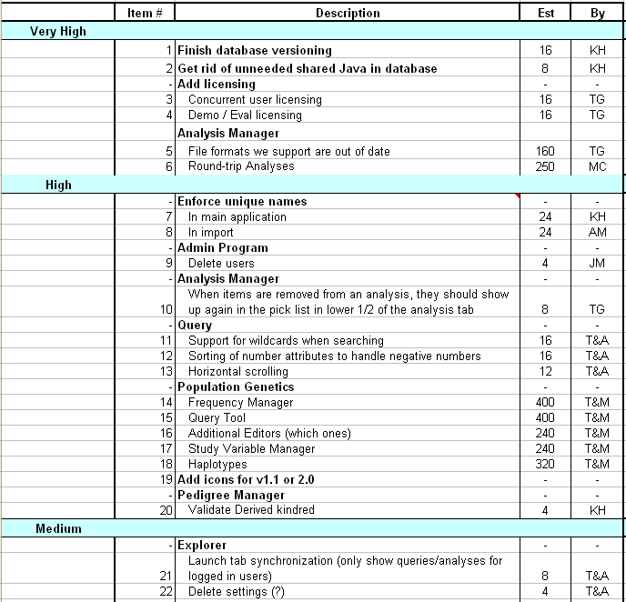
Sample Product Backlog

Slide 23
Sprint Backlog
A subset of Product Backlog Items, which defines the work for a Sprint
Created by Team members
Each Item has it’s own status
Updated daily

Slide 24
Sprint Backlog during the Sprint
Changes occur:
Team adds new tasks whenever they need in order to meet the Sprint Goal
Team can remove unnecessary tasks
But, Sprint Backlog can only be updated by the team
Estimates are updated whenever there’s new information

Slide 25
Burn down Charts
Are used to represent “work done”.
Are remarkably simple but effective Information disseminators
3 Types:
Sprint Burn down Chart (progress of the Sprint)
Release Burn down Chart (progress of release)
Product Burn down chart (progress of the Product)

Slide 26
Sprint Burn down Chart
Depicts the total Sprint Backlog hours remaining per day
Shows the estimated amount of time to complete
Ideally should burn down to zero to the end of the Sprint
Actually is not a straight line

Slide 27
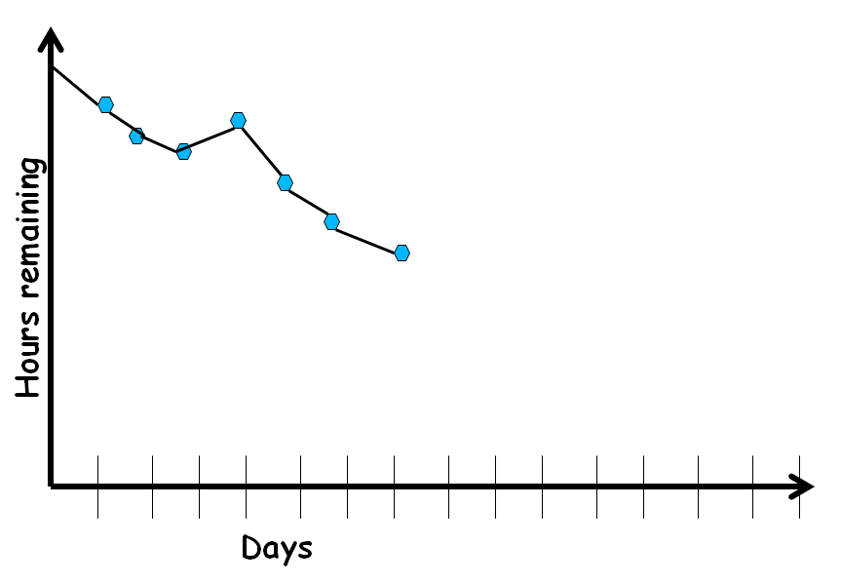
Sprint Burndown Chart

Slide 28
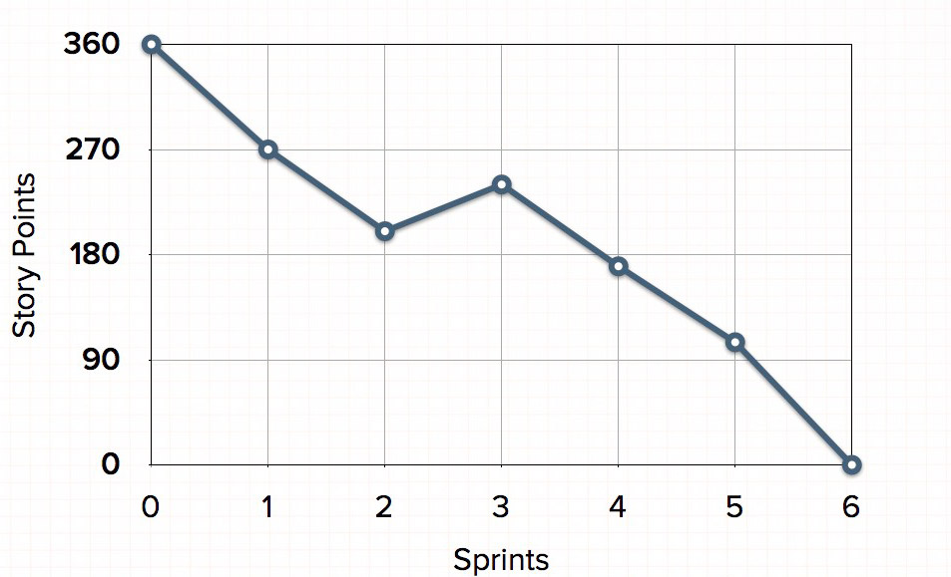
Release Burndown Chart
Will the release be done on right time?
How many more sprints?
X-axis: sprints
Y-axis: amount of story points remaining

Slide 29
Product Burndown Chart
It is a “big picture” view of project’s progress (all the releases)
Actual
burndown
Story
points
Expected
burndown
Sprint

Slide 30
Scalability of Scrum
A typical Scrum team is 6-10 people
Jeff Sutherland - up to over 800 people
“Scrum of Scrums” or “Meta-Scrum”

Slide 31
Extreme Programming (XP)

Slide 32
Extreme Programming Model
Extreme programming (XP) was proposed by Kent Beck in 1999.
The methodology got its name from the fact that:
Recommends taking the best practices to extreme levels.
If something is good, why not do it all the time.

Slide 33
Taking Good Practices to Extreme
If code review is good:
Always review --- pair programming
If testing is good:
Continually write and execute test cases --- test-driven development
If incremental development is good:
Come up with new increments every few days
If simplicity is good:
Create the simplest design that will support only the currently required functionality.

Slide 34
Taking to Extreme
If design is good,
everybody will design daily (refactoring)
If architecture is important,
everybody will work at defining and refining the architecture (metaphor)
If integration testing is important,
build and integrate test several times a day (continuous integration)

Slide 35
4 Values
Communication:
Enhance communication among team members and with the customers.
Simplicity:
Build something simple that will work today rather than something that takes time and yet never used
May not pay attention for tomorrow
Feedback:
System staying out of users is trouble waiting to happen
Courage:
Don’t hesitate to discard code

Slide 36
Best Practices
Coding:
without code it is not possible to have a working system.
Utmost attention needs to be placed on coding.
Testing:
Testing is the primary means for developing a fault-free product.
Listening:
Careful listening to the customers is essential to develop a good quality product.

Slide 37
Best Practices
Designing:
Without proper design, a system implementation becomes too complex
The dependencies within the system become too numerous to comprehend.
Feedback:
Feedback is important in learning customer requirements.

Slide 38
Extreme Programming Activities
XP Planning
Begins with the creation of “user stories”
Agile team assesses each story and assigns a cost
Stories are grouped to for a deliverable increment
A commitment is made on delivery date
XP Design
Follows the KIS principle
Encourage the use of CRC cards
For difficult design problems, suggests the creation of “spike solutions”—a design prototype
Encourages “refactoring”—an iterative refinement of the internal program design

Slide 39
Extreme Programming Activities
XP Coding
Recommends the construction of unit test cases before coding commences (test-driven development)
Encourages “pair programming”
XP Testing
All unit tests are executed daily
“Acceptance tests” are defined by the customer and executed to assess customer visible functionalities

Slide 40
Full List of XP Practices
Planning – determine scope of the next release by combining business priorities and technical estimates
Small releases – put a simple system into production, then release new versions in very short cycles
Metaphor – all development is guided by a simple shared story of how the whole system works
Simple design – system is to be designed as simple as possible
Testing – programmers continuously write and execute unit tests

Slide 41
Full List of XP Practices cont …
Refactoring – programmers continuously restructure the system without changing its behavior to remove duplication and simplify
Pair-programming -- all production code is written with two programmers at one machine
Collective ownership – anyone can change any code anywhere in the system at any time.
Continuous integration – integrate and build the system many times a day – every time a task is completed.

Slide 42
Full List of XP Practices
40-hour week – work no more than 40 hours a week as a rule
On-site customer – a user is a part of the team and available full-time to answer questions
Coding standards – programmers write all code in accordance with rules emphasizing communication through the code

Slide 43
Emphasizes Test-Driven Development (TDD)
Based on user story develop test cases
Implement a quick and dirty feature every couple of days:
Get customer feedback
Alter if necessary
Refactor
Take up next feature

Slide 44
Project Characteristics that Suggest Suitability of Extreme Programming
Projects involving new technology or research projects.
In this case, the requirements change rapidly and unforeseen technical problems need to be resolved.
Small projects:
These are easily developed using extreme programming.

Slide 45
Unified Process
4/8/2024

Slide 46
Unified Process
The Unified Process is an extensible framework which needs to be customized for specific type of projects.
There are two characteristics of Unified Process
Use Case Driven
Iterative

Slide 47
Unified Process
Developed Ivar Jacobson, Grady Booch and James Rumbaugh
Incremental and iterative
Rational Unified Process (RUP) is version tailored by Rational Software:
Acquired by IBM in February 2003.

Slide 48
Four Phases --- and iterative Development at Every phase
Inception Phase
Elaboration Phase
Construction Phase
Transition Phase

Slide 49
Four Phases of Unified Process
Inception
In this phase, Scope of project is defined & prototypes may be developed about the project.
Elaboration
In this phase, Functional & Non-Functional requirements are captured.

Slide 50
Construction
During this phase, Analysis, Design & Implementation activities are carried out.
System features are implemented in iterations.
Each iteration results in executable release of the software.
Transition
In this phase, product is installed in the user’s environment and maintained.

Slide 51
Unified Process Iterations in Phases
The duration of and iteration may vary from two weeks or less.
Iterations
Iterations
Iterations
Iterations
Inception
Elaboration
Construction
Transition

Slide 52
Unified process work products
Inception phase
vision document
initial use-case model
initial business case
initial risk list
project plan
prototype(s)
...
Elaboration phase
use-case model
requirements
analysis model
preliminary model
revised risk list
preliminary manual
...
Construction phase
design model
SW components
test plan
test procedure
test cases
user manual
installation manual
...
Transition phase
SW increment
beta test reports
user feedback
...

Slide 53
Structure of RUP Process
Two dimensions.
Horizontal axis:
Represents time and shows the lifecycle aspects of the process.
Vertical axis:
Represents core process workflows.

Slide 54
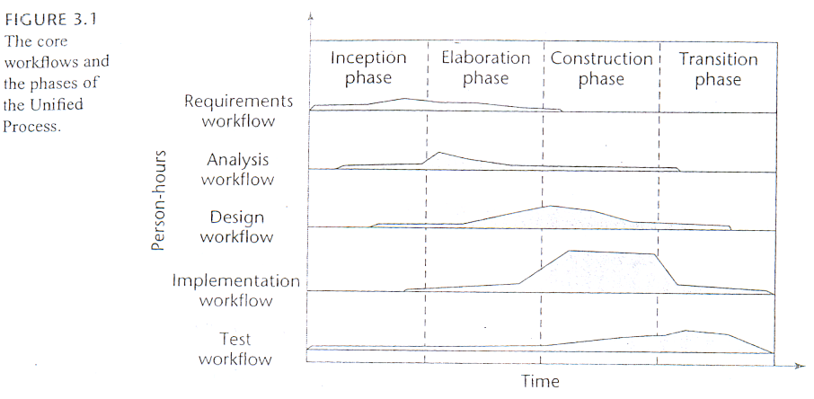
Phases of Unified Process

Slide 55
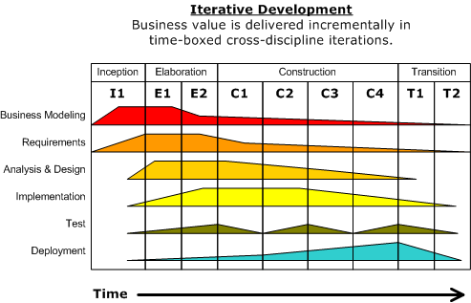
Two dimensions of Unified Process

Slide 56
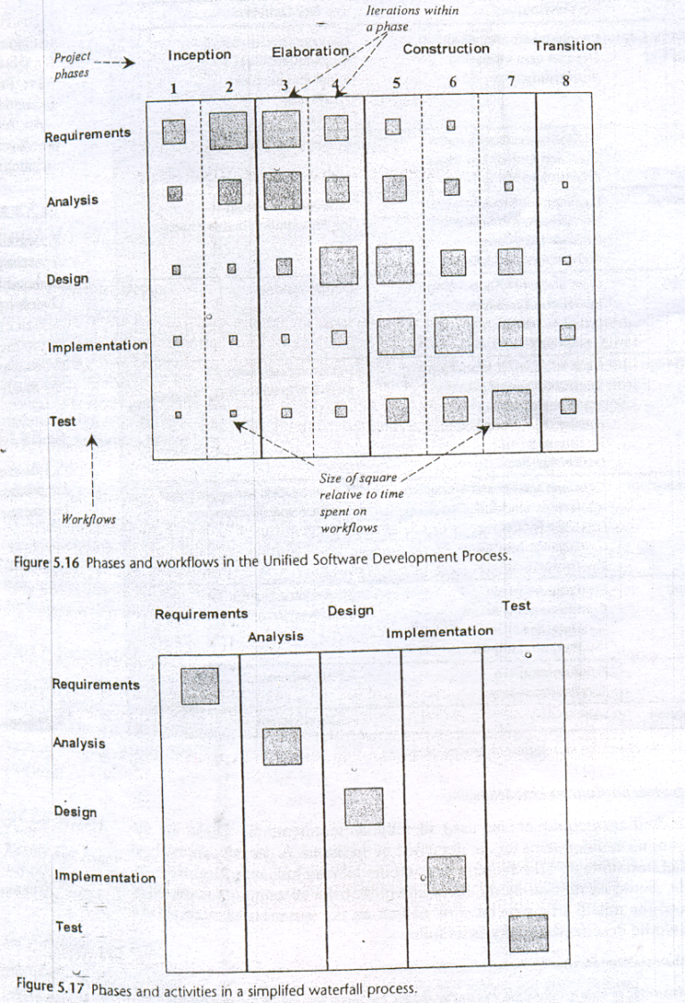

Slide 57
Inception activities
Formulate scope of project
Risk management, staffing, project plan
Synthesize a candidate architecture.

Slide 58
Outcome of Inception Phase
Initial requirements capture
Cost Benefit Analysis
Initial Risk Analysis
Project scope definition
Defining a candidate architecture
Development of a disposable prototype
Initial Use Case Model (10% - 20% complete)
First pass Domain Model

Slide 59
Summary
Discussed the basic concepts of Scrum.
Presented the characteristics of Scrum.
Explained the Scrum Life Cycle.
Discussed the Scrum Framework.
Roles
Ceremonies
Artifacts
Explained the Burn down Charts.
Explained the basic concepts of XP.
Discussed the basic concepts of RUP.

Slide 60
References
Rajib Mall, Fundamentals of Software Engineering, Fifth Edition, PHI, 2018.
Naresh Chauhan, Software Testing: Principles and Practices, (Chapter – 16), Second Edition, Oxford University Press, 2018.

Slide 61
Thank You

