Slide 1
Testing Object-Oriented Programs
Dr. Durga Prasad Mohapatra
Professor
Department of Computer Science and Engineering
National Institute of Technology, Rourkela, India

Slide 2
Plan of the Talk
Introduction
Challenges in testing OO programs
Test suite design using UML models
Test design patterns
Conclusion

Slide 3
Introduction
More than 50% of development effort is being spent on testing.
Quality and effective reuse of software depend to a large extent:
on thorough testing.
It was expected during initial years that OO would help substantially reduce testing effort as object-orientation incorporates several good programming features:
But, as we find it out today --- it only complicates testing.

Slide 4
Complicacy in testing
Soon it was realized that satisfactory testing object oriented programs is much more difficult.
Requires much more cost and effort in comparison to procedural programs.
as the various object-oriented features introduce additional complications and scope of new type of bugs.
Additional test cases are needed to be designed to detect the bugs.

Slide 5
Today’s Focus
Most reported research on OO paradigms focus on:
Analysis and design.
We discuss some important issues in testing object-oriented systems.

Slide 6
Fault Model
Different types of faults in a program:
Infinite for practical purposes .
A fault model:
A map of possible types of faults.
Necessary to guide any rational testing strategy.
A fault model may be constructed from analysis of failure data.

Slide 7
Places To Look For Faults
Some places (error types) can trivially be omitted from a fault model:
I Cannot make English grammar mistakes when I am writing a C program.
Cannot commit errors due to side effects (change global variables) while writing a Java program.
A test strategy:
Yields a test suite when applied to a unit under test.

Slide 8
Challenges in OO Testing
What is an appropriate unit for testing?
Implications of OO features:
Encapsulation
Inheritance
Polymorphism & Dynamic Binding, etc.
State-based testing
Test coverage analysis
Integration strategies
Test process strategy

Slide 9
What is a Suitable Unit for Testing?
What is the fundamental unit of testing conventional programs?
A function.
However, as far as OO programs are concerned:
Methods are not the basic unit of testing.

Slide 10
Weyukar's Anticomposition axiom
Any amount of testing of individual methods can not ensure that a class has been satisfactorily tested.

Slide 11
Weyukar's Anticomposition axiom
The main justification for anticomposition axiom is that
a method operates in the scope of the data and other methods of its object.
So, it is necessary to test a method in the context of these.
As objects can have significant states, the behavior of a method can be different based on the state of corresponding object.

Slide 12
Basic unit of testing
Therefore a method has to be tested with all other methods and data of the corr. object.
Moreover, a method needs to be tested at all states that the object can assume.
So, it is improper to consider a method as the basic unit of testing an OOP.
An object is the basic unit of testing of object-oriented programs.
In object oriented testing, unit testing is conducted by testing each object in isolation.

Slide 13
Suitable Unit for Testing OO Programs
Class level:
Testing interactions between attributes and methods must be addressed.
State of the object must be considered.

Slide 14
Suitable Unit of Testing cont…
Cluster level:
Tests the interactions among a group of cooperating classes.
A sequence of interactions is typically required to implement a visible behavior (i.e. a use case).
System level:
Tests an entire operational system.

Slide 15
Encapsulation
Encapsulation is not a source of errors:
However, an obstacle to testing.
It prevents accessing attribute values by a debugger.
While testing:
Precise current state information is necessary.

Slide 16
Solving Encapsulation-Related Problems
Several solutions are possible:
Built-in or inherited state reporting methods.
Low level probes to manually inspect object attributes.
Proof-of-correctness technique (formal).

Slide 17
Solving Encapsulation-Related Problems
Most feasible way: State reporting methods.
Reliable verification of state reporting methods is a problem.

Slide 18
Inheritance
Should inherited methods be retested?
Retesting of inherited methods is the rule, rather than an exception.
Retesting required:
Because a new context of usage results when a subclass is derived.
Correct behavior at an upper level:
Does not guarantee correct behavior at a lower level.

Slide 19
Inheritance --- Overriding
In case of method overriding:
Need to retest the classes in the context of overriding.
An overridden method must be retested even when only minor syntactic changes are made.

Slide 20
Deep Inheritance Hierarchy
A subclass at the bottom of a deep hierarchy:
may have only one or two lines of code,
but may inherit hundreds of features.
This situation creates fault hazards:
similar to unrestricted access to global data in procedural programs.
Inheritance weakens encapsulation.

Slide 21
Deep Inheritance Hierarchy cont...
A deep and wide inheritance hierarchy can defy comprehension:
Lead to bugs and reduce testability.
Incorrect initialization and forgotten methods can result.
Class flattening may increase understandibility.
Multiple Inheritance:
increases number of contexts to test.

Slide 22
Abstract and Generic Classes
Unique to OO programming:
Provide important support for reuse.
Must be extended and instantiated to be tested.
May never be considered fully tested:
Since need retesting when new subclasses are created.

Slide 23
Polymorphism
Each possible binding of a polymorphic component requires separate testing:
Often difficult to find all bindings that may occur.
Increases the chances of bugs .
An obstacle to reaching coverage goals.

Slide 24
Polymorphism cont…
Polymorphism complicates integration planning:
many server classes may need to be integrated before a client class can be tested.

Slide 25
Dynamic Binding
Dynamic binding implies:
The code that implements a given function is unknown until run time.
Static analysis cannot be used to identify the precise dependencies in a program.
It becomes difficult to identify all possible bindings and test them.

Slide 26
Object states
Objects store data parmently and also they have significant states.
The behavior of a object is usually different in different states.
Hence the object has to be tested at all its possible states.

Slide 27
Object states
All state transition functions also needs to be tested thoroughly.
There should be no extra transitions or extra states other than those defined in the state model.

Slide 28
Why are traditional testing techniques considered unsatisfactory for testing OOPs?
In procedural programs, procedures are the basic units where in OOPs objects are the basic units of testing.
Statement coverage based testing is not meaningful for testing OOPs as the inherited methods have to be retested in the derived class.
In fact, the different O-O features require different test cases to be designed compared to traditional testing.

Slide 29
Why are traditional testing techniques considered unsatisfactory for testing OOPs?
These O-O features are explicit in design models, and it is usually difficult to extract from an analysis of the source code.
Hence test cases are designed based on the design model.
So, this approach is considered to be intermediate between white box and black box approach & is called grey box approach, which is important for testing OOPs.

Slide 30
Test Process Strategy
Object-oriented development tends toward:
shorter incremental cycles.
Development characterized as:
design a little, code a little, test a little.
The distance between OO specification and implementation, therefore:
typically small compared to conventional systems.

Slide 31
Test Process Strategy cont...
The gap between white-box/black-box test is diminished.
Therefore lower importance of code-based testing.
Model-based testing has assumed importance (also called grey box testing).
Conventional white-box testing can be used for testing individual methods.

Slide 32
Testing Based on UML Models
UML has become the de facto standard for OO modeling and design:
Though UML is intended to produce rigorous models:
Does incorporate many flexibilities.
incomplete, inconsistent, and ambiguous models often result.
Never the less:
UML models are an important source of information for test design.

Slide 33
Test Approaches for UML-Based Designs
Two Approaches:
Interpret the generic test strategy to develop the test suite.
Apply the related test design pattern.

Slide 34
Development of test suite by interpreting the generic test strategy

Slide 35
Use Case-based Testing
Use cases roughly capture system level requirements.
A collection of use cases defines complete functionality of the system.
Each use case (UC) consists of a mainline scenario (sequence) and several alternate scenarios (sequences).
For each UC, the mainline & all alternate scenarios (sequences) are tested to check, if any errors show up.

Slide 36
Use Case-based Testing cont...
Several general kinds of tests can be derived from use cases:
Scenario Coverage:
1. Test cases for basic courses-- “the expected flow of events” mainline sequence.
2. Test cases of other courses-- “all other flows of events” alternate sequences.
Also, test cases for the features described in user documentation, traceable to each use case, can be generated from use cases.

Slide 37
Use Case Diagram cont...
Generic test requirements include:
At least one test case should exercise:
Every Use Case when actor communicates with Use Case.
Every extension combination such as Use Case 1 extends Use Case 2.
Every uses combination such as Use Case 1 uses Use Case 2.

Slide 38
Class Diagram-based Testing
Class diagram documents the structure of a system. It represents the entities and their inter-relationships.
Testing derived classes: All derived classes have to be instantiated & tested. In addition to the new methods defined in the derived class, the inherited methods must be retested.
The test cases should also exercise:
Each association relation (association testing)
Independent creation & destruction of the objects (container & components) in an aggregation relation (aggregation testing).

Slide 39
Testing Relations Among Classes
Relations among classes are:
Inheritance, Association, Composition, and Dependency.
Each relationship has corresponding generic test requirements
For example, a generalization relation is:
not Reflexive(R) and not Symmetric(S) but is Transitive(T)

Slide 40
Testing Relations cont...
For any relation, we can ask
which of the three (R, S, T) properties is required, excluded, or irrelevant.
The answers leads to a simple but effective test suite.

Slide 41
Testing Relations cont...
For example, when reflexivity is excluded,
Any x that would make xRx true should be rejected.
Example: Student is member of Dept-Library and Dept-Library is a part of Dept.
The relation is member of is not R, not S but is T.

Slide 42
State model-based testing
State charts can be used to represents state-based behavior of :
a class, subsystem, or system.
Statechart model:
provides most of the information necessary for class-level state-based testing.

Slide 43
State model-based testing
The concept of control flow of a conventional program :
Does not map readily to an OO program.
In a state model:
We specify how the object's state would change under certain conditions.

Slide 44
State model-based testing
Flow of control in OO programs:
Message passing from one object to another.
Causes the receiving object to perform some operation, can lead to an alteration of its state.
State Coverage: Each method of an object is tested at each state of the object.

Slide 45
State model-based testing
The state model defines the allowable transitions at each state.
States can be constructed:
Using equivalence classes defined on the instance variables.
Jacobson's OOSE advocates:
Design test cases to cover all state transitions.

Slide 46
State model-based testing
State transitions coverage: It is tested whether all transitions depicted in the state model work satisfactorily.
State transition path coverage: All transition paths in the state model are tested.

Slide 47
State model-based testing
Test cases can be derived from the state machine model of a class:
Methods result in state transitions.
Test cases are designed to exercise each transition at a state.
However, the transitions are tied to user-selectable activation sequences:
Use Cases

Slide 48
Difficulty with state model-based testing
The locus of state control is distributed over an entire OO application.
Cooperative control makes it difficult to achieve system state and transition coverage.
A global state model becomes too complex for practical systems.
Rarely constructed by developers.
A global state model is needed to show how classes interact.

Slide 49
Activity diagram-based testing
Activity diagrams are based on:
flow charts, state transition diagrams, flow graphs and Petri nets.
Can be considered to be a flow chart that can represent two or more threads of concurrent execution.
Supports all features of a basic flow graph,
Can be used to develop test models for control flow based techniques.

Slide 50
Activity diagram-based testing
Activity diagram can be used to construct:
Decision tables
Composite control flow graph representing a collection of sequence diagrams.
Control flow graph at method scope:
this may be useful to analyze path coverage.

Slide 51
Activity diagram-based testing
Generic test requirements:
At least one test case should exercise each different path:
Action 1 is followed by Action 2
Synch Point is followed by Action
Action is started after Signal
Synch Point is reached after Action

Slide 52
Sequence diagram-based Testing
A sequence diagram (SD) documents message exchanges in time dimension.
Generic tests include:
Message coverage: At least one test case should exercise each message.
Message path coverage: All end-to-end message paths in the SD should be identified and exercised.

Slide 53
Difficulties with Sequence Diagram-based testing
Representing complex control is difficult:
For example: notation for selection and iteration is clumsy.
It becomes difficult to determine whether all scenarios are covered.
Dynamic binding and the consequent superclass/subclass behavior :
Cannot be represented directly.

Slide 54
Difficulties with Sequence Diagram-based testing cont...
A Sequence diagram shows only a single collaboration.
Different bindings are shown on separate sheets.

Slide 55
Collaboration diagram-based testing
Collaboration diagram represents interactions among objects.
A collaboration diagram specifies:
The implementation of a use case.
May also depict the participants in design patterns.

Slide 56
Collaboration diagram-based testing
Each collaboration diagram represents only one slice of the interaction.
A composite collaboration diagram would be necessary:
To develop a complete test suite for an implementation.
Generic tests include:
Message coverage: At least one test case should exercise each message.
Other coverage like Condition Coverage

Slide 57
Component diagram-based testing
Component diagram shows the dependency relationships among:
components,
physical containment of components,
interfaces and calling components.
The basic testing practice with respect to component diagrams:
All call paths should be identified and exercised.

Slide 58
Deployment diagram-based testing
Deployment diagram represents the hardware, software, and network architecture.
Useful in integration planning.
When a component runs on a node,
test cases should exercise whether a component can be loaded and run on each designated host node.
When a node communicates with another node,
test cases should exercise open, transmit, and close communication for each remote component.

Slide 59
Test Coverage
Test coverage analysis:
helps determine the “thoroughness” of testing achieved.
Several coverage analysis criteria for traditional programs have been proposed:
What is a coverage criterion?
Tests that are adequate w.r.t a criterion:
Cover all elements of the domain determined by that criterion.

Slide 60
Test Coverage Criterion cont...
But, what are the elements that appropriately characterize an object-oriented program?
Certainly different from procedural programs.
For example: Statement coverage is not appropriate due to inheritance and polymorphism.
Appropriate test coverage criteria are needed.

Slide 61
Test Coverage Criteria Based on UML Models
Generalization criterion
Class attribute criterion
Condition coverage criterion
Full predicate coverage criterion
Each message on link criterion
All message paths criterion
Collection coverage criterion

Slide 62
Generalization (GN) Criterion
Given a test set T and a system model SM, T must cause:
every specialization defined in a generalization relationship to be created.
GN criterion fault model:
likely to reveal faults that can arise from violation of the substitutability principle.

Slide 63
Substitutability Principle
“An instance of a subclass can be used anywhere an instance of its superclass is expected.”

Slide 64
Class Attribute Criterion
Given a test set T, a system model SM, and a class C, T must cause
a set of representative attribute value combinations in each instance of class C must be created.
The value space of attributes provides an opportunity to develop test criteria.
The value space of an attribute are usually restricted by OCL constraints.
Example: age attribute in Customer class can have a constraint age >18

Slide 65
Condition Coverage Criterion
Each message in a collaboration diagram occurs only under certain conditions.
Given a test set T and collaboration diagram CD, T must cause:
Each condition in each decision to evaluate to both TRUE and FALSE.

Slide 66
Full Predicate Coverage Criterion
Given a test set T and collaboration diagram CD, T must cause:
Each clause in every condition in CD to take the values of TRUE and FALSE.
A condition may consist of more than one clause connected by Boolean operators (e.g., AND, OR).

Slide 67
Message On Each Link Criterion
Given a test set T and collaboration diagram CD, T must cause:
Message on each link connecting two objects in CD to be exercised at least once.
This criterion ensures:
All possible messages between two objects occur during tests.

Slide 68
All Message Paths Criterion
Given a test set T and collaboration diagram CD, T must cause:
Each possible message path in CD to be taken at least once.
A message path is a sequence of messages.
All message paths is a stronger criterion than message on each link criterion.

Slide 69
Collection Coverage Criterion
Given a test set T and collaboration diagram CD, T must test:
each interaction with a collection of objects of various representative sizes at least once.
Example: An object Staff can be an aggregation of Office staff, Faculty and Technical Staff.

Slide 70
Development of test suite by applying test design patterns

Slide 71
Test Design Pattern
A design pattern is a generalized (reusable) solution to a recurring problem.
It is based on common sense and some good practices.
It provides a concise description of:
common elements,
context, and
essential requirements for a solution.
Test design patterns are to testing what software design patterns are to programming.

Slide 72
Test Design Pattern cont...
Patterns developed under different scope of testing:
Scope Example Pattern
Method scope Polymorphic Message Test
Class Scope Modal Class Test
Reusable Components Abstract Class Test
Subsystem Round-trip Scenario Test
Integration Collaboration Integration
Application Scope Extended Use Case Pattern
Regression Test Retest Within Firewall

Slide 73
Extended Use Case (EUC)Test Pattern
Difficulties with use case :
– No variable definitions required
– No business rules required
– No input/output constraints
– Narrative can be ambiguous
In a test-ready model we need to
– Define all input/output relationships
– Define all operational variables

Slide 74
EUC Intent
Model the input output relationships in a use case using a decision table.
It then becomes possible to develop test cases:
by considering specific inputs for a use case and corresponding expected results.

Slide 75
EUC Context cont...
Unless test points are systematically selected based on a use case’s implicit constraints and relationships:
all fundamental relationships would not be exercised.
Example: A Use Case “Pay-Fees” can be a generalization of “Pay-by-Credit-Card” and
“Pay-by-Cash” Use Cases

Slide 76
EUC Fault Model
What kind of bugs can EUCs help detect?
Domain bugs.
Logic bugs.
Example: Customer registers with a Supermarket:
Domain error: Incorrect Pin code
Logic Error: Sales registered against an invalid customer code.

Slide 77
EUC Fault Model cont...
Generic system-scope faults:
Incorrect output.
Abnormal termination.
Inadequate response time.
Omitted capability.
Extra capability.

Slide 78
EUC Test Model
An Extended Use Case consists of the following:
A complete inventory of operational variables.
A complete specification of domain constraints for each operational variable.
An operational relation for each use case
The relative frequency of each use case (optional).

Slide 79
EUC Test Procedure
A test suite is developed in 4 Steps
1. Identify the Operational Variables.
2. Define the domains of the operational variables.
3. Develop the Operational Relations.
4. Develop Test cases.

Slide 80
1. Identify Operational Variables
Operational variables:
Factors which vary from one scenario to the next.
Determine different system responses.
Operational variables include:
Explicit inputs and outputs.
Environmental conditions which result in significantly different behavior.
Abstractions of the state of the system.

Slide 81
2. Define the Domains of the Operational Variables
The domains are developed by defining:
The valid and invalid values for each variable.

Slide 82
3. Develop the Operational Relation
Operational variables:
May determine distinct classes of system responses.
Express them in the form of a decision table:
When all the conditions in a row are true, the expected action is to be produced.

Slide 83
4. Develop Test Cases
Every variant is made true once and false once.
Oracle:
Expected results are typically developed by inspection.

Slide 84
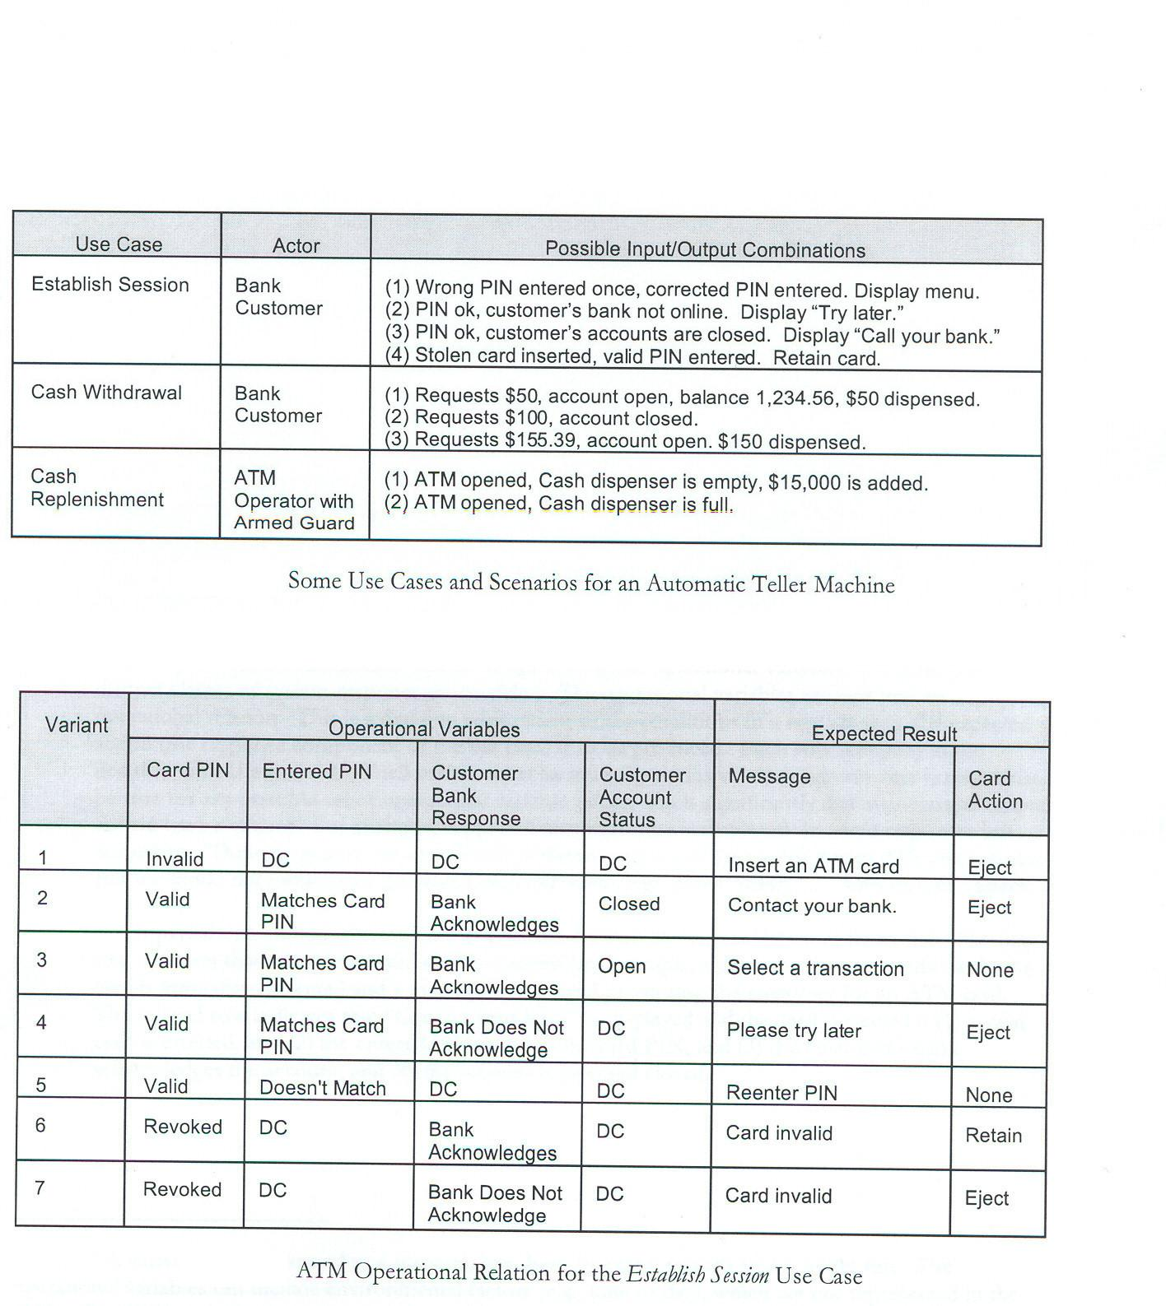
EUC Test Example

Slide 85
Modal Class Test (MCT) Pattern
Some classes can accept any message in any state:
But others restrict based on past messages received or current values (domain).
A modal class is a special class :
Places domain constraint as well as sequence constraint while accepting messages.
Domain Constraint: An object of class Account will not accept a withdrawal message if the balance is less than 0.
Sequence Constraint: In the frozen state, an Account object can accept a credit or debit message only after an unfreeze message.

Slide 86
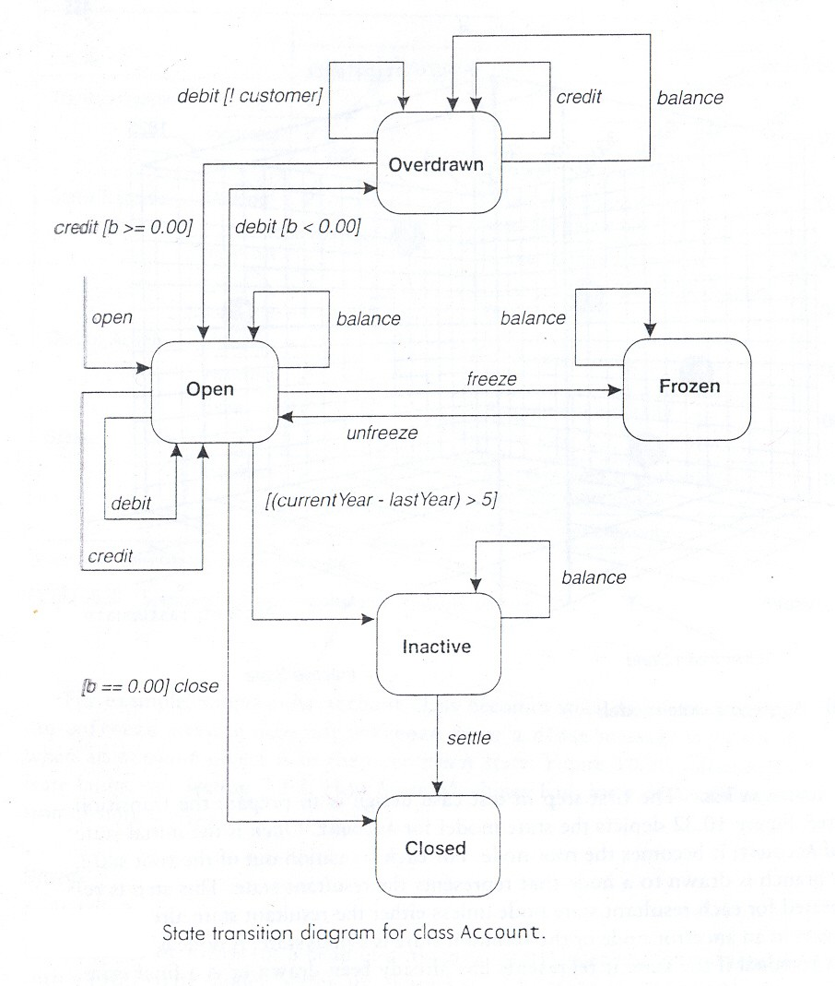
Modal Class Test (MCT) cont...

Slide 87
MCT Fault Model
A class may fail to implement its state model in five ways:
1. Missing transition: A valid message is rejected in a valid state.
2. Incorrect action: A wrong response for an accepting state and valid message.
3. Invalid resultant state: A message results in transition to a wrong state.
4. Invalid state: An invalid state is produced.
5. Sneak path: A sneak path allows a wrong message to be accepted.

Slide 88
MCT Test Strategy
The behavior of a class is represented using a state model.
Generate the transition tree.
Perform conditional transition test.
Tabulate events and actions along each path to form test cases.
Perform illegal transitions and sneak path test.

Slide 89
MCT Transition Tree
For each transition out of the root state ,
A branch is drawn to a node that represents the resultant state.
This step is repeated for each resultant state node.
A node is marked terminal :
if no transition to a new state (yet to be drawn) exists.
Each branch in the tree (an event path) becomes a test case.

Slide 90
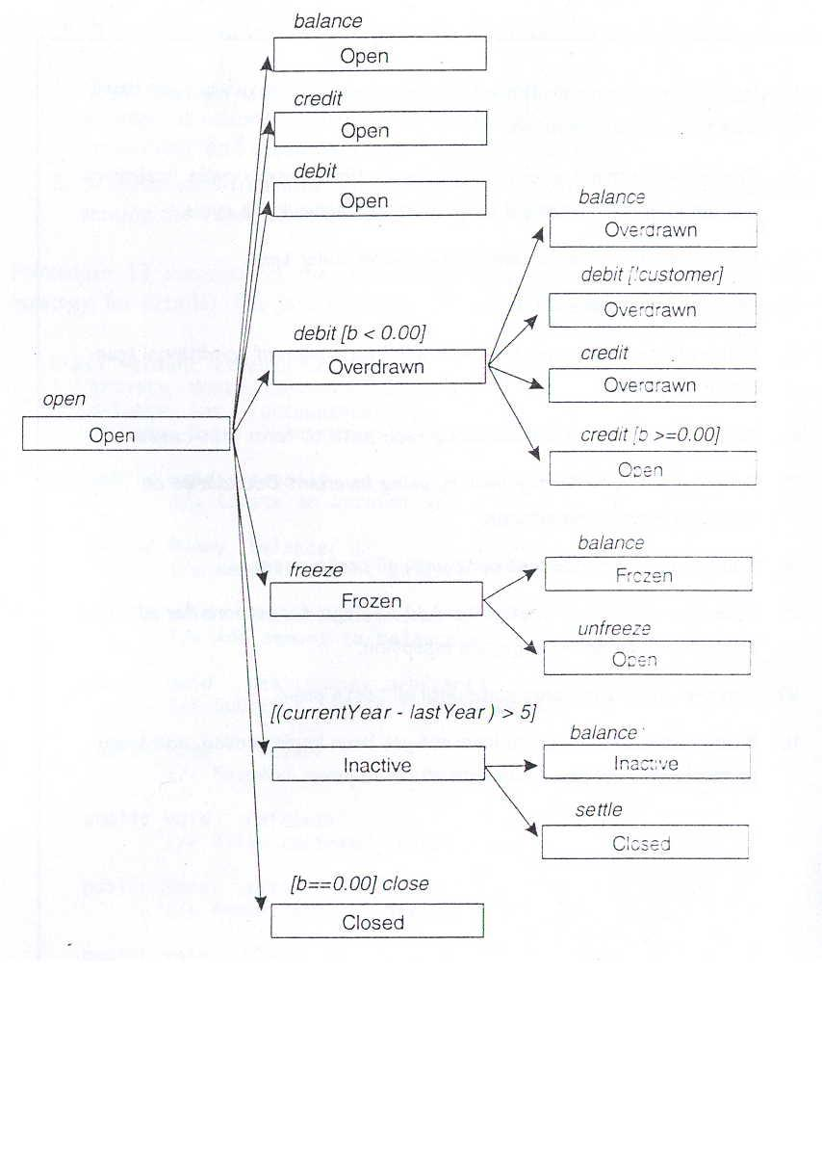
MCT Transition Tree Testing: Example

Slide 91
MCT Conditional Transition Test
Each conditional transition:
Analyzed to identify additional test cases.
For each conditional transition :
Develop a truth table for the variables in the condition.
Develop an additional test case:
For each entry in the truth table that is not already exercised.

Slide 92
MCT Sneak Path Test
Sneak Path is a bug that allows an illegal message to be accepted,
Resulting in an illegal transition.
Illegal Transition is present:
When a valid state of CUT accepts a message not specified for that state.
Illegal Message:
Results in an illegal transition.

Slide 93
MCT Sneak Path cont...
To test sneak paths send illegal messages:
Example: In the overdrawn state, messages: open, freeze, close etc can lead to possible sneak paths.
To confirm that no sneak paths exist:
Attempt each type of illegal message.
The expected response:
The message should be rejected.
Also, the state of the object should be unchanged after rejecting the illegal message.

Slide 94
Collaboration Integration Pattern(CIP)
CIP chooses the order of integration:
according to collaborations and dependencies.
Classes to be integrated are tested by testing one collaboration at a time.
A system consists of many collaborations.
Their sequence is determined by dependencies and sequential activation constraints.
Integration by collaboration:
Exercises interfaces between the participants of a collaboration.

Slide 95
CIP Test Procedure
1. Develop a dependency tree for the SUT.
2. Map collaborations onto tree until all components and interfaces are covered.
3. Choose a sequence in which to apply the collaborations.
4. Several heuristics are available for choosing a sequence.

Slide 96
CIP Test Procedure cont..
Example Heuristics:
Begin with the simplest and finish with the most complex.
Begin with the collaboration that requires the fewest stubs .
Test in order of risk of disruption of system testing.

Slide 97
CIP Test Procedure cont...
4. Develop test suite for each collaboration
5. Run the test suite and debug until first collaboration passes
6. Continue until all collaborations have been exercised

Slide 98
Integration Strategies
Essentially two approaches exist
Thread-based
Use-based

Slide 99
Thread-based integration Strategies
A thread consists of:
All the classes needed to respond to a single external input.
Each class is unit tested,
then each thread is exercised.

Slide 100
Use Case-based Integration Strategies
Use case-based integration:
Begins by testing classes that use services of none (or a few) of other classes.
Next, classes that use the first group of classes are tested.
Followed by classes that use the second group, and so on.

Slide 101
Research Challenge 1: Testing Based on Precode Artifacts
Precode artifacts:
Design,
Requirements,
Architecture specifications.
Software architecture involves description of elements from which systems are built,
Interactions among those elements,
Patterns that guide their composition,
Constraints on these patterns.

Slide 102
Research Challenge 2:Testing Evolving Software
Regression testing is used to test software that undergoes evolution due to:
Technology changes,
New or modified components.
Regression testing remains one of the most expensive activities performed during a software lifecycle.

Slide 103
Research Challenge 3: Measuring Effectiveness Of Testing Techniques
Quantitative values of effectiveness of a test-set design in revealing faults:
Analytical, statistical, or empirical.
We also need to understand the classes of faults for which the different criteria are useful.

Slide 104
Research Challenge 4: Test Data Generation
Generating test data (inputs for test cases) is often a labour-intensive process.
To date, available techniques generating test data automatically work for toy systems:
Do not scale to large systems.
Also, it should be possible to automatically execute test cases:
The test output should also be automatically analyzed.

Slide 105
Research Challenges 5: Methods and Tools
Along with fundamental research and empirical methods for testing:
tool development is also needed.
An important requirement:
Methods and tools be scalable to large systems.
Many of the tools and methods developed so far work only on toy systems.

Slide 106
Summary
Discussed introduction to O-O S/W testing
Challenges in testing OO programs
Test suite design using UML models
Test design patterns
Current research challenges

Slide 107
References
R. Mall, Fundamentals of Software Engineering, Fifth Edition, (Chapter – 10), PHI, 2018.
R. S. Pressman, Software Engineering, McGraw-Hill, 2018.
N. Chauhan, Software Testing; Principles and Practices, Second Edition, (Chapter – 14), Oxford University Press, 2018.
Notes:
‹#›

Slide 108
Thank You

