Slide 1
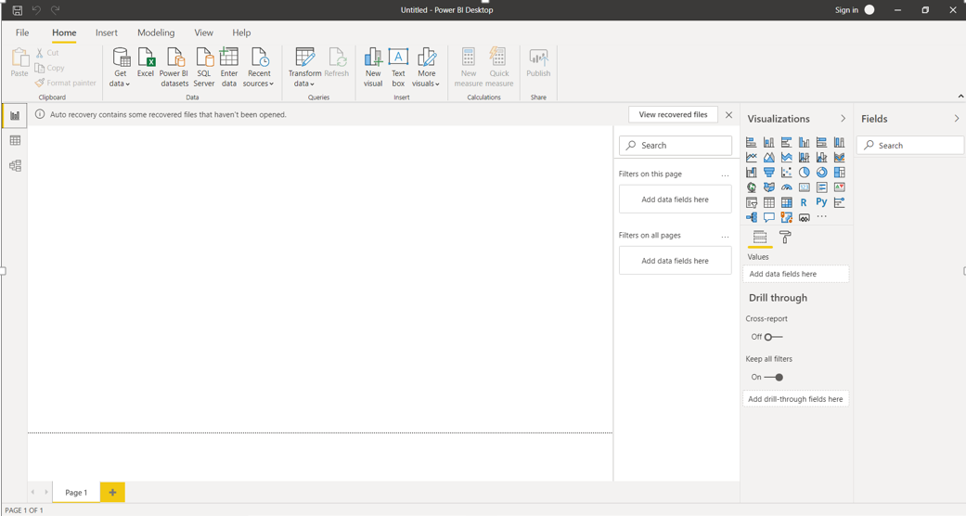
Power BI Report View

Slide 2
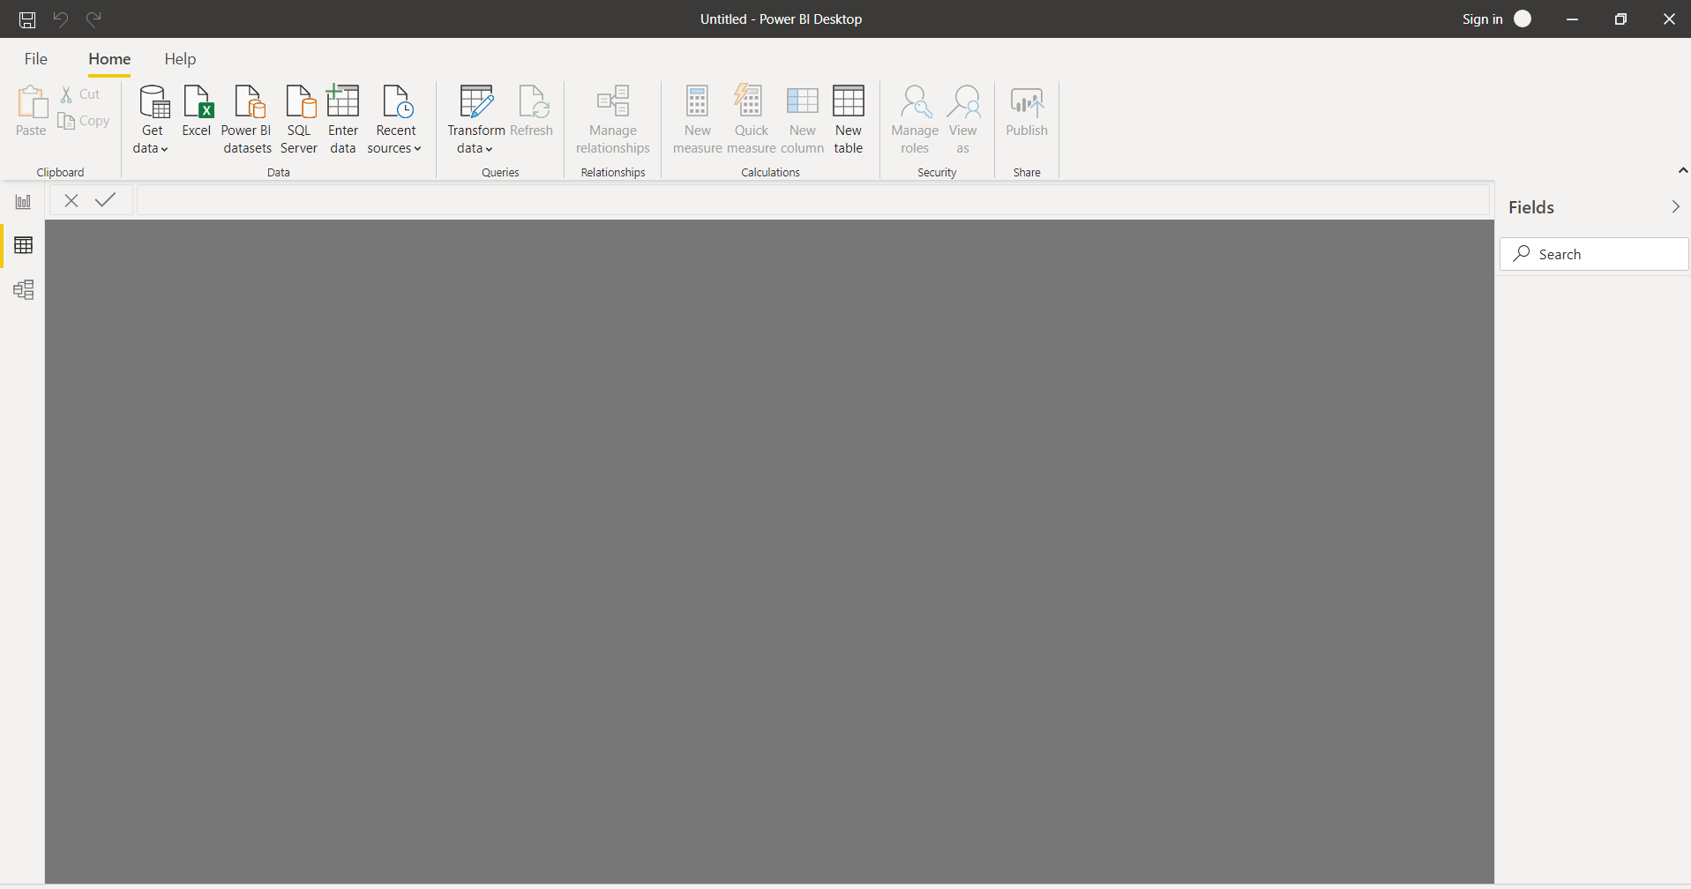
Data View

Slide 3
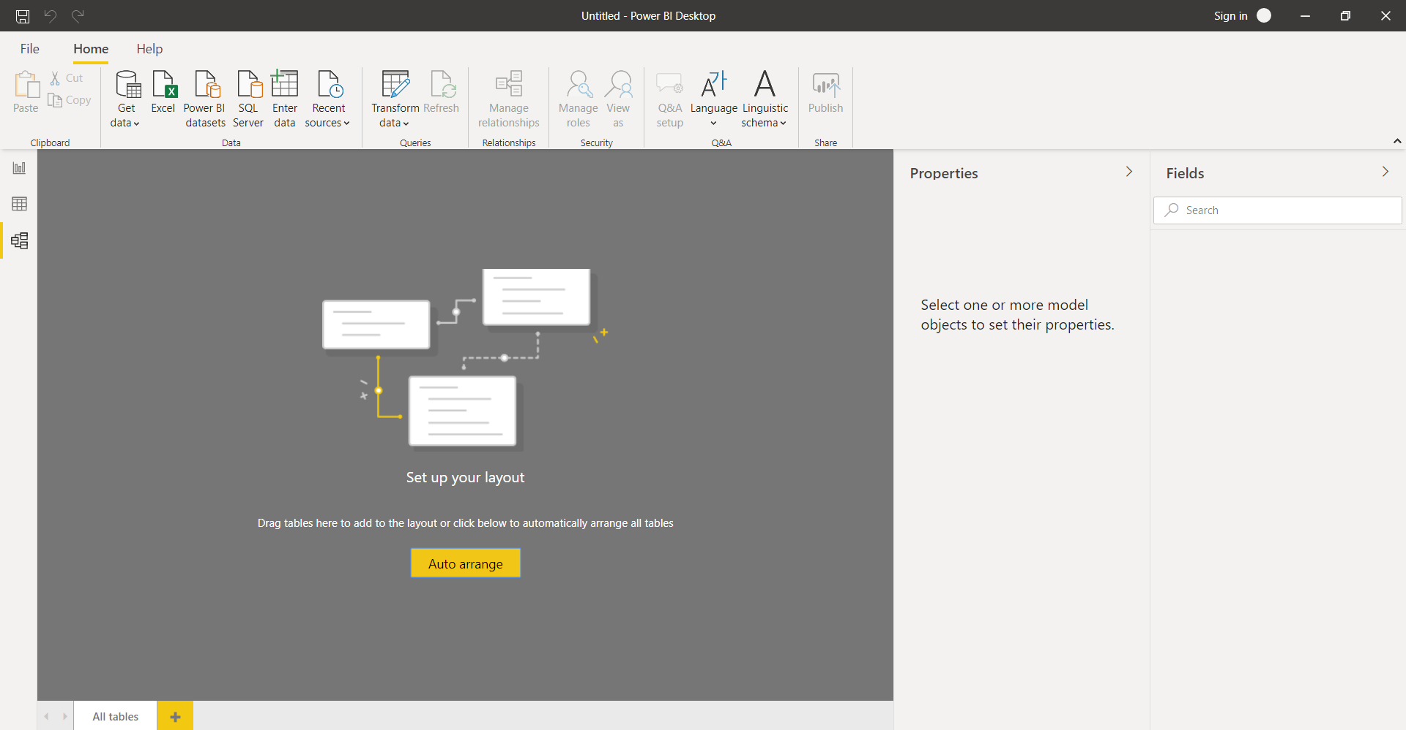
Model View

Slide 4
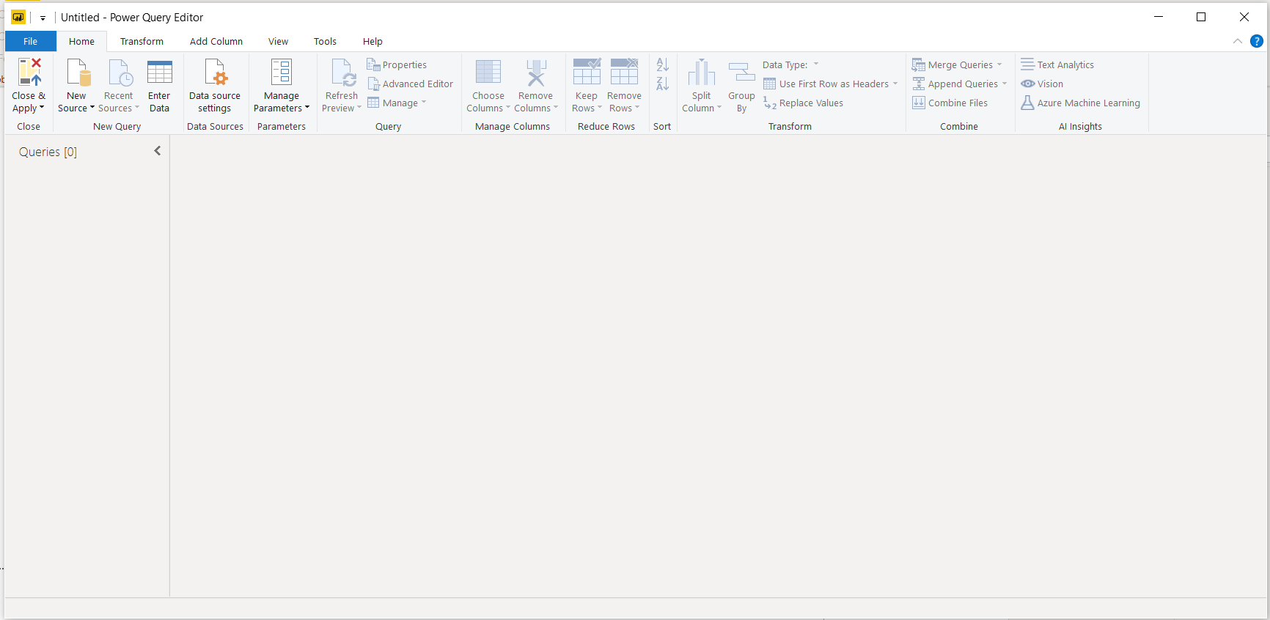
Power Query Editor

Slide 5
Advance Editor

