Slide 1


Slide 2

Table of Content
1
Our Team
3
The Main Idea
5
Stages of Development
2
Participant Activity
4
The Goals
6
Used Programs

Slide 3
Team
1
Scrum trainer:
Aleksandur Kolev-8g
2
1 Front-end developer:
Hristo Rusev-8b
3
Desinger:
Veselina Varadeva-8v
4
2 Front-end developer:
Polina Dineva-8a

Slide 5

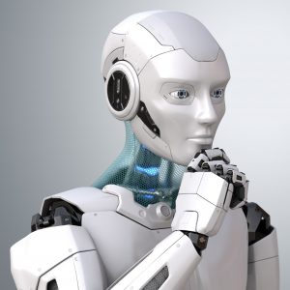
The Main Idea of the site BIOT
Exploring the Realm of Robotics has taken us on an awe-inspiring exploration of robots in the past, present, and future.
From the ancient automata to the cutting-edge advancements of today and the boundless possibilities that lie ahead, the world of robotics continues to captivate us.

Slide 6
The Goals of The Site
Advancing Healthcare: Transforming Lives with Robotics, eco-friendly materials
Endless Energy: Unleashing the Potential of Long-lasting Batteries
Past, Present, Future: Inspiring Progress and Innovation
Biot is more than just a website—it's a source of motivation for dreamers and doers alike. We aim to ignite the spark of inspiration within you, empowering you to pursue your passions, embrace innovation, and make a positive impact on the world.

Slide 7

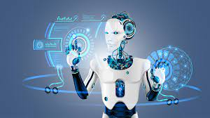
Stages of Development
1
Planning: In this stage, the purpose of the website, target audience, and goals are defined. The content and structure of the website are also planned, including the number of pages, site map, and wireframes.
Design: During this stage, the visual design of the website is created, encompassing the layout, color scheme, typography, and graphics. It is crucial to ensure that the website's design aligns seamlessly with the brand's identity and resonates with the intended target audience.
2

Slide 8
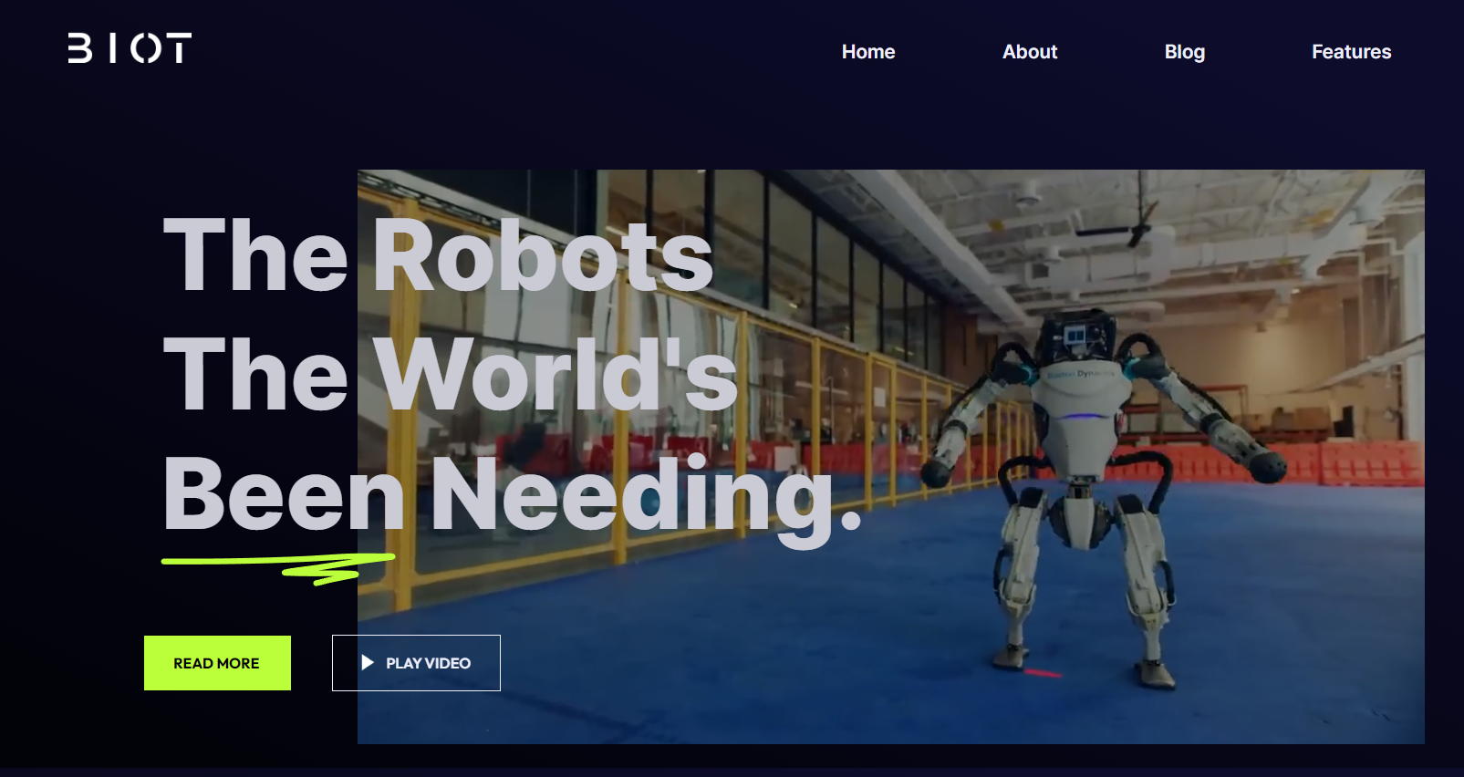
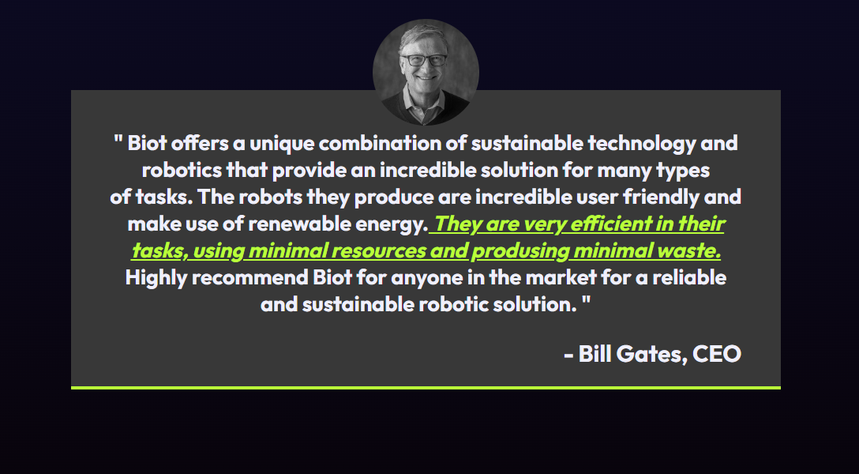
Stages of Development
3
Development: In this stage, the website's code is developed, and the website is built using HTML, CSS, and JavaScript. The development process involves creating the website's functionality and interactivity, including the implementation of forms, pages, and other essential features.
Launch: In this stage, the website is officially launched and made available to the public. It involves optimizing the website for search engines, ensuring it is easily discoverable. Additionally, analytics are set up to track and measure the website's performance, allowing for insights into user behavior, traffic, and other key metrics.
4

Slide 9










Used Programs

