Slide 1


Slide 2
Table of Content
1
Our Team
3
What is Durvenca
5
Stages of Development
2
The main idea
4
The Goals
6
Used Programs

Slide 3





OUR TEAM
ALEKSANDAR KOLEV
STANISLAV RADEV
SCRUM Trainer
9G
SCRUM Trainer
9G
GABRIELA ENCHEVA
VESELINA VARADEVA
SCRUM Trainer
9G
SCRUM Trainer
9G

Slide 4
The Main Idea of the site durvenca
Creating this project has taken us on an awe-inspiring exploration of nature. But it has also made us realise that there are a lot of environmental problems such as global warming, the greenhouse effect and deforestation.
This is why we decided to create a sandbox where the user can test different scenarios. We hope that our website will raise the awareness about these problems.

Slide 5
What is Durvenca
Durvenca is an interactive web-based simulation that serves as a sandbox for users to create and manage their virtual ecosystem. The core concept revolves around the placement and management of trees and factories within a simulated environment. Users can dynamically impact CO2 emissions and witness the effects of their choices on the ecosystem.

Slide 6
The Goals of The Site
Creating an innovation in the sandbox game genre.
Raising awareness about the dangers of environmental problems.
Allowing users to simulate different solutions for these problems through our sandbox.
Durvenca is more than just a website—it's a source of motivation for dreamers and doers alike. We aim to ignite the spark of inspiration within you, empowering you to pursue your passions, embrace innovation, and make a positive impact on the world.

Slide 7
Stages of Development
1
Planning: In this stage, the purpose of the website, target audience, and goals are defined. The content and structure of the website are also planned, including the number of pages, site map, and wireframes.
2
Design: During this stage, the visual design of the website is created, encompassing the layout, colour scheme, typography, and graphics. It is crucial to ensure that the website's design aligns seamlessly with the brand's identity and the website’s theme and resonates with the intended target audience.

Slide 8
Stages of Development
3
Development: In this stage, the website's code is developed, and the website is built using HTML, CSS, JavaScript, THREE.js, React and Tailwind. The development process involves creating the website's functionality and interactivity, including the implementation of a home page with informative area and a sandbox.
4
Launch: In this stage, the website is officially launched and made available to the public.

Slide 9







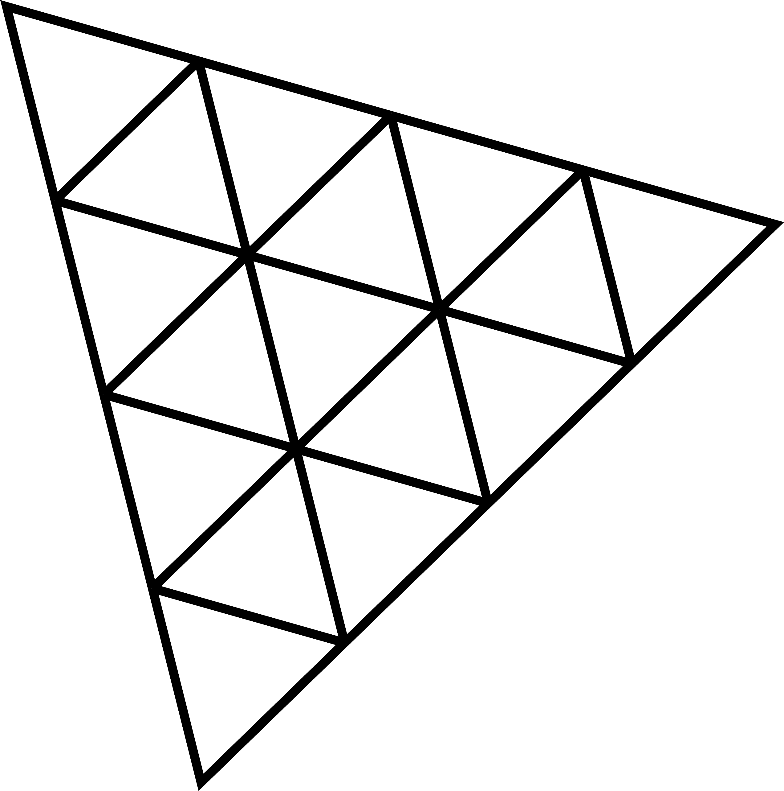
Used Programs

Slide 10







Used Programs

