Slide 1
PLANEX
A 3d solar system

Slide 2
Table of contents
01
02
03
Our team
Our idea
Stages of creation

Slide 3
I. Our team

Slide 4





Slide 5
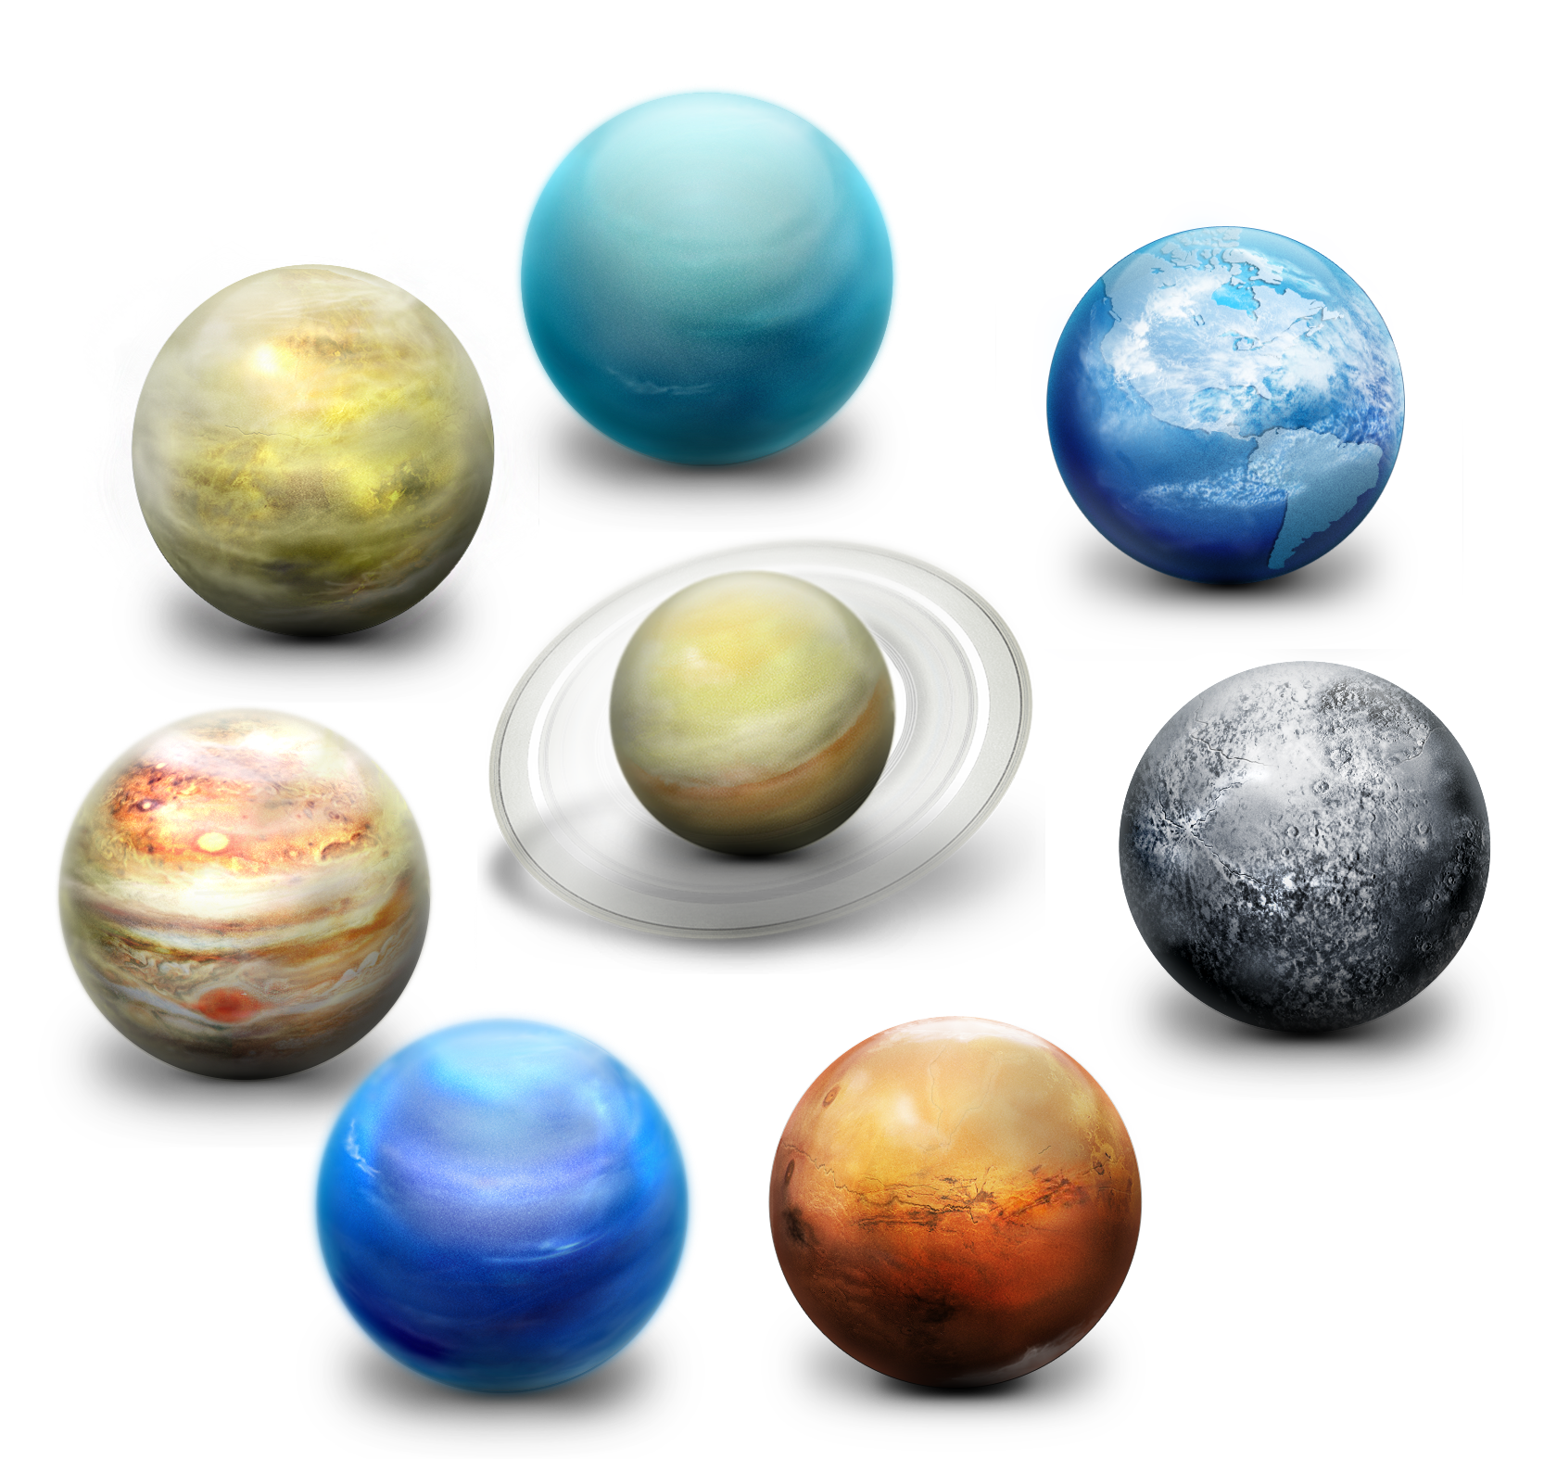
II. Our idea
Transforming Astronomy Education with Dynamic Simulations. Our vision is to create an engaging learning experience by harnessing the power of interactive simulation, allowing users to delve into the mysteries of the cosmos. Through Planex, we aim to bridge the gap between theoretical concepts and practical understanding, empowering enthusiasts and learners alike to explore the intricacies of celestial mechanics with ease. By offering a platform that combines accuracy, interactivity, and accessibility, we strive to inspire curiosity and foster a deeper appreciation for the wonders of our universe.

Slide 6
III. Stages of creation

Slide 7
Lets jump straighto the app!

