Slide 1


PLANEX

Slide 2
Table of contents
01
About us
03
Our idea
Stages of creation
02
A brief overview of who we are.
Description of our concept.
Detailing the progression of our creation process.

Slide 3
01
About us
Our essence.

Slide 4




Our team members

Slide 5
Stages of creation
02

Slide 6
Our stages
Set up electron an implement the design
Implement websocket function
Come up with the idea
Create the physics engine
Create the presentation and documentation

Slide 7
03
Our idea

Slide 8
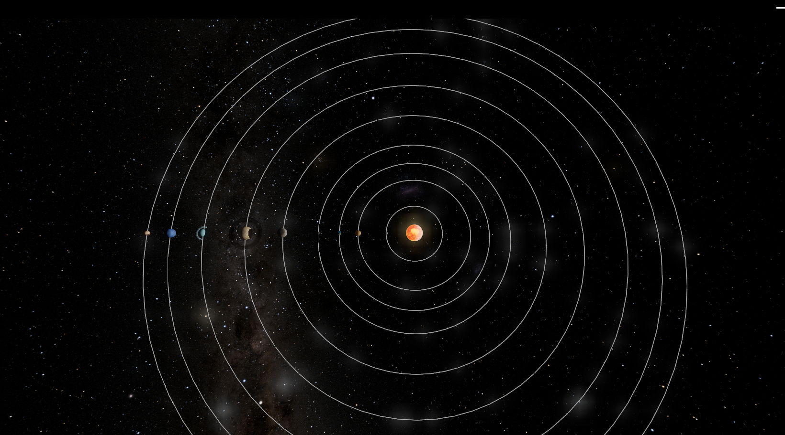
Our concept
Planex is an immersive application designed for enthusiasts and learners of physics and astronomy. At its core, it offers a 3D representation of the solar system, complete with all planets orbiting the sun, which serves as the central star. What sets Planex apart is its integration of cutting-edge technology and scientific accuracy.

Slide 9
Lets jump to the app!

