Slide 1







Frequency
(ERB_{N})
Level estimation path
Passive GC (pGC)
HP-AF
$$c_{2}^{(NH)}$$
f_{p1L}
1
b₂
$$α$$
f_{r1}
f_{ratL}
$$c_{2}^{(HL)}$$
b₁
c₁
0
hanning
hanning
OHC gain function
f_{p2}
s₁
s₂
$$c_{2}^{(HL)}$$
Level estimation P_{C}
G_{OHC}
(Frame rate processing)
b₂
P_{C}
Level
Signal path
G_{OHC}
HL_{OHC}
Passive GC (pGC)
HP-AF
$$c_{2}^{(NH)}$$
f_{p1}
1
IHC Loss
b₂
$$α$$
$$c_{2}^{(HL)}$$
L_{IHC}
f_{ratL}
b₁
c₁
0
hanning
Level
dependent
gain control
Level
independent
gain loss
Linear filtering ( Sampling rate: f_{s} )
GCFBv231

Slide 2
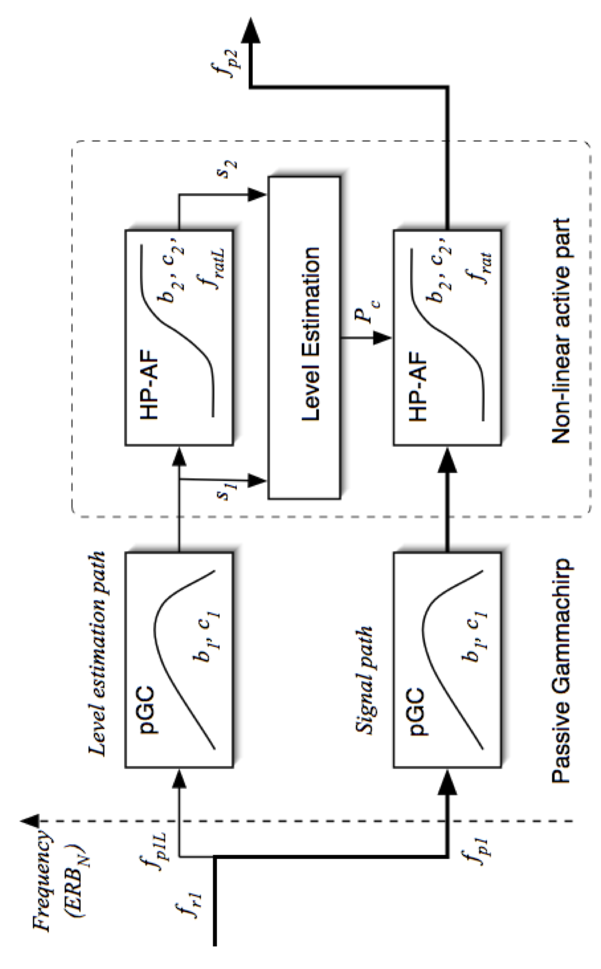
GCFBv211

Slide 3
Previous versions: not in use

Slide 4
Frequency
(ERB_{N})
Level estimation path
Passive GC (pGC)
HP-AF
$$c_{2}^{(NH)}$$
f_{p1L}
1
b₂
$$α$$
f_{r1}
f_{ratL}
$$c_{2}^{(HL)}$$
b₁
c₁
0
f_{p2}
hanning
hanning
OHC gain function
s₁
s₂
$$c_{2}^{(HL)}$$
Level estimation P_{C}
G_{OHC}
(Frame rate processing)
b₂
P_{C}
Level
Signal path
Passive GC (pGC)
HP-AF
$$c_{2}^{(NH)}$$
G_{OHC}
f_{p1}
1
IHC Loss
b₂
$$α$$
hanning
f_{ratL}
$$c_{2}^{(HL)}$$
G_{IHC} (< 0)
b₁
c₁
0
Dynamic
nonlinear
gain control
Linear gain loss
Linear filtering ( Sampling rate: f_{s} )
GCFBv231

Slide 5





Frequency
(ERB_{N})
Level estimation path
Passive GC (pGC)
HP-AF
$$c_{2}^{(NH)}$$
f_{p1L}
1
b₂
$$α$$
f_{r1}
f_{ratL}
$$c_{2}^{(HL)}$$
b₁
c₁
0
f_{p2}
hanning
hanning
IO function
$$c_{2}^{(NH)}$$
s₁
s₂
$$c_{2}^{(HL)}$$
Level estimation P_{C}
L_{OHC}
(Frame rate processing)
P_{C}
Level
Signal path
Passive GC (pGC)
HP-AF
$$c_{2}^{(NH)}$$
L_{OHC}
f_{p1}
1
IHC Loss
b₂
$$α$$
hanning
f_{ratL}
$$c_{2}^{(HL)}$$
HL_{IHC}
b₁
c₁
0
Non-linear
gain loss
Linear gain loss
Linear filtering ( Sampling rate: f_{s} )
WHISの場合：入力レベル換算なので、こういう形になる。もう少し改変

Slide 6
Frequency
(ERB_{N})
Level estimation path
f_{p1L}
pGC
HP-AF
f_{r1}
b₂
c₂
hanning
b₁
c₁
f_{ratL}
f_{p2}
Passive gammachirp
Fixed HP-AF
hanning
s₁
s₂
HP-AF
G_{HPAF}
Level estimation (P_{C} →f_{rat})
Gain calculation (→G_{HPAF})
Signal path
f_{p1}
pGC
HP-AF
b₂
c₂
hanning
b₁
c₁
f_{ratL}
Passive gammachirp
Fixed HP-AF
Non-linear
adaptation
GCFBv221
Linear filtering

Slide 7






Frequency
(ERB_{N})
Level estimation path
Passive GC
HP-AF
$$c_{2}^{(NH)}$$
$$α$$
f_{p1L}
1
b₂
$$c_{2}^{(HL)}$$
f_{r1}
f_{ratL}
b₁
c₁
0
f_{p2}
HP-AF gain function
hanning
hanning
s₁
s₂
$$c_{2}^{(HL)}$$
Level and shift estimation (P_{C} →f_{rat})
b₂
G_{HPAF}
Signal path
f_{rat}
G_{HPAF}
Passive GC
HP-AF
$$c_{2}^{(NH)}$$
$$α$$
f_{p1}
1
b₂
$$c_{2}^{(HL)}$$
hanning
IHC Loss
b₁
c₁
f_{ratL}
0
Non-linear
adaptation
Linear gain loss
Linear filtering
under work

