Slide 1








Frequency
(ERB_{N})
Level estimation path
Passive GC (pGC)
HP-AF
$$c_{2}^{(NH)}$$
f_{p1L}
1
b₂
$$α$$
f_{r1}
f_{ratL}
$$c_{2}^{(HL)}$$
b₁
c₁
0
DTVF
FB ana/syn
hanning
hanning
IO function
f_{p2}
s₁
s₂
$$c_{2}^{(NH)}$$
L_{OHC}
$$c_{2}^{(HL)}$$
Level estimation P_{C}
L_{OHC}
(Frame rate processing)
P_{C}
Level
Signal path
L_{OHC}
HL_{OHC}
HL_{IHC}
Passive GC (pGC)
HP-AF
$$c_{2}^{(NH)}$$
f_{p1}
1
IHC Loss
b₂
$$α$$
$$c_{2}^{(HL)}$$
HL_{IHC}
f_{ratL}
b₁
c₁
0
Linear filtering ( Sampling rate: f_{s} )
Level
dependent
gain loss
Level
independent
gain loss
WHIS

Slide 3







Frequency
(ERB_{N})
Level estimation path
Passive GC (pGC)
HP-AF
$$c_{2}^{(NH)}$$
f_{p1L}
1
b₂
$$α$$
f_{r1}
f_{ratL}
$$c_{2}^{(HL)}$$
b₁
c₁
0
hanning
hanning
OHC gain function
f_{p2}
s₁
s₂
$$c_{2}^{(HL)}$$
Level estimation P_{C}
G_{OHC}
(Frame rate processing)
b₂
P_{C}
Level
Signal path
G_{OHC}
HL_{OHC}
Passive GC (pGC)
HP-AF
$$c_{2}^{(NH)}$$
f_{p1}
1
IHC Loss
b₂
$$α$$
$$c_{2}^{(HL)}$$
L_{IHC}
f_{ratL}
b₁
c₁
0
hanning
Level
dependent
gain control
Level
independent
gain loss
Linear filtering ( Sampling rate: f_{s} )
GCFBv231

Slide 4
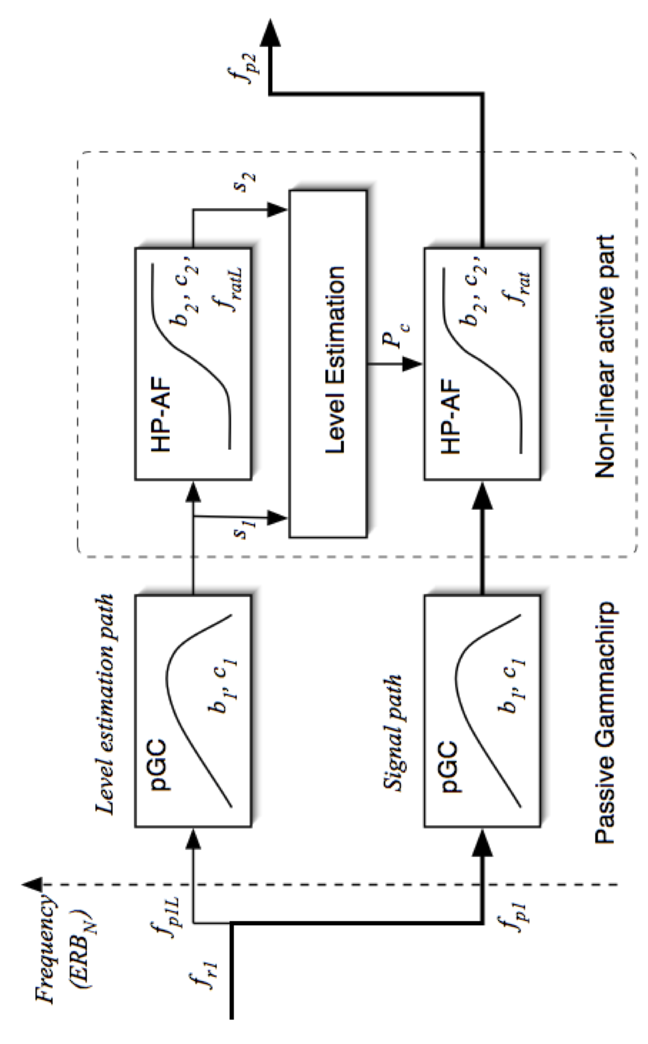
GCFBv211

