Slide 1
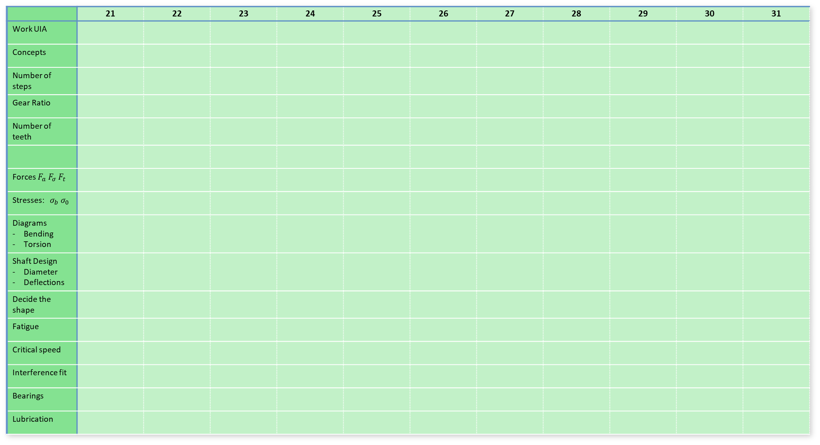
Tasks | January
 | 21 | 22 | 23 | 24 | 25 | 26 | 27 | 28 | 29 | 30 | 31
Work UIA
Concepts
Number of steps
Gear Ratio
Number of teeth
Forces $F_{a} F_{σ} F_{t}$
Stresses: $σ_{b} σ_{0}$
Diagrams Bending Torsion
Shaft Design Diameter Deflections
Decide the shape
Fatigue
Critical speed
Interference fit
Bearings
Lubrication

Slide 2
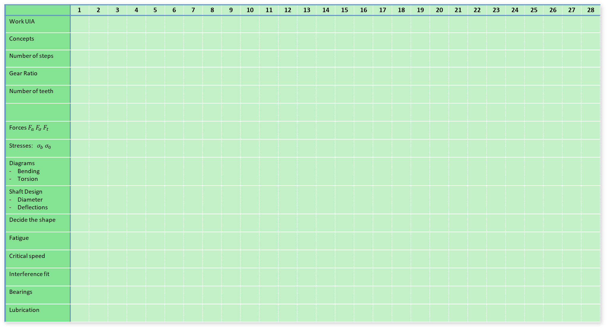
Tasks | February
 | 1 | 2 | 3 | 4 | 5 | 6 | 7 | 8 | 9 | 10 | 11 | 12 | 13 | 14 | 15 | 16 | 17 | 18 | 19 | 20 | 21 | 22 | 23 | 24 | 25 | 26 | 27 | 28
Work UIA
Concepts
Number of steps
Gear Ratio
Number of teeth
Forces $F_{a} F_{σ} F_{t}$
Stresses: $σ_{b} σ_{0}$
Diagrams Bending Torsion
Shaft Design Diameter Deflections
Decide the shape
Fatigue
Critical speed
Interference fit
Bearings
Lubrication

Slide 3
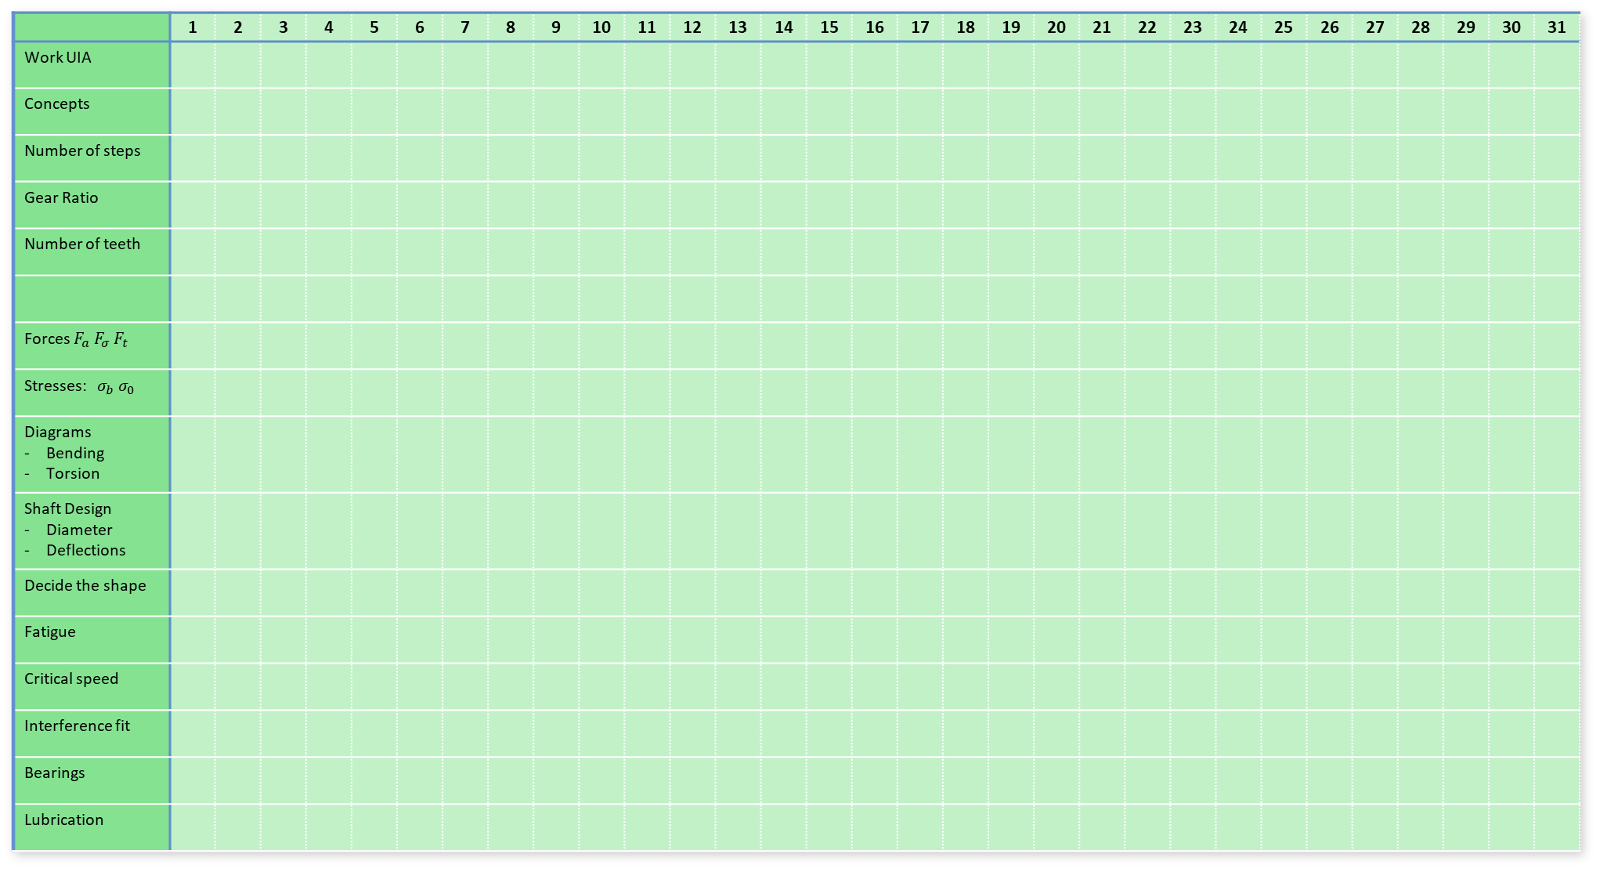
Tasks | March
 | 1 | 2 | 3 | 4 | 5 | 6 | 7 | 8 | 9 | 10 | 11 | 12 | 13 | 14 | 15 | 16 | 17 | 18 | 19 | 20 | 21 | 22 | 23 | 24 | 25 | 26 | 27 | 28 | 29 | 30 | 31
Work UIA
Concepts
Number of steps
Gear Ratio
Number of teeth
Forces $F_{a} F_{σ} F_{t}$
Stresses: $σ_{b} σ_{0}$
Diagrams Bending Torsion
Shaft Design Diameter Deflections
Decide the shape
Fatigue
Critical speed
Interference fit
Bearings
Lubrication

Slide 4
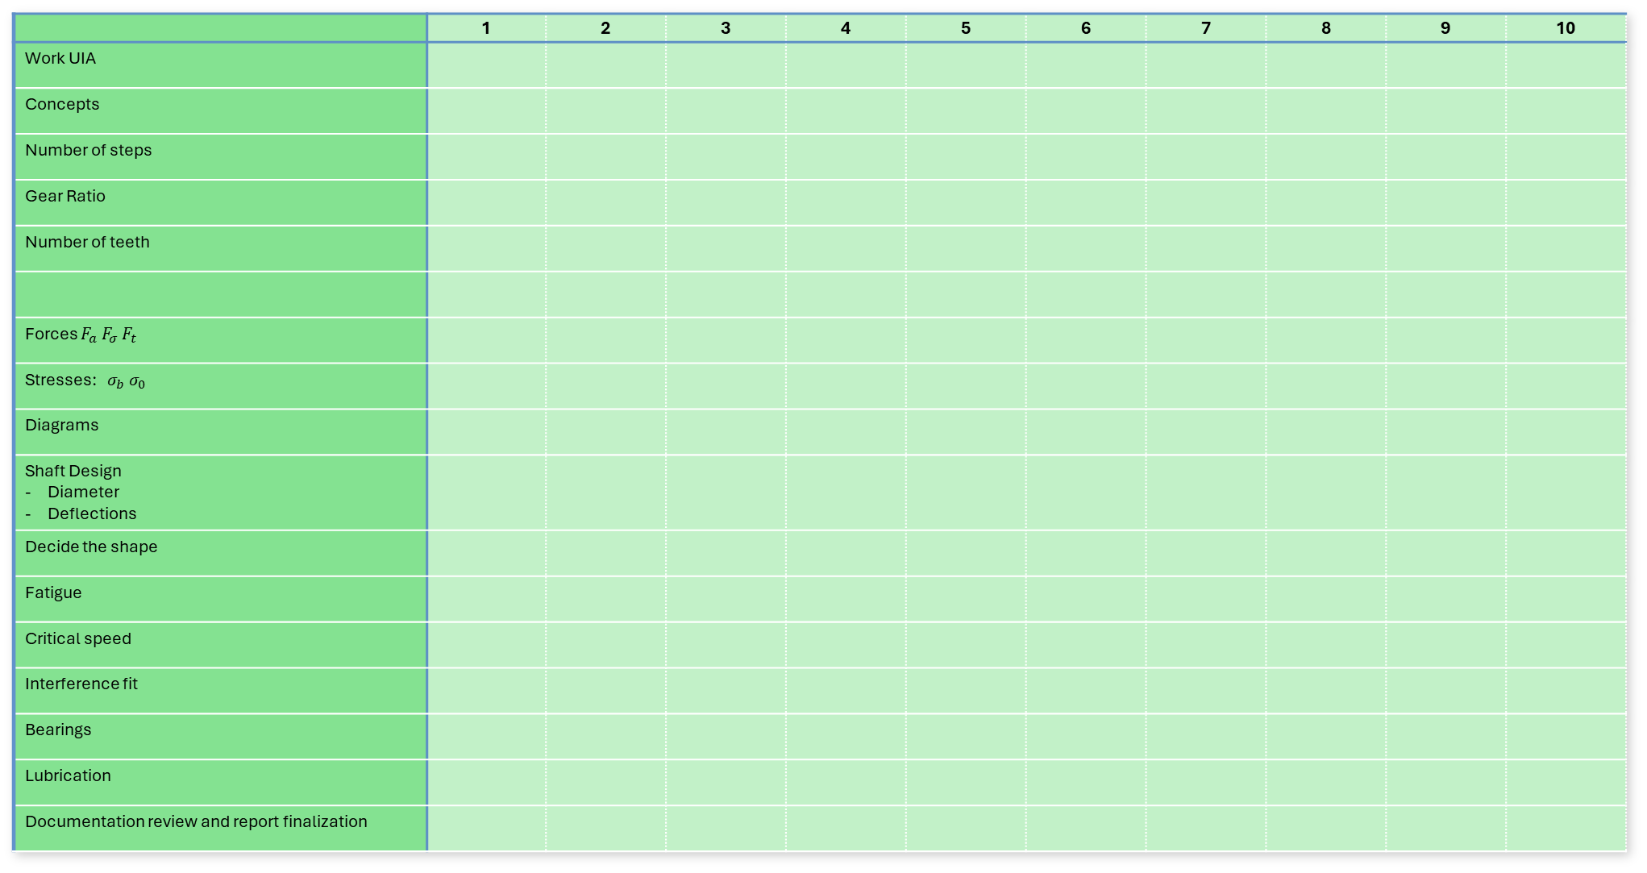
Tasks | April
 | 1 | 2 | 3 | 4 | 5 | 6 | 7 | 8 | 9 | 10
Work UIA
Concepts
Number of steps
Gear Ratio
Number of teeth
Forces $F_{a} F_{σ} F_{t}$
Stresses: $σ_{b} σ_{0}$
Diagrams
Shaft Design Diameter Deflections
Decide the shape
Fatigue
Critical speed
Interference fit
Bearings
Lubrication
Documentation review and report finalization

Slide 5
Slide Title
Ole
Jonas
Both
Task bars (length = duration)
Milestones

Slide 6
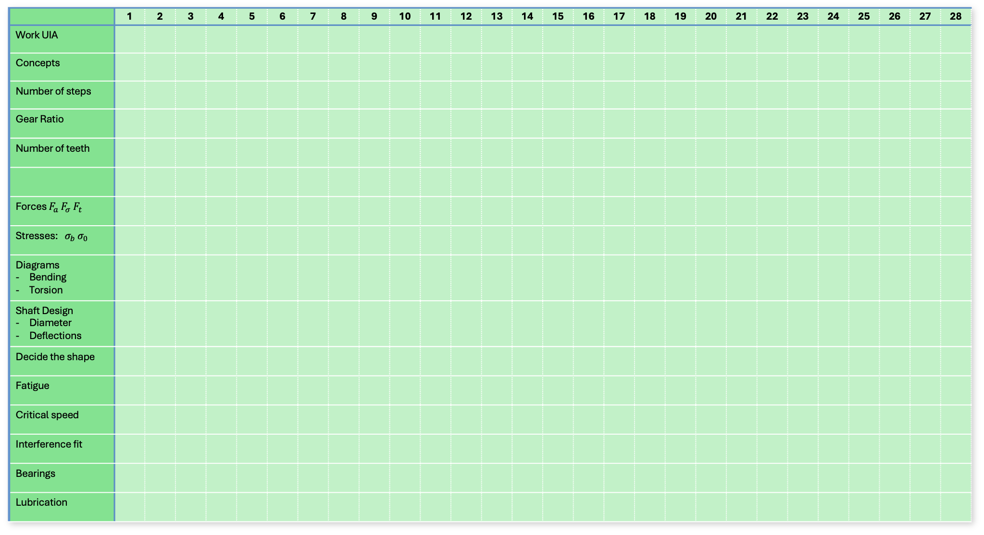
Product specification | Design of Gearbox
 | 1 | 2 | 3 | 4 | 5 | 6 | 7 | 8 | 9 | 10 | 11 | 12 | 13 | 14 | 15 | 16 | 17 | 18 | 19 | 20 | 21 | 22 | 23 | 24 | 25 | 26 | 27 | 28
Work UIA
Concepts
Number of steps
Gear Ratio
Number of teeth
Forces $F_{a} F_{σ} F_{t}$
Stresses: $σ_{b} σ_{0}$
Diagrams Bending Torsion
Shaft Design Diameter Deflections
Decide the shape
Fatigue
Critical speed
Interference fit
Bearings
Lubrication

