Slide 1
Intro to MongoDB and NodeJS
Presenters
Shaikh Mohammed Ammar (191080071)
Nityansh Doshi ()
Sahil Satpute

Slide 2
MongoDB Overview
MongoDB is a No-SQL database.
It is an open-source, cross-platform, document-oriented database written in C++ developed and supported by a company named 10gen aka MongoDb inc.
Development of MongoDB began in 2007 , started as a platform as a service.
Later in 2009, it was introduced in the market as an open source database server.

Slide 3
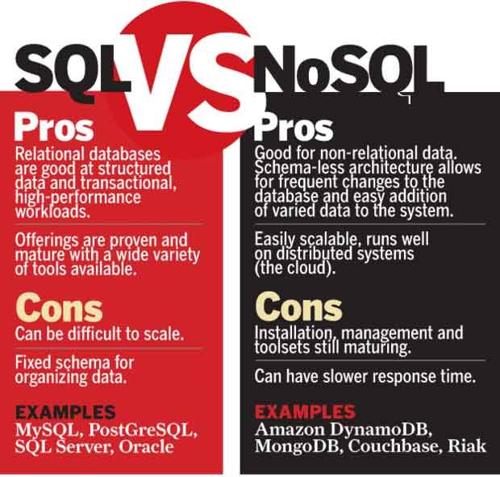
BSON | JSON
BSON is used for the documents.. | JSON is used for the javacript objects,
this is not JavaScript Object notation but it is Binary JSON | This is JavaScript object Notation
It is a binary form for representing simple or complex data structures including associative arrays | It is mainly used in Javascript language while programming.

Slide 4
Advantages of MongoDB
Support ad hoc queries
Indexing
Replication
Duplication of data
Load balancing
Supports map reduce and aggregation tools.
Uses JavaScript instead of Procedures.
It is a schema-less database written in C++.
Provides high performance.
Stores files of any size easily without complicating your stack.
Easy to administer in the case of failures.
And the list goes on…

Slide 5
Where should it be used?
Big and complex data
Mobile and social infrastructure
Content management and delivery
User data management
Data hub

Slide 6
Setting Up the Environment:
Steps to follow:
Head on to https://www.mongodb.com/try/download/community
Follow the video.

Slide 7
Getting Started with Mongo:
Following Topics will be covered:
Create Database
Drop Database
Create Collection
Drop Collection
Data Types - This is in the appendix (won’t be covering)
Insert Document
Query Document
Update Document
Delete Document
Projection
Limiting Records
Sorting Records
Indexing
Aggregation
Replication
Sharding
Creating Backup
Deployment

Slide 8
Before starting…
Resource on:
https://github.com/AMMAR-62/OSC_Project

Slide 9
Create Database:
No special command for creating the database
We use the “use database” command for this
If the database with the name exists we switch to that
Else a new database is created and we are switched to that
Also the default database is test … collections are inserted into test if db is not specified
Drop Database:
The “dropDatabase” command is used to drop existing database.
Syntax:
db.dropDatabase()

Slide 10
Drop Collection:
Create Collection
db.createCollection(name, options) is used to create collection.
Name – the name of the collection
Options – can include capped, autoIndexed, size, max.
But generally we directly use the insert command for creating collection.
db.COLLECTION_NAME.drop() is used to drop a collection
Syntax:
db.COLLECTION_NAME.drop()
It will returns true if the collection is dropped otherwise false.

Slide 11
Insert Document:
Two Methods:
Insert
Syntax: db.COLLECTION_NAME.insert(document)
Save
Syntax: db.COLLECTION_NAME.save(document)
Somethings to remember:
if we don't specify the _id parameter, then MongoDB assigns a unique ObjectId for this document.
_id: ObjectId(4 bytes timestamp, 3 bytes machine id, 2 bytes process id, 3 bytes incrementer)

Slide 12
Insert Document:
Other Method:
insertOne():
Syntax:
db.COLLECTION_NAME.insertOne(document)
insertMany():
Syntax:
db.COLLECTION_NAME.insertOne(document)

Slide 13
Query Document:
The “find()” method is used to query data from db.
Syntax:
db.COLLECTION_NAME.find()
The “pretty()” method is used to display the unstructured data in a more-readable format.
The ”findOne()” method returns only one document.
Syntax:
db.COLLECTION_NAME.findOne()

Slide 14
Where clause Equivalents:
AND
Syntax:
db.COLLECTION_NAME.find( { $and: [ { key1:value1 }, { key2:value2 } ] } )
OR
Syntax:
db.COLLECTION_NAME.find({ $or: [ { key1:value1 }, { key2:value2 } ] } )
NOT
Syntax:
db.COLLECTION_NAME.find({ $not: [ { key1:value1 }, { key2:value2 } ] } )
NOR
Syntax:
db.COLLECTION_NAME.find({ $nor: [ { key1:value1 }, { key2:value2 } ] } )

Slide 15
Update Document:
The “update()” method is used to updates the values in the existing document.
Syntax:
db.COLLECTION_NAME.update(SELECTION_CRITERIA, UPDATED_DATA)
The “save()” method can also be used as it replaces the existing document with a new one.
Syntax:
db.COLLECTION_NAME.save({_id: ObjectId(), NEW_DATA})
The “findOneAndUpdate()” method can also be used.
Syntax:
db.COLLECTION_NAME.findOneAndUpdate(SELECTION_CRITERIA,UPDATED_DATA).
The “updateOne()” method updates a single document.
Syntax:
db.COLLECTION_NAME.updateOne(filter, update)
The “updateMany()” method updates all the documents that matches the filter
Syntax:
db.COLLECTION_NAME.updateMany(filter, update)

Slide 16
Delete Document:
The “remove()” method is used to remove a document.
Syntax:
db.COLLECTION_NAME.remove(DELETION_CRITERIA, JUST_ONE)
DELETION_CRITERIA – deletion criteria according to documents will be removed.
JUST_ONE – to remove only the first document you specify the argument as 1

Slide 17
Projection:
In mongoDB projection means selecting only the necessary data
The find() method explained earlier accepts a second optional parameter
A list of fields that you want to retrieve.
You can give the arguments as 1 and 0.
Limiting Records:
We can use the “limit()” method to limit the no. of docs that we want.
Syntax:
db.COLLECTION_NAME.find().limit(NUMBER)
We can also use the “skip()” method which is to skip the number of docs.
Syntax:
db.COLLECTION_NAME.find().limit(NUMBER).skip(NUMBER)

Slide 18
Sorting Records:
We can use the “sort()” method which accepts a document along with sorting order.
To specify sorting order 1 and -1 are used for ascending and descending order respectively
Syntax:
db.COLLECTION_NAME.find().sort({KEY: 1})

Slide 19
Indexing:
Indexes are special data structures that store a small portion of the data set in an easy-to-traverse form.
We can use “createIndex()” method to create an index
Syntax:
db.COLLECTION_NAME.createIndex({KEY: 1})
“dropIndex()” method is used to drop a particular index
Syntax:
db.COLLECTION_NAME.dropIndex({KEY: 1})
The “dropIndexes()” method is used to drop multiple indexes
Syntax:
db.COLLECTION_NAME.dropIndexes({<KEY>: <boolean>, <KEY>:<boolean>})
The “getIndexes()” method returns the description of all the indexes in the collection.
Syntax: db.COLLECTION_NAME.getIndexes()

Slide 20
Aggregation
Aggregation operations group values from multiple documents and can perform operations on the grouped data to return a single result.
The “aggregate()” method is used for aggregation.
Syntax:
db.COLLECTION_NAME.aggregate(AGGREGATE_OPERATION)

Slide 21
Pipeline Concept:
There is a set of possible stages and each of those is taken as a set of documents as an input and produces a resulting set of documents (or the final resulting JSON document at the end of the pipeline). This can then in turn be used for the next stage and so on.)
$project − Used to select some specific fields from a collection.
$match − This is a filtering operation and thus this can reduce the amount of documents that are given as input to the next stage.
$group − This does the actual aggregation as discussed above.
$sort − Sorts the documents.
$skip − With this, it is possible to skip forward in the list of documents for a given amount of documents.
$limit − This limits the amount of documents to look at, by the given number starting from the current positions.
$unwind − This is used to unwind document that are using arrays. When using an array, the data is kind of pre-joined and this operation will be undone with this to have individual documents again. Thus with this stage we will increase the amount of documents for the next stage.

Slide 22
Replication:
Replication is the process of synchronizing data across multiple servers. Replication provides redundancy and increases data availability with multiple copies of data on different database servers.
Why Replication:
Date safety
Data availability
Disaster recovery
Reducing Downtime.
Replication can be achieved by using a replica set.

Slide 23

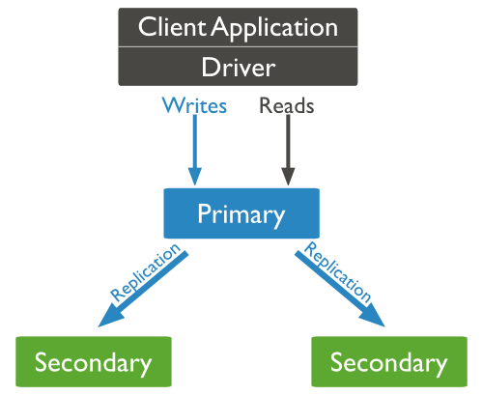



What is a replica set?
It is group mongod instances that host the same data set.
It is a group of two or more nodes.
One node is primary and remaining nodes are secondary
All data replicates from primary to secondary

Slide 24
Creating a Replica Set:
Replica Set Features:
Automatic failover
Automatic recovery
Set up a Replica Set:
Mongod –port “PORT” –dbpath “YOUR_DB_DATA_PATH” --replSet “REPLICA_SET_INSTANCE_NAME”

Slide 25
Sharding:
It is the process of storing data records across multiple machines and it is MongoDB’s approach to meeting the demands of data growth.
It basically solves the problem with horizontal scaling.
Why Sharding?
Single replica set has limitation of 12 nodes.
Vertical scaling is too expensive.

Slide 26
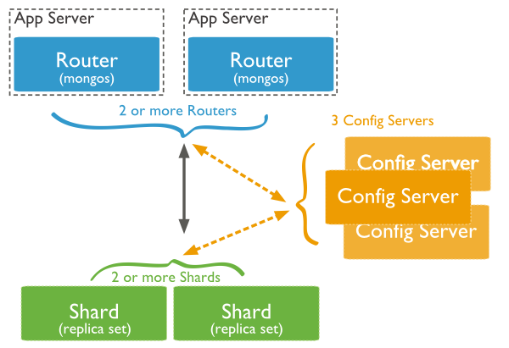
Components in Sharding:
Shards:
Shards are used to store data. each shard is a separate replica set.
Config Servers:
Config servers store the cluster's metadata.. The query router uses this metadata to target operations to specific shards.
Query Routers:
Query routers are basically mongo instances, interface with client applications and direct operations to the appropriate shard. A client sends requests to one query router

Slide 27
Creating Backup:
Dump MongoDB Data:
To create backup we use “mongodump” command.
Syntax:
Mongodump
The command will connect to the server running at 127.0.0.1 and port 27017 and back all data of the server to directory /bin/dump/.
Restore Data:
To restore backup MongoDB’s “mongorestore” command is used.
Syntax:
Mongorestore

Slide 28
Deployment:
To monitor the deployment, MongoDB provides some of the following commands −
Mongostat:
Checks the status of running instances and returns counters.
These include inserts, queries, updates, etc.
Syntax:
Mongostat
Mongotop:
Tracks and reports the read and write activity of mongod instance
Syntax:
Mongotop

