Slide 1
EXPRESS PRESENTATION-
Express is a web framework for Node js.
You can assume express as a layer built on the top of the Node.js that helps manage a server and routes. It provides a robust set of features to develop web and mobile applications.

Slide 2
NPM –
Once nodejs is installed npm comes installed with it. NPM basically is the package manager for node. It helps with installing various packages and resolving their various dependencies. It greatly helps with your Node development.
npm init-
This command creates a package.json file which contains information about the current project.
Some of this information includes:
A list of node packages required for the project — If another developer wants to run a project, npm looks inside package.json and downloads the packages in this list. If you have Node(nodejs) installed on your computer, you can create a package.json file by typing ‘npm init’ into the terminal.

Slide 3
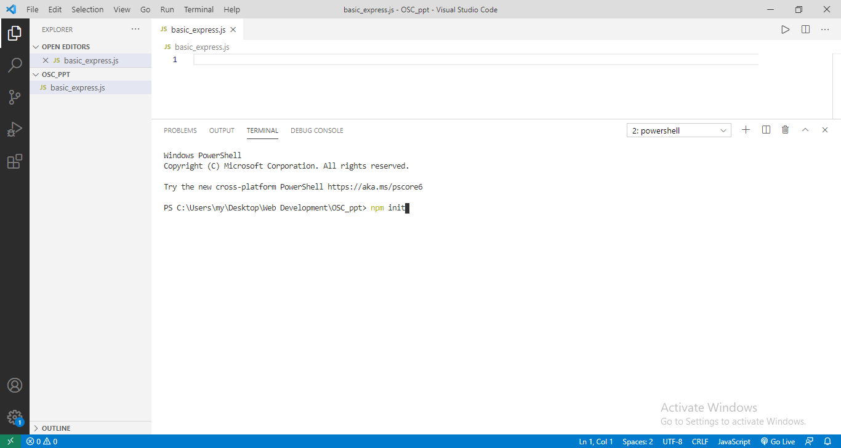

Slide 4
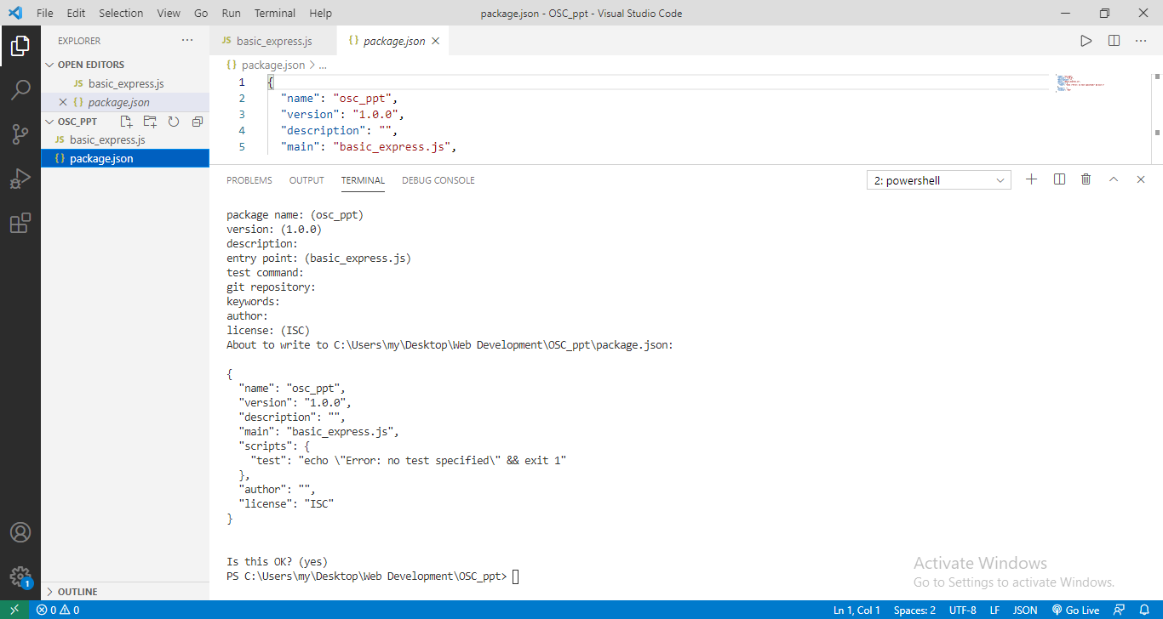

Slide 5
npm install express-
This command installs express for your current project only. These can be seen in the package.json file under the dependencies

Slide 6
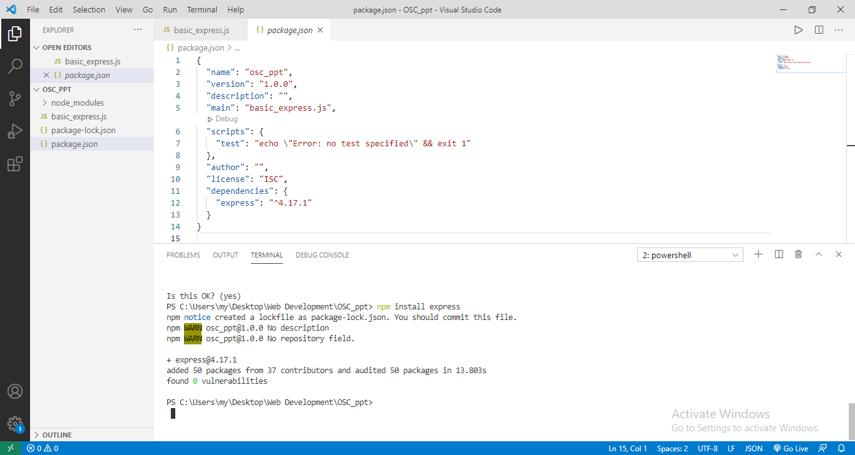

Slide 7
npm install nodemon-
This command installs nodemon package in the current project or directory. It automatically restarts the server whenever changes are made in the main file of the express and saved. Eg. Use ‘nodemon basic_express.js’ command.

Slide 8
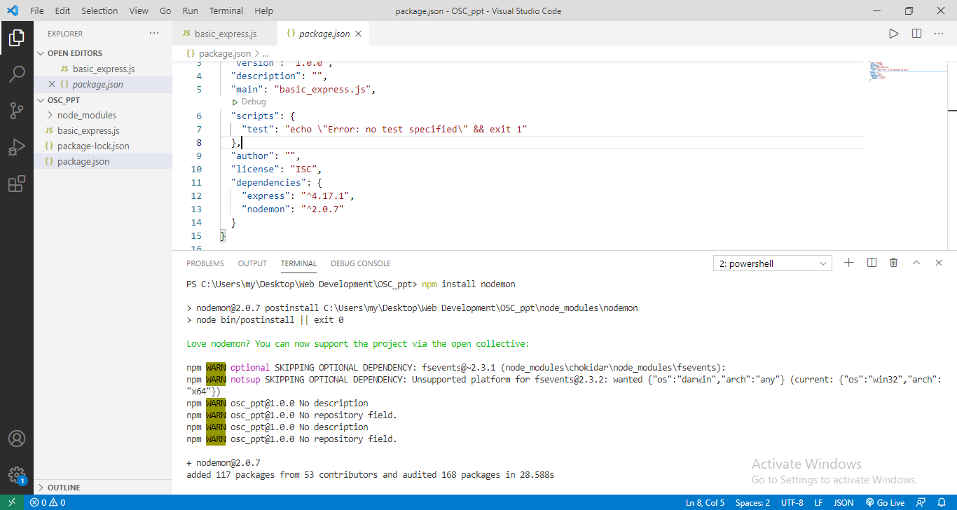

Slide 9
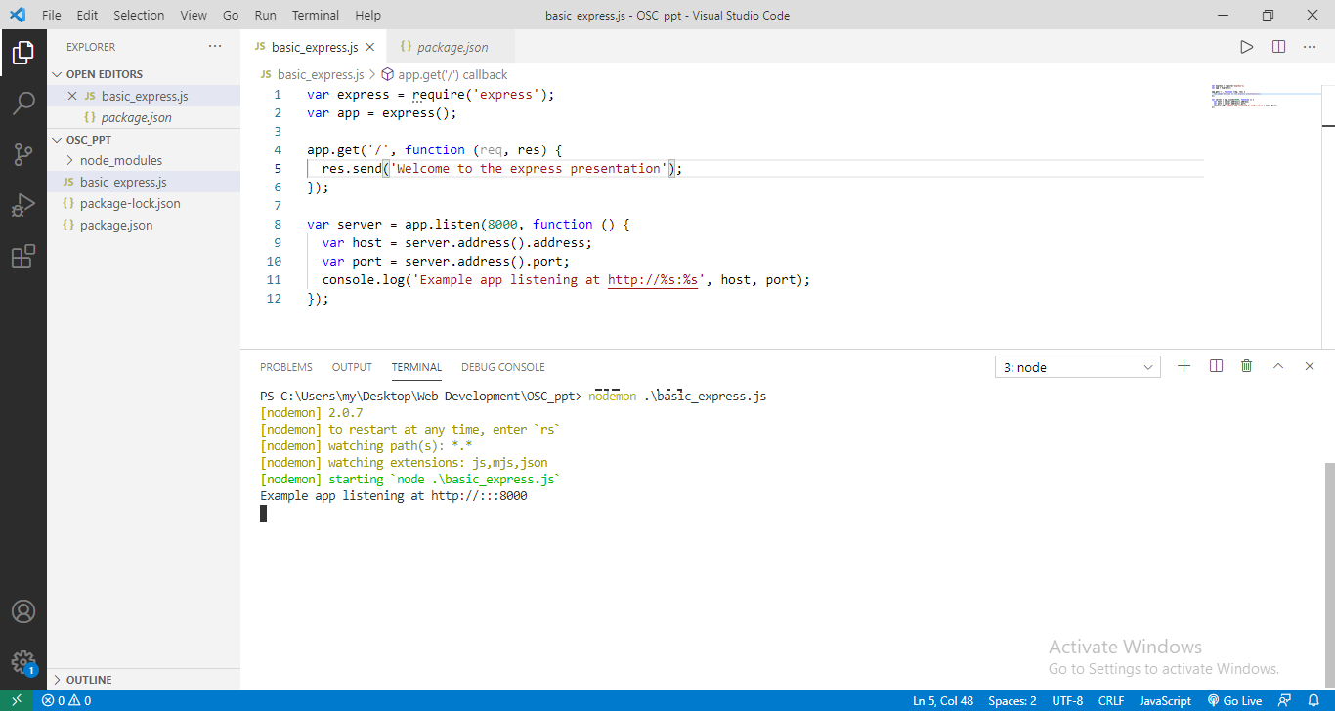

Slide 10
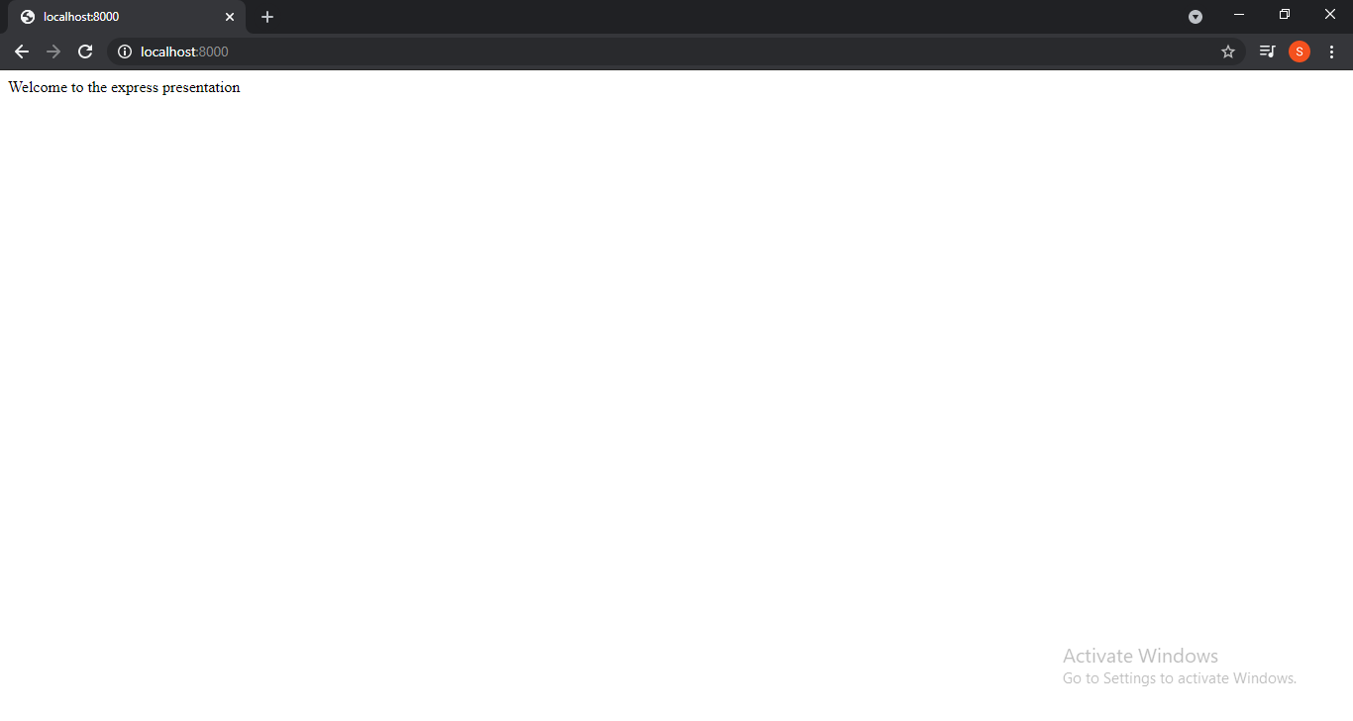

Slide 11
Express.js Request Object-
Express.js Request and Response objects are the parameters of the callback function which is used in Express application. The express.js request object represents the HTTP request and has properties for the request query string, parameters, body, HTTP headers, and so on.
Request object contains details about the client request.

Slide 12
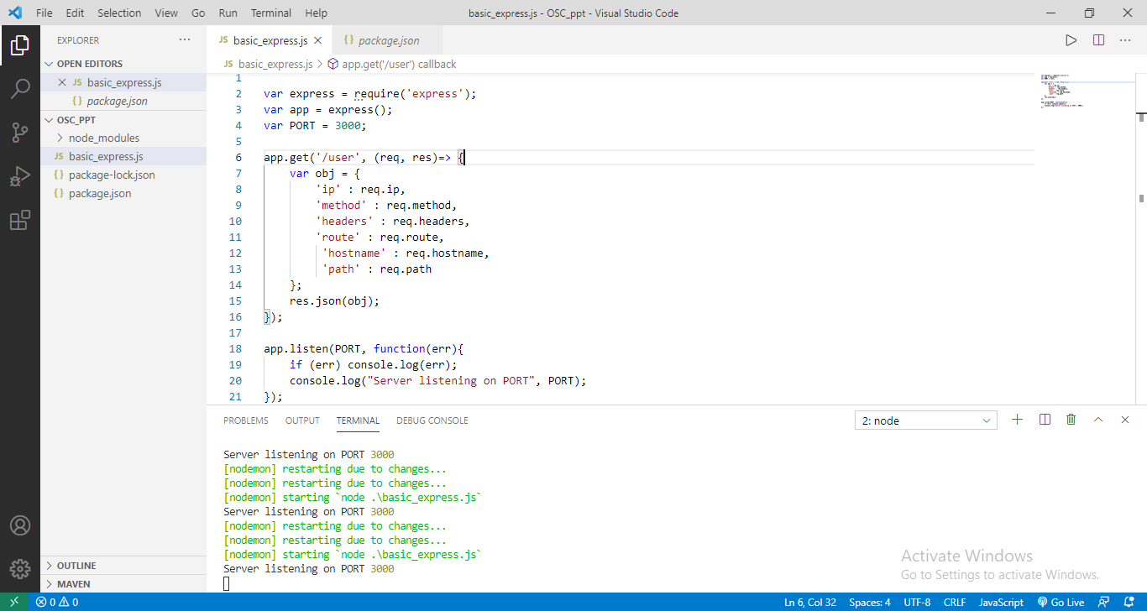

Slide 13
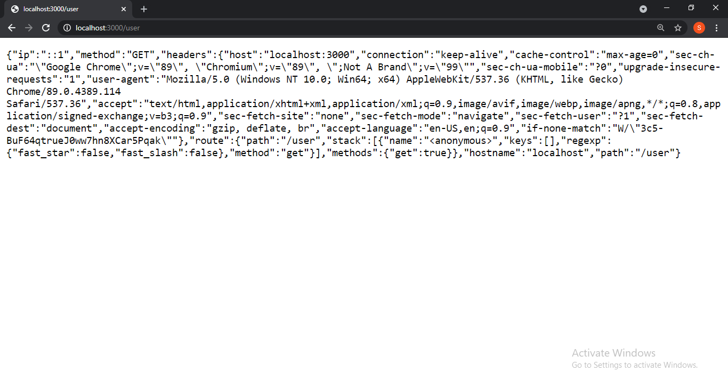

Slide 14
The above snapshot shows the various request object properties such as
->req.ip which gives the remote ip address of the system form which the request has been made.
->req.method gives the particular request method used currently, in this case get method is being used.
->req.headers gives various types of information such as host, user-agent and so on.
->req.route gives the currently matched route.
->req.hostname gives the hostname from the current http header.
->req.path gives the path part of the request url.
Some more important request object methods: are-
->req.app: This holds a reference to the instance of the express application.
->req.body: This contains key-value pairs of data submitted in the request body.

Slide 15
Express.js Response Object-
The Response object (res) specifies the HTTP response which is sent by an Express app when it gets an HTTP request. Response object sends response back to the client browser.
Properies of response object are-
res.app – This property holds a reference to the instance of the express application. ‘res.app’ is identical to the ‘req.app’ property in the request object.
Res.headerSent – It is the boolean property that indicates if the app sents http headers for the response.

Slide 16
Example:
app.get(‘/’, function(req, res) => {
console.dir(res.headerSent) //false
res.send(‘OK’)
console.dir(res.headerSent) //true });

Slide 17
Express.js Get request-
GET and POST both are two common HTTP requests used for building REST API's. GET requests are used to send only limited amount of data because data is sent into header while POST requests are used to send large amount of data because data is sent in the body.
Express.js facilitates you to handle GET and POST requests using the instance of express.

Slide 18
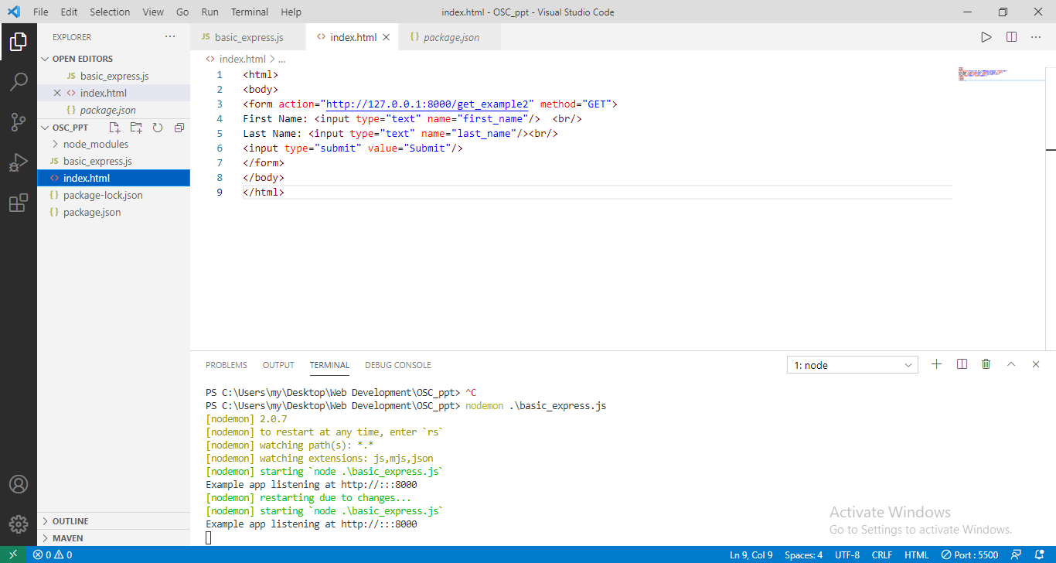
EXAMPLE-

Slide 19
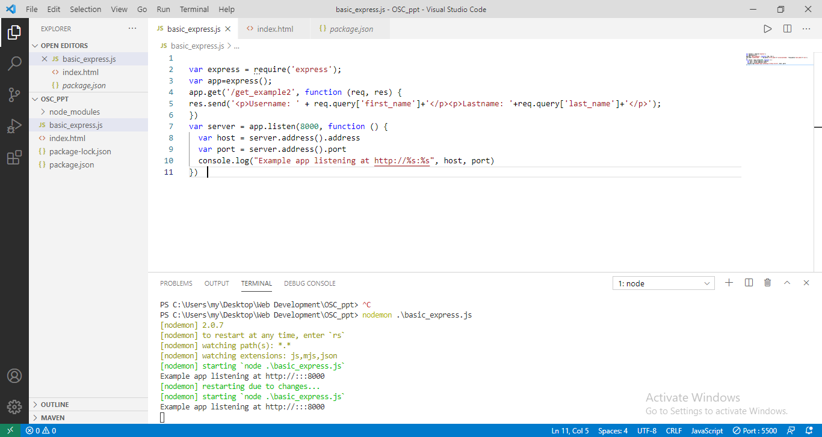

Slide 20
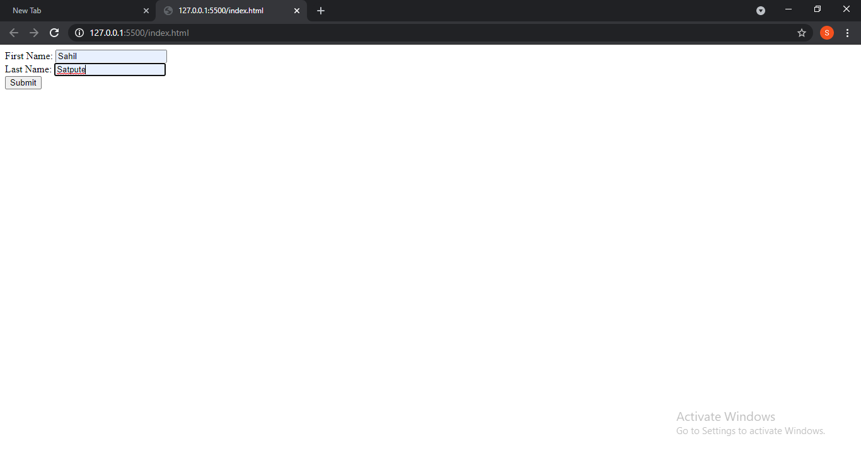

Slide 21
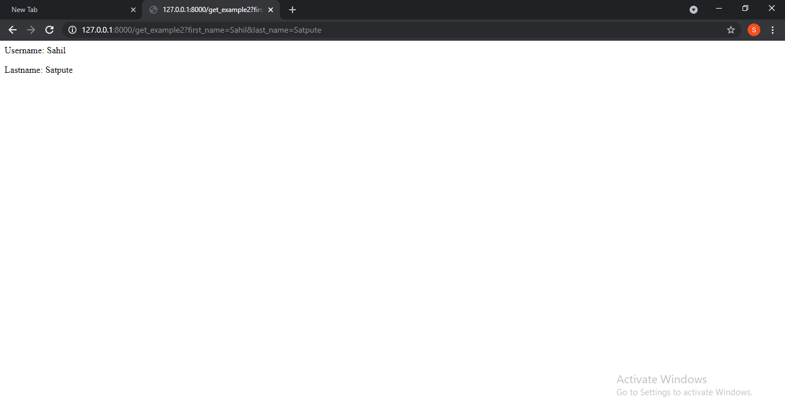

Slide 22
Express.js Post request-
Post method facilitates you to send large amount of data because data is send in the body. Post method is secure because data is not visible in URL bar but it is not used as popularly as GET method.
On the other hand GET method is more efficient and used more than POST.

Slide 23
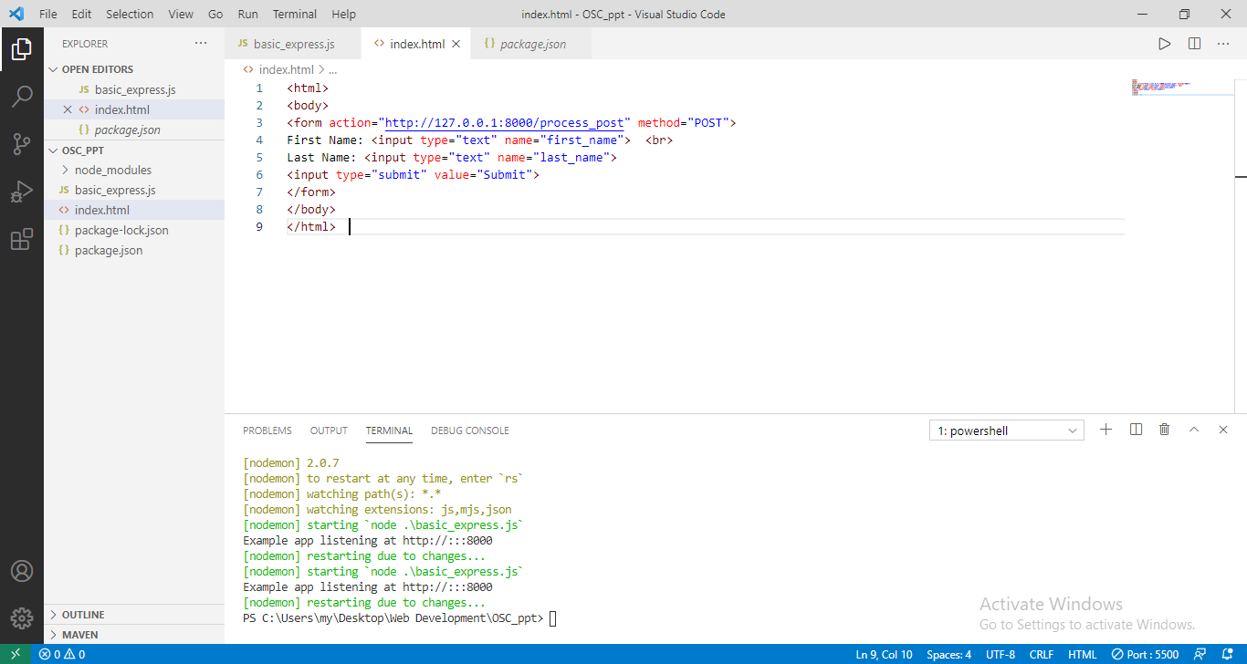
Example-

Slide 24
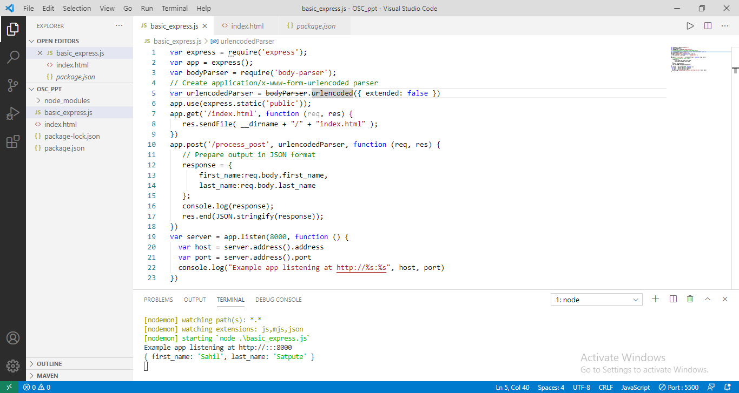

Slide 25
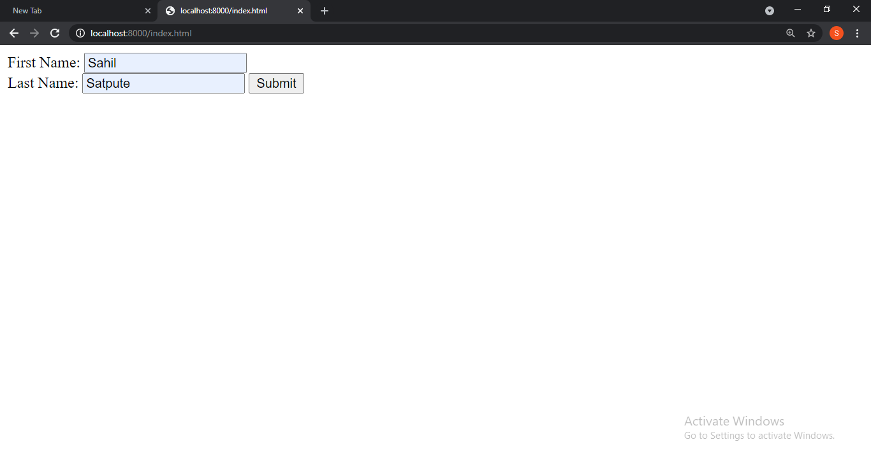

Slide 26
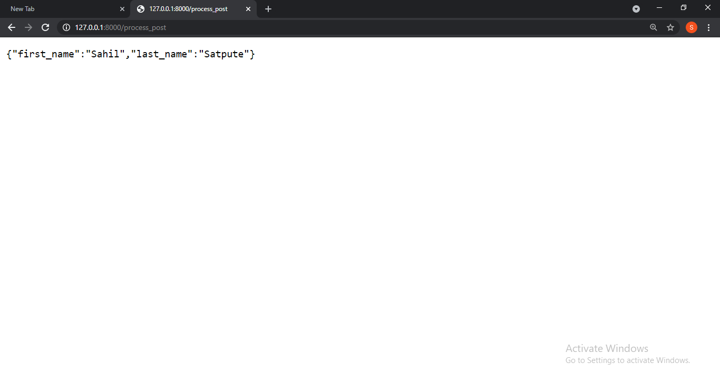
In below snippet no entries are visible in the url bar unlike get method.

Slide 27
Express.js Routing-
Routing is made from the word route. It is used to determine the specific behavior of an application.
It specifies how an application responds to a client request to a particular route, url or path and a specific HTTP request method (GET, POST, etc.). It can handle different types of HTTP requests.

Slide 28
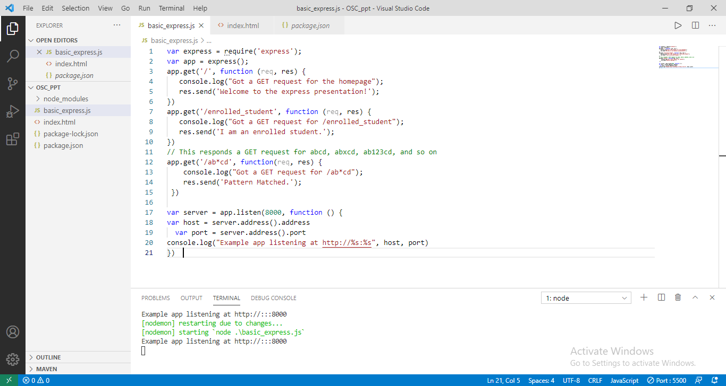
Example-

Slide 29
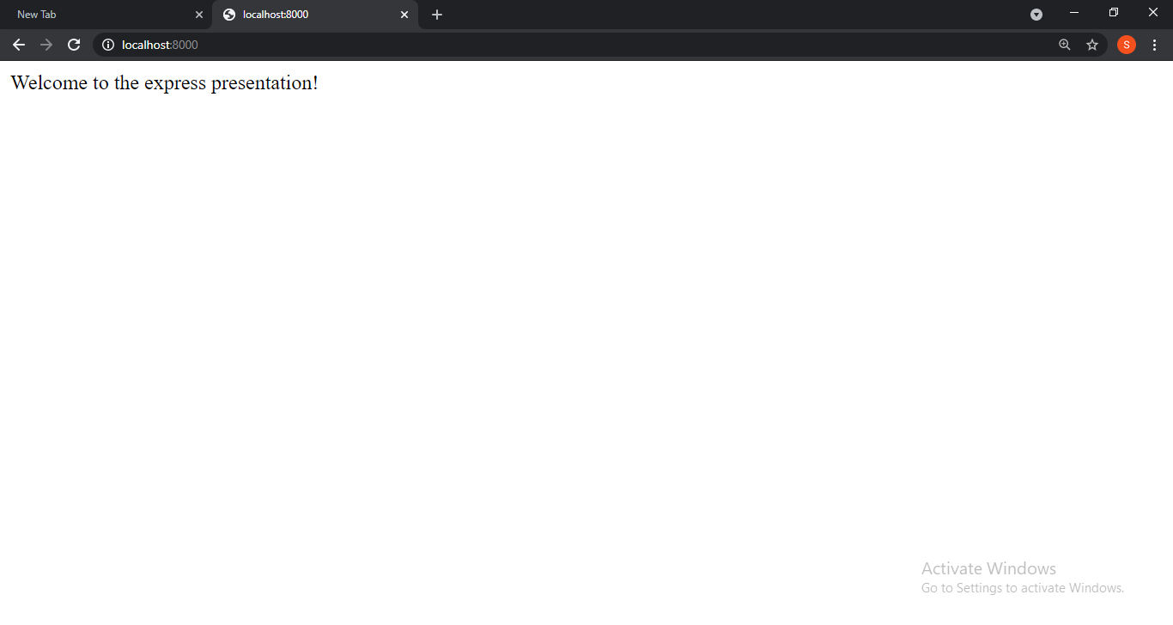

Slide 30


Slide 31
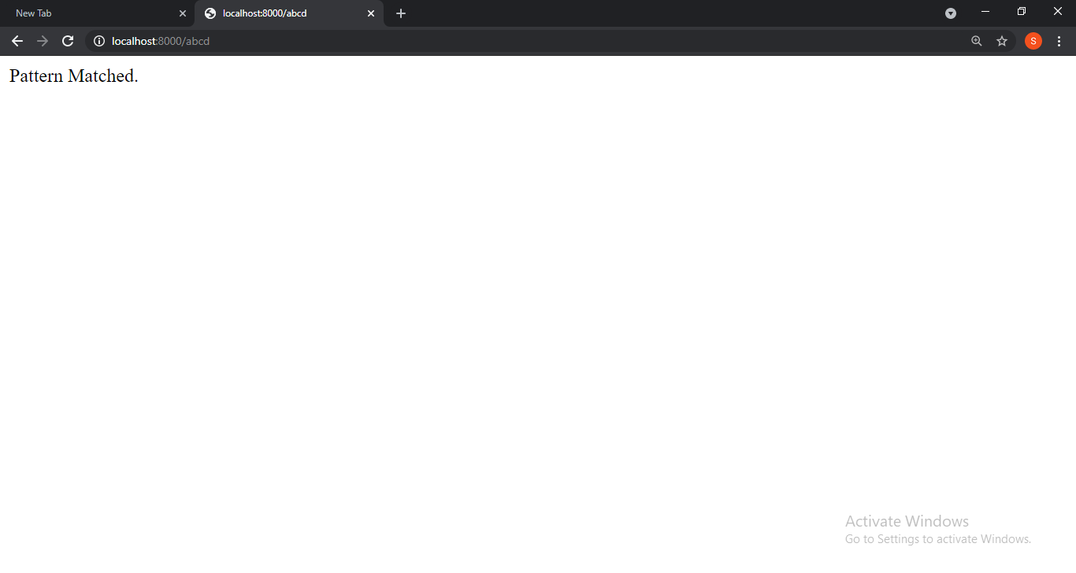

Slide 32


