Slide 1
Intro to MongoDB,NodeJS and ExpressJS
Presenters
Shaikh Mohammed Ammar (191080071)
Nityansh Doshi (191080053)
Sahil Satpute (191080066)

Slide 2
MongoDB Overview
MongoDB is a No-SQL database.
It is an open-source, cross-platform, document-oriented database written in C++ developed and supported by a company named 10gen aka MongoDb inc.
Development of MongoDB began in 2007 , started as a platform as a service.
Later in 2009, it was introduced in the market as an open source database server.

Slide 3
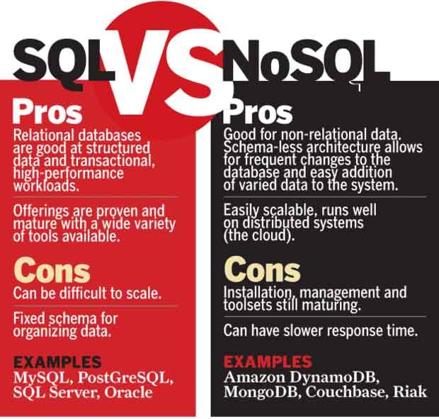
BSON | JSON
BSON is used for the documents.. | JSON is used for the javacript objects,
this is not JavaScript Object notation but it is Binary JSON | This is JavaScript object Notation
It is a binary form for representing simple or complex data structures including associative arrays | It is mainly used in Javascript language while programming.

Slide 4
Advantages of MongoDB
Support ad hoc queries
Indexing
Replication
Duplication of data
Load balancing
Supports map reduce and aggregation tools.
Uses JavaScript instead of Procedures.
It is a schema-less database written in C++.
Provides high performance.
Stores files of any size easily without complicating your stack.
Easy to administer in the case of failures.
And the list goes on…

Slide 5
Where should it be used?
Big and complex data
Mobile and social infrastructure
Content management and delivery
User data management
Data hub

Slide 6
Setting Up the Environment:
Steps to follow:
Head on to https://www.mongodb.com/try/download/community
Follow me.

Slide 7
Getting Started with Mongo:
Following Operations will be covered:
Create Database
Drop Database
Create Collection
Drop Collection
Data Types - This is in the appendix one reading is enough.
Insert Document
Query Document
Update Document
Delete Document
Projection
Limiting Records
Sorting Records
Indexing
Aggregation
Replication
Sharing

Slide 8
Create Database:
Steps to follow:
Head on to https://www.mongodb.com/try/download/community
Follow me.

Slide 9
NodeJS

Slide 10
What is NodeJS?
Node.js is a cross-platform runtime environment and library for running JavaScript applications outside the browser. It is used for creating server-side and networking web applications. It is open source and free to use. It can be downloaded from this link https://nodejs.org/en/
Many of the basic modules of Node.js are written in JavaScript. Node.js is mostly used to run real-time server applications.
Node.js is a platform built on Chrome's JavaScript runtime for easily building fast and scalable network applications. Node.js uses an event-driven, non-blocking I/O model that makes it lightweight and efficient, perfect for data-intensive real-time applications that run across distributed devices.
Node.js also provides a rich library of various JavaScript modules to simplify the development of web applications.

Slide 11
Features of NodeJS
Extremely fast: Node.js is built on Google Chrome's V8 JavaScript Engine, so its library is very fast in code execution.
I/O is Asynchronous and Event Driven: All APIs of Node.js library are asynchronous i.e. non-blocking. So a Node.js based server never waits for an API to return data. The server moves to the next API after calling it and a notification mechanism of Events of Node.js helps the server to get a response from the previous API call. It is also a reason that it is very fast.
Single threaded: Node.js follows a single threaded model with event looping.
Highly Scalable: Node.js is highly scalable because event mechanism helps the server to respond in a non-blocking way.
No buffering: Node.js cuts down the overall processing time while uploading audio and video files. Node.js applications never buffer any data. These applications simply output the data in chunks.
Open source: Node.js has an open source community which has produced many excellent modules to add additional capabilities to Node.js applications.
License: Node.js is released under the MIT license.

Slide 12
Install Node.js on Windows
To install and setup an environment for Node.js, you need the following two softwares available on your computer:
Text Editor. (Visual Studio Code)
Node.js Binary installable
How to download Node.js:
You can download the latest version of Node.js installable archive file from https://nodejs.org/en/

Slide 13
Install Node.js on Linux/Ubuntu
We can easily install Node.js on linux/ubuntu/etc. To install Node.js on Linux (Ubuntu) operating system, follow these instructions:
1) Open Ubuntu Terminal (You can use shortcut keys (Ctrl+Alt+T).
2) Type command sudo apt-get install python-software-properties
3) Press Enter (If you have set a password for your system then it will ask for the password)
4) Type the password and press enter
5) Type command sudo apt-add-repository ppa:chris-lea/node.js
6) Press Enter
7) Again Press Enter to continue
8) Type command sudo apt-get update ( Wait for sometime)
9) Type command sudo apt-get install nodejs npm
10) Type command sudo apt-get install nodejs
Installation completed. Now you can check the version of Node by node --version

Slide 14
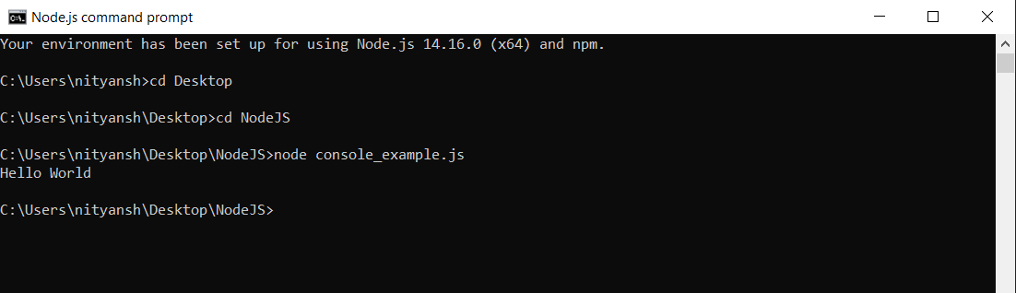
Node.js First Example
There can be console-based and web-based node.js applications.
Node.js console-based Example
console.log("Hello World");
Open Node.js command prompt and run the following code:
node console_example.js

Slide 15
Node.js web-based Example
A node.js web application contains the following three parts:
Import required modules: The "require" directive is used to load a Node.js module.
Create server: You have to establish a server which will listen to client's request similar to Apache HTTP Server.
Read request and return response: Server created in the second step will read HTTP request made by client which can be a browser or console and return the response.

Slide 16
How to create node.js web applications
Import required module: The first step is to use require directive to load http module and store returned HTTP instance into http variable. For example:
Create server: In the second step, you have to use created http instance and call http.createServer() method to create server instance and then bind it at port 8081 using listen method associated with server instance. Pass it a function with request and response parameters and write the sample implementation to return "Hello World".
Combine step1 and step2 together

Slide 17
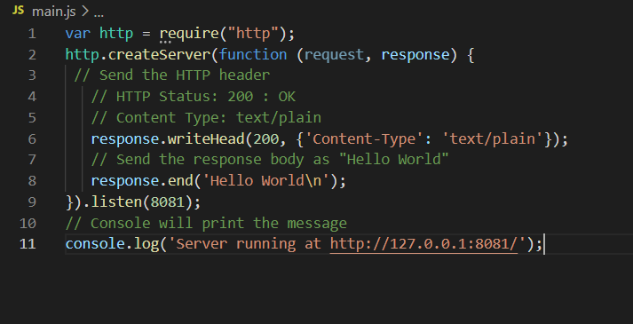
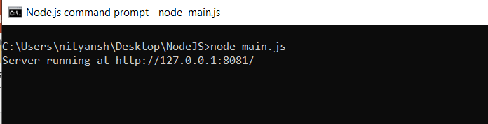
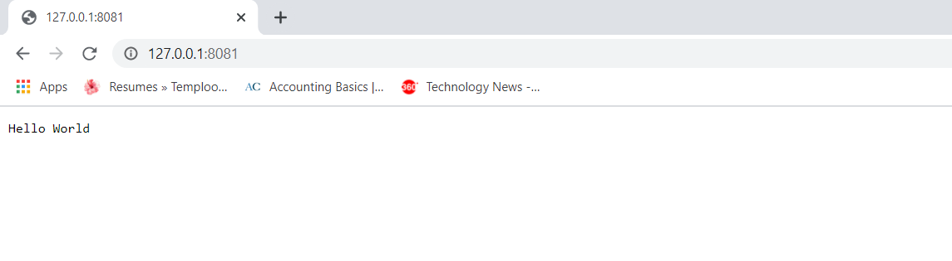

Slide 18
Node.js Console
The Node.js console module provides a simple debugging console similar to JavaScript console mechanism provided by web browsers.
There are three console methods that are used to write any node.js stream:
console.log()
console.error()
console.warn()
Node.js console.log()
The console.log() function is used to display simple message on console. Prints to stdout with newline.
console.log('Hello World');
var name="Nityansh"
console.log('Hello %s', name);

Slide 19
Node.js console.error()
The console.error() function is used to render error message on console.
Prints to stderr with newline.
console.error('Invalid input.');
Node.js console.warn()
The console.warn() function is used to display warning message on console.
It is an alias for console.error().
age=55;
console.warn(`My age is ${age}`);

Slide 20
Node.js REPL
The term REPL stands for Read Eval Print and Loop. It specifies a computer environment like a window console or a Unix/Linux shell where you can enter the commands and the system responds with an output in an interactive mode.
REPL Environment
The Node.js or node come bundled with REPL environment. Each part of the REPL environment has a specific work.
Read: It reads user's input; parse the input into JavaScript data-structure and stores in memory.
Eval: It takes and evaluates the data structure.
Print: It prints the result.
Loop: It loops the above command until user press ctrl-c twice.

Slide 21
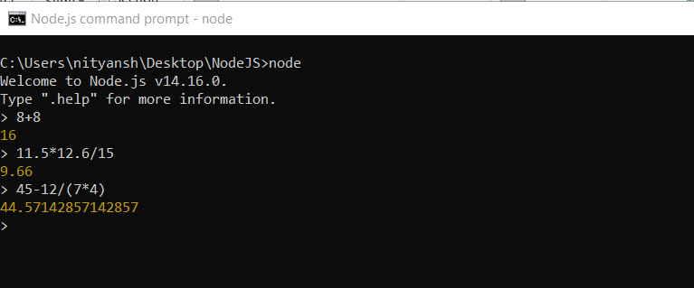
You can start REPL by simply running "node" on the command prompt.
You can execute various mathematical operations on REPL Node.js command prompt:
Node.js Simple expressions

Slide 22
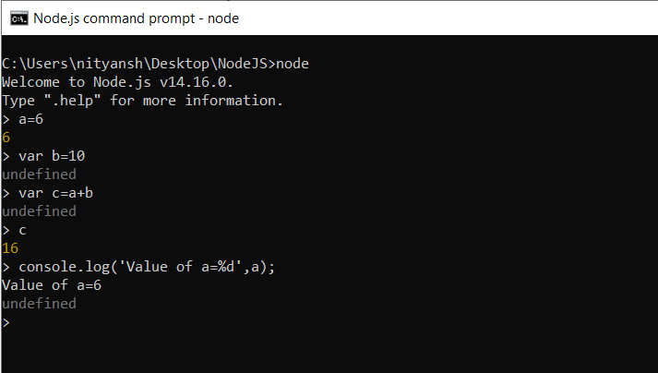
Using variable
Variables are used to store values and print later. If you don't use var keyword then value is stored in the variable and printed whereas if var keyword is used then value is stored but not printed. You can print variables using console.log()

Slide 23
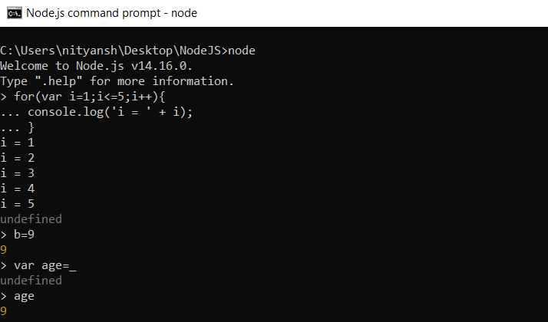
Node.js Multiline expressions and Underscore Variable
Node REPL supports multiline expressions.
We can use underscore _ to get the last result.

Slide 24
Node.js REPL Commands
Commands | Description
ctrl + c | It is used to terminate the current command.
ctrl + c twice | It terminates the node repl.
ctrl + d | It terminates the node repl.
up/down keys | It is used to see command history and modify previous commands.
tab keys | It specifies the list of current command.
.help | It specifies the list of all commands.
.break | It is used to exit from multi-line expressions.
.clear | It is used to exit from multi-line expressions.
.save filename | It saves current node repl session to a file.
.load filename | It is used to load file content in current node repl session.

Slide 25
Node.js Modules
What is a Module in Node.js?
Consider modules to be the same as JavaScript libraries.
A set of functions you want to include in your application.
Include Modules
To include a module, use the require() function with the name of the module:
var http = require("http");
Now your application has access to the HTTP module

Slide 26
Create Your Own Modules
You can create your own modules, and easily include them in your applications.
The following example creates a module that returns a date and time object:
var os = require('os’)
exports.system = function () {
return os.type();
};
We make use of the exports keyword to make properties and methods available outside the module file.

Slide 27
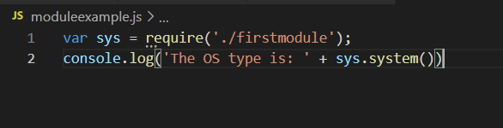
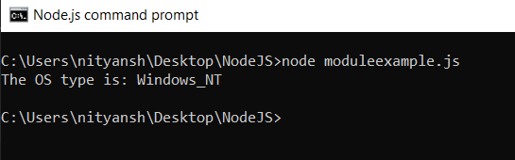
Include Your Own Module
Now you can include and use the module in any of your Node.js files.

Slide 28
Node.js Package Manager
Node Package Manager provides two main functionalities:
It provides online repositories for node.js packages/modules which are searchable on search.nodejs.org
It also provides command line utility to install Node.js packages, do version management and dependency management of Node.js packages.
The npm comes bundled with Node.js installables in versions after that v0.6.3. You can check the version by opening Node.js command prompt and typing the following command:
npm version

Slide 29
Installing Modules using npm
Following is the syntax to install any Node.js module:
npm install <Module Name>
Let's install a famous Node.js web framework called express:
Open the Node.js command prompt and execute the following command:
npm install express

Slide 30
EXPRESS PRESENTATION-
Express is a web framework for Node js.
You can assume express as a layer built on the top of the Node.js that helps manage a server and routes. It provides a robust set of features to develop web and mobile applications.

Slide 31
NPM –
Once nodejs is installed npm comes installed with it. NPM basically is the package manager for node. It helps with installing various packages and resolving their various dependencies. It greatly helps with your Node development.
npm init-
This command creates a package.json file which contains information about the current project.
Some of this information includes:
A list of node packages required for the project — If another developer wants to run a project, npm looks inside package.json and downloads the packages in this list. If you have Node(nodejs) installed on your computer, you can create a package.json file by typing ‘npm init’ into the terminal.

Slide 32
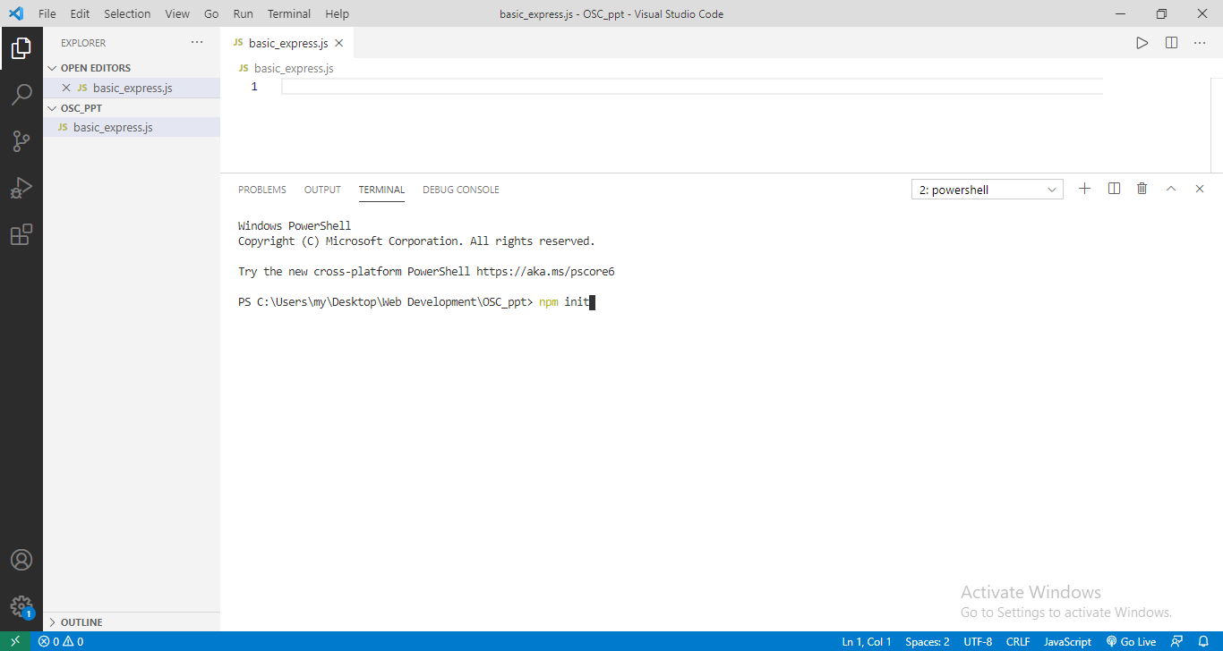

Slide 33
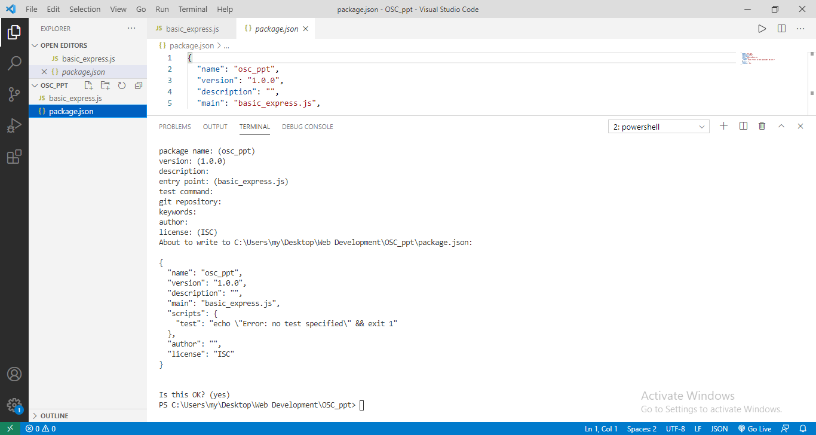

Slide 34
npm install express-
This command installs express for your current project only. These can be seen in the package.json file under the dependencies

Slide 35
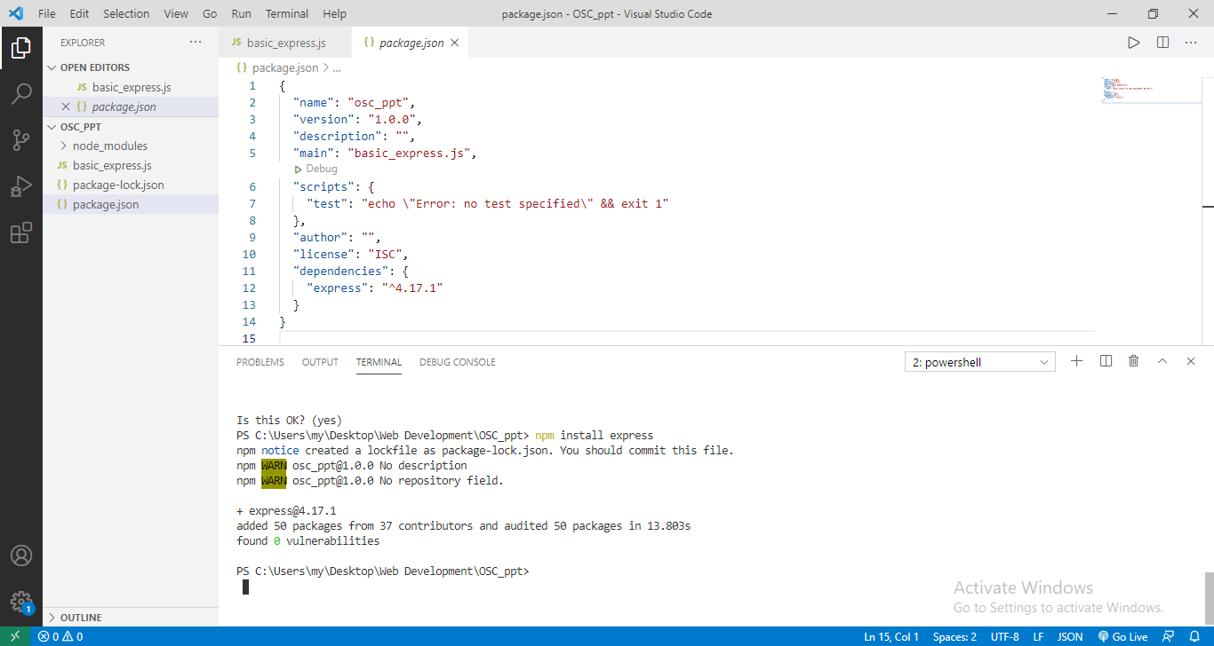

Slide 36
npm install nodemon-
This command installs nodemon package in the current project or directory. It automatically restarts the server whenever changes are made in the main file of the express and saved. Eg. Use ‘nodemon basic_express.js’ command.

Slide 37
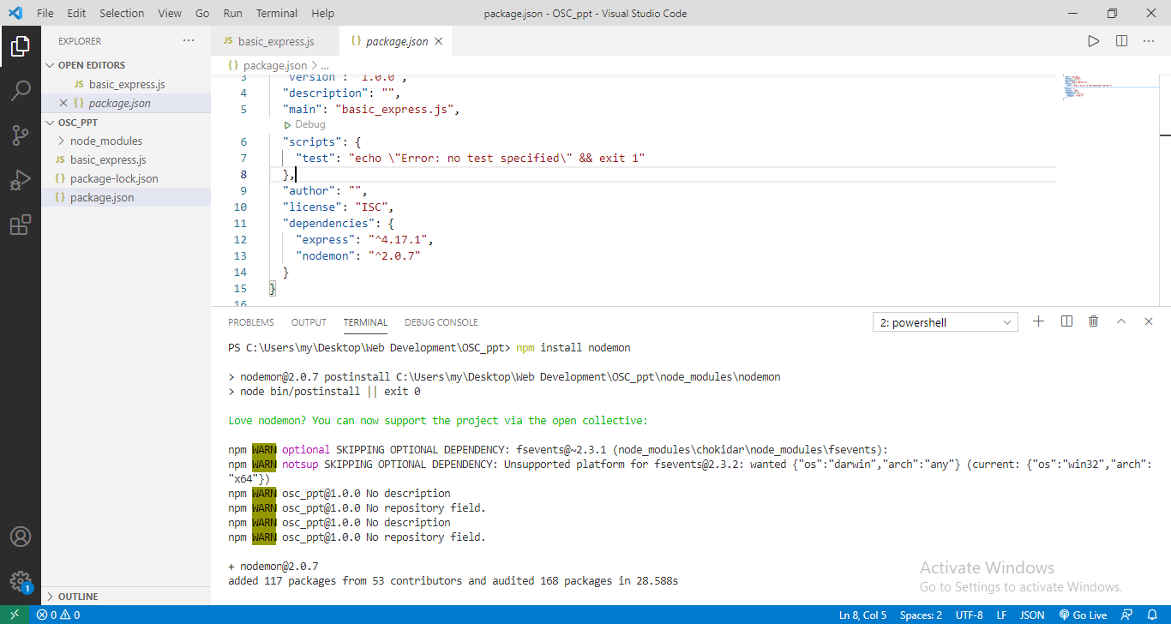

Slide 38
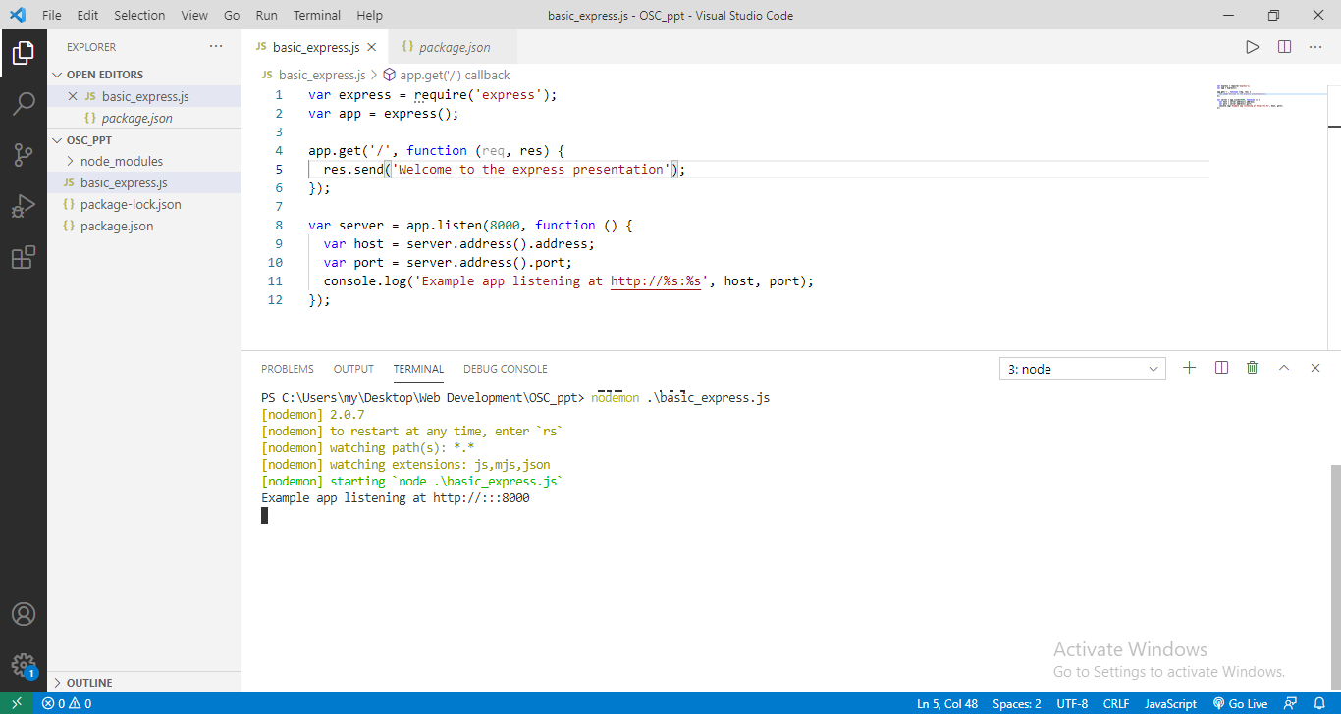

Slide 39
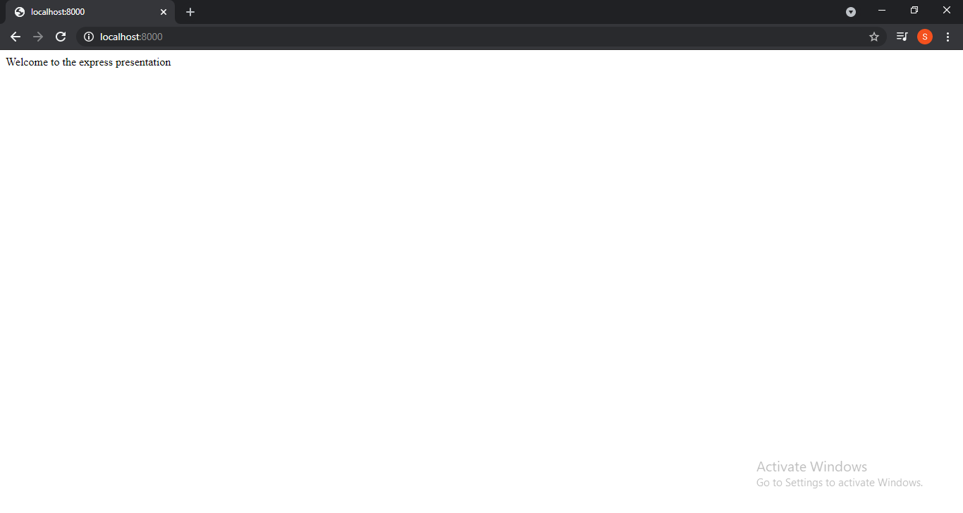

Slide 40
Express.js Request Object-
Express.js Request and Response objects are the parameters of the callback function which is used in Express application. The express.js request object represents the HTTP request and has properties for the request query string, parameters, body, HTTP headers, and so on.
Request object contains details about the client request.

Slide 41
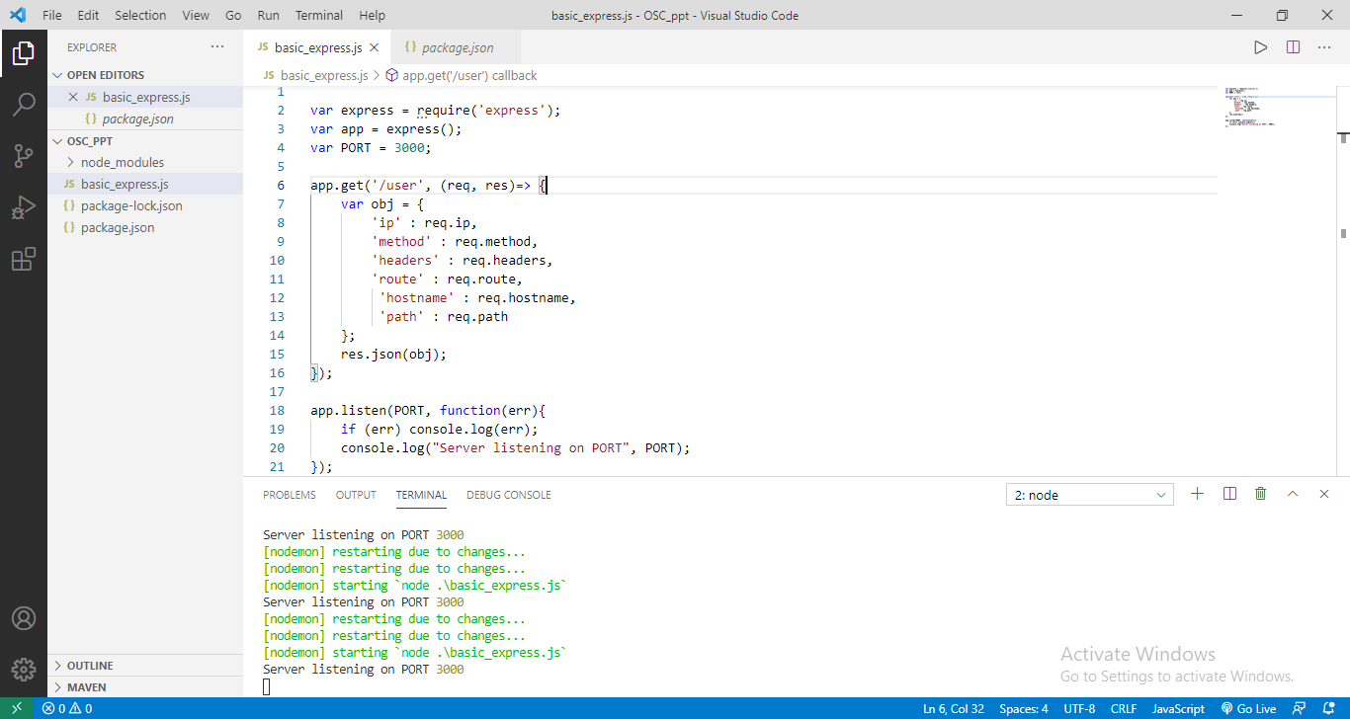

Slide 42
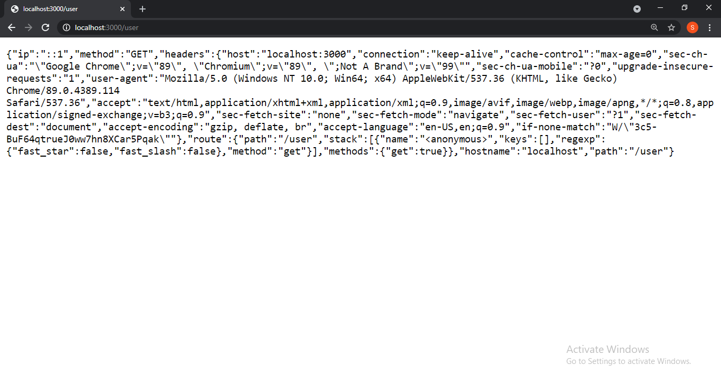

Slide 43
The above snapshot shows the various request object properties such as
->req.ip which gives the remote ip address of the system form which the request has been made.
->req.method gives the particular request method used currently, in this case get method is being used.
->req.headers gives various types of information such as host, user-agent and so on.
->req.route gives the currently matched route.
->req.hostname gives the hostname from the current http header.
->req.path gives the path part of the request url.
Some more important request object methods: are-
->req.app: This holds a reference to the instance of the express application.
->req.body: This contains key-value pairs of data submitted in the request body.

Slide 44
Express.js Response Object-
The Response object (res) specifies the HTTP response which is sent by an Express app when it gets an HTTP request. Response object sends response back to the client browser.
Properies of response object are-
res.app – This property holds a reference to the instance of the express application. ‘res.app’ is identical to the ‘req.app’ property in the request object.
Res.headerSent – It is the boolean property that indicates if the app sents http headers for the response.

Slide 45
Example:
app.get(‘/’, function(req, res) => {
console.dir(res.headerSent) //false
res.send(‘OK’)
console.dir(res.headerSent) //true });

Slide 46
Express.js Get request-
GET and POST both are two common HTTP requests used for building REST API's. GET requests are used to send only limited amount of data because data is sent into header while POST requests are used to send large amount of data because data is sent in the body.
Express.js facilitates you to handle GET and POST requests using the instance of express.

Slide 47
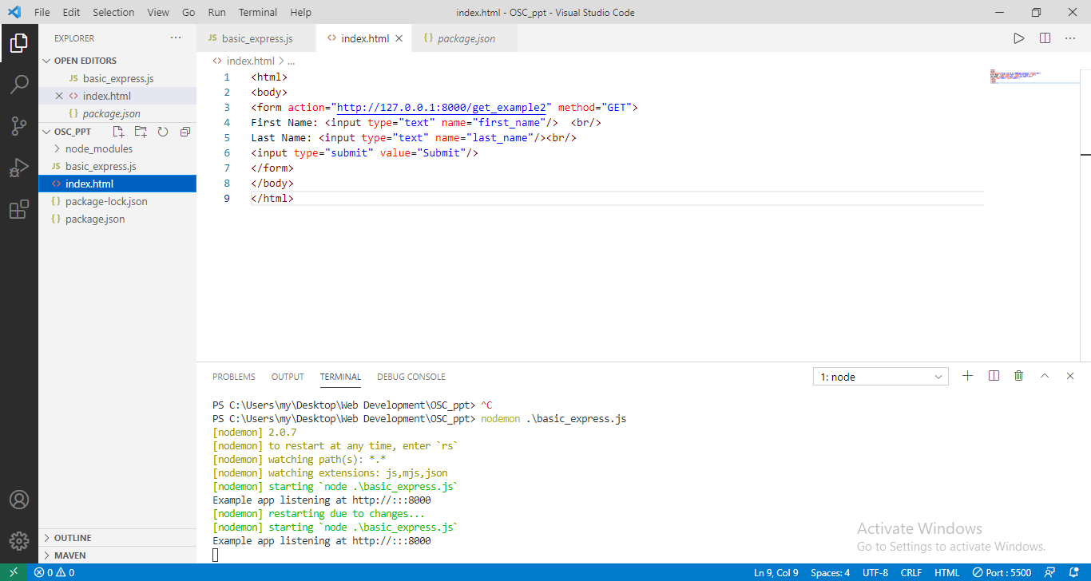
EXAMPLE-

Slide 48
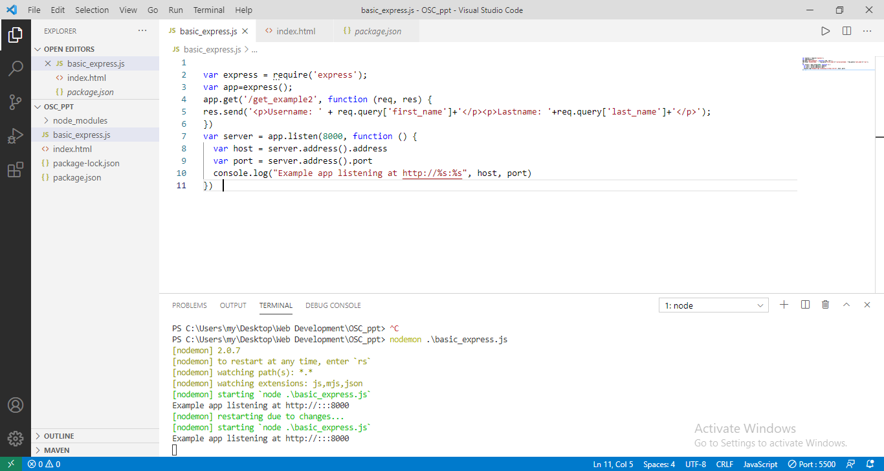

Slide 49
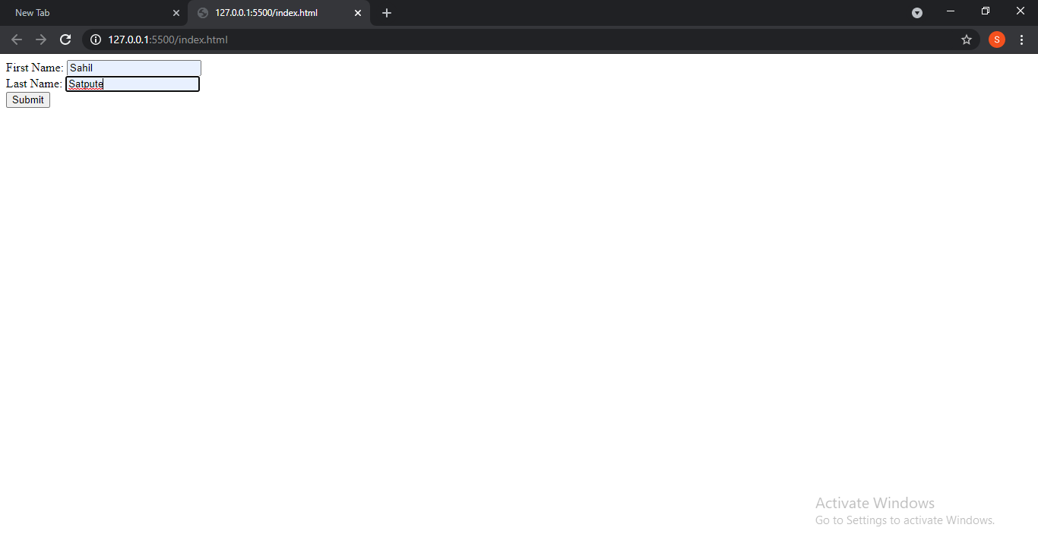

Slide 50
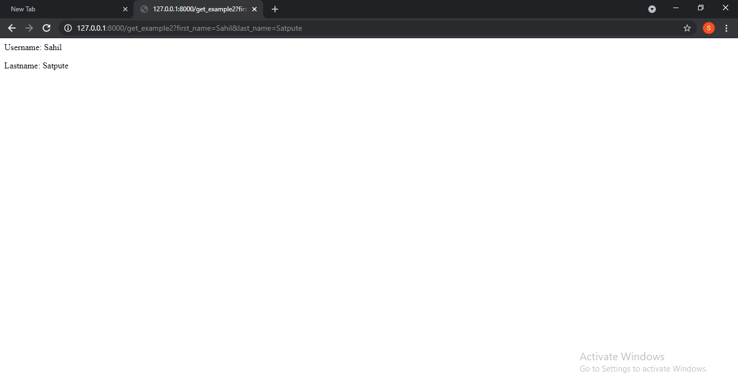

Slide 51
Express.js Post request-
Post method facilitates you to send large amount of data because data is send in the body. Post method is secure because data is not visible in URL bar but it is not used as popularly as GET method.
On the other hand GET method is more efficient and used more than POST.

Slide 52
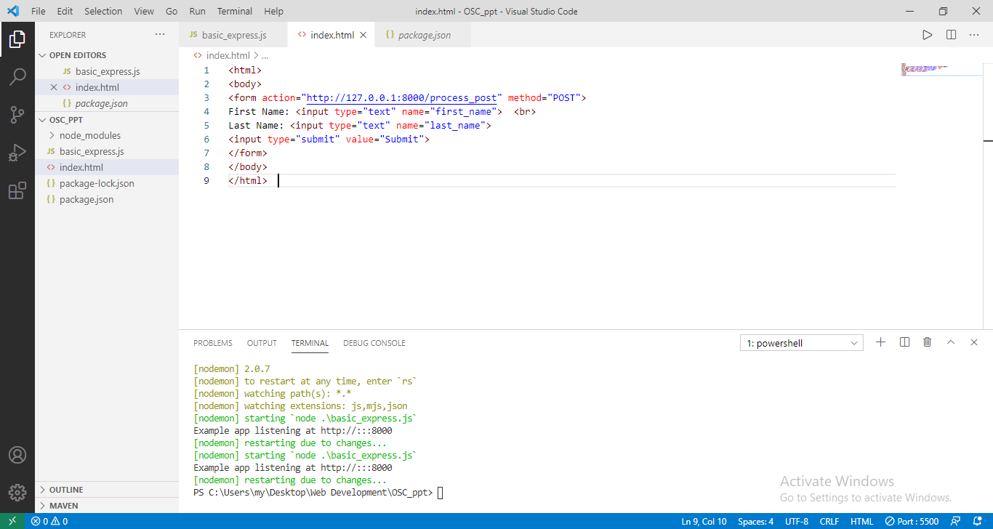
Example-

Slide 53
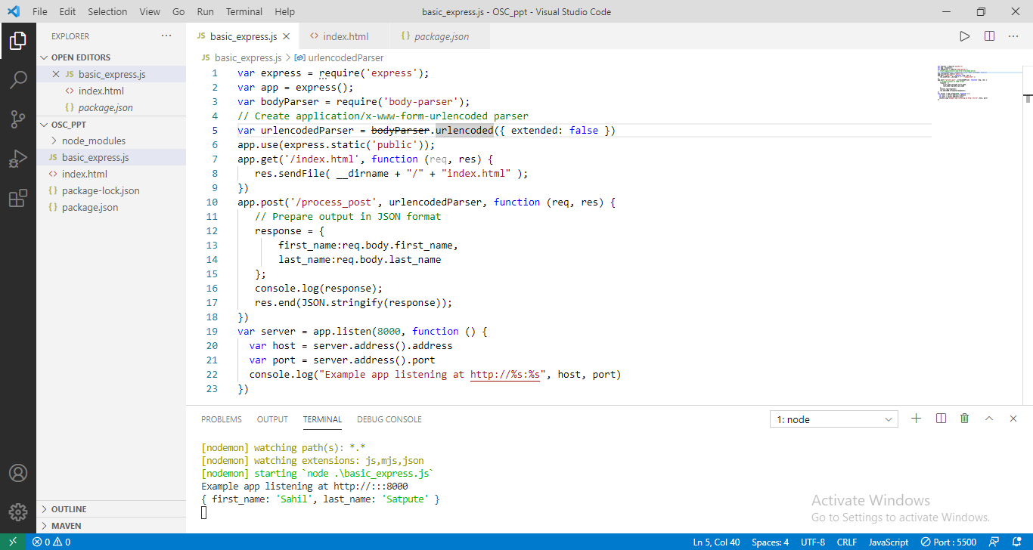

Slide 54
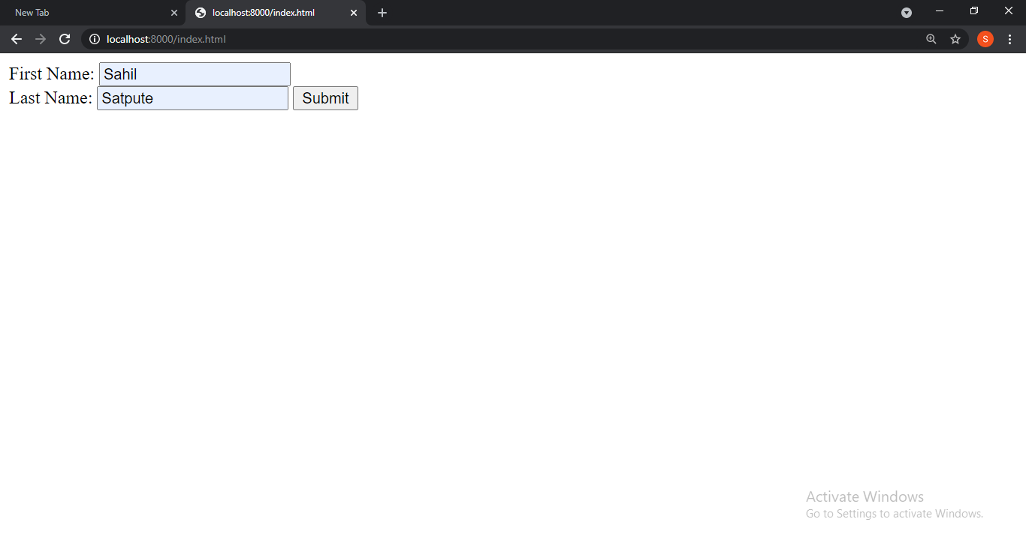

Slide 55
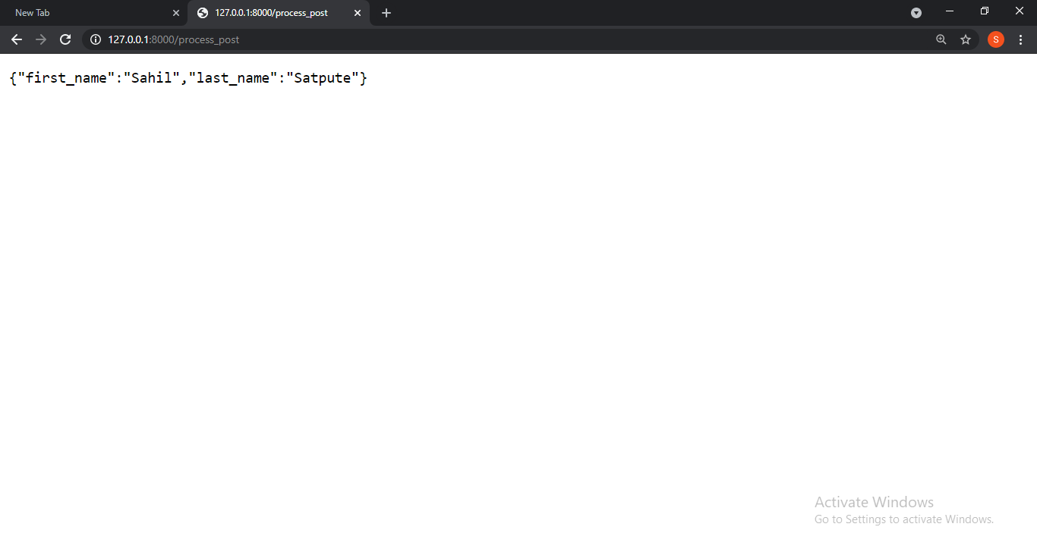
In below snippet no entries are visible in the url bar unlike get method.

Slide 56
Express.js Routing-
Routing is made from the word route. It is used to determine the specific behavior of an application.
It specifies how an application responds to a client request to a particular route, url or path and a specific HTTP request method (GET, POST, etc.). It can handle different types of HTTP requests.

Slide 57
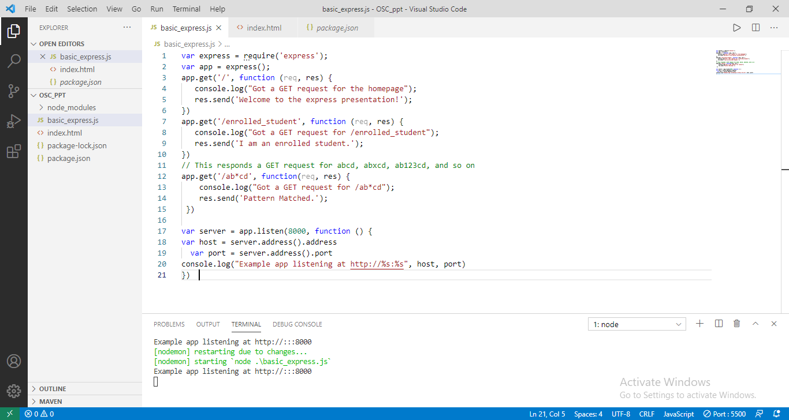
Example-

Slide 58
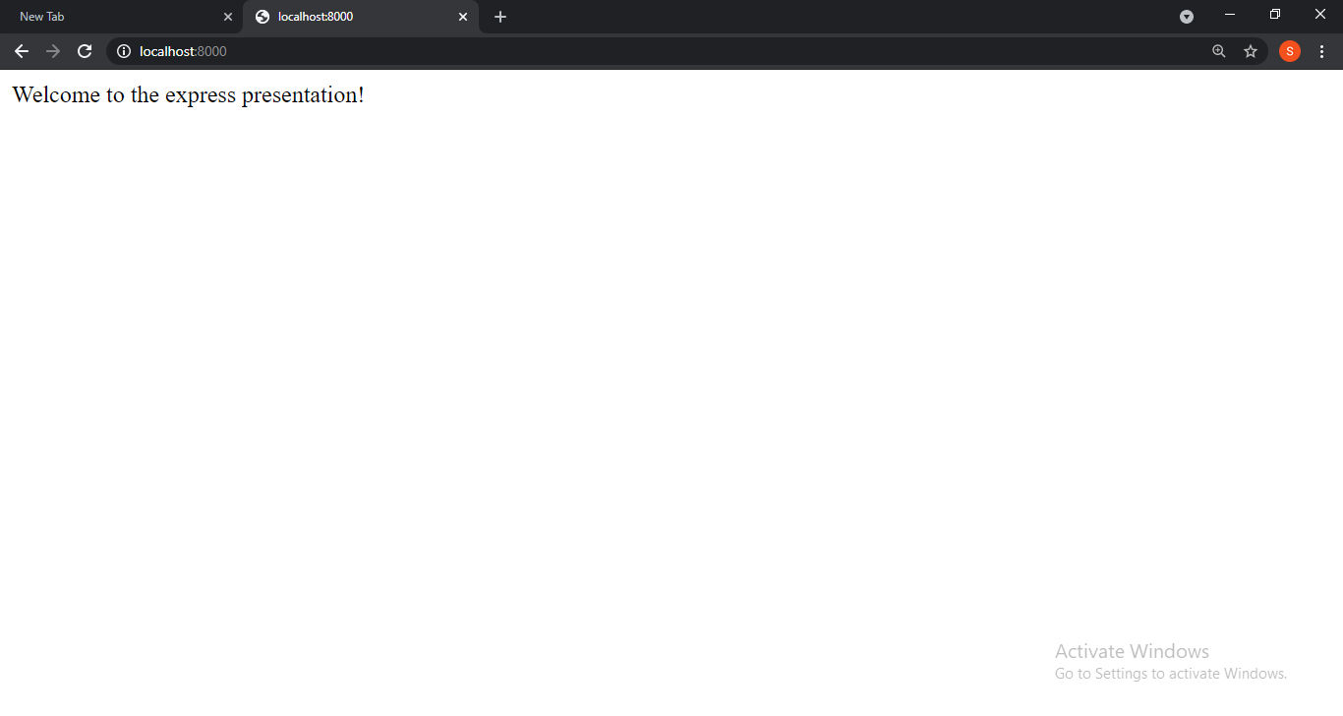

Slide 59


Slide 60
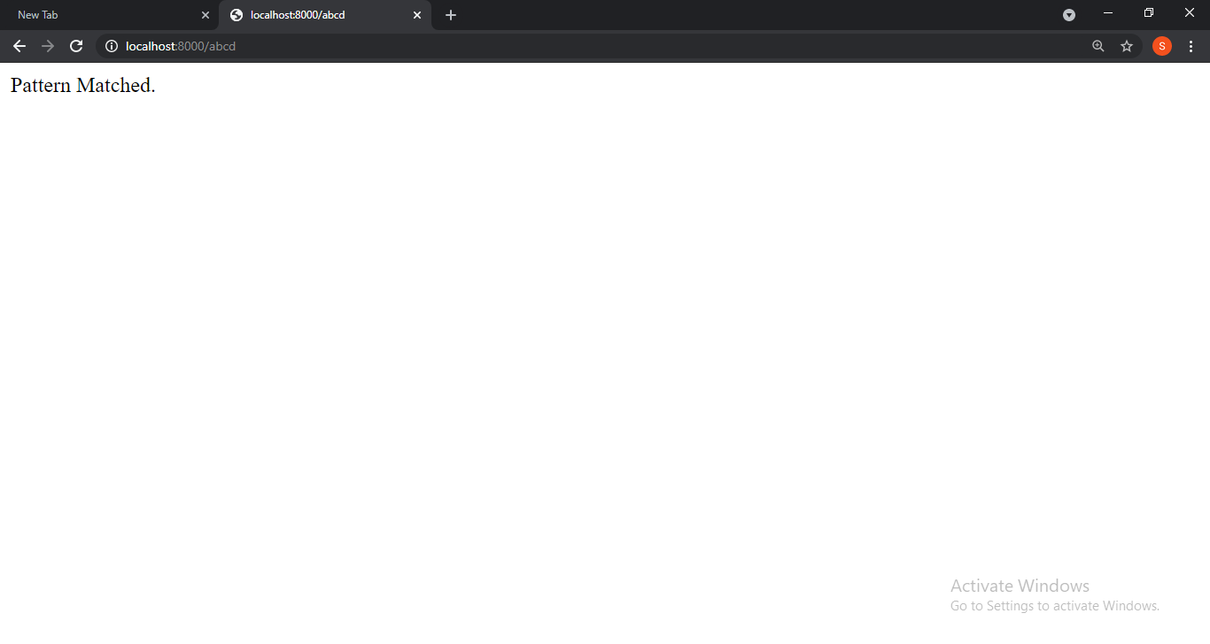

Slide 61


