Slide 1
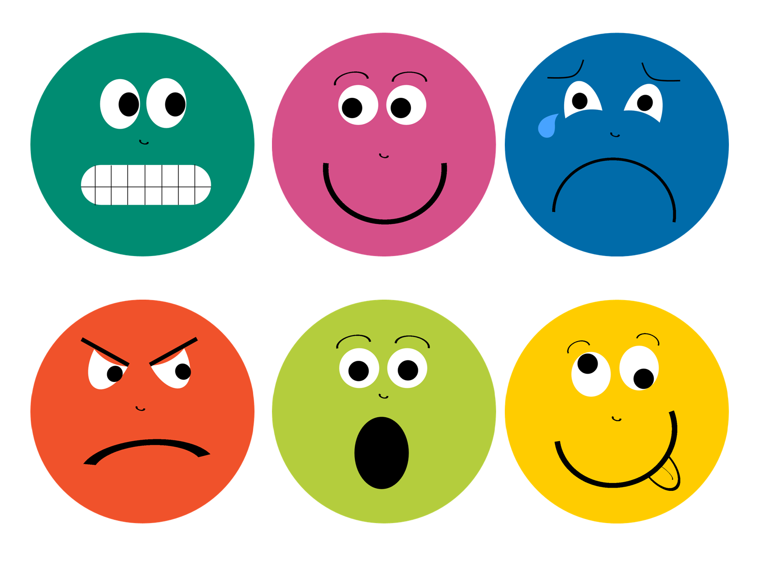

Speech Emotion Detection
Author: Arwa Ashi
Saudi Digital Academy
Final Project - Dec 3rd, 2020

Slide 2
Project outline:
Objective:
As a Data Scientist, I have been tasked with designing a model that detects speech emotions such as anger, disgust, fear, happiness, neutral, sadness and surprise.
Data Frame
Parse the waves’ filename
Exploratory Data Analysis
Visualization
Models
Using new wave to test the models’ performance
Emotion wave Comparison
Features
Test
Deep Learning
Machine Learning

Slide 3
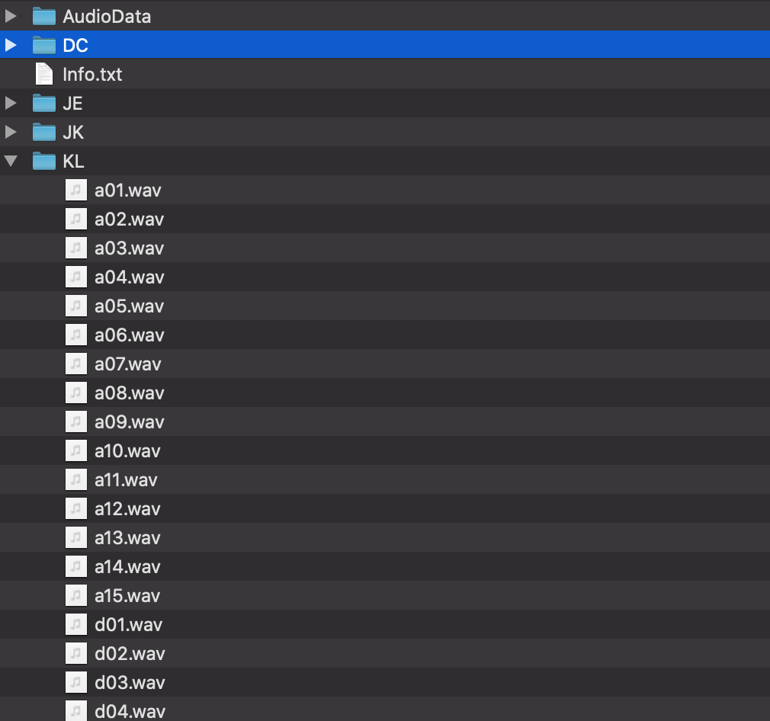
Data Frame
Speakers: 'DC', 'JE', 'JK' and 'KL' are four male speakers recorded for the SAVEE database
--------------------------------------
Audio data
Audio files consist of audio WAV files sampled at 44.1 kHz
There are 15 sentences for each of the 7 emotion categories.
The initial letter(s) of the file name represents the emotion class, and the following digits represent the sentence number.
The letters 'a', 'd', 'f', 'h', 'n', 'sa' and 'su' represent 'anger', 'disgust', 'fear', 'happiness', 'neutral', 'sadness' and 'surprise' emotion classes respectively.
E.g., 'd03.wav' is the 3rd disgust sentence.
Source: https://www.kaggle.com/barelydedicated/savee-database

Slide 4
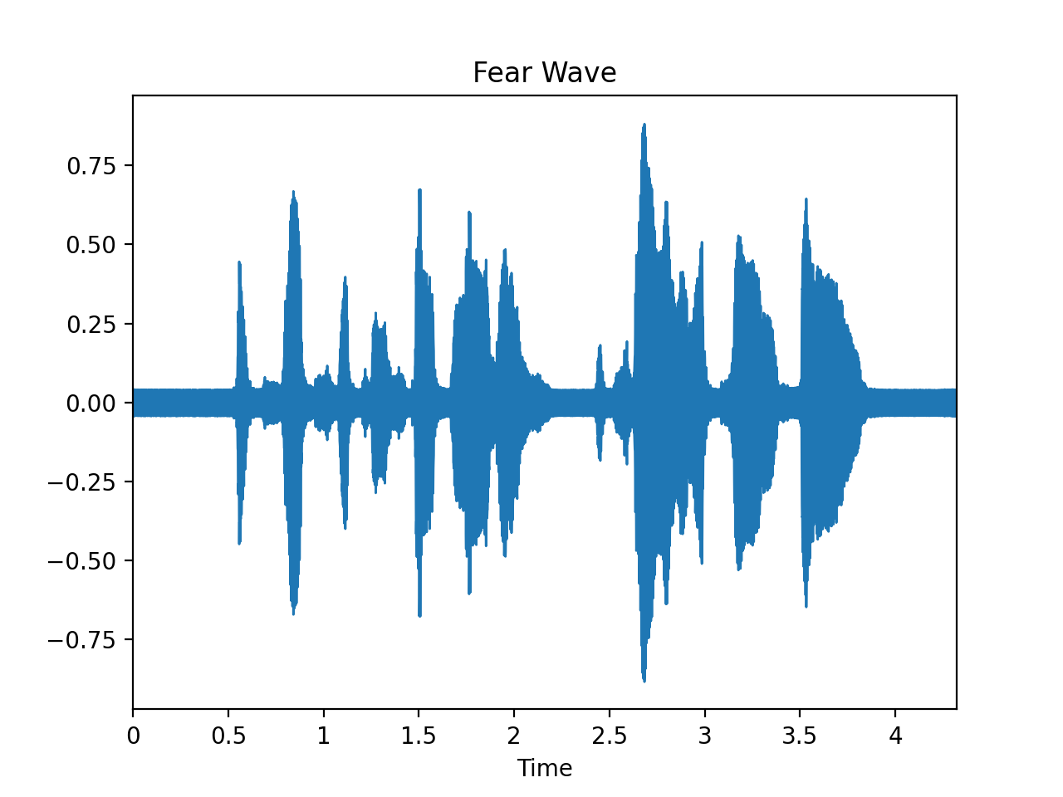
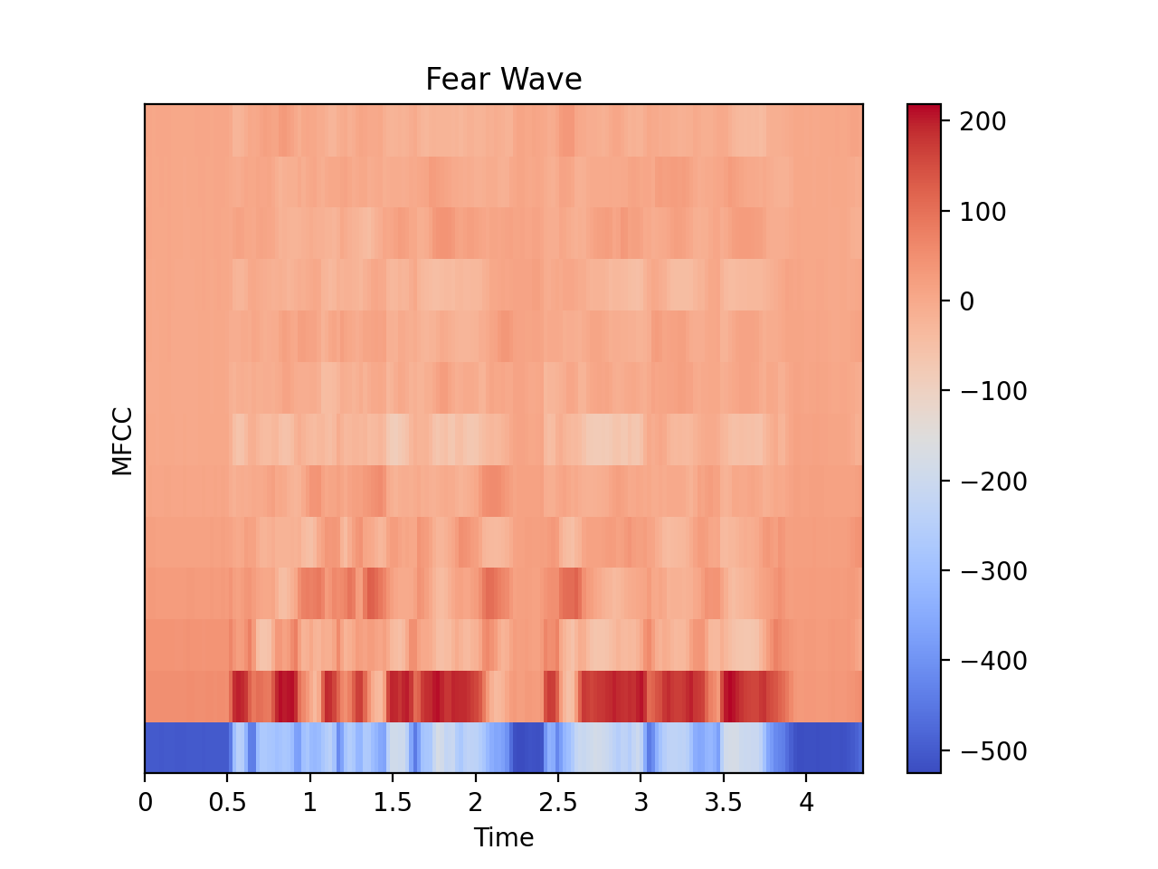
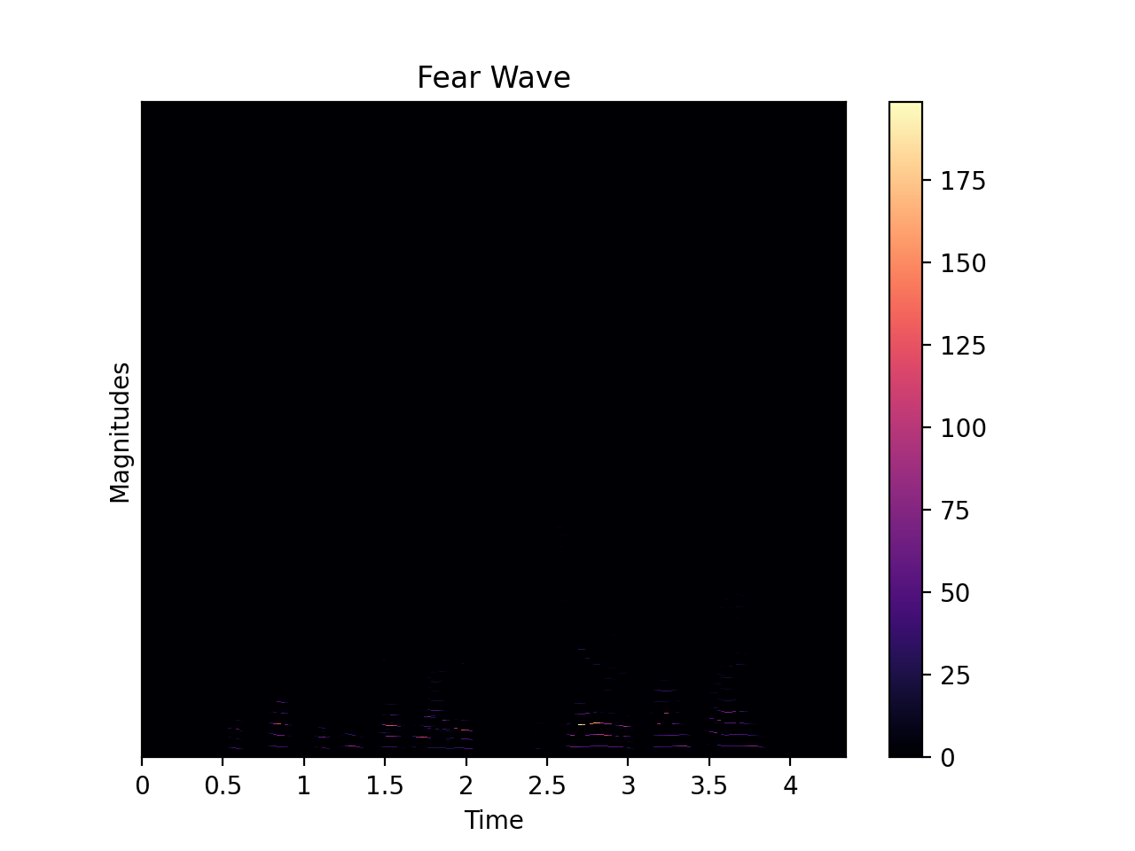

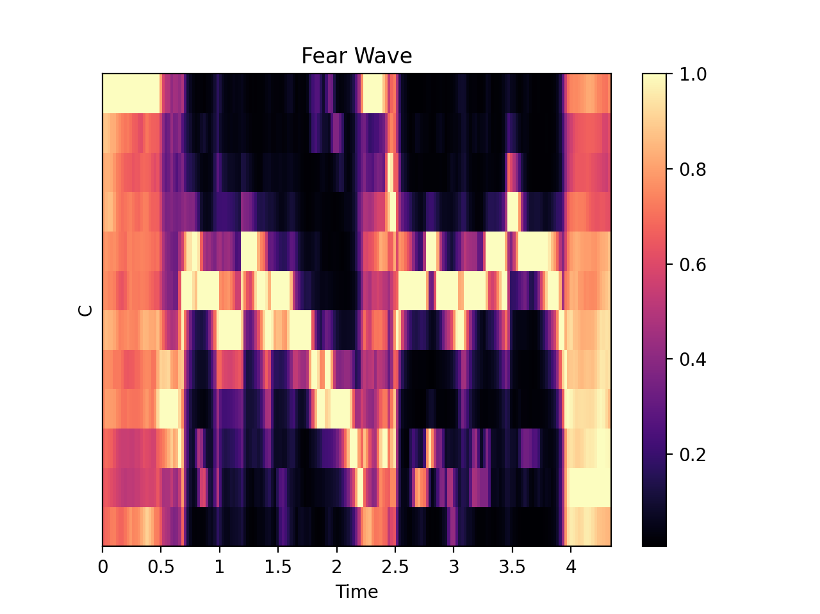
Features

Slide 5
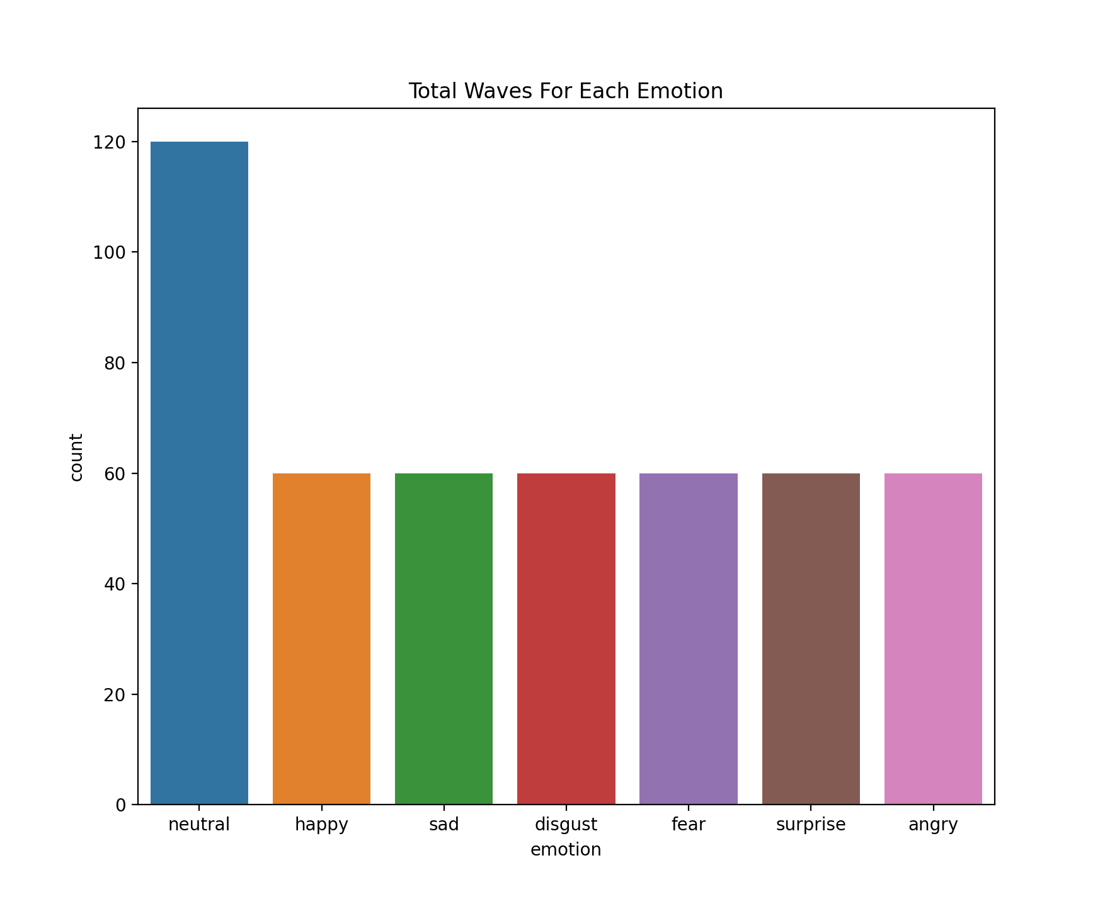
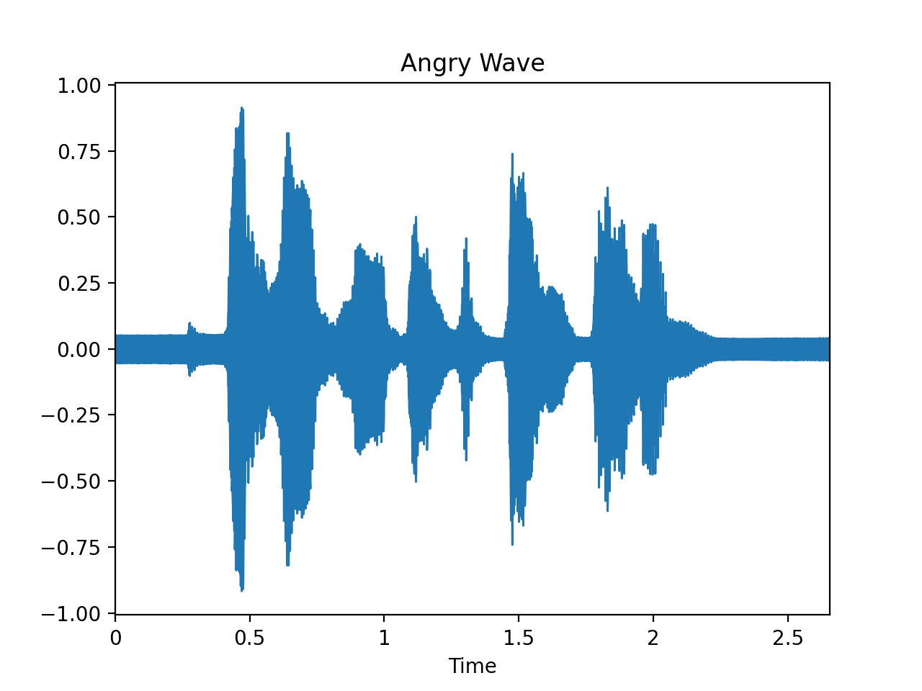
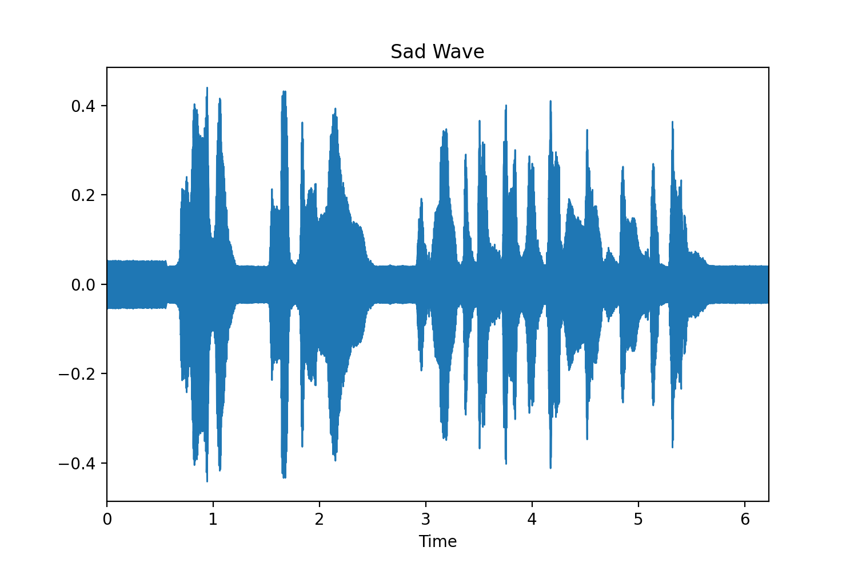
Exploratory Data Analysis
Total waves for each emotion

Slide 6
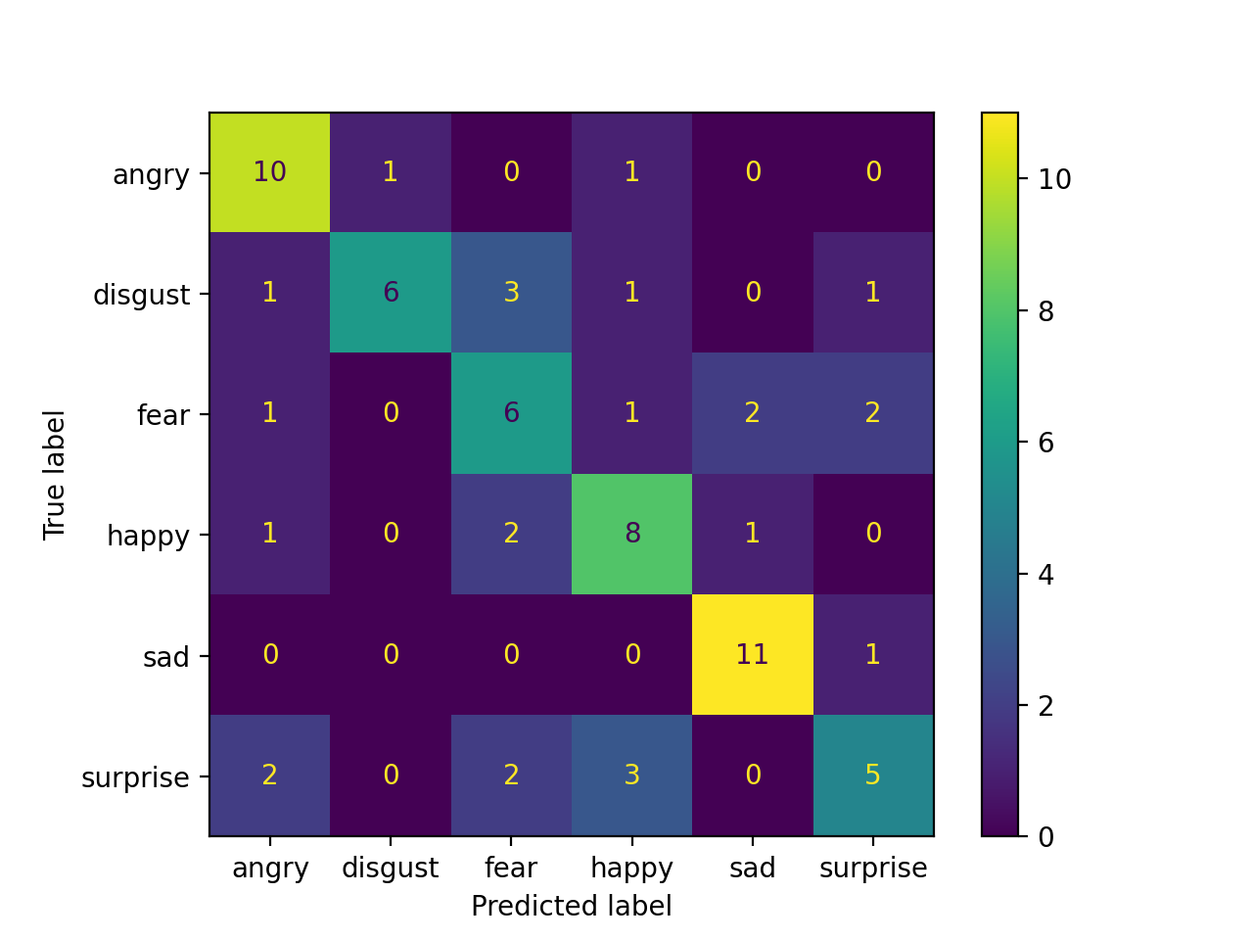
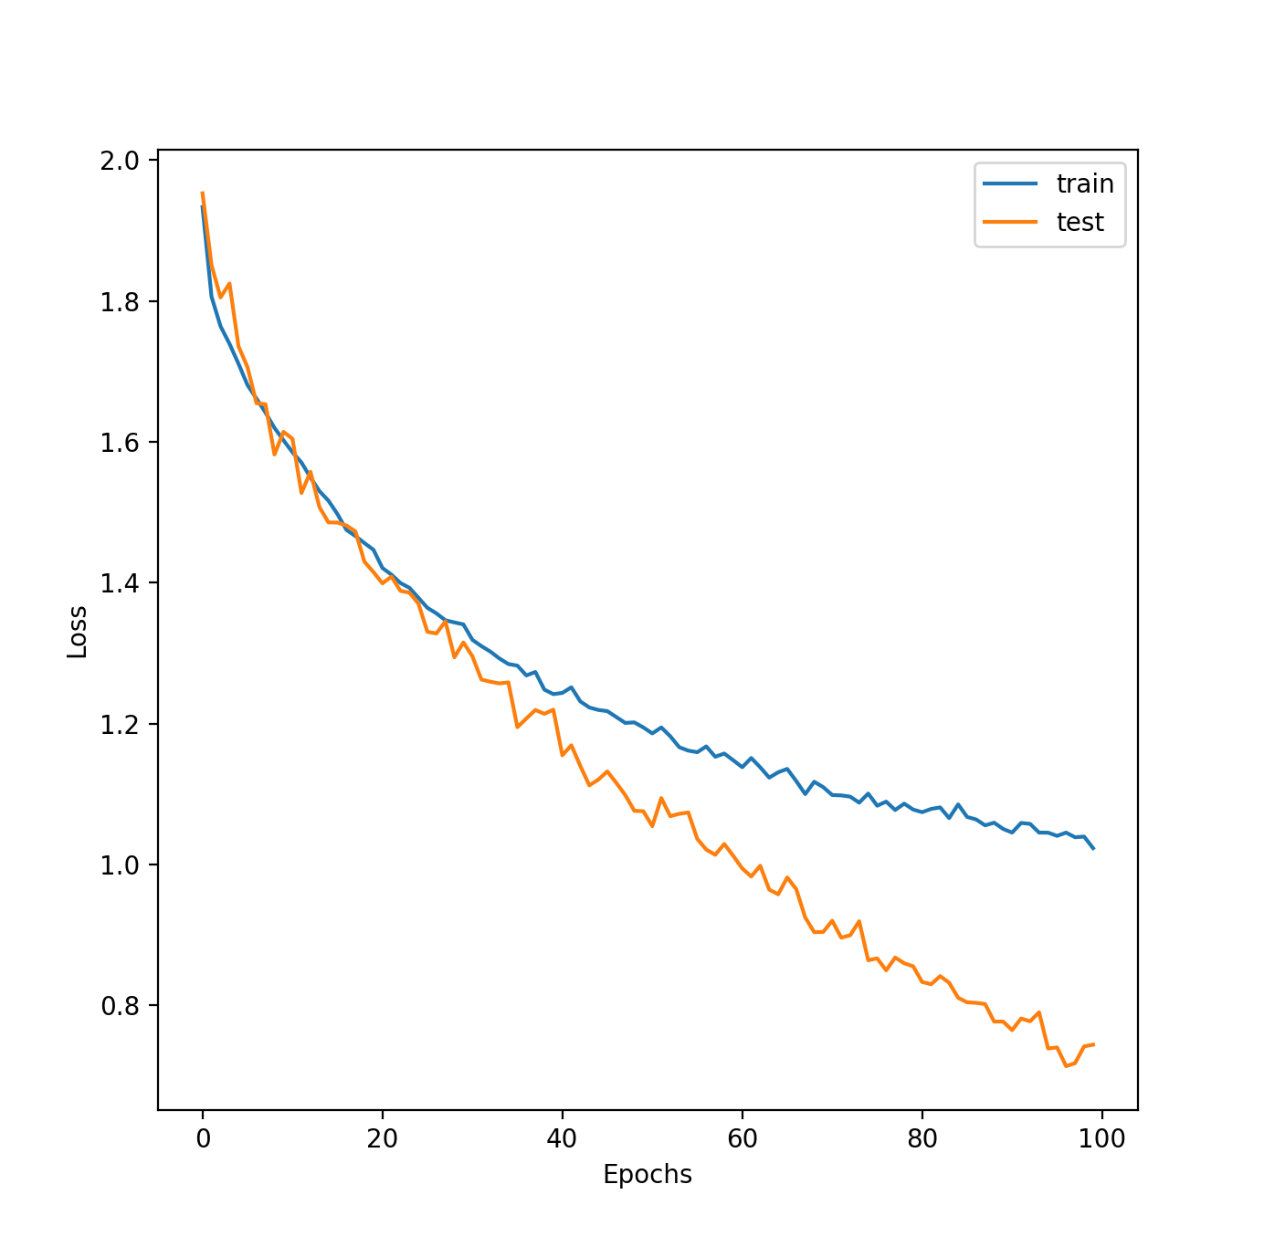
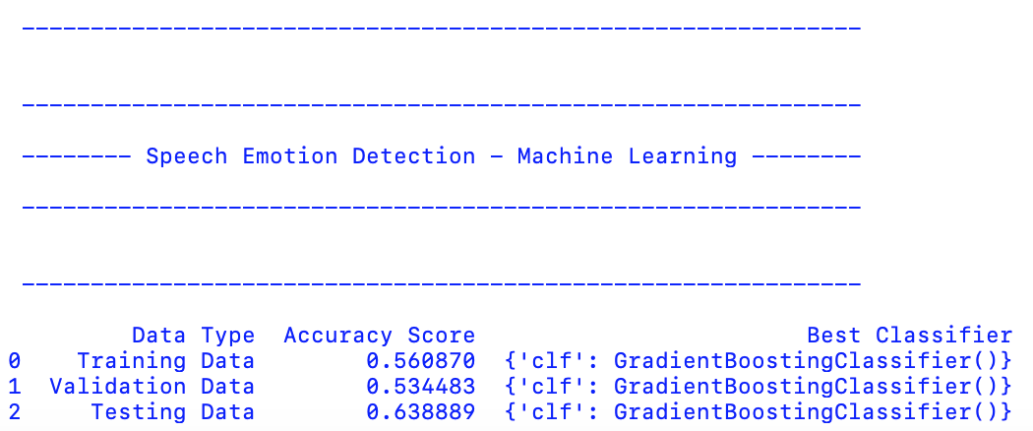
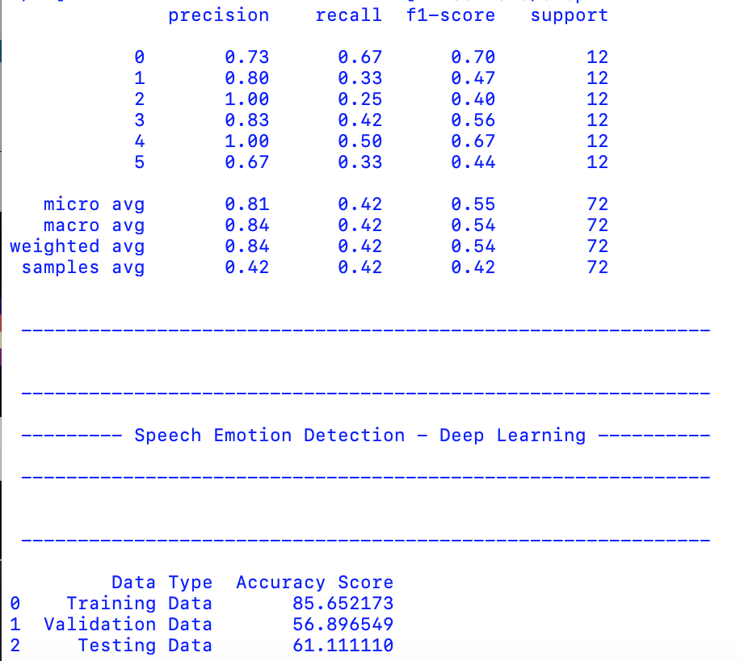
Models’ Results
Machine Learning model
Deep Learning Model

Slide 7
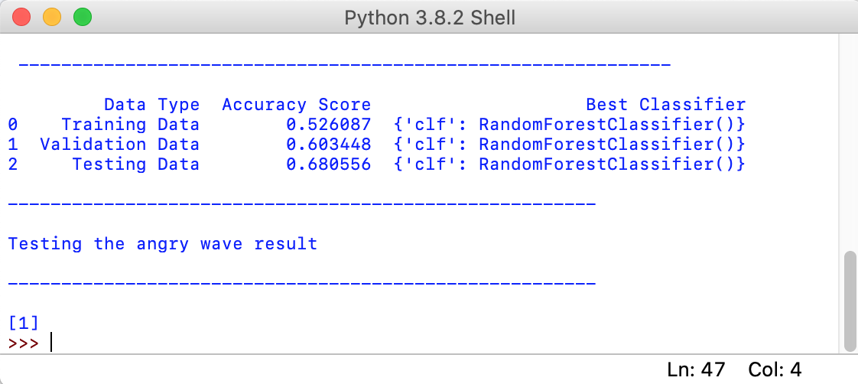
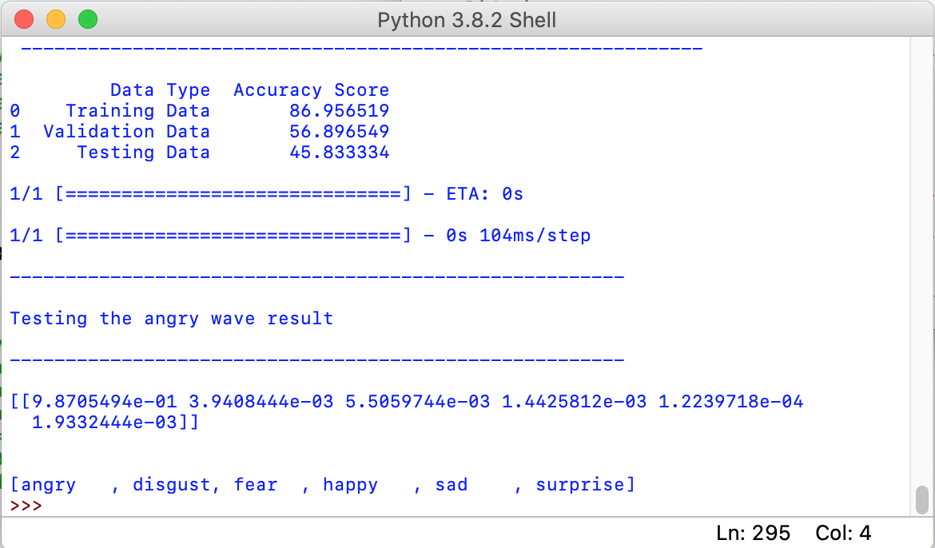
testing Angry wave to see How will the models perform?
Machine Learning model
Deep Learning Model
98% that the wave is an angry wave
[1] = angry emotion

Slide 8
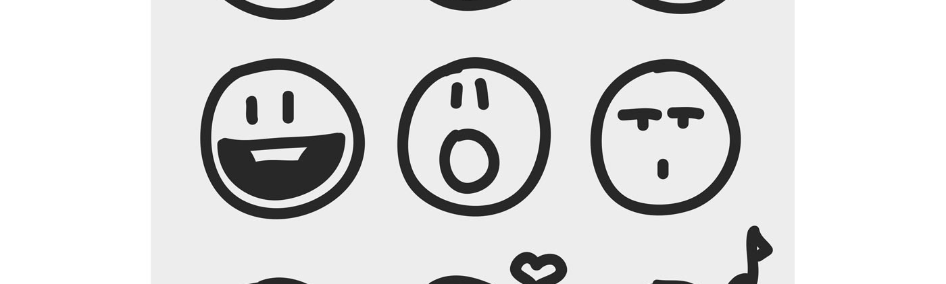
Questions?
Thank you

