Slide 1
Assembling the residual for crystal plasticity
Progress on the residual-assembly wrapper for the JHU UEL and UMAT
Santiago Garcia Harry Millwater Arturo Montoya David Restrepo
NASA STRI BZM AMMS Lab, UTSA July 15, 2026

Slide 2


Idea to solve JHU code problem
To use the residual method on their large crystal-plasticity model, we need r(u, a), not just a stress update.
Element
Formulation
(UEL)
Material
Formulation
(UMAT)
Residual
assembler
Deliverable:
A residual-assembly wrapper that lets JHU keep their UEL and UMAT, and overloads parameters after convergence.
2

Slide 3
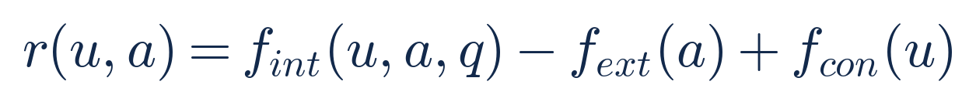
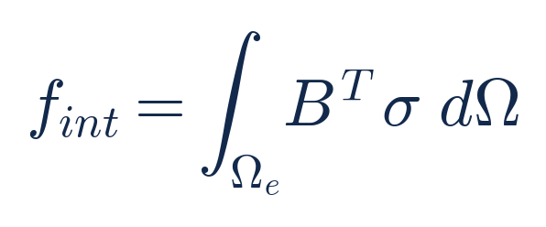
A stress update is not the residual
The solver drives the out-of-balance force to zero, not the stress. The residual is the whole element weak form:
The UMAT gives the stress. The UEL gives the element operator B. Neither one is the residual.
To assemble r we also need the mesh, the converged solution, the loads and boundary conditions, and the state.
The question we answered: what is the full set of inputs that turns a stress update into r(u, a)?
3

Slide 4
What the assembler actually needs
We have now fixed the complete input set. Three groups feed one assembler.
From JHU's subroutines
UEL: element operator B and strain
UMAT: stress and material tangent
From the model and results
mesh and connectivity (.inp)
converged solution U (ODB)
state variables STATEV (ODB)
loads, boundary conditions, time
The request
parameters to differentiate
sensitivity order
Residual
assembler
out: r(u, a), and the sensitivities du/da for every parameter
4

Slide 5
JHU keeps their code
Every input is something JHU already has. We wrap it; the physics does not change.
From the subroutines
the UEL already returns the element residual operator and the strain
the UMAT already returns the stress and the material tangent
parameters are seeded only after the solve has converged
From the Abaqus model
the input deck gives the mesh, sections, loads and boundary conditions
the ODB gives the converged solution and the state variables
nothing is rewritten inside their solver
In one line:
JHU brings a converged crystal-plasticity solve and their two subroutines. We assemble r(u, a) and return the parameter sensitivities.
5

Slide 6
What the wrapper does with them
The real Newton solve stays in ordinary arithmetic. Parameters are seeded only after convergence, so the solver path and the tangent are untouched.
assemble r(u, a) at the converged state
overload the parameters after convergence
extract the coefficients r(p)
solve K U(p) = -R(p)
parameter sensitivities du/da
Why this is cheap:
The tangent K is formed once and reused. Each extra order costs one more right-hand side and a back substitution, not a new nonlinear solve. No Abaqus re-runs.
6

Slide 7
What comes out, and how JHU uses it
From the one converged solve, JHU gets du/da for every parameter, to machine accuracy, with no extra Abaqus runs.
You can
calibrate or invert the material parameters with a gradient
propagate parameter uncertainty to the solution
rank which parameters matter most
predict the solution for a parameter change without re-running the model
You get back
the residual r(u, a), exposed for the first time
the solution sensitivities du/da, first and higher order
a report that shares norms and rankings, but not the model
For an Abaqus user:
Point the wrapper at the input deck and the ODB of a converged increment. It reads the mesh, solution and state, then returns du/da without editing or re-running the job.
7

Slide 8

How to use it: one element, worked through
Feed the assembler a case whose answer you already know. Here: one C3D8 cube under a uniform stress.
You give it
one C3D8 cube, 8 nodes, 1 mm side
Cauchy stress at each integration point: 100 MPa pulling along x, rest zero
the element operator B from the UEL
Residual
assembler
You get back
24 nodal internal forces (3 per node)
+25 N on each node of the loaded face
25 N pushing back on the opposite face
zero on every other component
Check:
Statics says 100 MPa on a 1 mm face is 100 N, split evenly over 4 nodes, so 25 N each. The assembler returns exactly that, to a relative error of 5e-16. That is the leftmost bar of the next chart.
8

Slide 9
How every check in the chart is built
Same recipe each time: pick a state whose residual is known in closed form, assemble it, compare.
Check | State fed in | Compared against | Rel. error
Divergence patch | uniform stress, one hex | surface-traction nodal forces | 5e-16
Linear-stress + body load | linear stress field | exact body-force balance | 1e-13
Self-equilibrium | uniform stress | zero net force and moment | 1e-13
Small-strain tangent | a small change in u | finite difference of f_int | 2e-16
Frame objectivity | rigid rotation of the element | rotated stress, rotated forces | 5e-16
Core vs kernel | identical inputs | the original hand kernel, bitwise | = 0
The point:
Every bar is the assembled residual against an answer known ahead of time, not against another program. The Abaqus reaction-force comparison is the one check still waiting on a license.
9

Slide 10
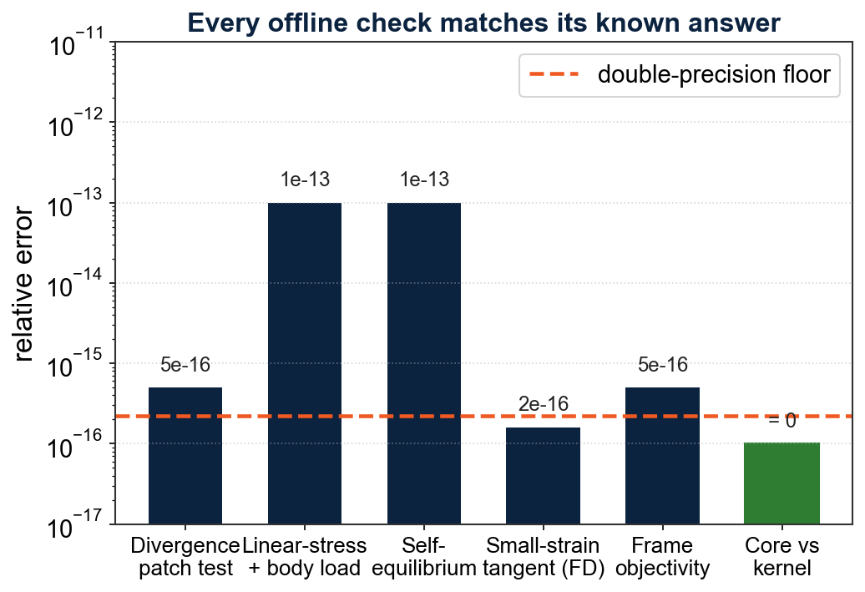
Where it stands
Done
the full input contract is defined (this deck)
the assembler builds r for the C3D8 element
every offline check matches its known answer (left)
it runs against the genuine OTILib
10

Slide 11
Next
Wire JHU's actual UEL and UMAT through the wrapper on a single element, then a small mesh.
Reach the parameter sensitivities: either make the element kernels carry OTI numbers, or feed the OTI-transformed UMAT into the assembler.
Check the assembled residual against Abaqus reaction forces at the converged increment.
Extend beyond C3D8, and apply distributed loads and linear constraints.
Next milestone:
One JHU element assembled through the wrapper, its residual matched to the Abaqus reaction at the converged increment, and first-order du/da returned.
11

Slide 12
Thank you
JHU keeps their UEL and UMAT and their converged solve.
We assemble the residual and hand back the parameter sensitivities.

