Slide 1
Model-agnostic material sensitivities via OTI
A two-program residual-assembler framework, verified end to end
Program 1 — UMAT to OTI source transformation Program 2 — offline residual assembler
Reference throughout: central finite differences of the original UMAT
NASA STRI project · Dept. of Mechanical, Aerospace & Industrial Engineering, UT San Antonio

Slide 2
OVERVIEW
Two programs, one protected boundary
• JHU develops and maintains the private material-model source; collaborators run production analyses with the compiled binaries.
• The residual method needs stress derivatives w.r.t. material parameters — a normal UMAT cannot return them.
• Two separately-distributable programs solve this without exposing the source or rerunning the production analysis.
JHU private
UMAT source
→
UMAT→OTI
transform
→
umat_<name>_oti.obj
+ contract
→
collaborator
FE record
→
residual
assembler
→
∂q/∂p
sensitivities
Only versioned public contracts and the OTI-enabled .obj cross the boundary — the material source stays private and the production analysis is unchanged.
Program 1 is owned by JHU / material developers; Program 2 by the collaborators. The two repos are independent and share only versioned contracts.

Slide 3
BACKGROUND
What is OTI, and why not finite differences?
• OTI = Order-Truncated Imaginary numbers — a hypercomplex algebra for exact automatic differentiation (OTILib / HYPAD).
• Each chosen material parameter is seeded on its own imaginary direction; every arithmetic operation in the UMAT carries the derivative coefficient automatically.
• The derivative flows through everything — the elastic predictor, the return-mapping Newton iterations, the tangent — with no re-derivation by hand.
• ∂σ/∂p is read out from the imaginary coefficient — exact to round-off, with no truncation or step-size error.
• One enriched run seeds many directions at once, returning all requested derivatives together.
Finite differences OTI
---------------------------------------
2N+1 full runs vs 1 enriched run
truncation + round-off
step-size error only
tune h per param vs no tuning
N = # parameters (here N = 6)
OTI returns the same derivative finite differences approximate — but exactly, and in one run.

Slide 4
PROGRAM 1 · UMAT → OTI TRANSFORMATION
Overload a UMAT to return its derivatives
• Inputs: the original UMAT source + a compact transformation contract (JSON).
• Automatic transform: trace PROPS→STRESS dependencies, promote the required variables/operations to OTI, generate parameter seeding + coefficient extraction.
• Output: umat_<name>_oti.obj — one relocatable object with three symbols:
– UMAT (original, unchanged)
– UMAT_OTI_INTERNAL (the OTI-promoted routine)
– UMAT_OTI_EVAL — offline entry returning the derivatives
• New outputs: DSIGMA_DP and, for history-dependent models, DSTATEV_DP.
SUBROUTINE UMAT_OTI_EVAL(
STRESS, STATEV, DDSDDE, STRAN, DSTRAN,
TIME,DTIME,TEMP,DTEMP, PROPS,NPROPS,
NTENS,NSTATV,NPARAM,
DSIGMA_DP, ! (NTENS , NPARAM)
DSTATEV_DP, ! (NSTATV, NPARAM)
DSIGMA_DP_IN, DSTATEV_DP_IN) ! carry-in
* derivatives returned SEPARATELY,
never stored in STATEV
* STATEV_OUT = physical state only
The standard UMAT interface is preserved; derivative outputs are added. DSIGMA_DP / DSTATEV_DP are dedicated arguments — never packed into STATEV.

Slide 5
PROGRAM 1 · INPUT
The transformation contract is compact
• The developer identifies only the UMAT, the parameters to differentiate (name → PROPS index), and the interface sizes.
• Parameter order fixes the OTI-direction order; nparam is inferred as the number of parameters.
• A separate verification case supplies one valid baseline property vector (and optional loading path) — values are where to test, not how to transform.
• The program completes the interface, derivative, history, validation, and platform settings automatically.
{ "material": "j2_linear_hardening",
"source": "umat_j2.for",
"kinematics": "small_strain",
"dimensions": {"stress_components": 6,
"material_properties": 4,
"state_variables": 1},
"parameters": {"E":1, "nu":2,
"SIGY0":3, "H":4},
"derivatives": {"stress": true,
"statev": "auto"} }
verification.json (separate — the baseline)
{ "props": [210000, 0.30, 250, 2000] }
The developer identifies the UMAT, the material parameters to differentiate, and one valid baseline property vector. The program completes the interface, derivative, history, validation, and platform settings automatically.

Slide 6
PROGRAM 1 · VERIFICATION
Non-circular verification against the original UMAT
• Primal parity: OTI STRESS, STATEV and consistent tangent DDSDDE are compared against a separately compiled original UMAT — not the transformed binary.
• Derivative check: DSIGMA_DP is compared with central finite differences of the original UMAT, perturbing PROPS.
• Consistent tangent: the OTI DDSDDE is checked against central FD of the original stress w.r.t. DSTRAN (the true algorithmic tangent).
• Path dependence: STRESS, STATEV, DSIGMA_DP and DSTATEV_DP are validated over a multi-increment path — elastic → plastic → unload → reload — with the state sensitivity chained across increments.
original UMAT
(.obj)
→
OTI UMAT
(.obj)
→
march same
strain path
→
compare STRESS,
STATEV, DDSDDE
→
FD of original
vs DSIGMA_DP
The reference is always an independent original-UMAT run — never a self-comparison. The framework passes only when it preserves the response AND produces accurate parameter derivatives.
Material-point pass thresholds: stress / STATEV parity ≤ 1e-8; DDSDDE, DSIGMA_DP and DSTATEV_DP vs central FD ≤ 1e-4.

Slide 7
PROGRAM 1 · RESULTS
Material-point validation — all models pass
Model | Constitutive law | Diff. parameters | #p | path | stress parity | DDSDDE vs FD | DSIGMA_DP vs FD | DSTATEV_DP vs FD
M1 | Isotropic linear elastic | E, nu | 2 | – | 2.1e-16 | 5.1e-17 | 2.3e-10 | –
M2 | Cubic anisotropic elastic | C11, C12, C44 | 3 | – | 0 | 0 | 2.4e-13 | –
M3 | J2 plasticity, lin. hardening | E, nu, sig_y0, H | 4 | yes | 8.7e-17 | 2.4e-08 | 2.2e-08 | 9.8e-09
M5 | Crystal-plasticity flow (Kocks) | tau0,dG,p,q,gam0,H | 6 | yes | 1.4e-16 | 8.2e-09 | 2.4e-07 | 1.6e-07
Stress and state parity is machine precision; every parameter sensitivity matches central finite differences of the original UMAT to a few ×10⁻⁷ or better — including the path-dependent state sensitivity DSTATEV_DP propagated across increments.
M3 and M5 are validated over a 5-increment elastic→plastic→unload→reload path. M5 uses 19 OTI directions (6 DSTRAN + 6 params + 1 state + 6 stress) to chain the state-transition Jacobians.

Slide 8
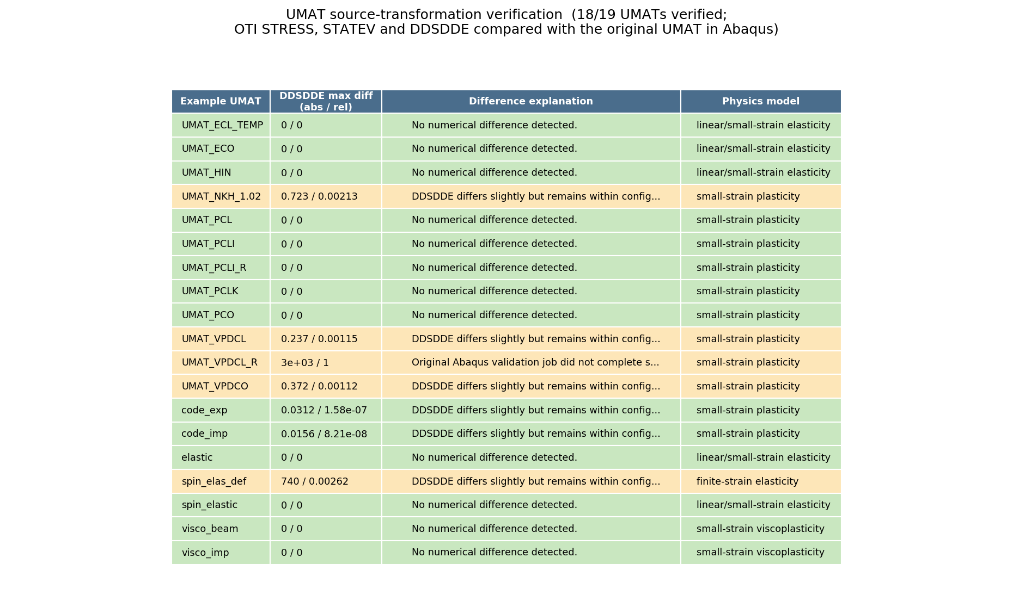
PROGRAM 1 · RESULTS
Source-transformation test suite (18 / 19 UMATs)
• 18 of 19 benchmark UMATs pass
• Different programming approaches and constitutive models: elasticity, plasticity, viscoplasticity, finite-strain.
• OTI STRESS/STATEV/DDSDDE compared with the original UMAT in Abaqus.
• The lone non-pass (UMAT_VPDCL_R) is an original job that did not converge.
The tool even caught a human error: spin_elas_def's large DDSDDE discrepancy (740) prompted an investigation that found a real bug in the original UMAT.

Slide 9
PROGRAM 2 · RESIDUAL ASSEMBLER
Reconstruct sensitivities offline
• Links the distributed .obj directly — no source, no recompilation of private code.
• Replays the OTI UMAT at each integration point of a converged FE record; for a path-dependent material it marches every increment carrying the state AND its parameter sensitivity.
• Assembles the residual R, its sensitivity ∂R/∂p = Σ Bᵀ (∂σ/∂p) dV, and the tangent K = Σ Bᵀ D B dV.
• Solves K ∂u/∂p = − ∂R/∂p for the free DOFs.
• Evaluates each requested ∂q/∂p = ∂q/∂p|explicit + (∂q/∂u) ∂u/∂p.
• No new primal solve in production — the analysis is replayed, not rerun.
K ∂u/∂p = − ∂R/∂p
∂R/∂p = Σ Bᵀ (∂σ/∂p) dV − ∂Fext/∂p
K = Σ Bᵀ D B dV
∂q/∂p = ∂q/∂p|exp + (∂q/∂u)·∂u/∂p
One job file produces the requested sensitivities without rerunning the production analysis.

Slide 10
PROGRAM 2 · INPUT
One sensitivity job drives the whole run
• Seven groups: schema, material, analysis, location, parameters, outputs, result.
• material: the OTI .obj + completed contract.
• analysis: FE model + converged replay record.
• outputs: response, set, component and spatial reduction (average / sum / volume-average).
• Request only the sensitivities the collaborator needs.
{ "schema": "resasm_sensitivity_job_v1",
"material": {"oti_umat":"..._oti.obj",
"contract":"..._oti.json"},
"analysis": {"model":"cube.inp",
"record":"cube.resrec.h5"},
"location": {"step":"LOAD","increment":"last"},
"parameters": ["tau0","dG","q","p","gam0","H"],
"outputs": [
{"type":"integration_point_stress",
"region":{"element_set":"DOMAIN"},
"component":"S12","reduction":"volume_average"}],
"result": {"summary_csv": true} }

Slide 11
PROGRAM 2 · VERIFICATION
Checked against full-analysis finite differences
• Baseline + perturbed FE analyses are run with the regular UMAT — no hard-coded constitutive law anywhere in the reference.
• The framework uses the baseline record + OTI .obj to compute R, ∂R/∂p, ∂u/∂p and each requested ∂q/∂p.
• Framework sensitivities are compared with centered finite differences of the perturbed regular-UMAT analyses.
• Passes when global displacement and response sensitivities agree with the independent full-analysis finite differences.
regular UMAT
baseline + ±h
→
full FE
analyses
→
central FD
∂q/∂p
→
residual method
(OTI .obj)
→
agree?
Elastic end-to-end matrix (M1, M2 × displacement/force control): equilibrium ‖R_free‖ ~1e-13, worst sensitivity error < 4e-9 vs full-analysis FD.

Slide 12
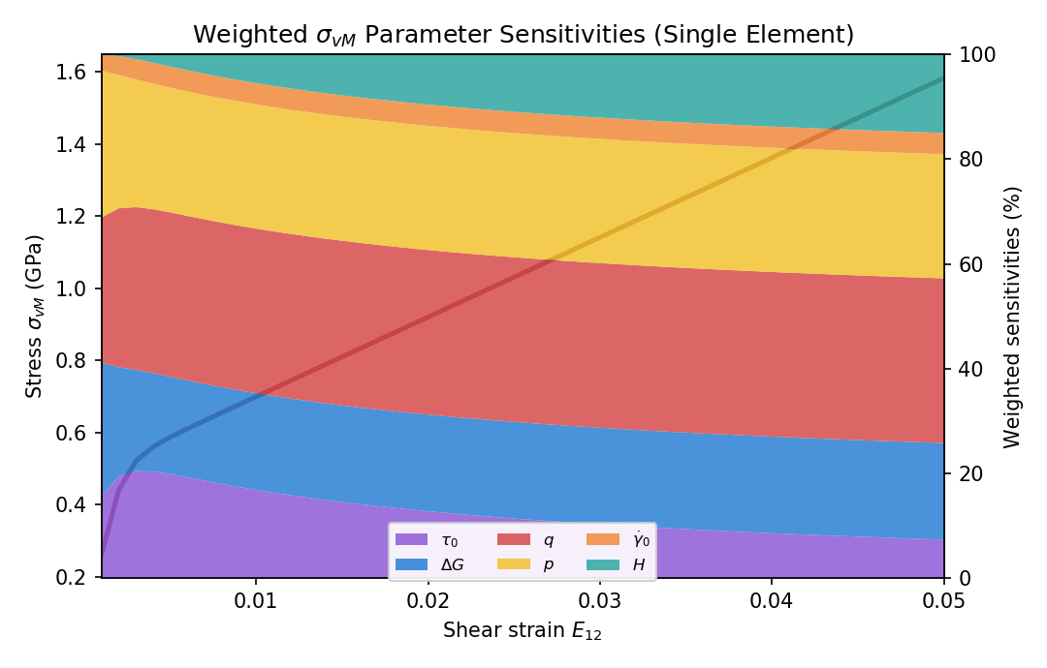
PROGRAM 2 · RESULTS
Crystal-plasticity sensitivities in one OTI run
• Single C3D8 element, simple shear, E12: 0 → 0.05 over 50 increments.
• All six sensitivities of σ_vM obtained in one enriched OTI run.
• y-axis is a weighted sensitivity — weighted = |p · dσ_vM/dp|, normalized to 100% — so different units compare on one scale.
• Glide exponents q, p and activation energy ΔG dominate; hardening H grows with strain; γ₀ stays small.
• σ_vM reaches 1.58 GPa at E12 = 0.05.
Six flow-rule sensitivities, one simulation.

Slide 13
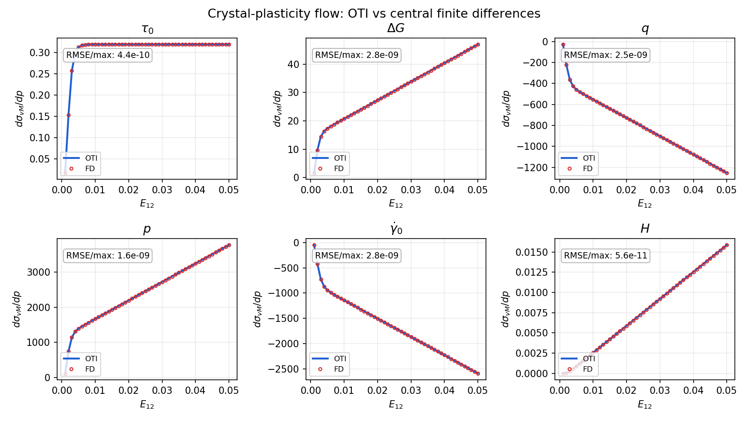
PROGRAM 2 · RESULTS
OTI matches finite differences — accuracy
• dσ_vM/dp along the shear path.
• OTI (line) vs central FD (points) — indistinguishable.
• Worst relative RMSE 2.8e-9 across all six parameters.
OTI is exact to FD truncation — the gold-standard reference.

Slide 14
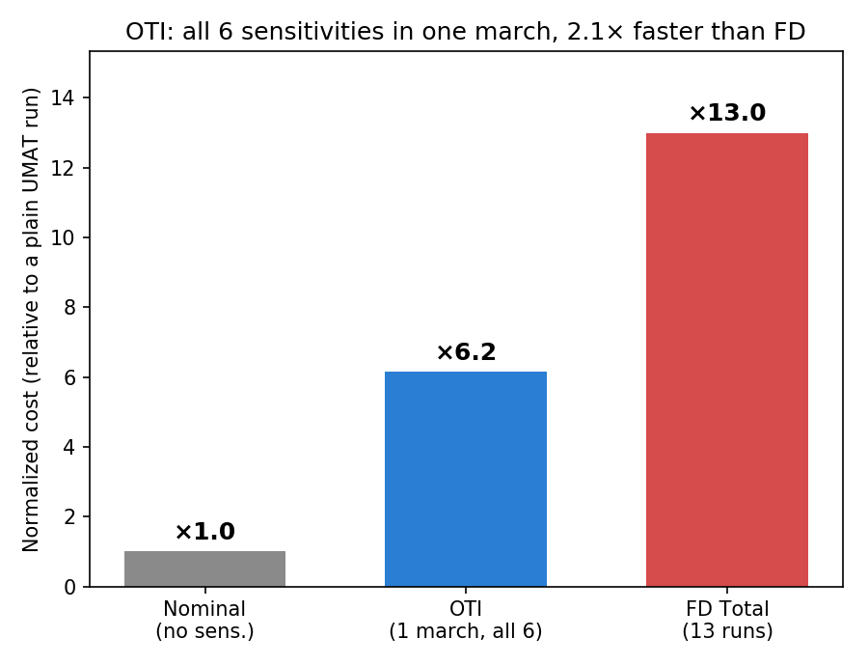
PROGRAM 2 · RESULTS
One enriched run vs many finite-difference runs
• Central differences need 2 × 6 + 1 = 13 full runs for six parameters.
• OTI returns all six in one enriched march.
• The state-alive whole-path march costs ~5.5× a plain UMAT run and returns every sensitivity plus the tangent — about 2.4× faster than the 13 finite-difference runs.
• An optimized OTI library reduces the per-run overhead substantially (≈1.1× reported elsewhere).
Fewer runs, and every derivative is exact — accuracy and cost both favor OTI over finite differences.

Slide 15
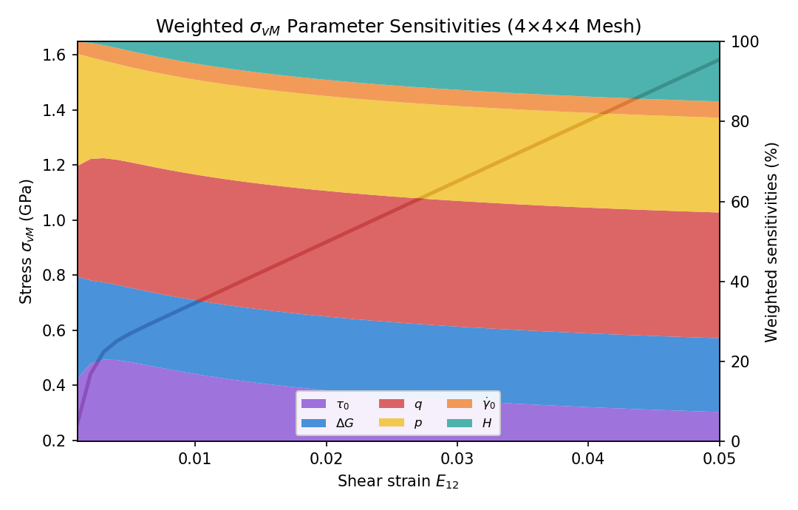
PROGRAM 2 · RESULTS
The residual solve is mesh independent
• Full residual solve on a 4×4×4 C3D8 mesh (64 elements, 375 DOF) under controlled simple shear, 50 increments.
• Global K and ∂R/∂p assembled; K ∂u/∂p = −∂R/∂p solved for the free DOFs.
• Homogeneous deformation ⇒ ‖∂u/∂p‖ = 4.5e-18.
• Volume-averaged σ_vM sensitivities match the single element to 1.0e-14.
Sensitivities are mesh independent — a direct check of the global residual assembly.

Slide 16
SUMMARY
Both programs validated, end to end
 | What it delivers | How it is verified | Result
Program 1 | UMAT → OTI .obj returning DSIGMA_DP / DSTATEV_DP | vs separately compiled original UMAT + FD | 18/19 UMATs; sens ≤2.4e-7
Program 2 | Offline residual solve for ∂u/∂p and ∂q/∂p | vs full regular-UMAT finite differences | RMSE ~1e-9; mesh-indep.
Path dep. | DSTATEV_DP chained across increments | multi-increment path vs FD of original | M3 ~2e-8 · M5 ~2e-7
• Material source stays private; the production analysis is unchanged and never rerun in production.
• One enriched run returns every requested sensitivity, matching finite differences to machine/FD precision.
• Next: drive the actual multi-slip UMAT_PCL through the assembler; add finite-strain and multi-step benchmark cases.
The framework preserves the original response and produces accurate parameter derivatives — for elasticity, plasticity, viscoplasticity and crystal-plasticity flow.

