Slide 1
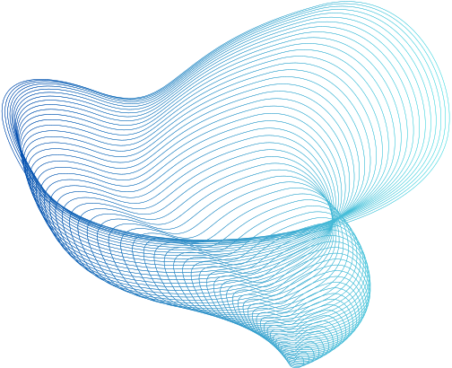

ML PROJECT
GROUP NO - 24
Aditi (2020354)
Arunoday Ghorai (MT23023)
Mo Rashid (MT23047)
Naman Sharma (2021266)
Nyasa Panwar (2021076)

Slide 2
PROBLEM STATEMENT
To Create a Video Compression and decompression Algorithm
DATASET DESCRIPTION
We analyze a data set comprising two 10-minute video clips (AlitaBattleAngel and AvengersEndgme). The focus of our project is to perform video compression and decompression on the video clips.
For the EDA, we extracted features like entropy, color, luminosity. We did Max pooling for the first 1000 frame.

Slide 3
METHODOLOGY
We use the YCbCr colour space to separate intensity (Y) and chroma (Cb and Cr) to perform image compression with vector quantization and colour retention. Following the RGB-to-YCbCr conversion, conventional Vector Quantization is done to non-overlapping parts of the image, giving code vectors. These vectors are then encoded by applying Mean Squared Error to get the closest match. For decompression, the index of the nearest code vector is saved. The codebook is checked during decoding, and the closest code vector is used to replace the image block while keeping luminosity and colour contrast.

Slide 4
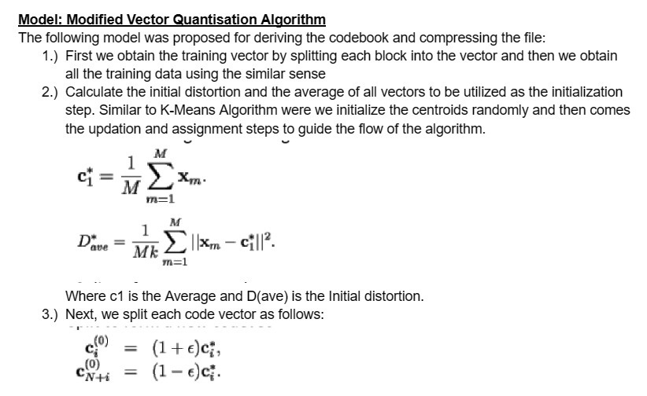
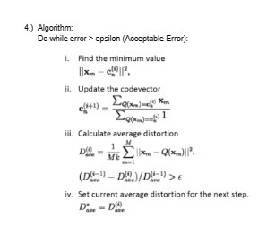
METHODOLOGY

Slide 5
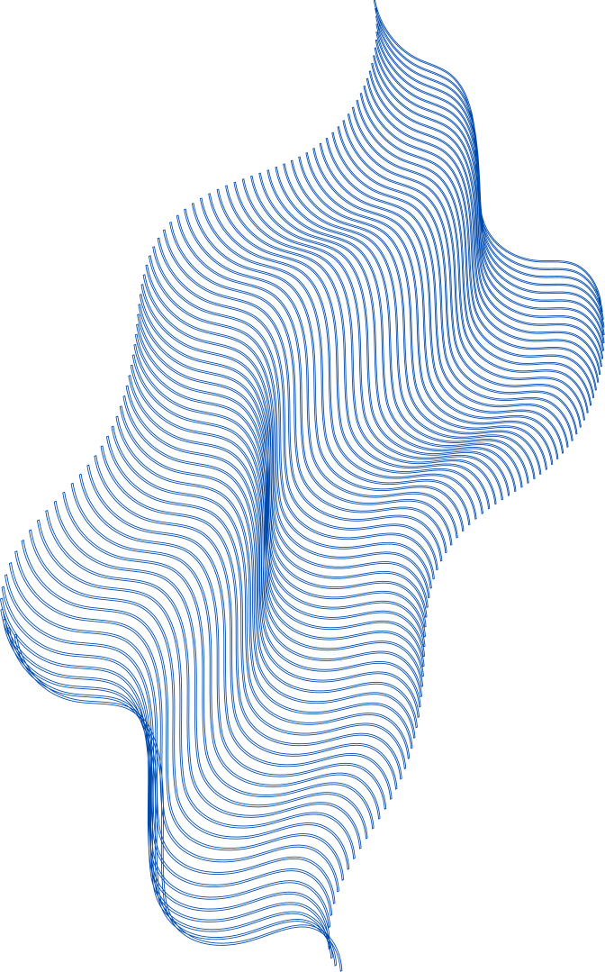
RESULTS
The following observations were recorded:
As the size of the codebook increases the quality of the image increases as the longer the code vector more spatial information about pixels and their intensity and color can be captured but the corresponding run time is also higher.
As Epsilon(E) decreases the error term has to be decreased and thus better the image quality. Again the time to convergence is longer here.

Slide 6
RESULTS
A decrease in block size from (32,32) to (2,2) increases the per-pixel information that can be captured so increased Sound To Noise Ratio but increased run times as well!
Using the Codebook for different images which are simultaneous in video is helpful for increase in variation in training data and thus better prediction and increased TSNR this can be done.

Slide 7
COMPARISON WITH EXISTING ANALYSIS
In our existing analysis, we used vector quantization after first convert the image to greyscale. However, in an effort to improve our process, before we perform vector quantization, we first convert the picture from RGB to YCbCr colour scale. This change in colour representation improves the effectiveness of vector quantization in capturing and maintaining important features of the image which are color and limuniosity.

Slide 8

CONCLUSION
FOR AVENGERS ENDGAME
The initial video of size 270Mb has a compressed state of size 2.044 Mb which is roughly 0.75% of the entire Size Also we have to add the decompressed images which is roughly 140Mb thus overall compression is roughly 50%.
FOR ALITA BATTLE ANGEL
The initial video of size 220Mb has a compressed state of size 4 Mb due to intensive fight scenes so longer codebook and weights which is roughly of the entire Size Also we have to add the decompressed images which is roughly 140Mb thus overall compression is roughly 63%.

