Slide 1
Outfit AI
Production-Ready Smart Wardrobe Recommender
Team Presentation Deck (Final Freeze)
Focus: Recommender quality, robust pipeline, measurable improvements
Presenters: Amogh (Technical), Dhanuja (Product + Recommender), Vaibhavi (Evaluation)
Outfit AI - Presentation Freeze - March 2026

Slide 2
Agenda
Clean story from problem -> system -> proof -> roadmap
1. Problem and project goal
2. Architecture and end-to-end pipeline
3. Engineering struggles and what we fixed
4. Recommender logic and explainability
5. Evaluation framework and key metrics
6. Known limits and next steps
7. Speaker-wise handoff
Outfit AI - Presentation Freeze - March 2026

Slide 3
Team Ownership and Delivery Plan
Recovered from project ownership logs
Amogh
Technical Lead
Architecture
Pipeline internals
Major fixes
Dhanuja
Recommender + Product
User flow
Explainability
Demo logic
Vaibhavi
Evaluation + Results
Testing framework
Metrics and visuals
Evidence narrative
Speaking order: Amogh (5 min) -> Dhanuja (3.5 min) -> Vaibhavi (3.5 min)
Outfit AI - Presentation Freeze - March 2026

Slide 4
Problem Statement and Objective
Build a reliable wardrobe recommender, not a random outfit picker
Initial pain points:
Detection ambiguity (shirt read as top + bottom)
Weak recommendation trust
UI exposing technical internals to users
No robust evaluation evidence
Final objective:
Accurate single-garment scan flow
Explainable top-bottom recommendations
Feedback-aware ranking behavior
Presentation-grade evaluation artifacts
Outfit AI - Presentation Freeze - March 2026

Slide 5
Amogh
System Architecture
FastAPI backend + modular services + frontend product layer
Frontend (HTML/CSS/JS): scan, wardrobe, outfits, calendar, palette, history, profile
API Layer (FastAPI): auth, scan, wardrobe, outfits, feedback, body profile
Core Services: YOLO detection, SAM2 segmentation, LAB color extraction, CLIP embedding
Recommender Engine: rule score + matrix factorization + MMR + repeat controls
Storage: SQLite/SQLAlchemy (WardrobeItem, Outfit, Feedback, BodyProfile)
Outfit AI - Presentation Freeze - March 2026

Slide 6
Amogh
End-to-End Pipeline
From one image upload to explainable outfit output
Upload Image
YOLO Detect (upper/lower)
SAM2 Segment (clean mask)
LAB Color + Palette
Save Wardrobe Item
Generate Outfit Plan
Collect Feedback and Adapt
Outfit AI - Presentation Freeze - March 2026

Slide 7
Amogh
Engineering Struggles and Fixes
We improved through iteration, not in one perfect attempt
Problems observed:
Shirt detected as both top and bottom
Outfit generation blocked by unknown item_type
Scan result showed raw mask path
Profile page lacked visual guidance
Fixes delivered:
Single-garment detection logic with conflict resolution
Generation gate removed + auto item-type assignment
UI now shows useful user details (type, color family, palette)
Body-shape icons + skin-tone swatch reference added
Outfit AI - Presentation Freeze - March 2026

Slide 8
Dhanuja
Recommender Design (Hybrid)
Practical, explainable, and measurable
Candidate generation: all valid top-bottom combinations
Scoring stack: rule score + collaborative signal + visual diversity + repeat/cooldown penalties
Ranking controls: MMR rerank, rotation quotas, feedback bias
Explainability: each outfit returns color reason, style reason, novelty signal, and confidence
Product value: recommendations are deterministic and auditable, not random
Outfit AI - Presentation Freeze - March 2026

Slide 9
Dhanuja
User Flow and Demo Flow
How we demo the complete recommender story live
1. Scan one garment image
2. Item saved to wardrobe with category + color metadata
3. Generate outfits for selected days
4. Show split-card output (top + bottom) with compatibility badge
5. Show 'Why this outfit?' explanation in plain language
6. Mark worn / like / dislike and explain feedback loop effect
Outfit AI - Presentation Freeze - March 2026

Slide 10
Vaibhavi
Evaluation Framework
Internal production-style testing pipeline
Vision evaluation:
YOLO detection accuracy proxy
SAM2 segmentation quality + success rate
Color extraction stability and mismatch tracking
End-to-end pipeline success rate
Recommender evaluation:
8 synthetic users
60-day simulation
3 replicates
Baseline vs personalized lifts
Coverage, repetition, and forgotten-item metrics
Outfit AI - Presentation Freeze - March 2026

Slide 11
Vaibhavi
Metric Snapshot (Latest Saved Artifacts)
Evidence-first status at freeze time
Detection Accuracy
0.7647
Segmentation Success
1.0000
Color Success
0.5161
Pipeline Success
0.4118
Score Lift
+0.1284
Diversity Lift
+0.0103
Repetition Lift
-0.0042
Coverage Lift
+0.0208
Reading: recommender metrics improved vs baseline; biggest remaining vision bottleneck is color classification.
Outfit AI - Presentation Freeze - March 2026

Slide 12
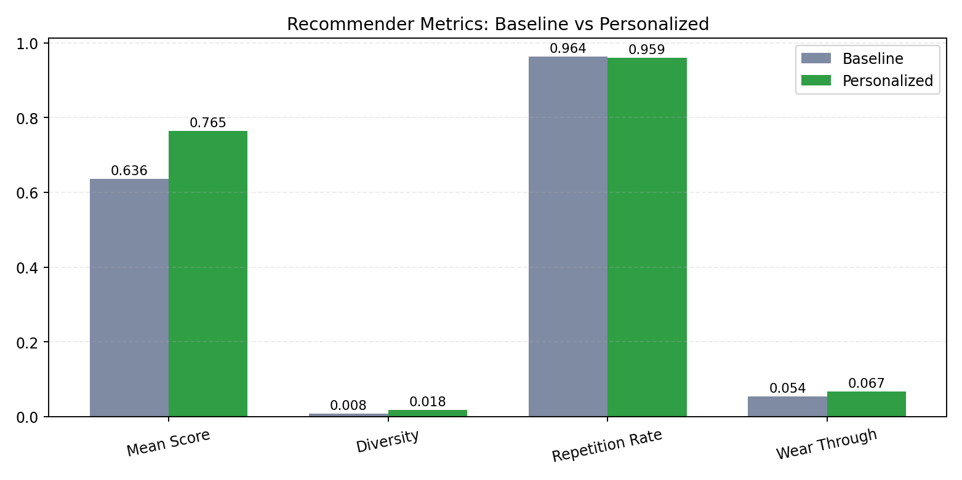
Vaibhavi
Recommender Visual 1
Baseline vs Personalized Comparison
Outfit AI - Presentation Freeze - March 2026

Slide 13
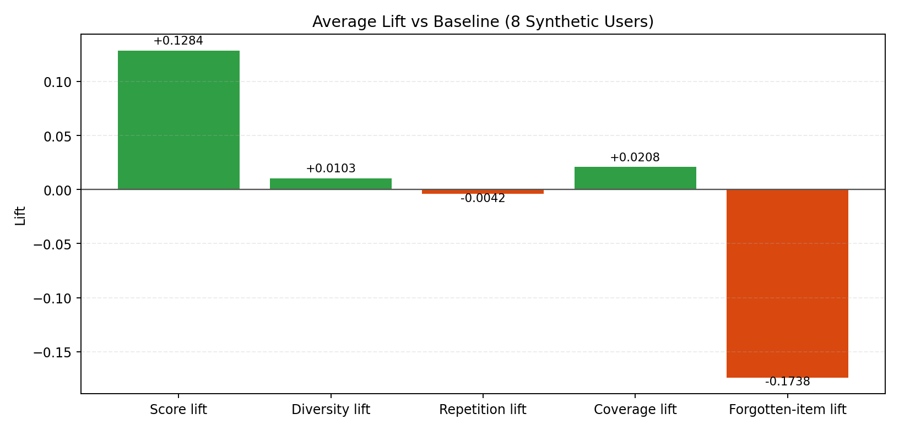
Vaibhavi
Recommender Visual 2
Average Lift by Metric
Outfit AI - Presentation Freeze - March 2026

Slide 14
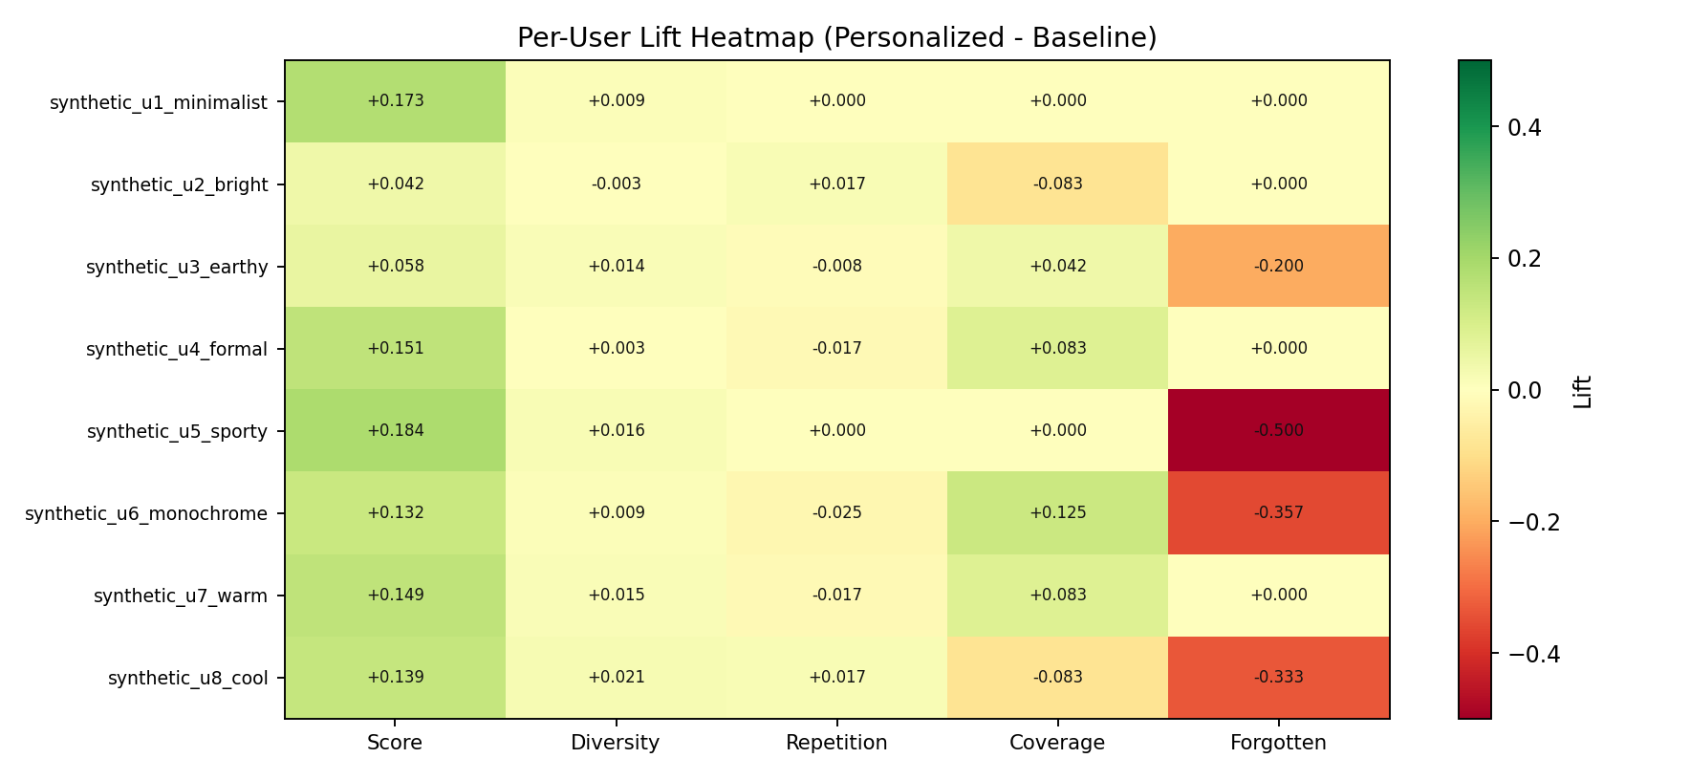
Vaibhavi
Recommender Visual 3
Per-user Lift Heatmap
Outfit AI - Presentation Freeze - March 2026

Slide 15
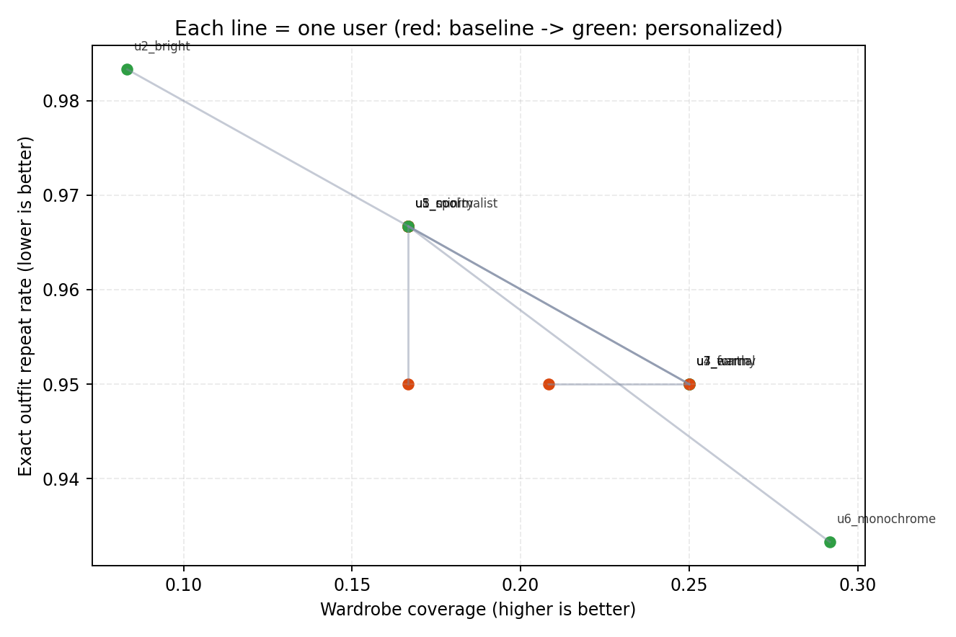
Vaibhavi
Recommender Visual 4
Coverage vs Repetition Trade-off
Outfit AI - Presentation Freeze - March 2026

Slide 16
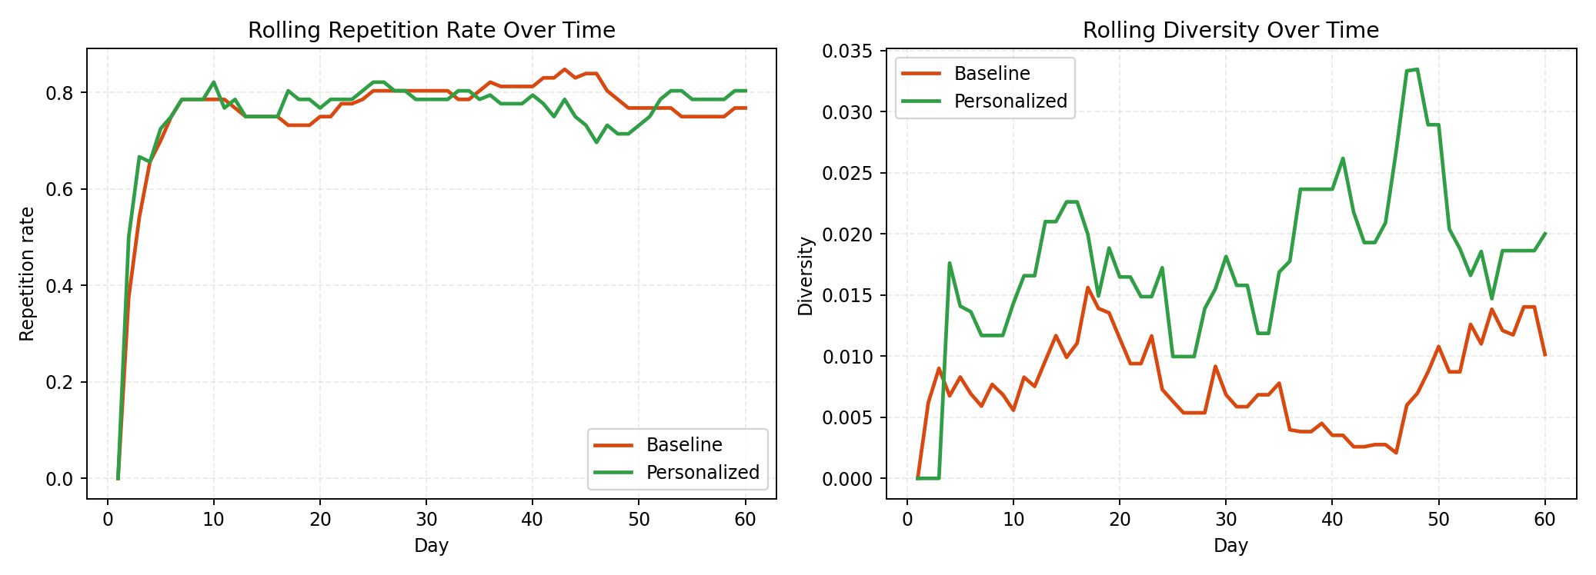
Vaibhavi
Recommender Visual 5
Trend Over Time
Outfit AI - Presentation Freeze - March 2026

Slide 17
What Is Strong vs What Is Pending
Honest quality statement for evaluation panel
Working well:
Hybrid recommender clearly beats baseline
Segmentation is stable (1.0 success)
UI now maps technical output to user-friendly actions
Evaluation artifacts support claims with evidence
Needs next pass:
Color classification still weaker than target
Detection robustness on harder formats can improve further
Current DB choice is dev-friendly but not high-concurrency
Presentation deck uses saved metrics (rerun before final publish if needed)
Outfit AI - Presentation Freeze - March 2026

Slide 18
How This Maps to Recommender Systems Concepts
Direct alignment with class topics
Collaborative Filtering: matrix factorization (SVD-style) from wear-pattern signals
Cosine Similarity: embedding-based compatibility and diversity controls
Ranking: weighted hybrid score with confidence and repetition penalties
Feedback Learning: liked/disliked/worn actions alter future ranking bias
Explainability: each recommendation carries plain-language reasons
Note: Pearson correlation is not used in current production pipeline
Outfit AI - Presentation Freeze - March 2026

Slide 19
Presentation Handoff Script
So all 3 speakers stay synchronized
Amogh
Slides 4 to 8
Architecture
Pipeline
Fix journey
Engineering choices
Dhanuja
Slides 9 + product flow
Recommender logic
Explainability
Live demo script
Vaibhavi
Slides 10 to 18
Evaluation method
Metrics
Visual proof
Honest limitations
Outfit AI - Presentation Freeze - March 2026

Slide 20
Final Closing
What makes this project defendable
We did not claim perfection. We showed measurable progress.
We identified weak points using a structured evaluation framework.
We fixed production-impact issues and improved recommendation quality.
We can explain every major system choice with data and trade-offs.
This project demonstrates engineering rigor, recommender relevance, and practical deployment thinking.
Thank you

