Slide 1


Python for Beginners
Archer Infotech , PUNE
www.archerinfotech.in

Slide 2
Python – CLustering

Slide 3
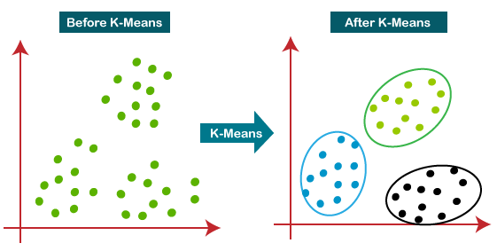
K-Means Clustering
K-Means Clustering is an unsupervised learning algorithm that is used to solve the clustering problems in machine learning or data science.
It is an iterative algorithm that divides the unlabeled dataset into k different clusters in such a way that each dataset belongs only one group that has similar properties

Slide 4
How does K-Means Works ?
Step-1: Select the number K to decide the number of clusters.
Step-2: Select random K points or centroids. (It can be other from the input dataset).
Step-3: Assign each data point to their closest centroid, which will form the predefined K clusters.
Step-4: Calculate the variance and place a new centroid of each cluster.
Step-5: Repeat the third steps, which means reassign each datapoint to the new closest centroid of each cluster.
Step-6: If any reassignment occurs, then go to step-4 else go to FINISH.
Step-7: The model is ready.

Slide 5
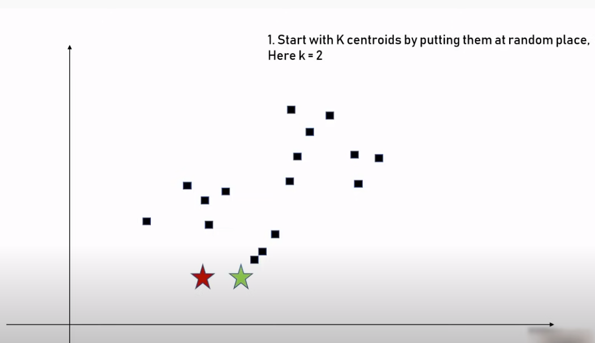
How does K-Means Works ?

Slide 6
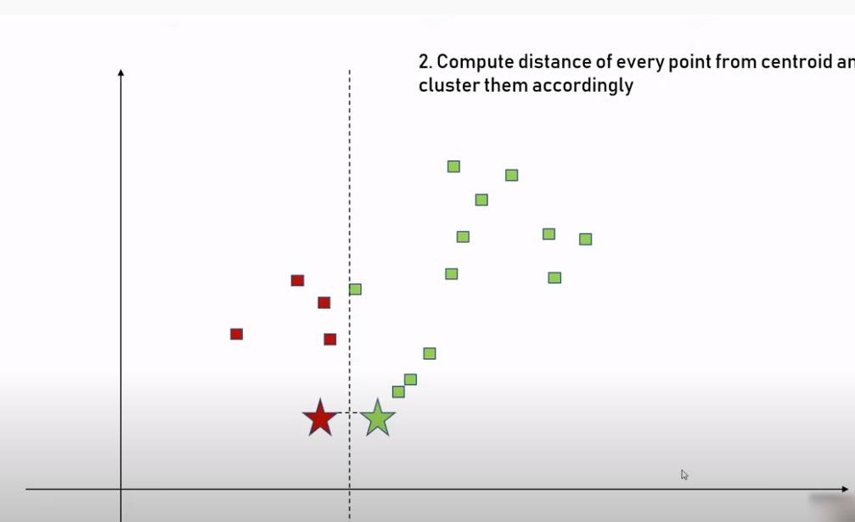
How does K-Means Works ?

Slide 7
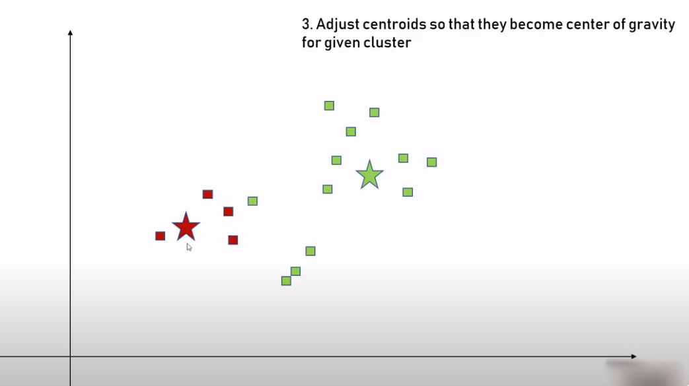
How does K-Means Works ?

Slide 8
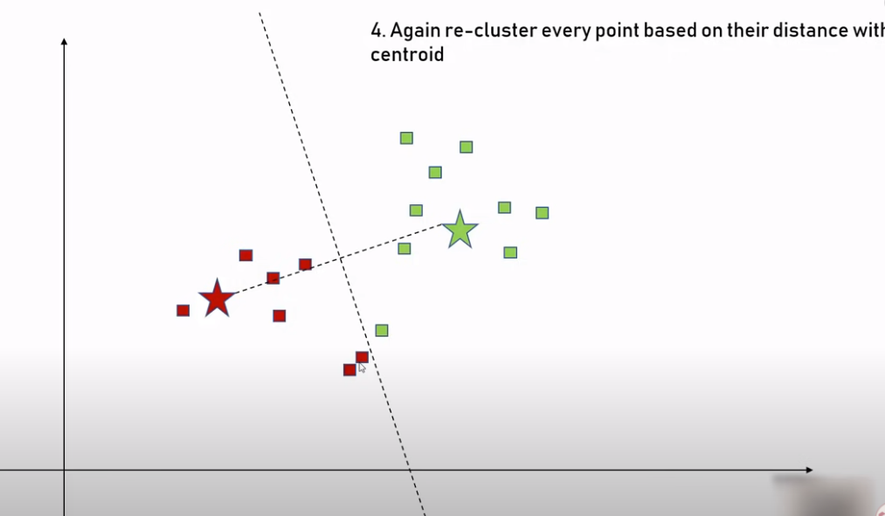
How does K-Means Works ?

Slide 9
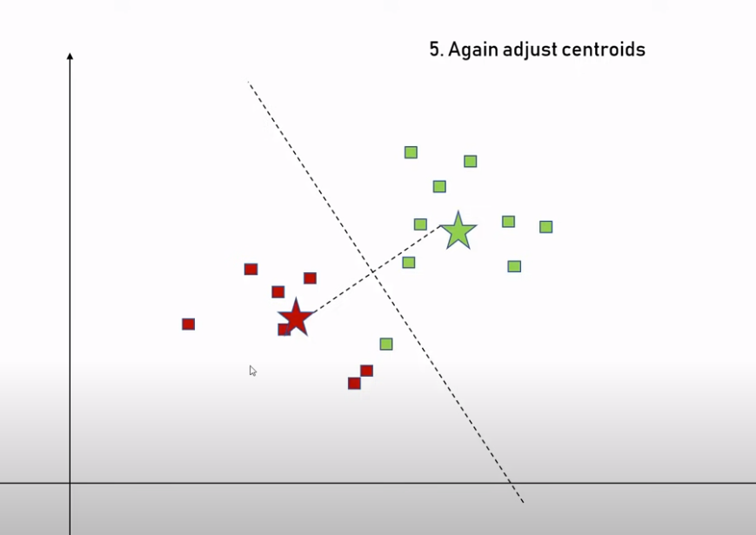
How does K-Means Works ?

Slide 10
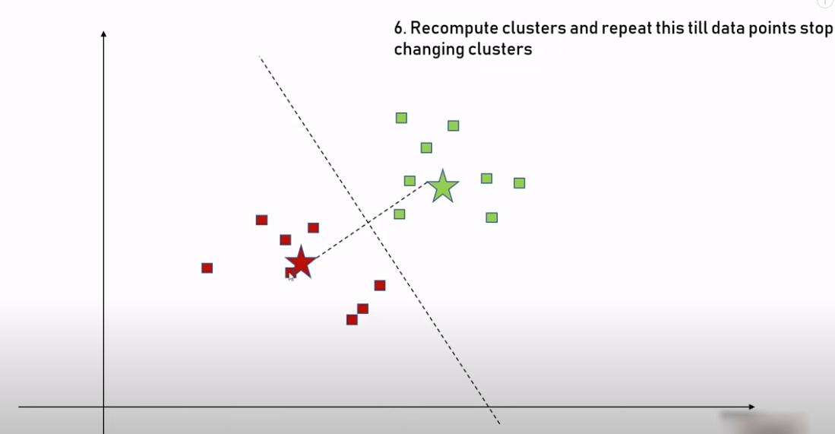
How does K-Means Works ?

Slide 11
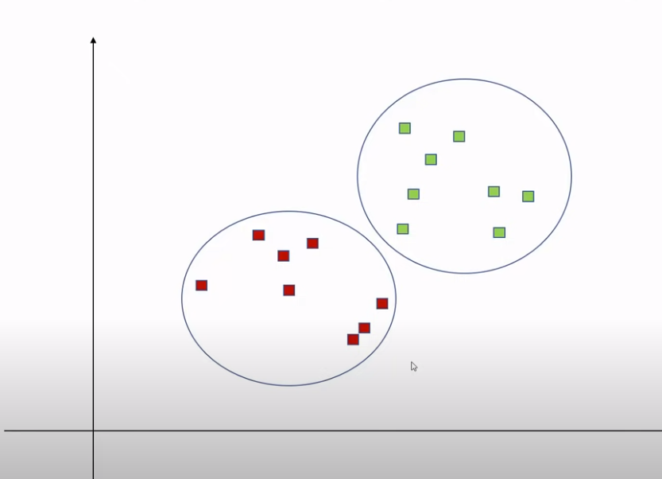
How does K-Means Works ?

Slide 12
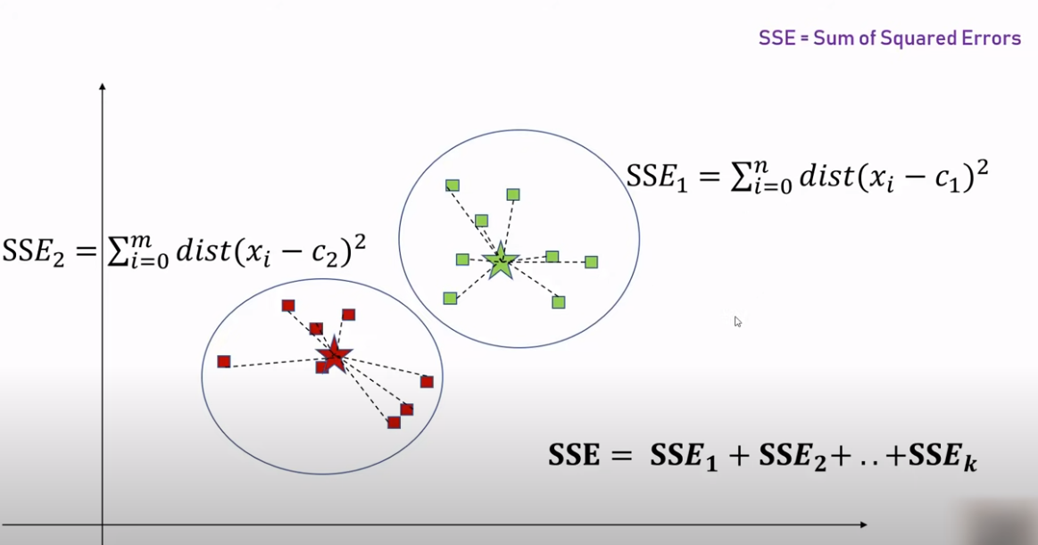
How to determine Correct k ?

Slide 13
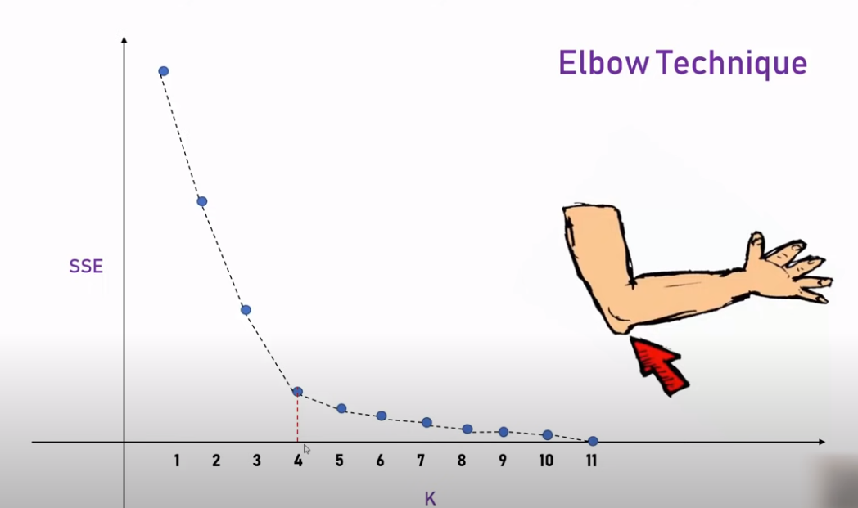
How to determine Correct k ?

Slide 14
Python – Hierarchical Clustering

Slide 15
Hierarchical Clustering
Hierarchical clustering is a type of unsupervised machine learning algorithm used to cluster unlabeled data points.
Types of Hierarchical Clustering
Agglomerative hierarchical clustering
Divisive hierarchical clustering

Slide 16
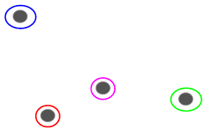
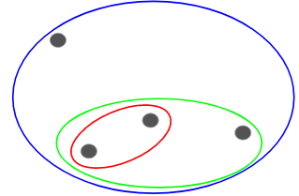
Agglomerative Hierarchical Clustering

Slide 17
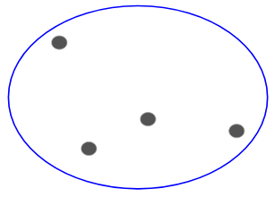
Divisive Hierarchical Clustering

Slide 18
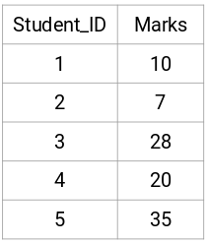
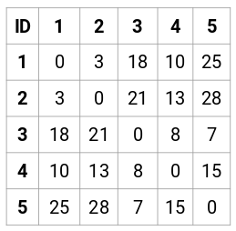
Steps to Perform Clustering

Slide 19
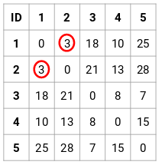
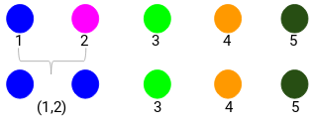
Steps to Perform Clustering

Slide 20
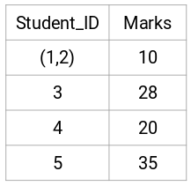
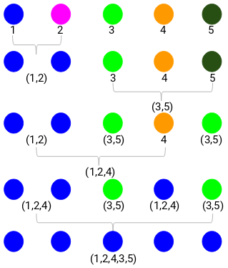
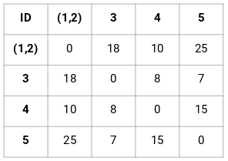
Steps to Perform Clustering

Slide 21
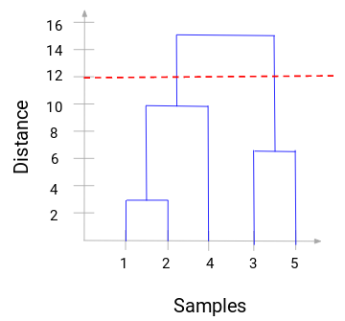
Choosing No Of Clusters
A dendrogram is a tree-like diagram that records the sequences of merges or splits.

Slide 22
Python – Apriori

Slide 23
Apriori Algorithm
Apriori algorithm is a machine learning model used in Association Rule Learning to identify frequent itemsets from a dataset
With the help of these association rule, it determines how strongly or how weakly two objects are connected
Apriori algorithm assumes that any subset of a frequent itemset must be frequent.
Say, a transaction containing {wine, chips, bread} also contains {wine, bread}. So, according to the principle of Apriori, if {wine, chips, bread} is frequent, then {wine, bread} must also be frequent.

Slide 24


Apriori Algorithm
Support : Fraction of transactions that contain an itemset.
For example, the support of item I is defined as the number of transactions containing I divided by the total number of transactions.
Confidence : Measures how often items in Y appear in transactions that contain X
Confidence is the likelihood that item Y is also bought if item X is bought. It’s calculated as the number of transactions containing X and Y divided by the number of transactions containing X.

Slide 25
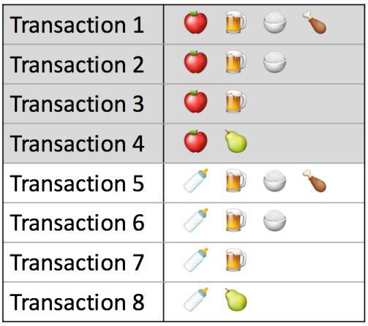
Apriori Algorithm - Support
Measure 1: Support.
This says how popular an itemset is, as measured by the proportion of transactions in which an itemset appears.
In Table the support of {apple} is 4 out of 8, or 50%.
Itemsets can also contain multiple items. For instance, the support of {apple, beer, rice} is 2 out of 8, or 25%.

Slide 26

Apriori Algorithm - Confidence
Measure 2: Confidence.
This says how likely item Y is purchased when item X is purchased, expressed as {X -> Y}.
This is measured by the proportion of transactions with item X, in which item Y also appears. In Table , the confidence of {apple -> beer} is 3 out of 4, or 75%.

Slide 27

Apriori Algorithm - Lift
Measure 3: Lift.
This says how likely item Y is purchased when item X is purchased, while controlling for how popular item Y is. In Table 1, the lift of {apple -> beer} is 1,which implies no association between items.
A lift value greater than 1 means that item Y is likely to be bought if item X is bought, while a value less than 1 means that item Y is unlikely to be

Slide 28
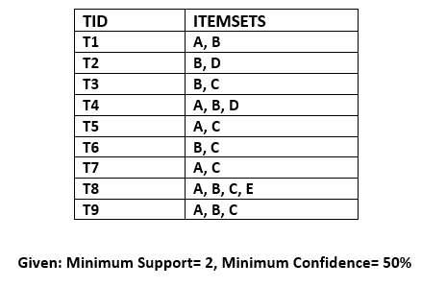
Apriori Algorithm Example

Slide 29
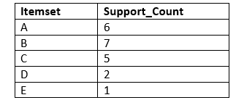
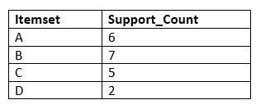
Apriori Algorithm Example
In the first step, we will create a table that contains support count (The frequency of each itemset individually in the dataset) of each itemset in the given dataset. This table is called the Candidate set or C1.

Slide 30
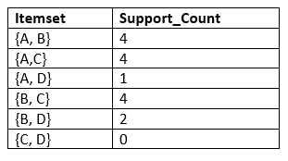
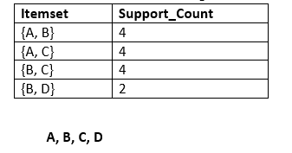
Apriori Algorithm Example
In this step, we will generate C2 with the help of L1. In C2, we will create the pair of the itemsets of L1 in the form of subsets. After creating the subsets, we will again find the support count from the main transaction table of datasets, i.e., how many times these pairs have occurred together in the given dataset. So, we will get the below table for C2

Slide 31
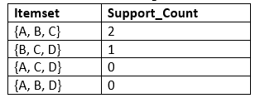
Apriori Algorithm Example
For C3, we will repeat the same two processes, but now we will form the C3 table with subsets of three itemsets together, and will calculate the support count from the dataset. It will give the below table:

Slide 32
Apriori Algorithm Example
As the given threshold or minimum confidence is 50%, so the first three rules A ^B → C, B^C → A, and A^C → B can be considered as the strong association rules for the given problem.
Rules | Support | Confidence
A ^B → C | 2 | Sup{(A ^B) ^C}/sup(A ^B)= 2/4=0.5=50%
B^C → A | 2 | Sup{(B^C) ^A}/sup(B ^C)= 2/4=0.5=50%
A^C → B | 2 | Sup{(A ^C) ^B}/sup(A ^C)= 2/4=0.5=50%
C→ A ^B | 2 | Sup{(C^( A ^B)}/sup(C)= 2/5=0.4=40%
A→ B^C | 2 | Sup{(A^( B ^C)}/sup(A)= 2/6=0.33=33.33%
B→ B^C | 2 | Sup{(B^( B ^C)}/sup(B)= 2/7=0.28=28%

Slide 33
Why it is Called Naive Bayes?
Naïve: It is called Naïve because it assumes that the occurrence of a certain feature is independent of the occurrence of other features. Such as if the fruit is identified on the bases of color, shape, and taste, then red, spherical, and sweet fruit is recognized as an apple. Hence each feature individually contributes to identify that it is an apple without depending on each other.
Bayes: It is called Bayes because it depends on the principle of Baye’s Theorem.

Slide 34
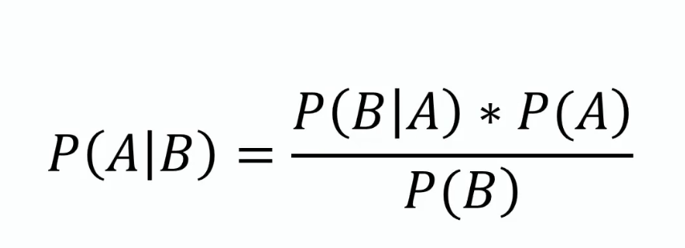
Bayes Theorem
P(A|B) is Posterior probability: Probability of hypothesis A on the observed event B.
P(B|A) is Likelihood probability: Probability of the evidence given that the probability of a hypothesis is true.
P(A) is Prior Probability: Probability of hypothesis before observing the evidence.
P(B) is Marginal Probability: Probability of Evidence.

Slide 35
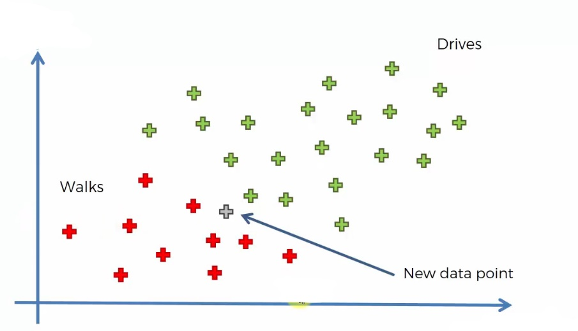
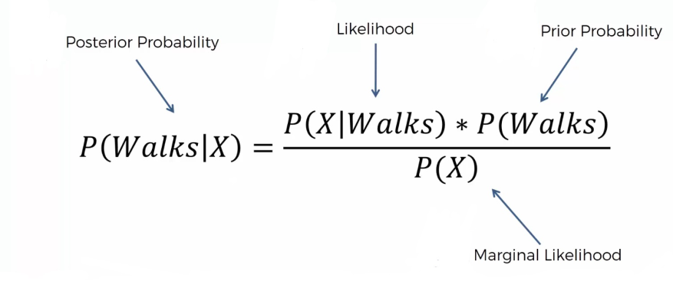
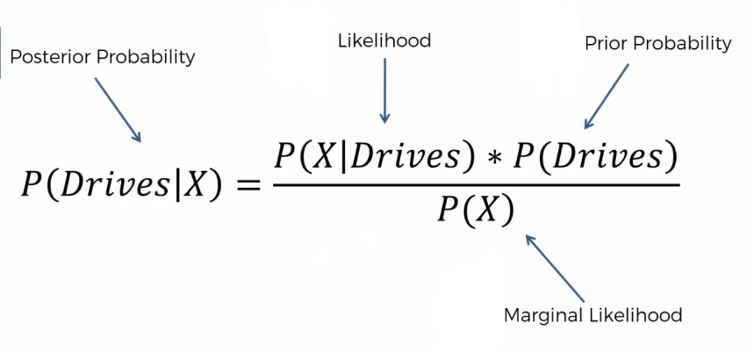
Bayes Example
Note that we are taken age on the X-axis and Salary on the Y-axis.

Slide 36
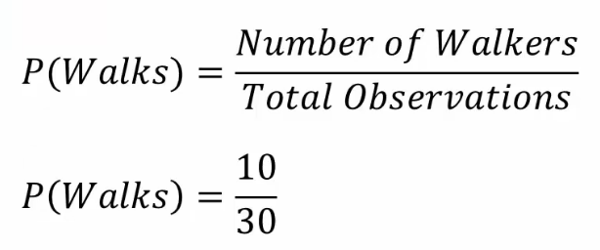
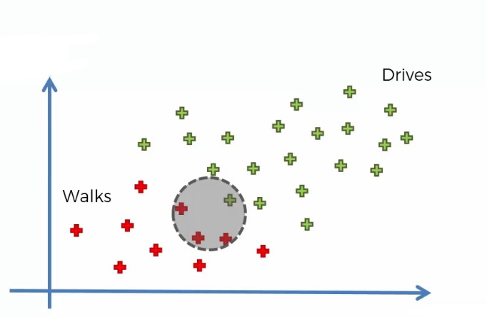
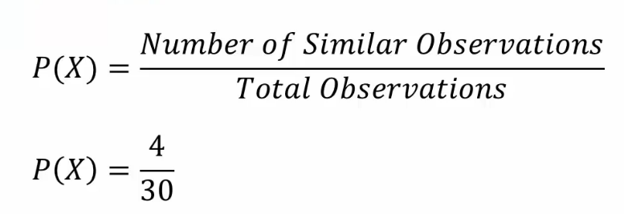
Bayes Example

Slide 37
Bayes Example

Slide 38
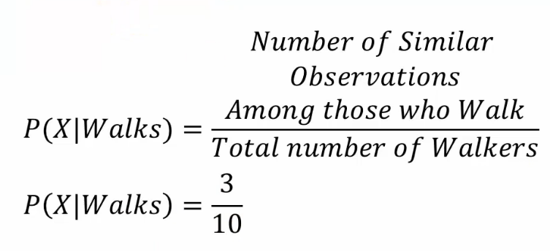
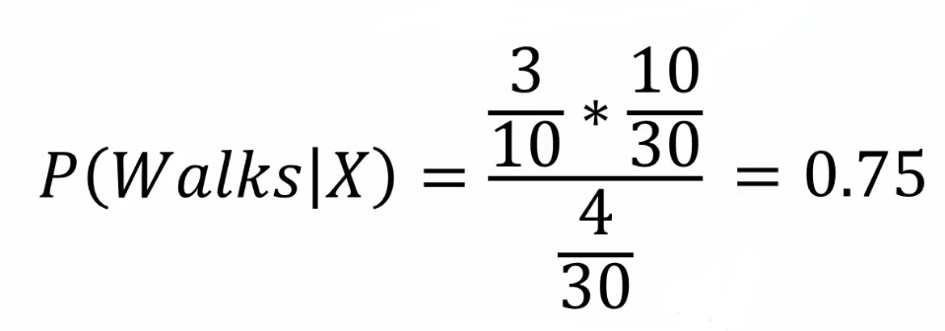
Bayes Example
Similarly we can find the posterior probability of Driving, and it is 0.25
When comparing the posterior probability, we can find that P(walks|X) has greater values and the new point belongs to the walking category.

Slide 39
Working of Naïve Bayes' Classifier:
Convert the given dataset into frequency tables.
Generate Likelihood table by finding the probabilities of given features.
Now, use Bayes theorem to calculate the posterior probability.

Slide 40
Working of Naïve Bayes' Classifier:
If the weather is sunny, then the Player should play or not?
 | Outlook | Play
0 | Rainy | Yes
1 | Sunny | Yes
2 | Overcast | Yes
3 | Overcast | Yes
4 | Sunny | No
5 | Rainy | Yes
6 | Sunny | Yes
7 | Overcast | Yes
8 | Rainy | No
9 | Sunny | No
10 | Sunny | Yes
11 | Rainy | No
12 | Overcast | Yes
13 | Overcast | Yes

Slide 41
Working of Naïve Bayes' Classifier:
Frequency table for the Weather Conditions:
Weather | Yes | No
Overcast | 5 | 0
Rainy | 2 | 2
Sunny | 3 | 2
Total | 10 | 5
Likelihood table weather condition:
Weather | No | Yes
Overcast | 0 | 5 | 5/14= 0.35
Rainy | 2 | 2 | 4/14=0.29
Sunny | 2 | 3 | 5/14=0.35
All | 4/14=0.29 | 10/14=0.71

Slide 42
Working of Naïve Bayes' Classifier:
P(Yes|Sunny)= P(Sunny|Yes)*P(Yes)/P(Sunny)
P(Sunny|Yes)= 3/10= 0.3
P(Sunny)= 0.35
P(Yes)=0.71
So P(Yes|Sunny) = 0.3*0.71/0.35= 0.60
P(No|Sunny)= P(Sunny|No)*P(No)/P(Sunny)
P(Sunny|NO)= 2/4=0.5
P(No)= 0.29
P(Sunny)= 0.35
So P(No|Sunny)= 0.5*0.29/0.35 = 0.41
So as we can see from the above calculation that P(Yes|Sunny)>P(No|Sunny)
Hence on a Sunny day, Player can play the game.

Slide 43
Types of Model
Gaussian: The Gaussian model assumes that features follow a normal distribution. This means if predictors take continuous values instead of discrete, then the model assumes that these values are sampled from the Gaussian
distribution.
Multinomial: The Multinomial Naïve Bayes classifier is used when the data is multinomial distributed. It is primarily used for document classification problems, it means a particular document belongs to which category such as Sports, Politics, education, etc. The classifier uses the frequency of words for the predictors.
Bernoulli: The Bernoulli classifier works similar to the Multinomial classifier, but the predictor variables are the independent Booleans variables. Such as if a particular word is present or not in a document. This model is also famous for document classification tasks.

Slide 44
THANK YOU !!!
Amol Patil - 9822291613

