Slide 1
HEART DISEASE PREDICTION
An End-to-End AI Mini-Project
AI Mini-Project | Group Project
TEAM MEMBERS
EBENEZER ROHI
MAXWELL NJOROGE
AMON KIPRONO
EMANUEL KIPROP
JOY JEROP
VICTOR GITONGA
CALEN MOGERE

Slide 2
Problem Definition & Objective
The Problem
Cardiovascular disease is a leading global cause of death. Early risk identification improves treatment outcomes.
The Goal
Build a binary classification model to predict heart disease presence from clinical measurements.
Task Type
Supervised Classification (0 = No Disease, 1 = Disease Present)
Why It Matters
Supports early screening in resource-limited settings
Complements (not replaces) physician diagnosis
Demonstrates full real-world AI development lifecycle

Slide 3
Data Acquisition
1,020
10
8
1
Raw Rows
Columns
Clinical Features
Target Variable
Dataset Fields
Why This Dataset?
Age, Gender, Chest Pain Type
Resting BP, Cholesterol
Max Heart Rate, ST Depression
Exercise-Induced Angina
Target: Heart_Disease (0/1)
Styled after well-known public heart disease datasets (UCI/Kaggle schema). Realistic, moderately messy — ideal for demonstrating the full cleaning-to-deployment workflow.

Slide 4
Data Cleaning & Preprocessing
Issues Found
Actions Taken
"unknown" values mixed into Age
Inconsistent casing: male/Male/FEMALE
Mixed target labels: zero/one/0/1
13 exact duplicate rows
Missing values across every column
Outliers in clinical measurements
Standardized text casing across categories
Mapped target labels to clean 0/1
Dropped rows with missing target label
Removed duplicate rows
Imputed missing values (median/mode)
Capped outliers using IQR method
1,020 rows → 769 clean rows

Slide 5
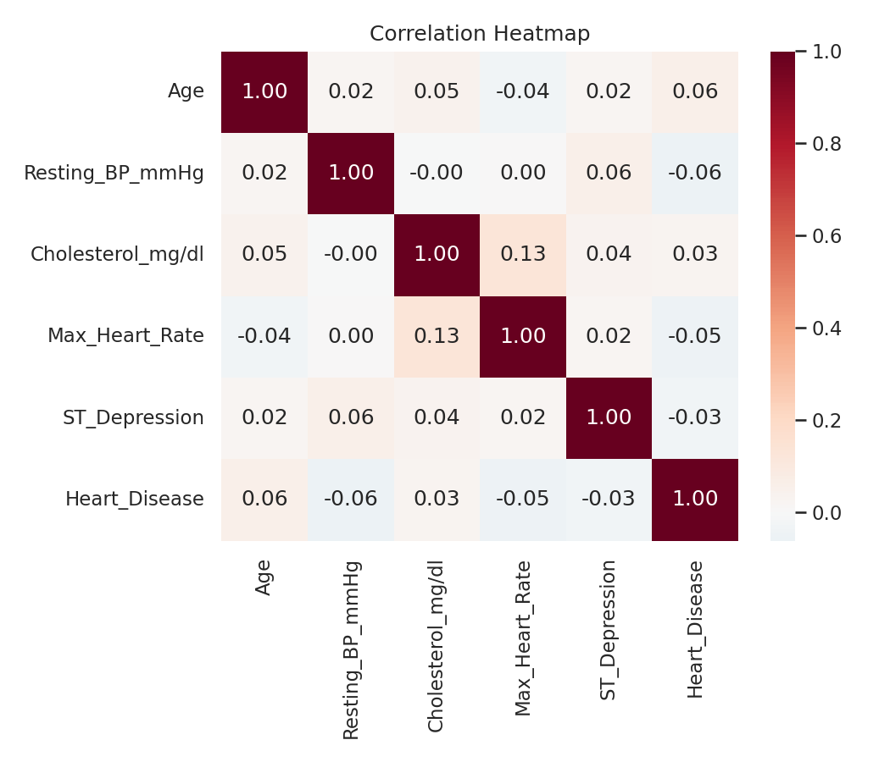
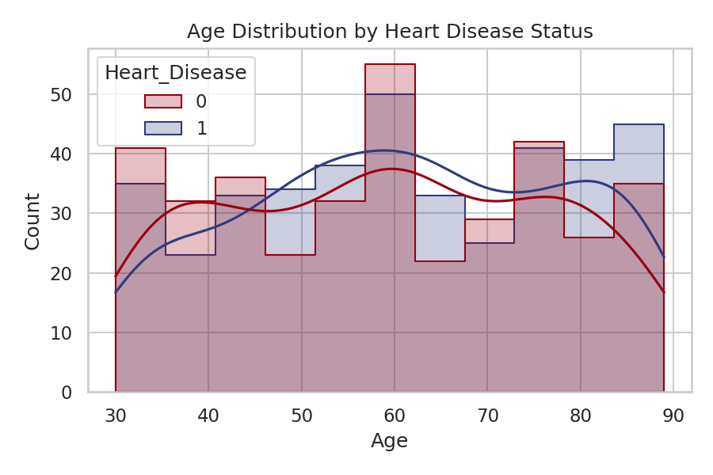
Exploratory Data Analysis
Correlation Heatmap
Age Distribution by Target
No single feature shows a dominant linear correlation with the target — a signal revisited in Results & Insights.

Slide 6
Feature Engineering
One-Hot Encoding
Age Grouping
Gender, Chest Pain Type, and Exercise-Induced Angina converted to binary columns.
Age binned into clinically meaningful ranges: <40, 40-55, 56-70, 70+.
Cholesterol Flag
Feature Scaling
New binary feature flagging cholesterol above the clinical threshold of 240 mg/dl.
Numeric features standardized (z-score) — scaler fit only on training data to avoid leakage.
Final feature set: 14 columns

Slide 7
Model Building
Logistic
Regression
Decision
Tree
Random
Forest
SVM
Random Forest
(Tuned)
Training Setup
80/20 stratified train-test split, preserving class balance
Fixed random seed (42) for reproducibility
Random Forest hyperparameters tuned via 5-fold GridSearchCV (n_estimators, max_depth, min_samples_split), optimizing F1-score

Slide 8
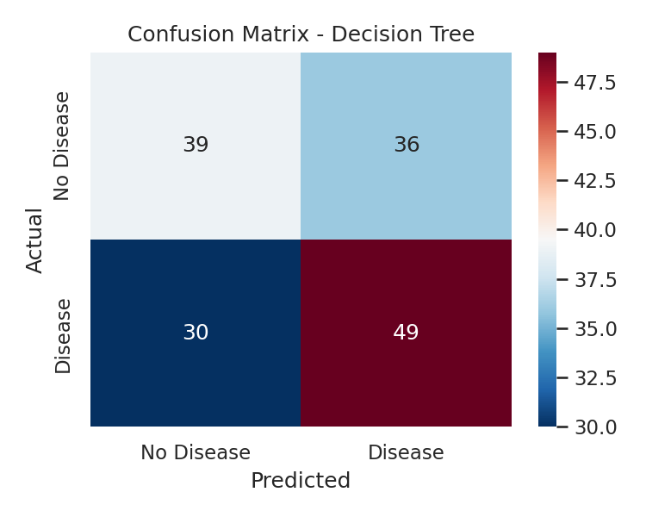
Model Evaluation
Model | Accuracy | Precision | Recall | F1-Score
Decision Tree (Best) | 0.571 | 0.576 | 0.620 | 0.598
Random Forest (Tuned) | 0.519 | 0.527 | 0.608 | 0.565
Random Forest | 0.539 | 0.551 | 0.544 | 0.548
Logistic Regression | 0.448 | 0.468 | 0.557 | 0.509
SVM | 0.442 | 0.457 | 0.468 | 0.463
Decision Tree selected as final model — highest F1-score (0.598) among all candidates.

Slide 9
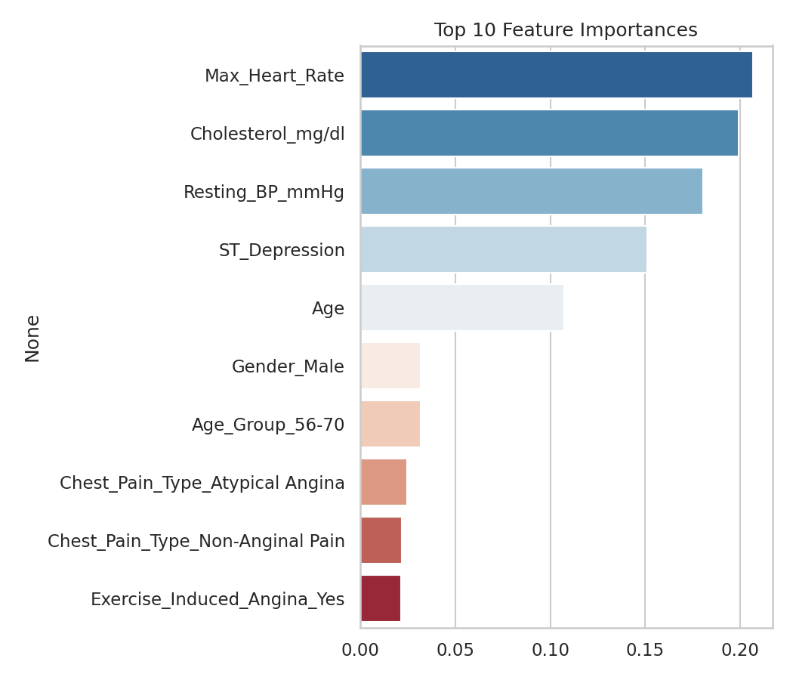
Results Interpretation & Insights
Honest Assessment
Performance is modest (F1 ≈ 0.60) — only somewhat above random baseline
Likely due to small dataset size (769 rows) and weak/non-linear feature-target relationships
This is a valuable insight, not a failure: real clinical tools need larger, higher-quality labeled data
Model should support, never replace, physician diagnosis
Top Feature Importances

Slide 10
Deployment
Streamlit Web App
Inputs → Output
User enters patient clinical details via a simple form
App returns predicted risk + probability instantly
Loads the exact trained model, scaler & feature order
Runs locally: streamlit run app/app.py
Age, Gender, Chest Pain Type
Resting BP, Cholesterol, Max HR
ST Depression, Exercise Angina
→ Risk Prediction + Probability %
(Educational demo — not a medical diagnostic tool)

Slide 11
Conclusion & Learnings
Completed the full AI development lifecycle: problem definition → data cleaning → EDA → feature engineering → modeling → evaluation → deployment
Learned to handle real-world messy data: inconsistent formats, ambiguous labels, missing values
Practiced transparent reporting of model limitations, not just showcasing strong results
Delivered a usable, interactive deployment — not just a notebook
GitHub Repository: ______________________

Slide 12
♥
Thank You
Questions & Discussion

