Slide 1
The AMOS Project Course Introduction
Prof. Dr. Dirk Riehle
Friedrich-Alexander University Erlangen-Nürnberg
AMOS A01
Licensed under CC BY 4.0 International
Notes:
It is Friedrich-Alexander University Erlangen-Nürnberg – FAU, in short.
Corporate identity wants us to say “Friedrich-Alexander University”.

Slide 2
Course Learning Goals 1 / 2 [1] [2] [3] [4]
To introduce students to agile methods by creating useful software.
[1] Professional = ambition + collaboration with external partner
[2] Agile methods = our focus here, specifically Scrum + XP
[3] We teach both overall processes as well as best practices
[4] Useful software is software that has value to someone!

Slide 3
Course Learning Goals 2 / 2
Learning objectives (lectures / tutorials, projects)
Gain conceptual understanding and practical skills of using
agile software development methods
software project management tools
software development tools
Learn how to work
with an external stakeholder
in a (student) project team
Project objectives
Develop useful software
Perform a great demo on demo-day!

Slide 4
Skills Required for Course
General skills
Willingness and ability to work in a team
Ability to acquire skills during the project
Role-specific skills
Product owner (PO) role
Strong conceptual thinking
Ability to communicate well
Affinity to technology
Software developer (SD) role
Technology stack (specific to project)
Development tools like git and GitHub
Test-driven development
Scrum master (SM) role
Strong organizational skills

Slide 5
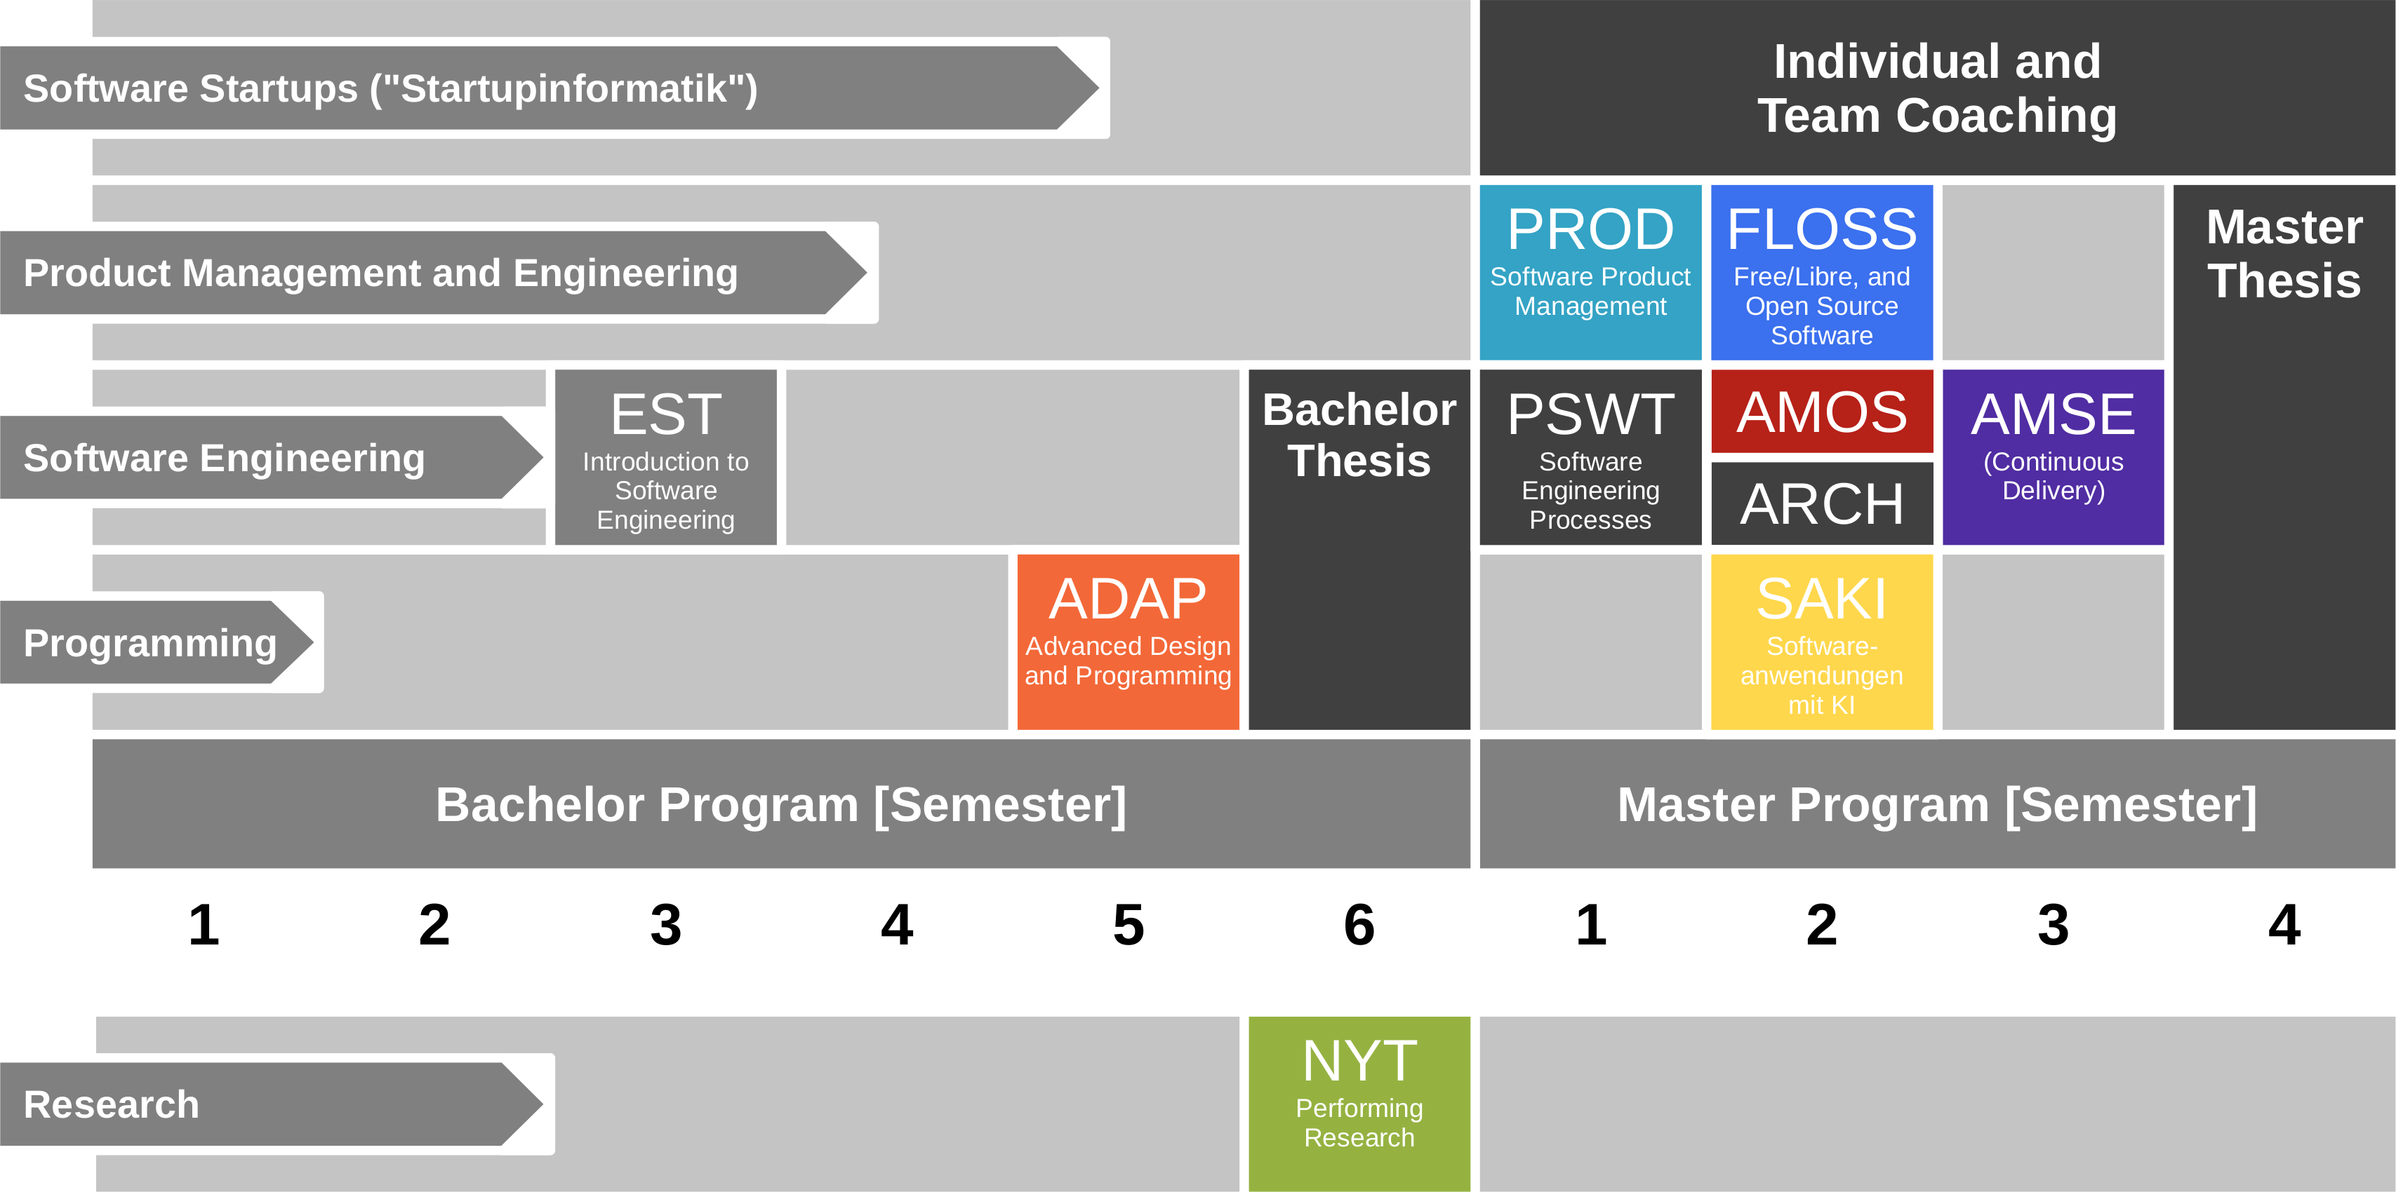
Course Position in Curriculum

Slide 6
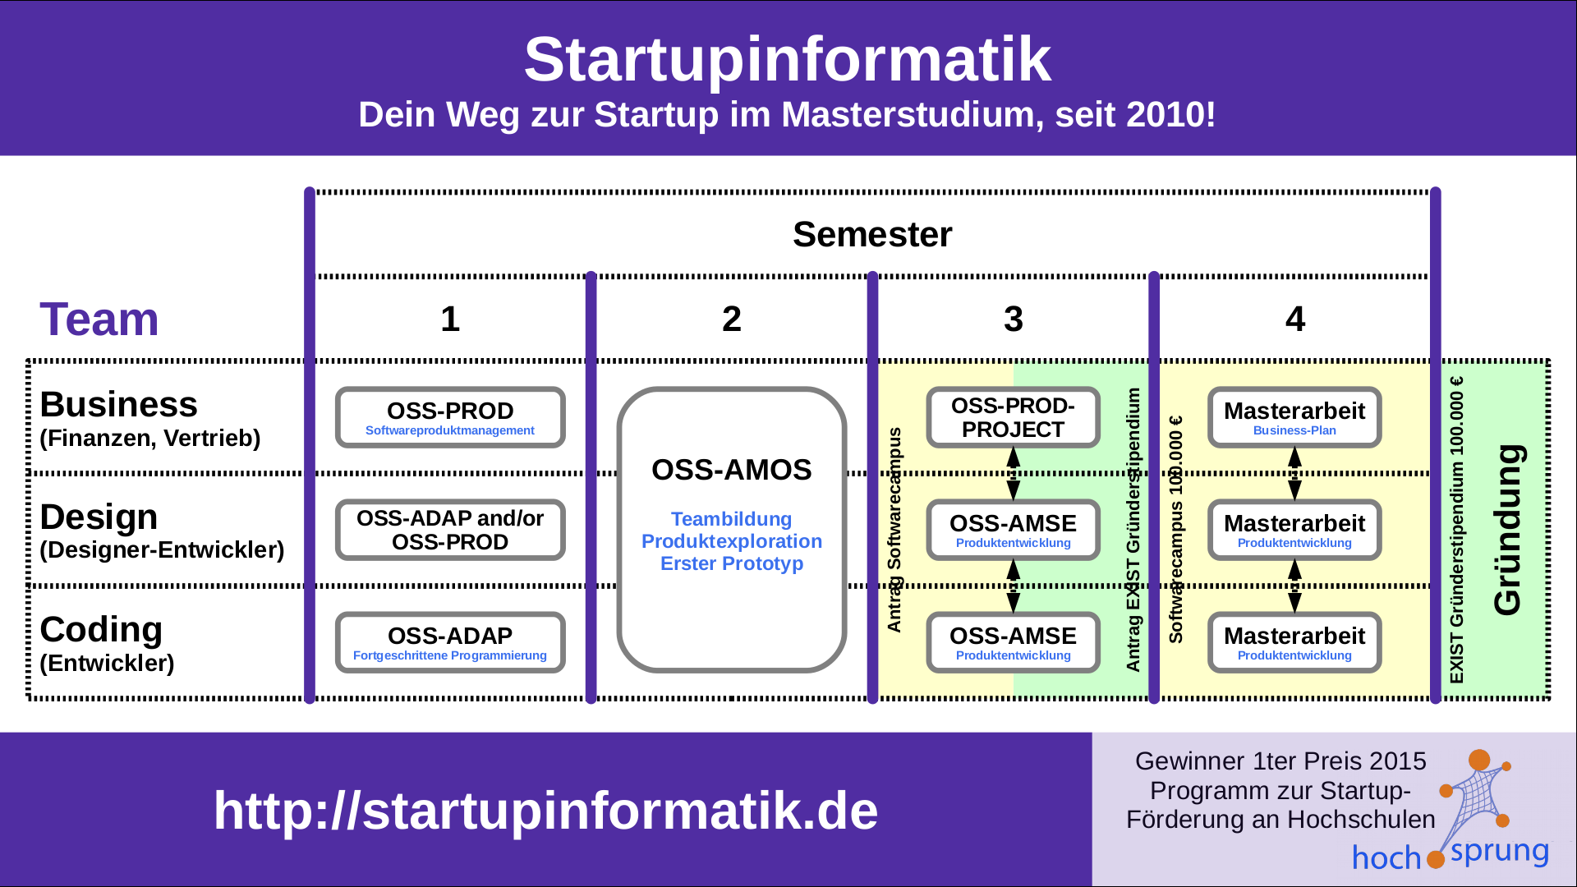

Slide 7
Course Grading [1] (Separate Roles)
OSS-AMOS-PO (Product Owner)
Theory (lectures) = 20% of grade
2 SWS in 5 ECTS = 20%
As measured by class quizzes
Grading scale is [0..10] points
Practice (project) = 80% of grade
Individual contribution to teamwork = 50%
As measured in team meetings
Grading scale is [0|1|2|3]
Independent work = 50%
As measured by artifacts provided
Grading scale is [0|1|2|3]
OSS-AMOS-SD (Software Developer)
Theory (lectures) = 10% of grade
2 SWS in 10 ECTS = 10%
As measured by class quizzes
Grading scale is [0..10] points
Practice (project) = 90% of grade
Individual contribution to teamwork = 50%
As measured in team meetings
Grading scale is [0|1|2|3]
Independent work = 50%
As measured by artifacts provided
Grading scale is [0|1|2|3]
[1] Also see http://osr.cs.fau.de/teaching/course-resources/grading-schemes-and-scales/

Slide 8
Course Grading [1] (Integrated Roles)
Individual contribution to teamwork = 50%
As measured in team meetings
Grading scale is [0|1|2|3]
Independent work = 50%
As measured by artifacts provided
Grading scale is [0|1|2|3]
[1] Also see http://osr.cs.fau.de/teaching/course-resources/grading-schemes-and-scales/

Slide 9
Receiving a Grade for the Course
If you want to receive a grade
You must register through the course management system before the deadline
If you cannot register through the course management system
Please follow these instructions https://wp.me/PDU66-2bx
Otherwise: No grade

Slide 10
Course Language [1]
Class
Lecturer: English
Student: Choice of German or English
Project and exercises
Team: Choice of German or English
Submissions: Choice of industry partner
[1] http://osr.cs.fau.de/2012/03/10/english-or-german-deutsch-oder-englisch/

Slide 11
Course Information
Course index
See link in course management system

Slide 12
Thank you! Questions?
dirk.riehle@fau.de – http://osr.cs.fau.de
dirk@riehle.org – http://dirkriehle.com – @dirkriehle
DR

Slide 13
Credits and License
Original version
© 2012-2020 Dirk Riehle, some rights reserved
Licensed under Creative Commons Attribution 4.0 International License
Contributions
...

