Slide 1




Realtime Scheduler

Slide 2
Main features
500 tasks stress test
20k stress test
Working days
Working days multiple parents
Active times
Sequentielle Transaktion
20k stress test Ergebnis
Management Api (start, stop, release)
Prio Berechnung (mittels Unit-Test)

Slide 3
Working days
Tasks
{
"id": "cd6095dd-86cd-56de-a423-4134c59763w5",
"group_id": "Buchung",
"priority": 100,
"deadline": null,
"active_times": [],
"working_days": [
false,
true,
false,
true,
true,
false,
false
],
"type_flag": "batch",
"mode": "parallel",
"force": false,
"index_number": null,
"meta": null
}
Group
{
"id": "Buchung",
"parent_id": null,
"priority": 100,
"deadline": null,
"active_times": [],
"working_days": [
true,
false,
false,
true,
true,
true,
false
],
"type_flag": "batch",
"mode": "parallel",
"last_index_number": null,
"parallelism_degree": 100
}
Dispatch?
Yes
{
"id": "cd6095dd-86cd-56de-a423-4134c59763w1",
"group_id": "Buchung",
"priority": 100,
"deadline": null,
"active_times": [],
"type_flag": "batch",
"mode": "parallel",
"force": false,
"index_number": null,
"meta": null
}
No
Working days = Dienstag

Slide 4
Working days multiple groups
Tasks
{
"id": "cd6095dd-86cd-56de-a423-4134c59763w5",
"group_id": "Buchung",
"priority": 100,
"deadline": null,
"active_times": [],
"working_days": [
false,
true,
false,
true,
true,
false,
false
],
"type_flag": "batch",
"mode": "parallel",
"force": false,
"index_number": null,
"meta": null
}
Parent
Group
Dispatch?
{
"id": „Oberbuchung",
"parent_id": null,
"priority": 100,
"deadline": null,
"active_times": [],
"working_days": [
true,
true,
false,
false,
false,
false,
false
],
"type_flag": "batch",
"mode": "parallel",
"last_index_number": null,
"parallelism_degree": 100
}
{
"id": "Buchung",
"parent_id": “Oberbuchung“,
"priority": 100,
"deadline": null,
"active_times": [],
"working_days": [
true,
false,
false,
true,
true,
true,
false
],
"type_flag": "batch",
"mode": "parallel",
"last_index_number": null,
"parallelism_degree": 100
}
Yes
No
{
"id": "cd6095dd-86cd-56de-a423-4134c59763w1",
"group_id": "Buchung",
"priority": 100,
"deadline": null,
"active_times": [],
"working_days": [],
"type_flag": "batch",
"mode": "parallel",
"force": false,
"index_number": null,
"meta": null
}
Working days = Dienstag

Slide 5
Working days multiple groups
Tasks
{
"id": "cd6095dd-86cd-56de-a423-4134c59763w5",
"group_id": "Buchung",
"priority": 100,
"deadline": null,
"active_times": [],
"working_days": [
false,
true,
false,
true,
true,
false,
false
],
"type_flag": "batch",
"mode": "parallel",
"force": false,
"index_number": null,
"meta": null
}
Parent
Dispatch?
{
"id": „Oberbuchung",
"parent_id": null,
"priority": 100,
"deadline": null,
"active_times": [],
"working_days": [
true,
false,
false,
false,
false,
false,
false
],
"type_flag": "batch",
"mode": "parallel",
"last_index_number": null,
"parallelism_degree": 100
}
Group
Yes
{
"id": "Buchung",
"parent_id": “Oberbuchung“,
"priority": 100,
"deadline": null,
"active_times": [],
"working_days": [],
"type_flag": "batch",
"mode": "parallel",
"last_index_number": null,
"parallelism_degree": 100
}
No
{
"id": "cd6095dd-86cd-56de-a423-4134c59763w1",
"group_id": "Buchung",
"priority": 100,
"deadline": null,
"active_times": [],
"working_days": [],
"type_flag": "batch",
"mode": "parallel",
"force": false,
"index_number": null,
"meta": null
}
Working days = Tuesday

Slide 6
Active times
Tasks
{
"id": "cd6095dd-86cd-56de-a423-4134c59763a1",
"group_id": "Finanzwesen",
"priority": 100,
"deadline": null,
"active_times": [],
"working_days": [
true,
true,
true,
true,
true,
true,
true
],
"type_flag": "batch",
"mode": "parallel",
"force": false,
"index_number": null,
"meta": null
}
Group
{
"id": "Finanzwesen",
"parent_id": null,
"priority": 100,
"deadline": null,
"active_times": [{
"from": "13:00:00",
"to": "17:00:00"
}],
"working_days": [
true,
true,
true,
true,
true,
true,
true
],
"type_flag": "batch",
"mode": "parallel",
"last_index_number": null,
"parallelism_degree": 100
}
Dispatch?
Yes
{
"id": "cd6095dd-86cd-56de-a423-4134c59763w1",
"group_id": “Finanzwesen",
"priority": 100,
"deadline": null,
"active_times": [{
"from": “18:00:00",
"to": "19:30:00"
}],
"type_flag": "batch",
"mode": "parallel",
"force": false,
"index_number": null,
"meta": null
}
No
Active_time = „14:30:00“

Slide 7
Sequenzielle Transaktion
Tasks
{
"id": "3853c1cc-a493-11ea-bb36-0272ac5704s3",
"group_id": "StrengSequenzielleTransaktion",
"priority": 100,
"deadline": null,
"active_times": [],
"working_days": [
true,
true,
true,
true,
true,
true,
true
],
"type_flag": "batch",
"mode": "sequential",
"force": false,
"index_number": 1,
"meta": null
}
Group
Dispatch?
{
"id": "StrengSequenzielleTransaktion",
"parent_id": null,
"priority": 100,
"deadline": null,
"active_times": [],
"working_days": [
true,
true,
true,
true,
true,
true,
true
],
"type_flag": "batch",
"mode": "sequential",
"last_index_number": 0,
"parallelism_degree": 1
}
Yes
{
"id": "3853c1cc-a493-11ea-bb36-0272ac5704s3",
"group_id": "StrengSequenzielleTransaktion",
"priority": 100,
"deadline": null,
"active_times": [],
"working_days": [
true,
true,
true,
true,
true,
true,
true
],
"type_flag": "batch",
"mode": "sequential",
"force": false,
"index_number": 2,
"meta": null
}
No

Slide 8
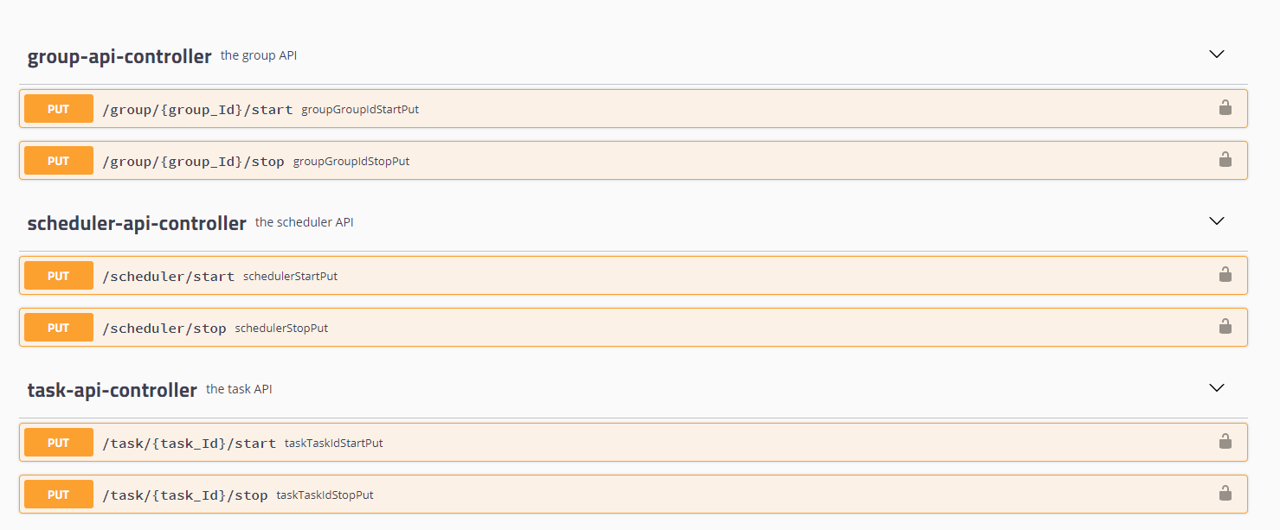
Management Api

Slide 9
20k stress test
20.000 Tasks ~ 4 min scheduling and dispatching
20.000 Tasks ~ 18 min finishing (depends on feedback)

