Slide 1




Realtime Scheduler

Slide 2
Main features
500 tasks stress test
20k stress test
Working days
Working days multiple parents
Active times
Sequentielle Transaktion
Management Api (start, stop, release)
Prio Berechnung (mittels Unit-Test)
20k stress test Ergebnis

Slide 3
Working days
Tasks
{
"id": "cd6095dd-86cd-56de-a423-4134c59763w5",
"group_id": "Buchung",
"priority": 100,
"deadline": null,
"active_times": [],
"working_days": [
false,
true,
false,
true,
true,
false,
false
],
"type_flag": "batch",
"mode": "parallel",
"force": false,
"index_number": null,
"meta": null
}
Group
{
"id": "Buchung",
"parent_id": null,
"priority": 100,
"deadline": null,
"active_times": [],
"working_days": [
true,
false,
false,
true,
true,
true,
false
],
"type_flag": "batch",
"mode": "parallel",
"last_index_number": null,
"parallelism_degree": 100
}
Dispatch?
Yes
{
"id": "cd6095dd-86cd-56de-a423-4134c59763w1",
"group_id": "Buchung",
"priority": 100,
"deadline": null,
"active_times": [],
"type_flag": "batch",
"mode": "parallel",
"force": false,
"index_number": null,
"meta": null
}
No
Working days = Dienstag

Slide 4
Working days multiple groups
Tasks
{
"id": "cd6095dd-86cd-56de-a423-4134c59763w5",
"group_id": "Buchung",
"priority": 100,
"deadline": null,
"active_times": [],
"working_days": [
false,
true,
false,
true,
true,
false,
false
],
"type_flag": "batch",
"mode": "parallel",
"force": false,
"index_number": null,
"meta": null
}
Parent
Group
Dispatch?
{
"id": „Oberbuchung",
"parent_id": null,
"priority": 100,
"deadline": null,
"active_times": [],
"working_days": [
true,
false,
false,
false,
false,
false,
false
],
"type_flag": "batch",
"mode": "parallel",
"last_index_number": null,
"parallelism_degree": 100
}
{
"id": "Buchung",
"parent_id": “Oberbuchung“,
"priority": 100,
"deadline": null,
"active_times": [],
"working_days": [
true,
true,
false,
true,
true,
true,
false
],
"type_flag": "batch",
"mode": "parallel",
"last_index_number": null,
"parallelism_degree": 100
}
Yes
No
{
"id": "cd6095dd-86cd-56de-a423-4134c59763w1",
"group_id": "Buchung",
"priority": 100,
"deadline": null,
"active_times": [],
"type_flag": "batch",
"mode": "parallel",
"force": false,
"index_number": null,
"meta": null
}
Working days = Dienstag

Slide 5
Working days multiple groups
Tasks
{
"id": "cd6095dd-86cd-56de-a423-4134c59763w5",
"group_id": "Buchung",
"priority": 100,
"deadline": null,
"active_times": [],
"working_days": [
false,
true,
false,
true,
true,
false,
false
],
"type_flag": "batch",
"mode": "parallel",
"force": false,
"index_number": null,
"meta": null
}
Parent
Dispatch?
{
"id": „Oberbuchung",
"parent_id": null,
"priority": 100,
"deadline": null,
"active_times": [],
"working_days": [
true,
false,
false,
false,
false,
false,
false
],
"type_flag": "batch",
"mode": "parallel",
"last_index_number": null,
"parallelism_degree": 100
}
Group
Yes
{
"id": "Buchung",
"parent_id": “Oberbuchung“,
"priority": 100,
"deadline": null,
"active_times": [],
"working_days": [],
"type_flag": "batch",
"mode": "parallel",
"last_index_number": null,
"parallelism_degree": 100
}
No
{
"id": "cd6095dd-86cd-56de-a423-4134c59763w1",
"group_id": "Buchung",
"priority": 100,
"deadline": null,
"active_times": [],
"working_days": [],
"type_flag": "batch",
"mode": "parallel",
"force": false,
"index_number": null,
"meta": null
}
Working days = Tuesday

Slide 6
Active times
Tasks
{
"id": "cd6095dd-86cd-56de-a423-4134c59763a1",
"group_id": "Finanzwesen",
"priority": 100,
"deadline": null,
"active_times": [],
"working_days": [
true,
true,
true,
true,
true,
true,
true
],
"type_flag": "batch",
"mode": "parallel",
"force": false,
"index_number": null,
"meta": null
}
Group
{
"id": "Finanzwesen",
"parent_id": null,
"priority": 100,
"deadline": null,
"active_times": [{
"from": "13:00:00",
"to": "17:00:00"
}],
"working_days": [
true,
true,
true,
true,
true,
true,
true
],
"type_flag": "batch",
"mode": "parallel",
"last_index_number": null,
"parallelism_degree": 100
}
Dispatch?
Yes
{
"id": "cd6095dd-86cd-56de-a423-4134c59763w1",
"group_id": "Buchung",
"priority": 100,
"deadline": null,
"active_times": [{
"from": “18:00:00",
"to": "19:30:00"
}],
"type_flag": "batch",
"mode": "parallel",
"force": false,
"index_number": null,
"meta": null
}
No
Active_time = „14:30:00“

Slide 7
Sequenzielle Transaktion
Tasks
{
"id": "3853c1cc-a493-11ea-bb36-0272ac5704s3",
"group_id": "StrengSequenzielleTransaktion",
"priority": 100,
"deadline": null,
"active_times": [],
"working_days": [
true,
true,
true,
true,
true,
true,
true
],
"type_flag": "batch",
"mode": "sequential",
"force": false,
"index_number": 1,
"meta": null
}
Group
Dispatch?
{
"id": "StrengSequenzielleTransaktion",
"parent_id": null,
"priority": 100,
"deadline": null,
"active_times": [],
"working_days": [
true,
true,
true,
true,
true,
true,
true
],
"type_flag": "batch",
"mode": "sequential",
"last_index_number": 0,
"parallelism_degree": 1
}
Yes
{
"id": "3853c1cc-a493-11ea-bb36-0272ac5704s3",
"group_id": "StrengSequenzielleTransaktion",
"priority": 100,
"deadline": null,
"active_times": [],
"working_days": [
true,
true,
true,
true,
true,
true,
true
],
"type_flag": "batch",
"mode": "sequential",
"force": false,
"index_number": 2,
"meta": null
}
No

Slide 8
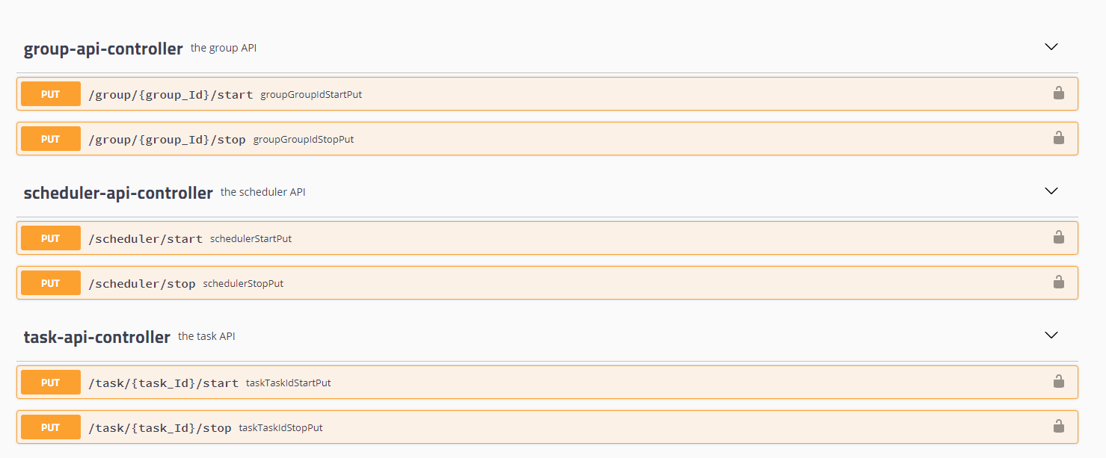
Management Api

Slide 9
20k stress test
20.000 Tasks ~ 8 min scheduling and dispatching
20.000 Tasks ~ 18 min finishing (dependant on feedback)

