Slide 1




Realtime Scheduler

Slide 2
Main features
500 tasks stress test
20k stress test
Working days
Working days multiple parents
Active times
Sequentielle Transaktion
Management Api (start, stop, release)
Prio Berechnung (mittels Unit-Test)
20k stress test Ergebnis

Slide 3
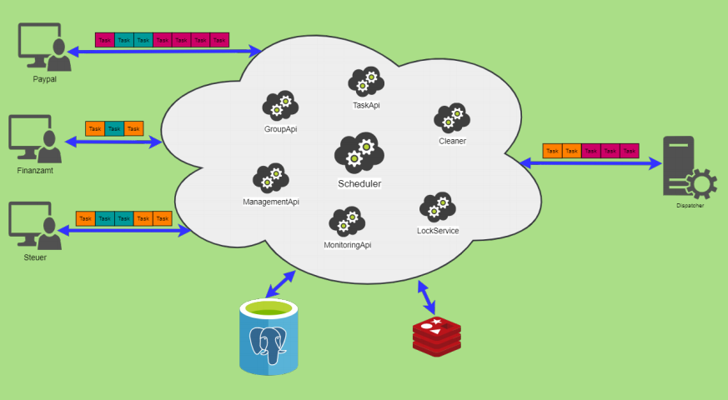

Slide 4
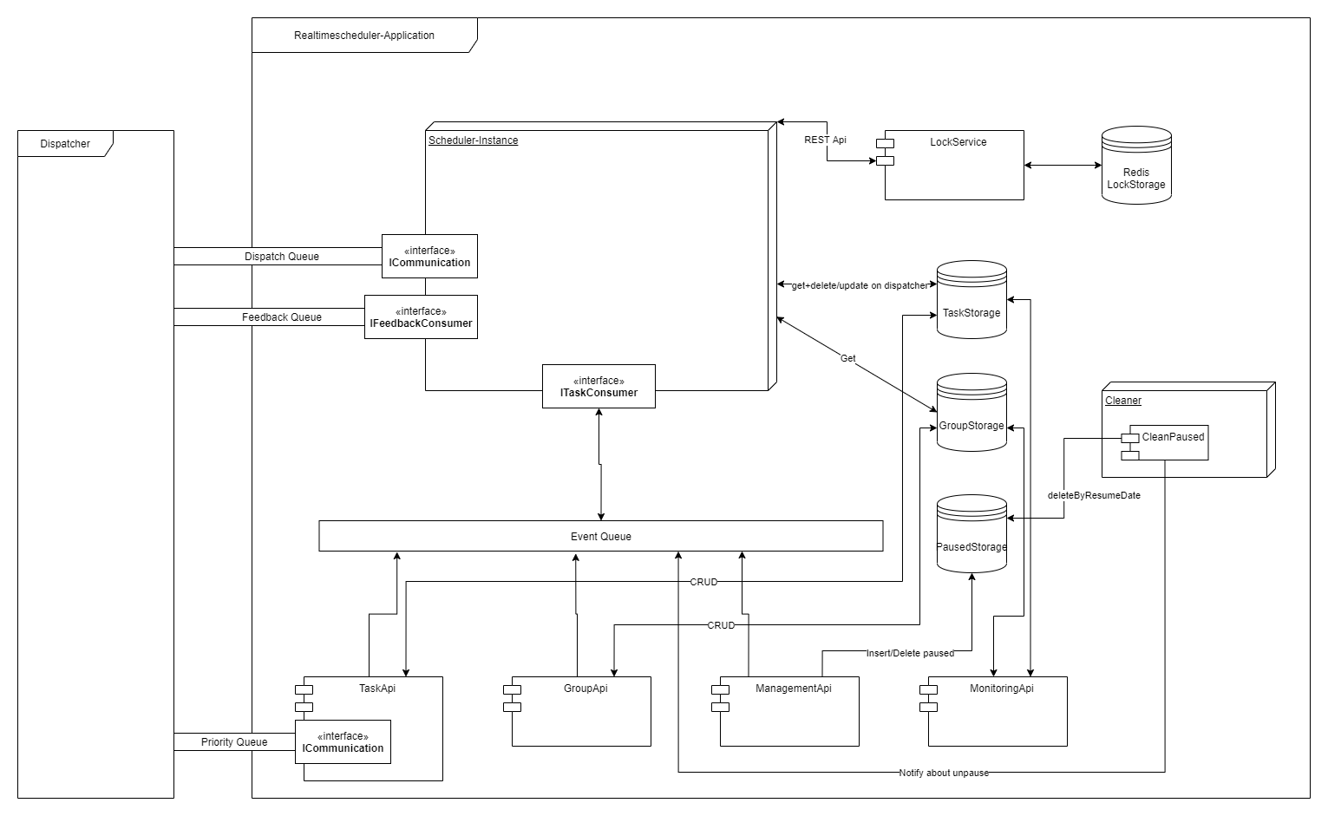

Slide 5
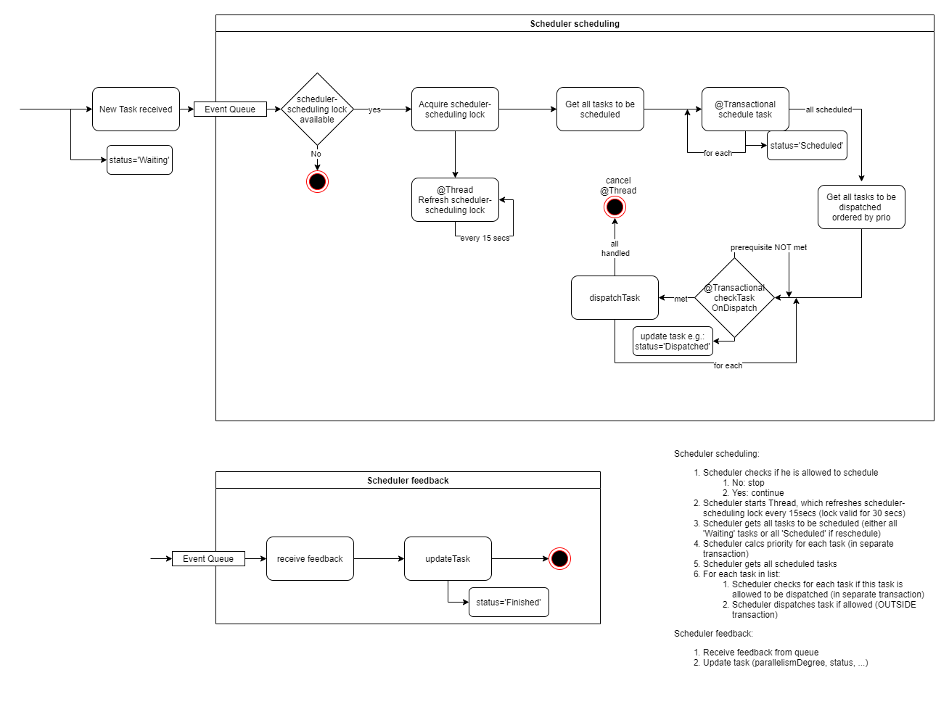

Slide 6
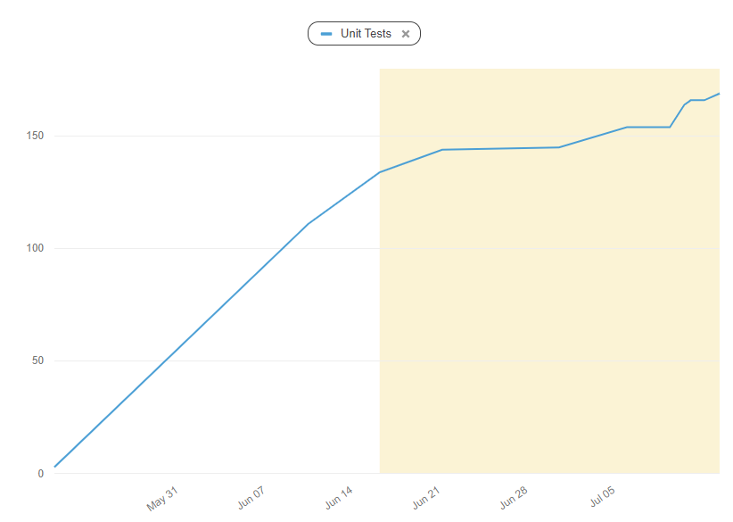
Jacoco Test Coverage
Notes:
Wir haben von Anfang an darauf wert gelegt, eine Testabdeckung für unser Projekt zu gewährleisten. Da es als Open Source Project geplant ist, ist eine hohe Testabdeckung von extremen Vorteil, da auch unabhängige Entwickler sich am Quellcode beteiligen können und Dinge verändern können und sich trotzdem sicher sein können, durch eine automatische Testabdeckung, dass nicht alles kaputt gegangen ist. Man kann einen steilen Anstieg der Unit-Tests im Juni beobachten, zu dieser Zeit haben wir festgelegt, dass wir eine mindest Testabdeckung von 80% erreichen wollen.

Slide 7

Notes:
Hier zeigen wir live die Swagger UI mit den entsprechenden Endpoints
https://taskapi-amos.cfapps.io/swagger-ui.html
https://managementapi-amos.cfapps.io/swagger-ui.html#/task-api-controller
https://groupapi-amos.cfapps.io/swagger-ui.html#/group-id-api-controller

Slide 8

DOES CODING MAKE YOU HAPPY?
Notes:
https://themonkeycode.weebly.com/uploads/5/3/3/5/53357177/9718231_orig.jpg

Slide 9
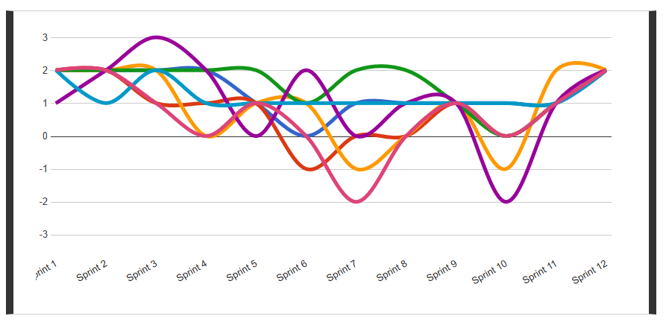
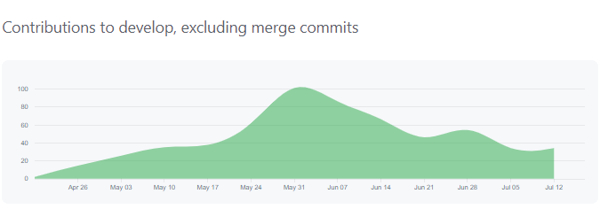
Amos Team Happiness Index

Slide 10
Working days
Tasks
{
"id": "cd6095dd-86cd-56de-a423-4134c59763w5",
"group_id": "Buchung",
"priority": 100,
"deadline": null,
"active_times": [],
"working_days": [
false,
true,
false,
true,
true,
false,
false
],
"type_flag": "batch",
"mode": "parallel",
"force": false,
"index_number": null,
"meta": null
}
Group
{
"id": "Buchung",
"parent_id": null,
"priority": 100,
"deadline": null,
"active_times": [],
"working_days": [
true,
false,
false,
true,
true,
true,
false
],
"type_flag": "batch",
"mode": "parallel",
"last_index_number": null,
"parallelism_degree": 100
}
Dispatch?
Yes
{
"id": "cd6095dd-86cd-56de-a423-4134c59763w1",
"group_id": "Buchung",
"priority": 100,
"deadline": null,
"active_times": [],
"type_flag": "batch",
"mode": "parallel",
"force": false,
"index_number": null,
"meta": null
}
No
Working days = Dienstag

Slide 11
Working days multiple groups
Tasks
{
"id": "cd6095dd-86cd-56de-a423-4134c59763w5",
"group_id": "Buchung",
"priority": 100,
"deadline": null,
"active_times": [],
"working_days": [
false,
true,
false,
true,
true,
false,
false
],
"type_flag": "batch",
"mode": "parallel",
"force": false,
"index_number": null,
"meta": null
}
Parent
Group
Dispatch?
{
"id": „Oberbuchung",
"parent_id": null,
"priority": 100,
"deadline": null,
"active_times": [],
"working_days": [
true,
false,
false,
false,
false,
false,
false
],
"type_flag": "batch",
"mode": "parallel",
"last_index_number": null,
"parallelism_degree": 100
}
{
"id": "Buchung",
"parent_id": “Oberbuchung“,
"priority": 100,
"deadline": null,
"active_times": [],
"working_days": [
true,
true,
false,
true,
true,
true,
false
],
"type_flag": "batch",
"mode": "parallel",
"last_index_number": null,
"parallelism_degree": 100
}
Yes
No
{
"id": "cd6095dd-86cd-56de-a423-4134c59763w1",
"group_id": "Buchung",
"priority": 100,
"deadline": null,
"active_times": [],
"type_flag": "batch",
"mode": "parallel",
"force": false,
"index_number": null,
"meta": null
}
Working days = Dienstag

Slide 12
Working days multiple groups
Tasks
{
"id": "cd6095dd-86cd-56de-a423-4134c59763w5",
"group_id": "Buchung",
"priority": 100,
"deadline": null,
"active_times": [],
"working_days": [
false,
true,
false,
true,
true,
false,
false
],
"type_flag": "batch",
"mode": "parallel",
"force": false,
"index_number": null,
"meta": null
}
Parent
Dispatch?
{
"id": „Oberbuchung",
"parent_id": null,
"priority": 100,
"deadline": null,
"active_times": [],
"working_days": [
true,
false,
false,
false,
false,
false,
false
],
"type_flag": "batch",
"mode": "parallel",
"last_index_number": null,
"parallelism_degree": 100
}
Group
Yes
{
"id": "Buchung",
"parent_id": “Oberbuchung“,
"priority": 100,
"deadline": null,
"active_times": [],
"working_days": [],
"type_flag": "batch",
"mode": "parallel",
"last_index_number": null,
"parallelism_degree": 100
}
No
{
"id": "cd6095dd-86cd-56de-a423-4134c59763w1",
"group_id": "Buchung",
"priority": 100,
"deadline": null,
"active_times": [],
"working_days": [],
"type_flag": "batch",
"mode": "parallel",
"force": false,
"index_number": null,
"meta": null
}
Working days = Tuesday

Slide 13
Active times
Tasks
{
"id": "cd6095dd-86cd-56de-a423-4134c59763a1",
"group_id": "Finanzwesen",
"priority": 100,
"deadline": null,
"active_times": [],
"working_days": [
true,
true,
true,
true,
true,
true,
true
],
"type_flag": "batch",
"mode": "parallel",
"force": false,
"index_number": null,
"meta": null
}
Group
{
"id": "Finanzwesen",
"parent_id": null,
"priority": 100,
"deadline": null,
"active_times": [{
"from": "13:00:00",
"to": "17:00:00"
}],
"working_days": [
true,
true,
true,
true,
true,
true,
true
],
"type_flag": "batch",
"mode": "parallel",
"last_index_number": null,
"parallelism_degree": 100
}
Dispatch?
Yes
{
"id": "cd6095dd-86cd-56de-a423-4134c59763w1",
"group_id": "Buchung",
"priority": 100,
"deadline": null,
"active_times": [{
"from": “18:00:00",
"to": "19:30:00"
}],
"type_flag": "batch",
"mode": "parallel",
"force": false,
"index_number": null,
"meta": null
}
No
Active_time = „14:30:00“

Slide 14
Sequenzielle Transaktion
Tasks
{
"id": "3853c1cc-a493-11ea-bb36-0272ac5704s3",
"group_id": "StrengSequenzielleTransaktion",
"priority": 100,
"deadline": null,
"active_times": [],
"working_days": [
true,
true,
true,
true,
true,
true,
true
],
"type_flag": "batch",
"mode": "sequential",
"force": false,
"index_number": 1,
"meta": null
}
Group
Dispatch?
{
"id": "StrengSequenzielleTransaktion",
"parent_id": null,
"priority": 100,
"deadline": null,
"active_times": [],
"working_days": [
true,
true,
true,
true,
true,
true,
true
],
"type_flag": "batch",
"mode": "sequential",
"last_index_number": 0,
"parallelism_degree": 1
}
Yes
{
"id": "3853c1cc-a493-11ea-bb36-0272ac5704s3",
"group_id": "StrengSequenzielleTransaktion",
"priority": 100,
"deadline": null,
"active_times": [],
"working_days": [
true,
true,
true,
true,
true,
true,
true
],
"type_flag": "batch",
"mode": "sequential",
"force": false,
"index_number": 2,
"meta": null
}
No

Slide 15
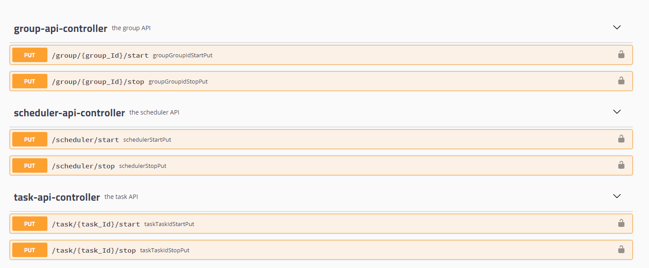
Management Api

Slide 16
20k stress test
20.000 Tasks ~ 8 min scheduling and dispatching
20.000 Tasks ~ 18 min finishing (dependant on feedback)

