Slide 1
DIABETIC RETINOPATHY HEMORRHAGE DETECTION
The aim is to extract the actual hemorrhage region from a suspicious seed point using localized adaptive thresholding.
Total Dataset Size distribution
Dataset: DIARETDB1
Training samples: 574 (64%)
Validation samples: 144 (16%)
Test samples: 180 (20%)
total - 898 images
Implementation: Preprocessing → Seed Extraction → SWAT Segmentation → Feature Analysis → Classification

Slide 2
PROBLEM STATEMENT
Diabetic Retinopathy (DR) is a major cause of preventable blindness.
Hemorrhages are one of the earliest clinical signs.
Manual screening is:
Time-consuming
Requires ophthalmologists
Objective: Automatically detect retinal hemorrhages from fundus images using image processing .

Slide 3
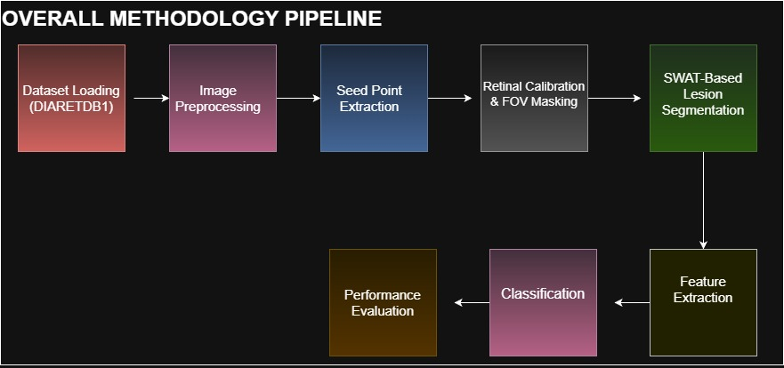
OVERALL METHODOLOGY PIPELINE

Slide 4
METHODOLOGY
1. Data Collection
Retinal fundus images were obtained from the DIARETDB1 dataset.
The dataset contains labeled images indicating the presence or absence of hemorrhages.
Total images used: 898
Training: 574
Validation: 144
Testing: 180
2. Data Preprocessing
Extracted green channel for better hemorrhage visibility.
Applied CLAHE to enhance contrast.
Performed gamma correction for illumination normalization.
Used matched filtering and Otsu thresholding for seed point detection.
3. SWAT-Based Segmentation
Extracted 128×128 local windows around detected seed points.
Applied adaptive thresholding.

Slide 5
5. Model Selection & Training
Implemented multiple CNN architectures:
SimpleCNN (custom-built)
BiraNet (custom with Batch Normalization)
LeNet-5 (classic CNN)
InceptionV3 (pretrained transfer learning)
Trained for up to 20 epochs.
6. Model Evaluation
Evaluated models using:
Accuracy
Sensitivity (Recall)
Specificity
Precision
Confusion Matrix
ROC–AUC Curve
Applied EarlyStopping and learning rate scheduling to optimize training.
7. Final Model Selection
InceptionV3 achieved highest AUC (0.91).

Slide 6
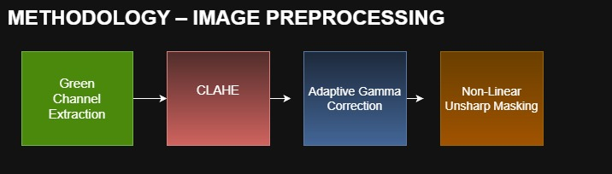
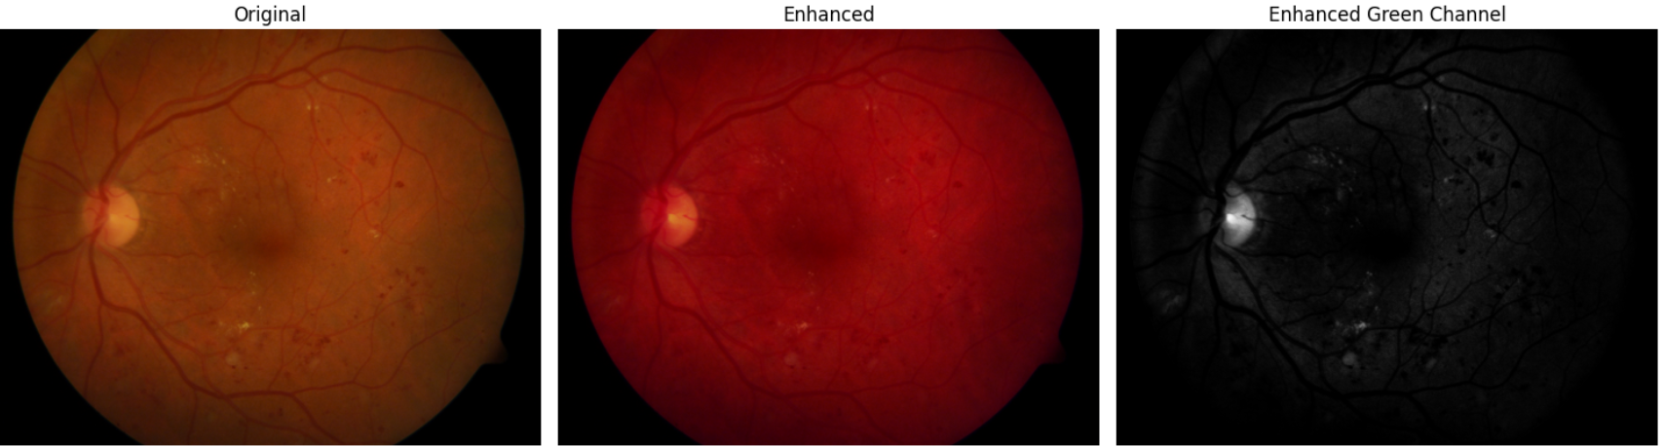
IMAGE PREPROCESSING
output
output

Slide 7
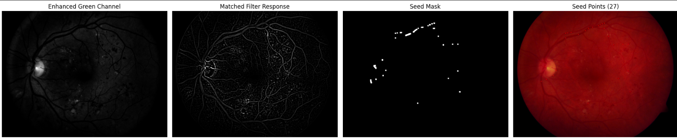
Output: After seed extraction
Detects bleeding patterns
Identifies suspicious regions
Real hemorrhage region -> Slightly darker than surrounding retina

Slide 8
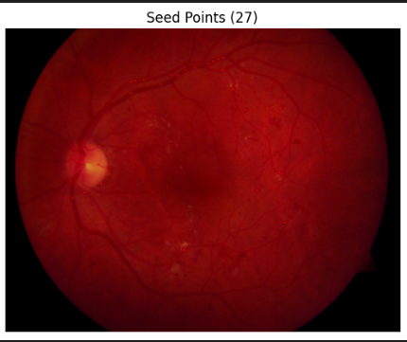
Lesion Detection and SWAT SEGMENTATION
First, suspicious regions were identified using seed point extraction.
Then, SWAT-based segmentation was applied to precisely isolate intraretinal hemorrhages.
For each seed point:
Extract local 128×128 window
Apply segmentation (SWAT)
Generate lesion mask
Medical Interpretation:
Focused analysis mimics ophthalmologist zooming into suspicious region.

Slide 9
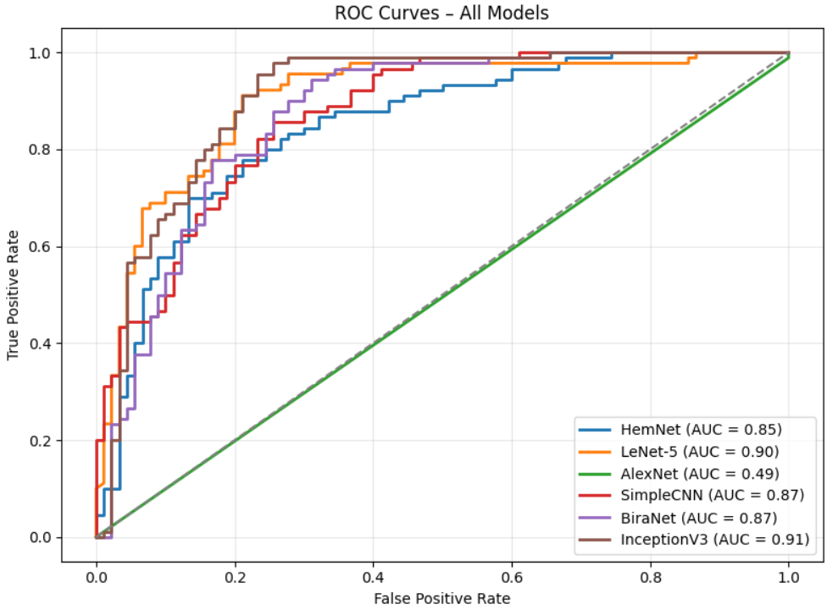
InceptionV3 > LeNet-5 > SimpleCNN = BiraNet > HemNet >> AlexNet
InceptionV3:
Best discrimination between hemorrhage and non-hemorrhage

Slide 10
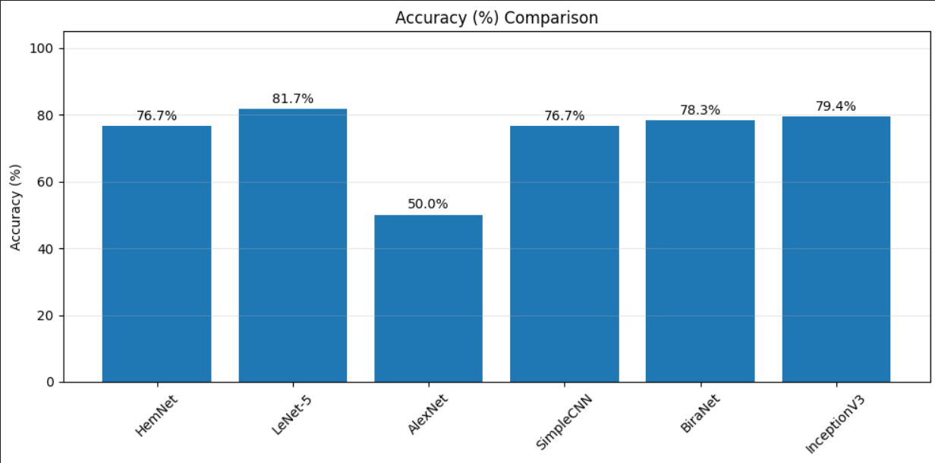
Although LeNet-5 achieved the highest accuracy (81.7%),
InceptionV3 obtained the highest AUC (0.91), indicating superior overall discriminative capability.
Since AUC is more reliable for medical screening evaluation, InceptionV3 can be considered the best-performing model in this study.

Slide 11
Results
Model | Accuracy (%) | AUC Score
InceptionV3 | 79.4% | 0.91 ⭐
LeNet-5 | 81.7% ⭐ | 0.90
BiraNet | 78.3% | 0.87
SimpleCNN | 76.7% | 0.87
->Accuracy measures the percentage of correctly classified samples at a fixed decision threshold (usually 0.5), showing overall prediction correctness.
->In contrast, AUC (Area Under the ROC Curve) evaluates how well the model distinguishes between hemorrhage and non-hemorrhage across all possible thresholds, reflecting its overall discriminative ability.
->In medical diagnosis tasks, AUC is generally more reliable because it better captures the trade-off between sensitivity and false positives

