Slide 1
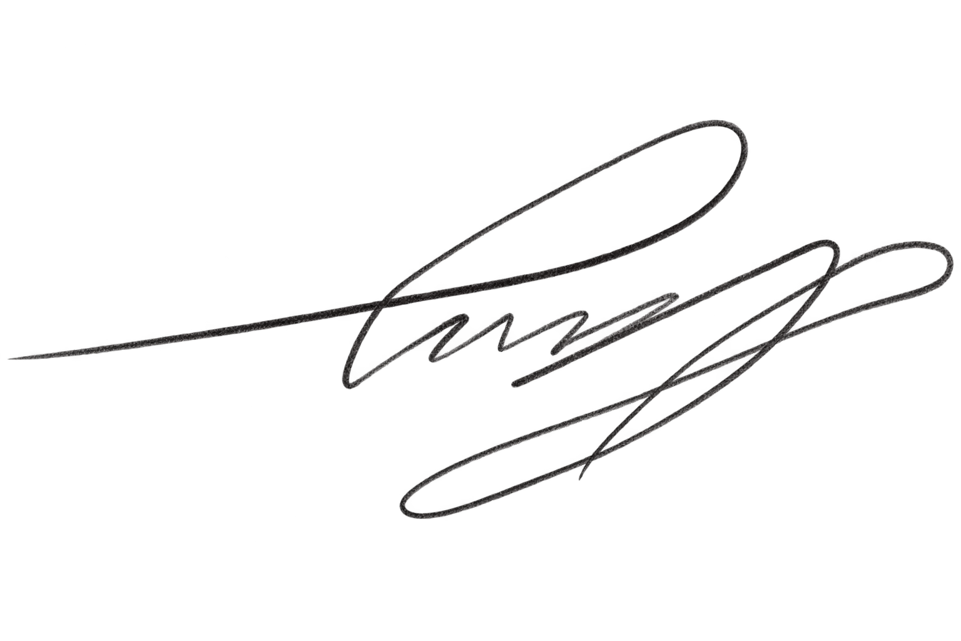

>
>
CSC
WEBB COMPUTER SCIENCE FOR CHANGE
CSC BACK-TO-SCHOOL HACKATHON
CERTIFICATE OF
Silver Award
PRESENTED TO
Amrito Kundu
Awarded for earning second place at the CSC Back-to-School Hackathon.
Harry Chen
October 12, 2026
Ayaan Bhagat
CSC PRESIDENT
DATE AWARDED
CO-PRESIDENT
Notes:
Source for recipient names, judging awards, and winner categories: organizer screenshots supplied by the user.
1A3868EE-E120-47A9-A7F7-0F4A1460887D_4_5005_c.jpeg
F1BA4873-49E8-4B71-AA05-BB5EB2ECC8C3_4_5005_c.jpeg
923CB504-6588-47E6-AAED-7A4CCCD13315_4_5005_c.jpeg
9977614E-2B03-4018-B8AA-8AE97939A7B3_4_5005_c.jpeg
7D3402DF-66DC-4A49-8B44-3481E0BDA4E5_4_5005_c.jpeg

