Slide 1
Integrating Istio & Calico on AKS
Drew Oetzel, Brandon Jozsa, Jordan Nielsen,
Chris Wiederspan

Slide 2
Microservices
Service A
Service B
Service C

Slide 3
Microservices
Service A (Java)
Service B (Python)
Service C (Go)

Slide 4
Challenges with Distributed Systems
●
Deployment
●
Resiliency
●
Networking
●
Security

Slide 5
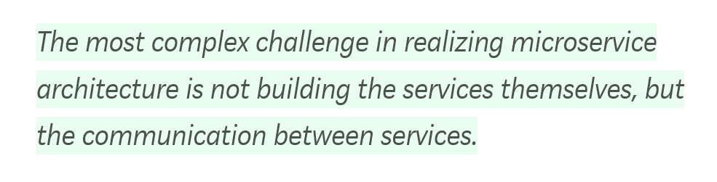
Microservices, life is not a bed of roses…
https://medium.com/microservices-in-practice/service-mesh-for-microservices-2953109a3c9a

Slide 6
AKS/Kubernetes to the Rescue
Azure managed control plane
Automated upgrades, patches
High reliability, availability
Easy, secure cluster scaling
Self-healing
API server monitoring
At no charge
App/ workload definition
Self-managed master node(s)
User
Kubernetes API endpoint
API server
etcd Store
Scheduler
Controller Manager
Cloud Controller
Schedule pods over private tunnel
Customer VMs
Docker
Docker
Docker
Docker
Docker
Pods
Pods
Pods
Pods
Pods
Notes:
A Kubernetes cluster is typically made up of
Master nodes for system components like the API server, etcd store, and scheduler
Agent nodes for user container workloads
Managing the cluster involves:
Monitoring the API server
Ensuring HA/DR for the etcd store
Safely managing upgrades across Kubernetes versions
Safely scaling the cluster in and out
Patching master and agent VM nodes
And on and on…
This is complex, error-prone, and expensive
A managed service like AKS moves those tasks to the cloud provider

Slide 7
Kubernetes is amazing, but it doesn’t do everything
But it doesn’t help with higher-level problems, such as L7 metrics, traffic splitting, rate limiting, circuit breaking, etc.

Slide 8


Popular tools
●
Eureka – Service Registry
●
Ribbon – Client side load balancer
●
Hystrix – Circuit Breaker
●
Zipkin – Distributed Tracing

Slide 9
“Micro” Services?
Microservice A
Actual Service A
Ribbon
Hystrix
Metrics
Tracer

Slide 10
“Micro” Services?
Microservice B
Microservice A
Actual Service A
Actual Service B
Library 1
Library 5
Library 2
Library 6
Library 3
Library 7
Library 4
Library 8

Slide 11

What is Envoy?
service proxy, developed by Lyft
written in C++, highly parallel, non-blocking L3/4 network filter
out of the box L7 filters HTTP 2, including gRPC
baked in service discovery/health checking advanced load balancing
stats, metrics, tracing
●
●
●
●
●
●
●
●

Slide 12

Sidecar model
A kind of deployment in Kubernetes
Microservice A
Envoy
Microservice B
Envoy
Actual Service A
Actual Service B
Pod
Pod

Slide 13
Service communication
Without Envoy
Microservice A Microservice B
Actual Service A
Actual Service B
calls http://serviceB
Pod
Pod

Slide 14
Service communication
With Envoy
Microservice A
Microservice B
Actual Service A
Actual Service B
calls http://serviceB
Envoy
Envoy
Pod
Pod

Slide 15
Service Mesh
Microservice 1
Microservice 2
Microservice N
Actual Service 1
Actual Service 2
Actual Service N
. . .
Envoy
Envoy
Envoy

Slide 16
Configure a fleet of Envoys can be verbose and error prone without automation.
We need a Control Plane.

Slide 17

Meet Istio Service Mesh

Slide 18

What is Istio?
Control plane for a service mesh
Abstracts Envoy concepts and configurations Easy to operate: YAML files a la Kubernetes
●
●
●
●
Kubectl or Istioctl can be used
Created by Lyft with the help of other companies New project, just reached 1.0
●
●

Slide 19
Istio Features
Security
Service-to-service encryption
Policy-based access (ACL), authentication, authorization
Traffic management
Policy-based routing
Load splitting
Blue/Green deploy
Observability
Render service graph
Provide infrastructure for tracing

Slide 20
Security
Mutual TLS (mTLS)
Service identity
Authentication
Origin
Service-to-service
Authorization
Policy-based access control (network ACL)

Slide 21
Traffic management
Ingress infrastructure
Policy-based routing (L4, L7)
Traffic “tee”
Request routing, flighting, canary (blue/green)
Failure recovery
Timeouts, service retry, circuit breaking

Slide 22
Observability
Telemetry
qps, latency, bandwidth
Visualize service graph
Infrastructure for tracing
Span id generation/propagation

Slide 23
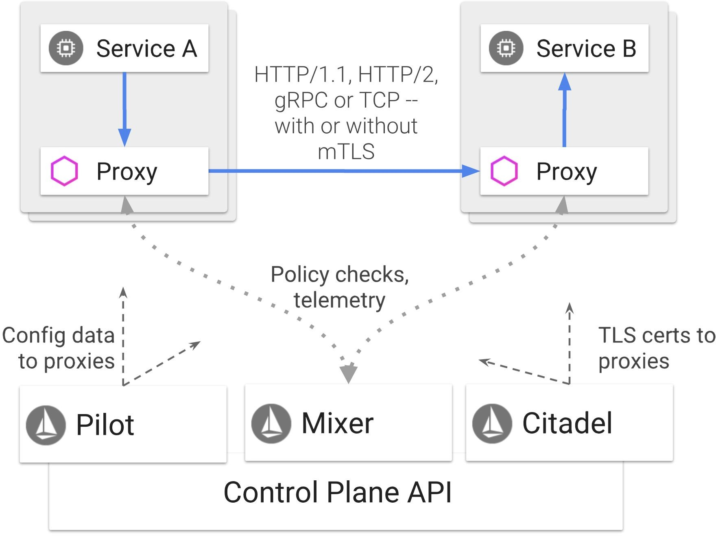
Istio: an introduction

Slide 24



Istio: an introduction
Control Plane API
Pilot
Config to Envoys
Envoy
SvcA
Service A

Slide 25
Istio: an introduction
k8s consul zk
Control Plane API
Pilot
Config to Envoys
Data plane API
Envoy
SvcA
Service A

Slide 26
Pilot
Istio, the packet’s-eye view
Ingress Routing
Traffic Mirroring
Traffic Shifting
Canary Deployments
Circuit Breaking
Fault Injection

Slide 27
Istio: an introduction
Control Plane API
Pilot
Config to Envoys
Envoy
SvcA
Service A
Service B

Slide 28
Istio: an introduction
Control Plane API
Pilot
Mixer
Config to Envoys
Policy checks, Telemetry
Envoy
Envoy
SvcA
SvcB
Service A
Service B

Slide 29

Istio: an introduction
Control Plane API
Pilot
Config to Envoys
REPORT
prom ES
Mixer
Mixer fat client
Mixer fat client
Envoy
Envoy
SvcA
RBAC
Rate limit
SvcB
CHECK
Service A
Service B

Slide 30
Mixer
Istio: an introduction
Check
ACLs / Authorization
Rate Limiting
Report
Logs
Metrics
Tracing

Slide 31

Istio: an introduction
Control Plane API
Pilot
Mixer
Config to Envoys
Policy checks, Telemetry
Envoy
Envoy
SvcA
SvcB
Service A
Service B

Slide 32

Istio: an introduction
Control Plane API
Pilot
Mixer
Citadel
Config to Envoys
TLS certs to Envoys
Policy checks, Telemetry
Envoy
Envoy
SvcA
SvcB
Service A
Service B

Slide 33


Istio: an introduction
Control Plane API
Pilot
Mixer
Citadel
Config to Envoys
TLS certs to Envoys
Policy checks, Telemetry
Envoy
Envoy
SvcA
SvcB
Service A
Service B

Slide 34

Istio: an introduction
Control Plane API
etcd
API Server
Pilot
Mixer
Citadel
Config to Envoys
TLS certs to Envoys
Policy checks, Telemetry
kubectl
Envoy
Envoy
SvcA
SvcB
Service A
Service B

Slide 35






@m165
Istio: an introduction
Control Plane API
Pilot
Mixer
Citadel
Config to Envoys
TLS certs to Envoys
Policy checks, Telemetry
Envoy
Envoy
Envoy
Envoy
Envoy
Envoy
Envoy
Envoy
SvcA
SvcB
Envoy
Envoy
Ingress
Service A
Service B
Egress

Slide 36
What pilot can do?
Microservice A
Microservice B
Actual Service A
Actual Service B
Envoy
Envoy
Traffic control – enforce route rules & policies Resiliency – circuit breaker, timeouts, retries
●
●

Slide 37
What mixer can do?
Quota / API Management Telemetry (Prometheus, ...) Tracing (Jeager, …)
Your own integration (pluggable model)
●
●
●
●

Slide 38
What citadel can do?
Microservice A
Microservice B
Actual Service A
Actual Service B
Mutual TLS
Envoy
Envoy
Enforce mTLS between services
Along with mixer and pilot allows authorization and auditing
●
●

Slide 39
Demo

