Slide 1

Facial Recognition using Convolution Neural Network
Batch No: B-01 Project Guide:
M. Sai Rahul (164G1A0589) Dr. T. Hitendra Sarma Ph.D.
Syam Kakarla (164G1A05B0) ` Professor
G. Priyaranjan Reddy (164G1A0571)
C. Sai Charan Singh (164G1A0584)
Srinivasa Ramanujan Institute of Technology
Department of Computer Science & Engineering

Slide 2
Abstract
Facial recognition is one of the popular biometric process which is widely used in surveillance, security, criminal identification, etc.
Deep learning is a subset of machine learning which uses artificial neural networks inspired by the human brain to solve supervised learning (Classification) problems

Slide 3
Contd..
Convolution Neural Networks is one of the neural network architectures, widely used in face recognition problems.
This project proposes a Convolutional Neural Networks (CNN) based facial recognition system

Slide 4
Contd..
This proposed facial recognition system includes :
Building the new face dataset
Data Preparation
Data Analysis
Building the CNN model
Training
Evaluation
Hyper Parameter Tuning
Prediction

Slide 5
Hardware and Software Requirements
Hardware :
CPU: 1xsingle core hyper threaded
RAM: .~12.6 GB Available
Disk: ~320 GB Available
GPU: 1xTesla K80
Software :
Python3
Jupyter Notebook
Scikit Learn
TensorFlow

Slide 6
Existing System
There are several classification models used for face recognition like:
Eigen Face Recognition
Fischer Face Recognition
Local Binary Pattern Histogram ( LBPH )
Some pre-processing techniques includes:
PCA
LDA

Slide 7
Proposed System
The proposed system is based on convolutional neural networks which performs feature extraction automatically
This project aims to develop an end-to-end process to build a custom facial recognition system using convolutional neural network.

Slide 8
Problem Definition
To develop a real time facial recognition system the existing architectures may or may not be handy with real time data.
In order to deal with such real time data and the projects aims to build a CNN model with high accuracy

Slide 9

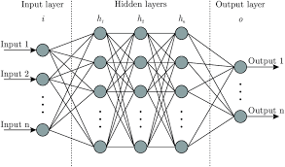
Problem Definition
Fully Connected Neural Network:
Feature Extraction
…
Vector

Slide 10
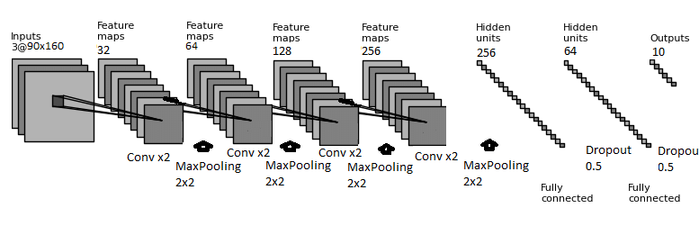
Problem Definition
Convolutional Neural Network:

Slide 11
Planning
1 : Data Collection 2 : Data Cleaning and Exploratory Data Analysis
3 : Model building, training and hyperparameter tuning
4 : Developing Web Application
5 : Documentation and Publication

Slide 12
Literature Survey
[1] Face Recognition Based on Convolutional Neural Network
A modified CNN architecture by adding two normalization operations to two of the layers
The normalization operation used is Batch Normalization
The CNN architecture uses Softmax to classify the faces
In the experimental part Georgia Tech Database is used
An accuracy of about 98.8 is obtained.
Coşkun, Musab, et al. "Face recognition based on convolutional neural network." 2017 International Conference on Modern Electrical and Energy Systems (MEES). IEEE, 2017.

Slide 13
Literature Survey
[2] Illumination Invariant Face Recognition using Convolutional Neural Networks
The problem of face recognition under non-uniform illumination using deep convolutional neural networks (CNN) is addressed
The symmetry of facial information is exploited to improve the performance of the system by considering the horizontal reflections of the facial images
Experiments conducted on Yale facial image dataset demonstrate the efficiency of the proposed approach
Fuzzy fischer approach was used in this problem
Near infrared (NIR) has the potential to overcome the problems associated with visible and thermal IR face recognition which is more robust against illumination variations and face detection

Slide 14
Literature Survey
Ramaiah, N. Pattabhi, Earnest Paul Ijjina, and C. Krishna Mohan. "Illumination invariant face recognition using convolutional neural networks." 2015 IEEE International Conference on Signal Processing, Informatics, Communication and Energy Systems (SPICES). IEEE, 2015.

Slide 15
Literature Survey
[3] A Convolutional Neural Network based on TensorFlow for Face Recognition
A Convolutional Neural Network (CNN) based on TensorFlow, an open source deep learning framework, is proposed for face recognition
Experimental results show that the proposed method has better recognition accuracy and higher robustness in complex environment
They have used Adaboost algorithm
Yuan, Liping, et al. "A convolutional neural network based on TensorFlow for face recognition." 2017 IEEE 2nd Advanced Information Technology, Electronic and Automation Control Conference (IAEAC). IEEE, 2017.

Slide 16
Literature Survey
[4] When Face Recognition Meets with Deep Learning: an Evaluation of Convolutional Neural Networks for Face Recognition
It uses LFW database (Labelled Faces in the Wild)
It also gives a major comparison of 3 published CNNs like DeepFace, DeepID, WebFace.
Quantitatively compares the architectures of CNNs and evaluates the effect of different implementation choices.
Hu, Guosheng, et al. "When face recognition meets with deep learning: an evaluation of convolutional neural networks for face recognition." Proceedings of the IEEE international conference on computer vision workshops. 2015.

Slide 17
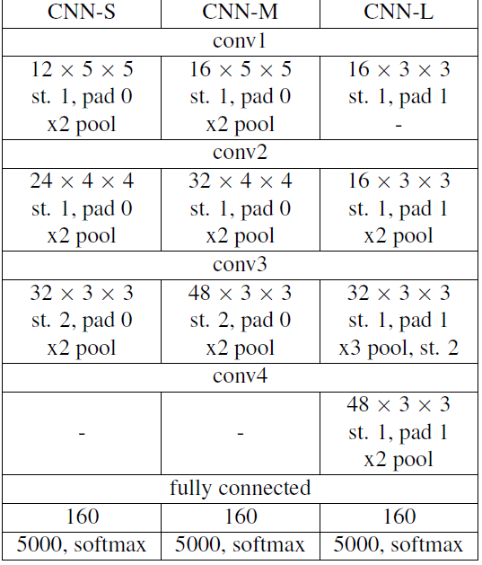
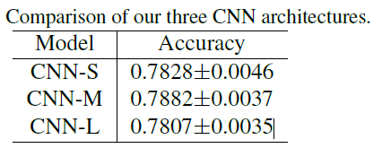
Literature Survey (Cont..)

Slide 18
References
[1] Coşkun, Musab, et al. "Face recognition based on convolutional neural network." 2017 International Conference on Modern Electrical and Energy Systems (MEES). IEEE, 2017.
[2] Ramaiah, N. Pattabhi, Earnest Paul Ijjina, and C. Krishna Mohan. "Illumination invariant face recognition using convolutional neural networks." 2015 IEEE International Conference on Signal Processing, Informatics, Communication and Energy Systems (SPICES). IEEE, 2015.

Slide 19
References
[3] Yuan, Liping, et al. "A convolutional neural network based on TensorFlow for face recognition." 2017 IEEE 2nd Advanced Information Technology, Electronic and Automation Control Conference (IAEAC). IEEE, 2017.
[4] Hu, Guosheng, et al. "When face recognition meets with deep learning: an evaluation of convolutional neural networks for face recognition." Proceedings of the IEEE international conference on computer vision workshops. 2015.

Slide 20
Thank you
Queries
?
Notes:
DOS VIDANYA

