Slide 1
STATISTICS FUNDAMENTALS, PART 2

Slide 2
TODAY’S LEARNING OBJECTIVES
STATISTICS FUNDAMENTALS, PART 2
Feature Selection
Numerical & Categorical variables
Validate your findings using statistical analysis
Are my variables impactful? If so, by how much?
Correlation, Chi-Squared, T-Test
Correlation vs. Causation
Sampling Bias

Slide 3
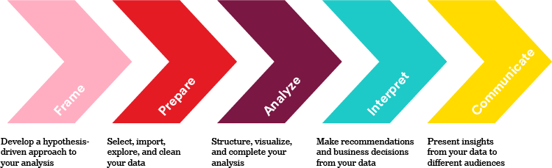
STATISTICS FUNDAMENTALS, PART 2
We are here

Slide 4
INTRODUCTION
FEATURE SELECTION

Slide 5
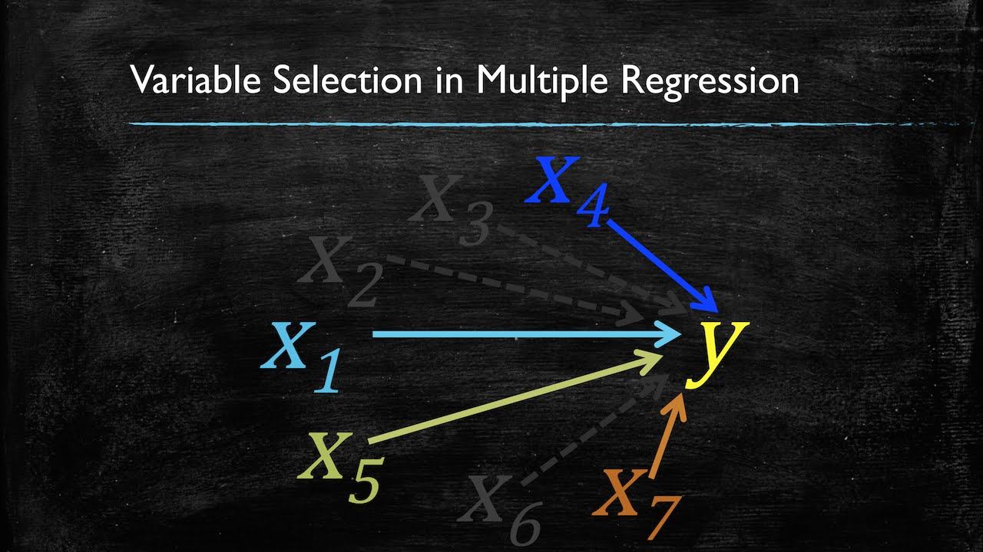
FEATURE SELECTION
Helps you create an accurate predictive model by choosing features that give you as good or better accuracy while requiring less data.

Slide 6
FEATURE SELECTION
Benefits
Removes unneeded, irrelevant and redundant attributes from data that may decrease the accuracy of the model.
Reduces complexity: simpler and easier to understand/explain
Requires less data: less computing

Slide 7
FEATURE SELECTION
Techniques
Filter Methods: utilize statistical tool to assign scores to each feature i.e Univarate feature selection.
Numerical vs. Numerical – Correlation
Categorical vs. Numerical (A/B Testing) - ANOVA/T-Test
Categorical vs. Categorical - Chi-Squared Test
Wrapper Methods: run a model using all features and prune them down based on the strongest features
Recursive Feature Elimination (RFE)
Embedded Methods: prunes features while you create a model
LASSO algorithm

Slide 8
INTRODUCTION
UNIVARIATE
FEATURE
SELECTION

Slide 9
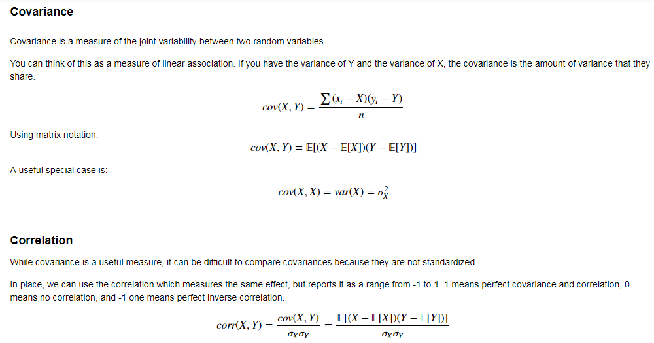
UNIVARIATE FEATURE SELECTION

Slide 10
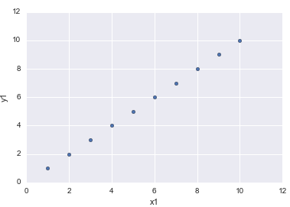
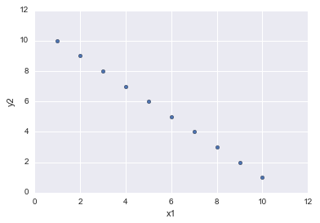
UNIVARIATE FEATURE SELECTION
Correlation is the measure of interdependence or association between two variables. It is measured on a scale of -1 (negatively associated) to 1 (positively associated).
Correlation of 1
Correlation of -1

Slide 11
INTRODUCTION
A/B TESTING

Slide 12
UNIVARIATE FEATURE SELECTION
How can we prove a statistically significant difference between two groups of observations?
Imagine we are testing the health of smokers vs. non-smokers. At a cursory glance, our results may show that smokers are marginally healthier than non-smokers.
Are they healthier due to random chance or is there a statistically significant difference? Maybe we happened to assemble a strange group of smoking triathletes and a group of non-smoking couch potatoes.

Slide 13
HYPOTHESIS TESTING STEPS
Then, you would identify the proper statistical procedure/test to evaluate the chosen hypothesis.
The result of the test is some evidence that the null hypothesis is true. If that evidence is small, you would reasonably reject the null hypothesis and accept the alternate hypothesis.
If that evidence is large, then you can’t reject the null hypothesis and accept the alternate hypothesis. However, this doesn’t mean we accept the null hypothesis. It just simply means that a verdict of “not null” was rendered.

Slide 14
HYPOTHESIS TESTING AND P-VALUES
To be more specific, the result of a hypothesis test is called a p-value (or probability value) and it represents the probability that the our data could have reasonably occurred (or been generated) if the null hypothesis was true.
A small p-value would indicate the it’s not very likely that this data would have occurred under the null hypothesis while a large p-value would indicate that it is likely that this data would have occurred.
Notes:
Generally, 5% (or .05) is the standard cutoff for a p-value. This means that p-values below .05 can be interpreted as enough statistical evidence to reject the null hypothesis.
This cutoff value is sometimes referred to as α (alpha) or a sensitivity level for our statistical experiment.

Slide 15
CHOOSING A HYPOTHESIS TEST
There are a lot of hypothesis tests to choose from and many of them allow you to test similar hypotheses using your data so how do you choose one?
Assumptions – Every hypothesis test comes with its own set of assumptions that need to be met in order to use it. If your data does not meet these assumptions, your results will be nonsensical.
Specifics – Pick the hypothesis test that best aligns to the question you have about your data. Choosing a more general hypothesis test means you can only make a general claim about your data.

Slide 16
CHOOSING A HYPOTHESIS TEST
Process of conducting a hypothesis test
Collect Sample Data
Determine test and calculate test statistic
Validate against appropriate distribution
Is this sample ‘weird’ or ‘normal’?
Determine if statistically significant

Slide 17
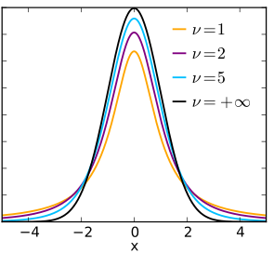

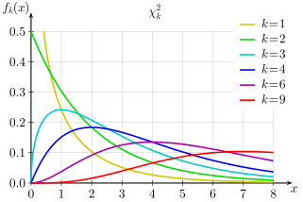
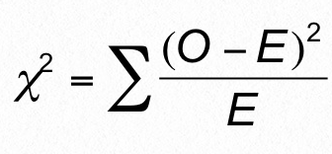
HANDY HYPOTHESIS TESTS
Test | Description | Assumptions | Formula for test statistic | Distribution shape
T-test | Tests whether there are any statistically significant differences in means between groups | Data is normally distributed (or is large enough for CLT to apply). The standard deviation of the true/larger population is unknown. The two data sets are independent.
Chi-Squared | Checks if two categorical variables are independent by looking at observed frequencies vs. expected frequencies. | The sampling method is simple random sampling. The variables under study are each categorical. If sample data are displayed in a contingency table, the expected frequency count for each cell of the table is at least 5.
V = degrees of freedom
k = degrees of freedom

Slide 18
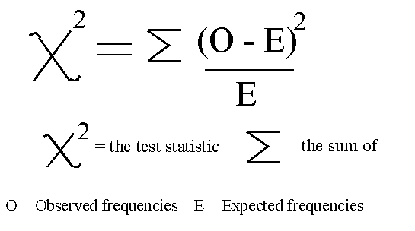
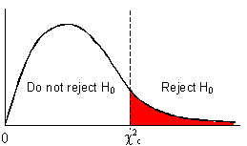
UNIVARIATE FEATURE SELECTION
Chi-Squared Tests check if two categorical variables are independent by looking at observed frequencies vs. expected frequencies. Our base assumption is that the two variables are independent.
We first calculate a test statistic based on our data. We then compare that test statistic to a critical value from the chi-squared distribution.

Slide 19
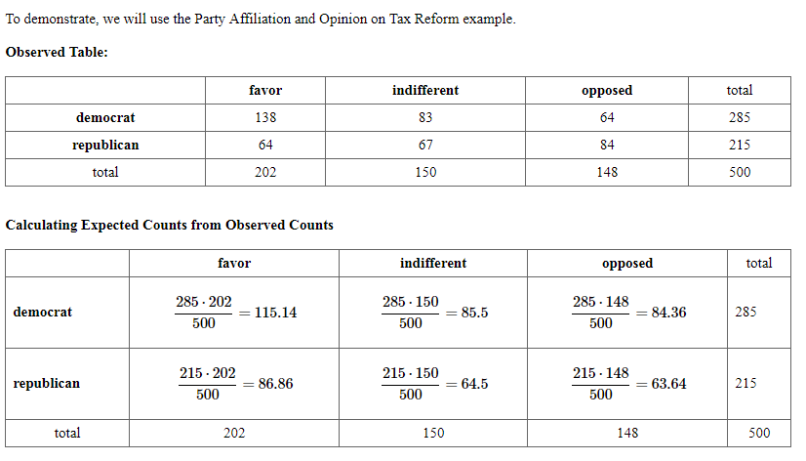
UNIVARIATE FEATURE SELECTION
Example: are party affiliation and opinion on tax reform independent?

Slide 20
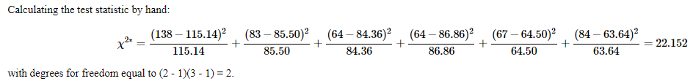
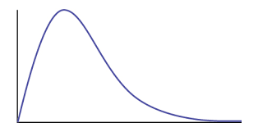
UNIVARIATE FEATURE SELECTION
Example: are party affiliation and opinion on tax reform independent?
Degrees of freedom = (# of columns -1)(# of rows – 1)
We take the test statistic (22.152) and compare it to a value from the chi-squared distribution.
As you can see, it’s much higher than the critical value (at p=0.05) which means the probability of observing this sample set is very, very low (less than 5%).
Therefore, we reject the base assumption and assume that political affiliation and opinion on tax reform are dependent.
Reject base assumption if Χ² >5.99
Don’t reject base assumption if Χ² <5.99
Χ² = 5.99
Χ² = 22.152

Slide 21
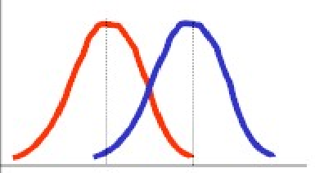
UNIVARIATE FEATURE SELECTION
T-Tests are used to test whether there are any statistically significant differences in means between groups.
“Health level” of smokers
“Health level” of non-smokers

Slide 22
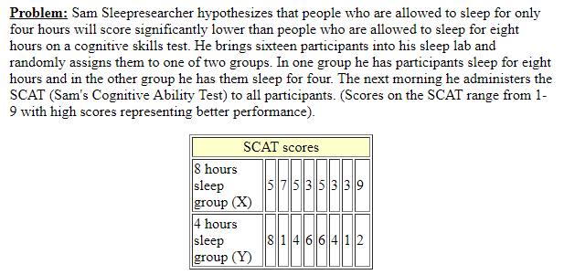
UNIVARIATE FEATURE SELECTION
Example: does amount of sleep affect SCAT scores?

Slide 23
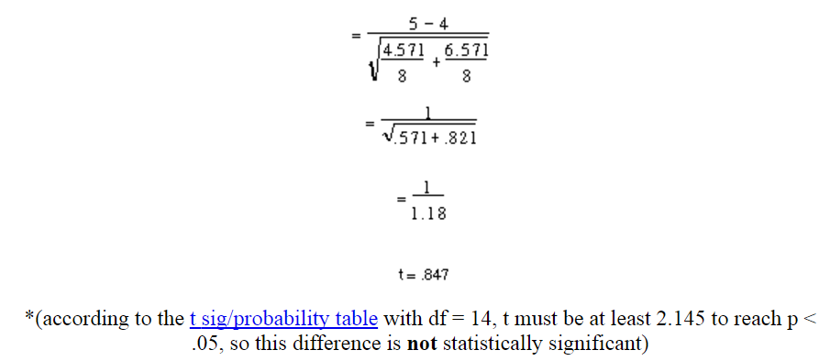
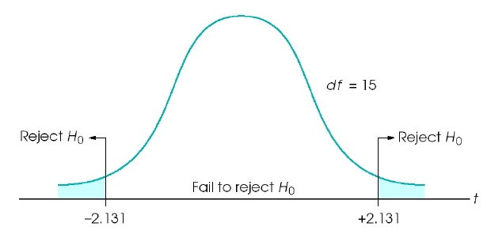
UNIVARIATE FEATURE SELECTION
Example: does amount of sleep affect SCAT scores?
T = 0.847
T = 0.847
-2.145
2.145

Slide 24
UNIVARIATE FEATURE SELECTION
The chart below can help you determine which statistical tests to apply to your feature and response variables
Response Variable Type
 | Numerical | Categorical
Numerical | Correlation | ANOVA / T-Test
Categorical | ANOVA / T-Test | Chi-Squared Test
Independent Variable Types

Slide 25
INTRODUCTION
CORRELATION VS. CAUSATION

Slide 26
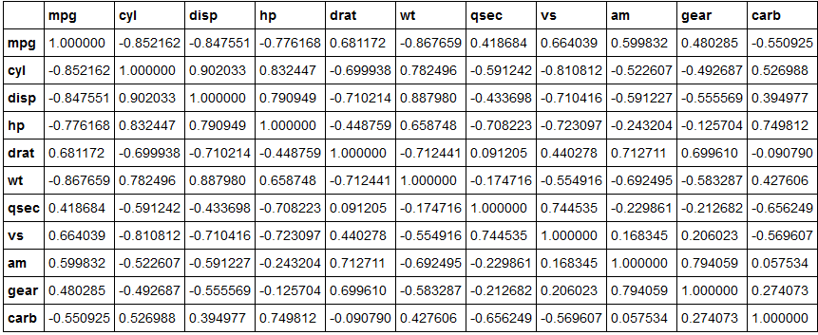
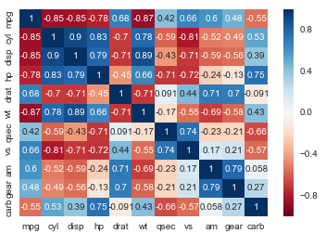
CORRELATION MATRICES AND COLINEARITY
Correlation is particularly useful for quickly determining the association between several variables in a large dataset. Most often, this is represented as a correlation matrix.
This is also useful for identifying collinearity or a lack of independence between variables in a dataset which is key to avoid for many types of statistical models.

Slide 27
CAUSATION AND CORRELATION
Correlation does not equal causation. It is simply a measure of association.
There is also often a lack of understanding of the difference between causation and correlation.
Understanding this difference is critical in the data science workflow, especially when Identifying and Acquiring data.
Additionally, this comes up when we Present our results to stakeholders as we don’t want to overstate what our model measures.
Be careful not to say “caused” when you really mean “associated” or “coincided with.”

Slide 28
LECTURE
WHAT IS CAUSATION?

Slide 29
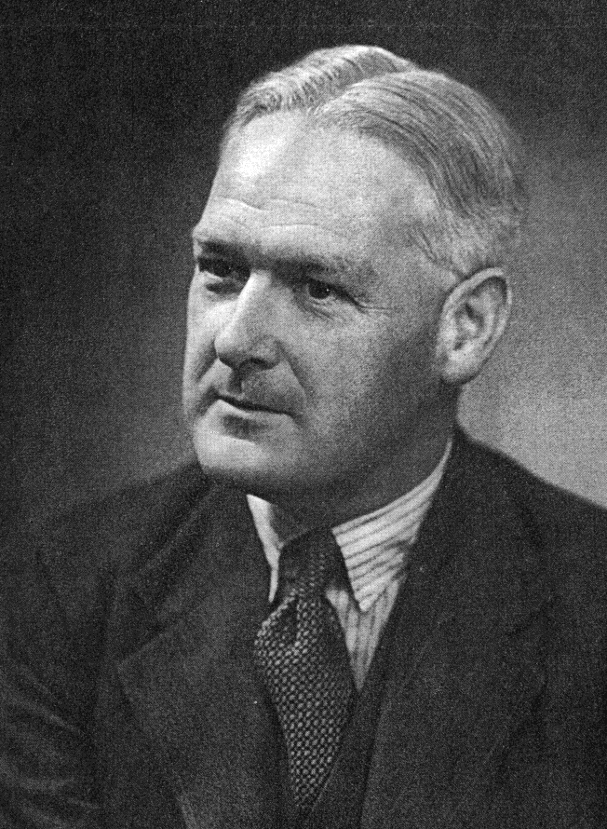
CAUSAL CRITERIA
Causal criteria is one approach to assessing causal relationships. However, it’s very hard to define universal causal criteria.
One attempt that is commonly used in the medical field is based on work by Bradford Hill.

Slide 30
CAUSAL CRITERIA
Criteria | Description
Strength of association | Is there a strong association between the predictor and outcome variables?
Consistency | Does the association remain under different or varying circumstances?
Specificity | Is the predictor variable causing the observed effect? Could there potentially be other variables involved?
Temporality | Does the predictor variable precede (or come before) the outcome variable?
Dose Response Relationship | Does an increase in the predictor variable increase the effect on the outcome variable?
Plausibility | Does this relationship make sense? Would someone else believe it?
Coherence | Is this result consistent with similar studies of the predictor and outcome variables?
Experiment | Was the evidence obtained from a properly designed experiment?
Analogy | Is there a similar association found in an adjacent subject area?
Notes:
Source: http://www.southalabama.edu/coe/bset/johnson/bonus/Ch11/Causality%20criteria.pdf

Slide 31
CAUSAL CRITERIA EXAMPLE
Criteria | Example Description
Strength of association | The lung cancer rate for smokers was quite a bit higher than for nonsmokers (e.g., one study estimated that smokers are about 35% more likely than nonsmokers to get lung cancer).
Consistency | Different methods (e.g., prospective and retrospective studies) produced the same result. The relationship also appeared for different kinds of people (e.g., males and females)
Specificity | Lung cancer is best predicted from the incidence of smoking.
Temporality | Smoking in the vast majority of cases preceded the onset of lung cancer.
Dose Response Relationship | Data showed a positive, linear relationship between the amount smoked and the incidence of lung cancer.
Notes:
Source: http://www.southalabama.edu/coe/bset/johnson/bonus/Ch11/Causality%20criteria.pdf

Slide 32
CAUSAL CRITERIA EXAMPLE
Criteria | Example Description
Plausibility | Biological theory of smoking causing tissue damage which over time results in cancer in the cells was a highly plausible explanation.
Coherence | The conclusion (that smoking causes lung cancer) “made sense” given the current knowledge about the biology and history of the disease.
Experiment | Tar painted on laboratory rabbits’ ears was shown to produce cancer in the ear tissue over time. Hence, it was clear that carcinogens were present in tobacco tar.
Analogy | Induced smoking with laboratory rats showed a causal relationship. It, therefore, was not a great jump for scientists to apply this to humans.
Notes:
Source: http://www.southalabama.edu/coe/bset/johnson/bonus/Ch11/Causality%20criteria.pdf

Slide 33
CAUSAL CRITERIA
Establishing causality is hard. As a result, most analyses find an association instead.
Hill’s Criteria are a great starting point, they aren’t necessarily exhaustive and elements may not be particularly relevant for non-medical fields.
Scenario: crime rates and abortions
Was the decrease in crime rates in the earl 90s caused by Roe v. Wade?

Slide 34
INTRODUCTION
CONFOUNDING EFFECTS

Slide 35
CONFOUNDING
Often times, associations may be influenced by another confounding factor.
In the example of ice cream and homicides, you might find that an increase in ice cream sales corresponds to an increase in the homicide rate. However, we know that doesn’t make logical sense.
This normally points to the presence of a confounding factor which would explain both ice cream and homicides (e.g., summer weather).

Slide 36


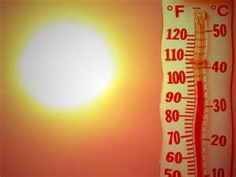
CONFOUNDING

Slide 37
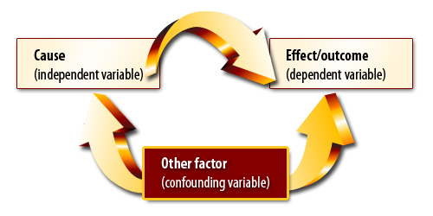
CONFOUNDING
Confounding variables often hide the true association between causes and outcomes.

Slide 38
DIRECTED ACYCLIC GRAPH
These types of graphics are called Directed Acyclic Graph (or DAGs) and can help determine which variables are most important for your model.
It also provides a nice way to visually demonstrate the logic of your models especially if they become more complex than ice cream and homicides.
A DAG always includes at least one predictor variable and one outcome variable.

Slide 39
A FEW KEY TAKEAWAYS
Subject matter expertise is key in identifying potential biases in your analysis. There is no amount of statistics that can replace subject matter expertise.
A DAG can be a useful tool for thinking through the logic of your model.
There is a difference between causation and correlation. Statistics usually show correlation/association, not causation.
The “right” data is important. Your analysis is only as good as your understanding of the problem and the data you have to work with. Garbage in garbage out.

Slide 40
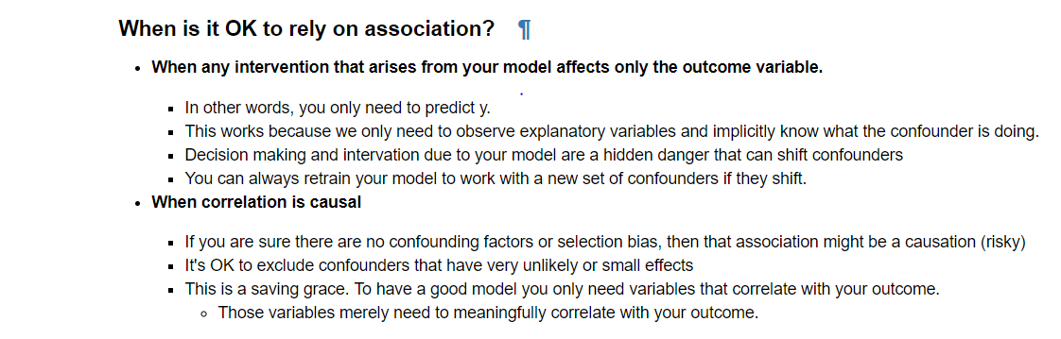
A FEW KEY TAKEAWAYS

Slide 41
INTRODUCTION
SAMPLING BIAS

Slide 42
BIAS (AND CONFOUNDING)
Scenario: Suppose we were building a model for a sales team to estimate the amount of sales with TV and internet ads as our predictors.
What if the TV ads were run in November/December (peak buying season) while internet ads were run during February/March (low buying season)?
If we compare the two, we’re likely to reach the wrong conclusion! Seasonal trends are affecting our associations.
This is an example of bias and confounding. It isn’t that TV ads are better than Google ads, but that November/December is a better buying season than February/March.

Slide 43
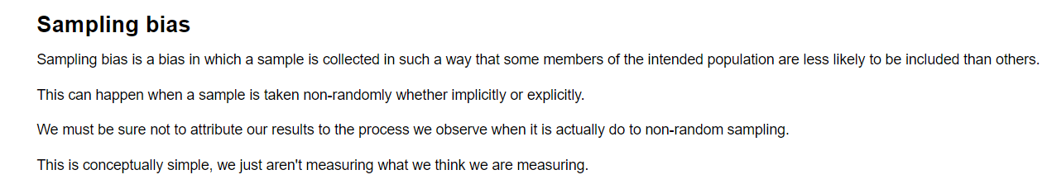
SAMPLING BIAS

Slide 44
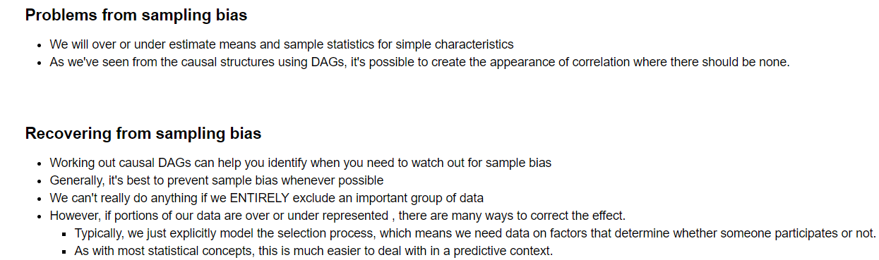
SAMPLING BIAS

Slide 45
COURSE
BEFORE NEXT CLASS

Slide 46
DUE DATE
BEFORE NEXT CLASS
Finish Unit Project 1 and Unit Project 2

Slide 47
LESSON
Q & A

Slide 48
LESSON
EXIT TICKET
DON’T FORGET TO FILL OUT YOUR EXIT TICKET
LESSON 3
STATISTICS FUNDAMENTALS

