Slide 1
DECISION TREES AND RANDOM FORESTS

Slide 2
TODAY’S LEARNING OBJECTIVES
DECISION TREES AND RANDOM FORESTS
Understand and build decision tree models for classification and regression with the sklearn library
Know how to extract the most important predictors in a random forest model

Slide 3

WHERE ARE WE IN THE MACHINE LEARNING UNIVERSE?

Slide 4
INTRODUCTION
MOTIVATION

Slide 5

DECISION TREES
Motivation: suppose we wanted to predict whether a passenger lives or dies on the titanic.
Would this be a regression or classification problem?
How would we interpret the coefficients?

Slide 6
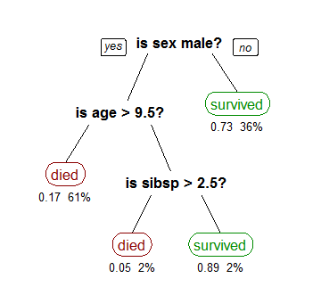
DECISION TREES
Decision Trees are a machine learning model for regression and classification that develops a series of yes/no rules to explain the differences present in the outcome variable.
P(Survival) = 0.73
% of Observations = 36%
The idea is to get to the right answer with the smallest number of questions

Slide 7
DECISION TREES
Structure
When displayed, these series of rules appear as a tree with several branching paths or splits.
The starting point of a decision tree is referred to as the root and subsequent branching points are called nodes. Nodes that do not split further are then called leaves.
Using our example decision tree:
Root
Split
Node
Leaf

Slide 8
DECISION TREES
The structure of a decision tree is determined by what yes/no rules will best predict the outcome variable.
For classification trees, this is measured at each point by the gini impurity which measures the homogeneity of the outcome variable in a dataset
0 (everything is one class) to 1 (there is an equal amount of each class).
For regression trees, MSE (or mean squared error) is often used in place of gini impurity.
The gini impurity for this branch is very close to 0 since almost everyone (95%) belongs to one class (died)

Slide 9
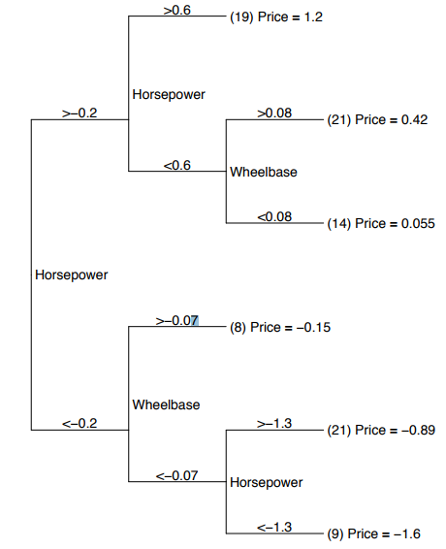
DECISION TREES
Example: predicting price of 1993 model cars (all features have been standardized to have 0 mean and unit variance)
What’s the root node?
How many leaves are there?
How many nodes are there?
What combination of characteristics correspond to us predicting the cheapest car prices?
What combination of characteristics correspond to us predicting the most expensive car prices?

Slide 10
INTRODUCTION
HOW DO WE DETERMINE SPLITS?
GINI IMPURITY

Slide 11



DECISION TREES
Gini impurity aka gini index is a measure of how homogenous or “pure” our class distribution is.
0 means a pure class (everything is the same) and 1 means completely diverse (everything is different and you have a really, really big J value)
Gini impurity for a fair coin is
What’s the gini impurity for an unfair coin that has a 90% chance of heads and 10% chance of tails?
Where
J = # of classes you have
i = class
p = probability of class_{i}

Slide 12
DECISION TREES
Here’s a high level step-by-step on how to make a decision tree:
Calculate the “purity” of every feature using gini impurity and something called information gain
You want to see if any of your classes tend to fall under a particular feature.
Values for categorical and ranges for numerical
Pick the feature with the highest “purity” and set that as your split
If you don’t have any splits, then that’s your root
Repeat steps 1 – 3 without the feature you just selected to see the next “best” feature that splits your data.
Question: When do we stop this process?

Slide 13
INTRODUCTION
EXAMPLE

Slide 14
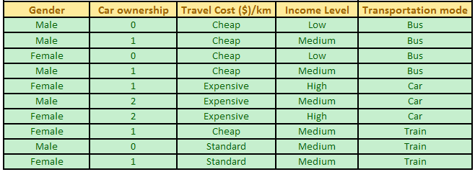
DECISION TREES
Example: let’s predict an individual’s mode of transportation based on car ownership, travel cost, and income level.
Features
Response

Slide 15

DECISION TREES
Let’s calculate the gini index for the transportation data set:
Given a Gini Index of 0 = pure and 1 = impure, what does a value of 0.66 tell us about our class distribution?
P(Bus) = 0.4
P(Car) = 0.3
P(Train) = 0.3

Slide 16
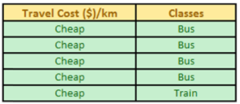


DECISION TREES
Step 1
Filter your dataset by every attribute value you have (categorical and numerical) and calculate the gini index.
Let’s take a look at Travel Cost:
What’s the gini index for each set?
Data filtered by
Travel Cost = ‘Cheap’
4 Bus
1 Train
Data filtered by
Travel Cost = ‘Expensive’
3 Car
Data filtered by
Travel Cost = ‘Standard’
2 Train

Slide 17


DECISION TREES
Step 1
Now, calculate the gini index for each attribute value:
Now we need to aggregate the purity of this feature by calculating something called the information gain.
This helps us answer the question “how good is this feature at separating my classes?”

Slide 18




DECISION TREES
Information gain uses our gini indices. It’s calculated by the following:
For the transportation example, the information gain for travel cost is computed by:
Where
J = # of different values for the feature
K = total observations for that feature value
N = total observations in dataset
Parent = the original dataset or the one previous to the current split you’re working on
J = 3 (Cheap, Expensive, Standard)
K = 5 (Cheap), 2 (Expensive) and 3 (Standard)
N = 10
Gini (Parent) = 0.66
Gini (feature) = 0.32 (Cheap), 0 (Expensive), and 0 (Standard)

Slide 19
DECISION TREES
Step 2
Find the information gain for every feature and its values.
Pick the feature with the highest information gain and set that as a split
Since travel cost has the highest information gain, we select that feature to be our node! And since this is our first split, this will be our root:
Step 3
Filter the data set by the most “impure” feature and repeat steps 1 – 4 to find your next most important split
 | Gender | Car Ownership | Travel Cost | Income Level
Information Gain | 0.06 | 0.207 | 0.5 | 0.293
Travel Cost is Cheap?
No
Yes
Repeat steps 1 - 3
Bus: 5
Train: 1
Prediction: Bus (83%)

Slide 20
DECISION TREES
Step 3
For our example, filter the dataset for Travel Cost != ‘Cheap’ and repeat steps 1 - 3
Travel Cost is Cheap?
No
Yes
Repeat steps 1 - 3
Bus: 5
Train: 1
Prediction: Bus (83%)
Leave out Travel Cost when you repeat steps 1 – 3 and only look at these rows when repeating steps 1 - 3

Slide 21
INTRODUCTION
PROS AND CONS
OF DECISION TREES

Slide 22
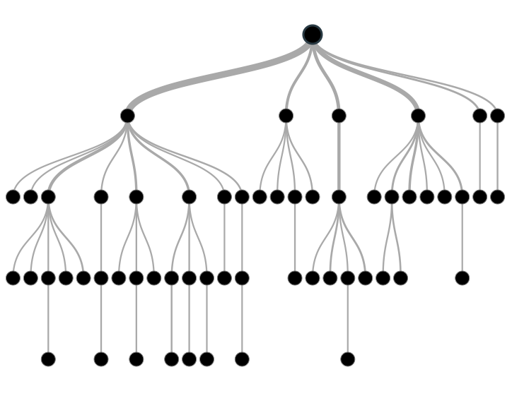
PROS OF DECISION TREES
Decision trees are non-linear which gives them more flexibility over linear models (e.g. linear regression).
Decision trees also produce easily interpreted visuals from which variable importance can be derived.

Slide 23
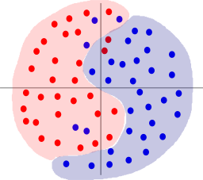
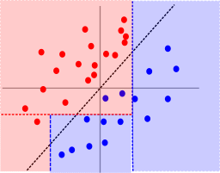
CONS OF DECISION TREES
Decision trees are computationally intensive relative to other models, especially if you don’t prune them.
Decision trees are sometimes too flexible and can easily overfit your data. Cross-validation and tuning are key to keeping decision tree models generalizable.

Slide 24
CONCLUSION
TOPIC REVIEW

Slide 25
REVIEW Q&A
What are decision trees?
From a high level, how would you describe the splitting criteria?
What are some benefits to using decision trees?
What are some common problems with decision trees?

Slide 26
CITATIONS
THANKS FOR THE FOLLOWING
Decision Tree Visualization: https://littleml.files.wordpress.com/2012/01/screen-shot-2012-01-23-at-10-00-17-am1.png
90's Flowchart, Munroe, Randall: https://xkcd.com/210/
Questions on some data-mining algorithms: https://stackoverflow.com/questions/4084668/questions-on-some-data-mining-algorithms

Slide 27
CITATIONS
THANKS FOR THE FOLLOWING
An Introduction to Statistical Learning, James, G et al (2013): http://www-bcf.usc.edu/~gareth/ISL/getbook.html
The Lorax (Character), Seuss Wikia: http://seuss.wikia.com/wiki/The_Lorax_(Character)
Classification and Regression Trees, Cosma Shalizi: http://www.stat.cmu.edu/~cshalizi/350/lectures/22/lecture-22.pdf

