Slide 1
INTRODUCTION TO REGRESSION ANALYSIS

Slide 2
LEARNING OBJECTIVES
INTRODUCTION TO REGRESSION ANALYSIS
Define simple linear regression and assumptions
Build a linear regression model using a dataset that meets the linearity assumption using the sci-kit learn library
Understand and identify multicollinearity in a multiple regression.

Slide 3
OPENING
AI IN THE NEWS

Slide 4


INTRODUCTION TO REGRESSION ANALYSIS
https://www.theverge.com/2017/8/11/16137388/dota-2-dendi-open-ai-elon-musk

Slide 5
OPENING
INTRODUCTION TO REGRESSION ANALYSIS

Slide 6

WHERE ARE WE IN THE DATA SCIENCE WORKFLOW?
Data has been acquired and parsed.
Today we’ll refine the data and build models.
We’ll also use plots to represent the results.
We are here

Slide 7
INTRODUCTION
MOTIVATION

Slide 8
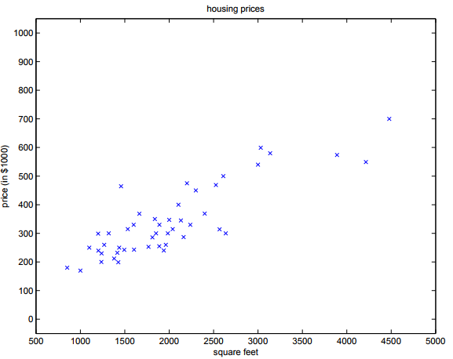
SIMPLE LINEAR REGRESSION
Motivation: suppose we have a dataset giving the living areas and prices of 47 houses from Portland, Oregon
How can we learn to predict the prices of other houses in Portland, as a function of the size of their living areas?
Living Area (feet sq) | Price (1000$s)
2104 | 400
1600 | 330
2400 | 369
1416 | 232
… | …

Slide 9
INTRODUCTION
SIMPLE LINEAR REGRESSION

Slide 10
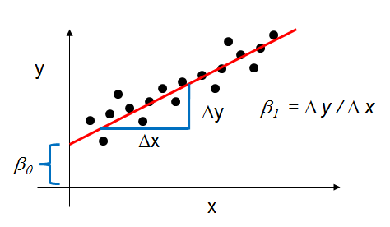
SIMPLE LINEAR REGRESSION
Definition: Explanation of a continuous variable given a series of independent variables
The simplest version is just a line of best fit: y = mx + b
Explain the relationship between x and y using the starting point b and the power in explanation m.

Slide 11
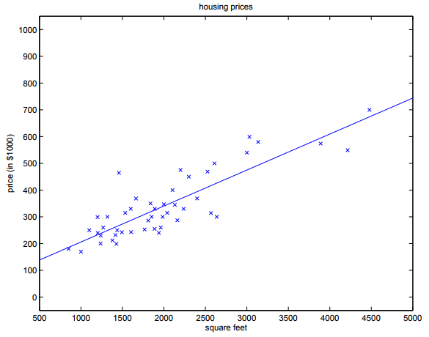
SIMPLE LINEAR REGRESSION
Let’s go back to the housing price data set. Our hypothesis is that housing price, y, is a linear function of square footage, x, which gives us the following equation:
Y = mx + b
Y = Housing Price
x = Square Footage
m = ?
b = ?

Slide 12
SIMPLE LINEAR REGRESSION
How do we get our slope and y-intercept?
Which of these lines best fits our data?
y = 80 + 0.1575x
y = 100 + 0.187x
y = 110 + 0.147x

Slide 13
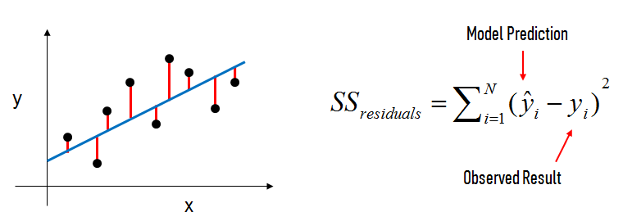

SIMPLE LINEAR REGRESSION
Draw a line that minimizes the sum of the residuals between the predicted point and the actual point => Ordinary Least Squares (OLS)
Where = mx + b for the i^{th} observation of N observations

Slide 14
Checks
SIMPLE LINEAR REGRESSION ASSUMPTIONS

Slide 15
SIMPLE LINEAR REGRESSION
Linear regression works best when:
The data is normally distributed (but doesn’t have to be)
X’s significantly explain y (have low p-values)
X’s are independent of each other (low multicollinearity)
Resulting values pass linear assumption (depends upon problem)
If data is not normally distributed, we could introduce bias.

Slide 16
OPENING
EVALUATE MODEL FIT

Slide 17
WHAT IS R-SQUARED? WHAT IS A RESIDUAL?
R-squared and Residuals
R-squared is the central metric introduced for linear regression
Which model performed better, one with an r-squared of 0.79 or 0.81?
R-squared measures explain variance.
But does it tell the magnitude or scale of error?
We’ll explore loss functions and find ways to refine our model.

Slide 18
CONCLUSION
REVIEW

Slide 19
CONCLUSION
What is simple linear regression?
How do we come up with the coefficients?
What does the slope and intercept mean?

