Slide 1
INTRODUCTION TO LOGISTIC REGRESSION

Slide 2
TODAY’S LEARNING OBJECTIVES
INTRODUCTION TO LOGISTIC REGRESSION
Logistic Regression & decision boundaries
Gradient Descent and how it fits into Logistic Regression
Evaluate a model using metrics such as classification accuracy/error, confusion matrix, ROC/AUC curves, and loss functions
Build a Logistic Regression using sklearn

Slide 3
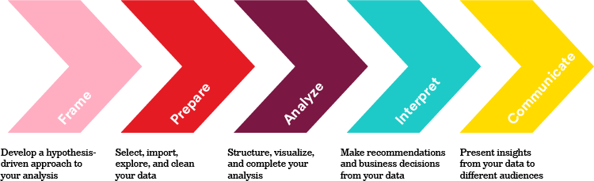
WHERE ARE WE IN THE DATA SCIENCE WORKFLOW?
Data has been acquired and parsed.
Today we’ll refine the data and build models.
We’ll also use plots to represent the results.
We are here

Slide 4

WHERE ARE WE IN THE MACHINE LEARNING UNIVERSE?

Slide 5
DEMO
WHY NOT
LINEAR REGRESSION?

Slide 6
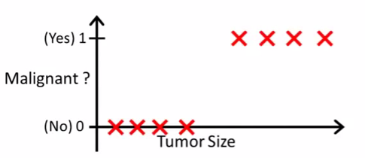
LOGISTIC REGRESSION
Motivation: suppose we want to predict whether a tumor is malignant or benign based on its size.

Slide 7
LOGISTIC REGRESSION
Would Linear Regression work?
Decision Boundary
Find where y = 0.5 => x = 2
Anything larger than 2 we will classify as a malignant tumor
Anything less than 2 we will classify as a benign tumor
0.5
X = 2
What types of problems can you foresee with this technique?

Slide 8

LOGISTIC REGRESSION
Problem 1
Suppose we have another training example, p
Because OLS is minimizing the residuals, it stretches out the line and moves our decision boundary!
These points are now classified as benign!
P
0.5
X = 6

Slide 9
LOGISTIC REGRESSION
Problem 2
Linear Regression outputs predictions < 0 or > 1
Decision Boundary
We want a model that predicts values between 0 and 1
We want a decision boundary AKA “anything past this is class A and anything before it is class B”

Slide 10
INTRODUCTION
LOGISTIC REGRESSION

Slide 11

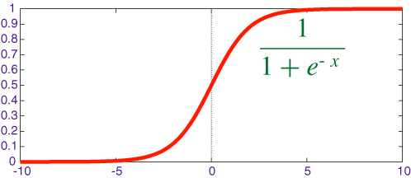
LOGISTIC REGRESSION
We will use Logistic Regression to predict a binary response (0 or 1).
We use the Sigmoid/Logistic function to output probabilities for our predictions. It has the functional form of
This is called our Link function.
We need it in order to find optimal parameters in our model
A standard rule is to classify our “1” class as anything with a probability > 0.5 and our “0” class anything below that.
The point at which the probability = 0.5 is called the decision boundary.
Decision Boundary

Slide 12
TRANSFORMING LINEAR REGRESSION
Intuition: the “linearity” of logistic regression is in the decision boundary we develop. You can imagine it as a line (in 2-D) that separates the two classes.
Questions you’re still thinking
How do we develop this line and what’s the criteria for it? How does it relate to the Sigmoid function?
X2
X1

Slide 13

TRANSFORMING LINEAR REGRESSION
Question: how do we develop the decision boundary?
X2
Layman’s definition
We fit a line that best “divides” the two classes
Mathematical definition
We fit a line such that we minimize the sum of the residuals between the true label and the “strength” (aka probability) of our guess.
X1

Slide 14


TRANSFORMING LINEAR REGRESSION
X2
We can also rewrite the equation as this:
If then we predict 1.
if then we predict 0
X1

Slide 15


TRANSFORMING LINEAR REGRESSION
Question: how does our decision boundary relate to the sigmoid function?
X2
Where
X1
The sigmoid function outputs values from [0,1] that represent the “strength” aka probability of our prediction

Slide 16

KNOWLEDGE CHECK
Why is Linear Regression not an appropriate tool to use in classification?
How does Logistic Regression account for the failings of Linear Regression?
What is the main criteria for how Logistic Regression develops its decision boundary?
How does the Sigmoid function relate to the decision boundary?
EXERCISE

Slide 17
INTRODUCTION
INTERPRETING
LOGISTIC REGRESSION

Slide 18
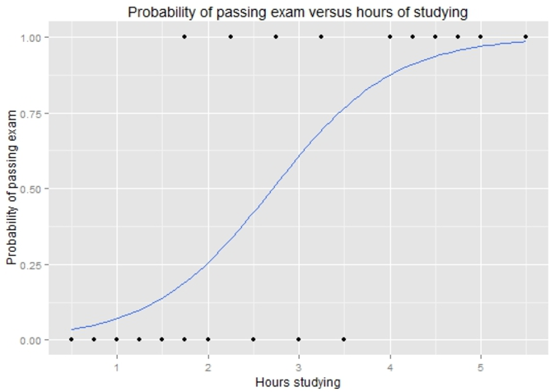

TRANSFORMING LINEAR REGRESSION
Example: how does the number of hours spent studying affect the probability that the student will pass the exam?

Slide 19


TRANSFORMING LINEAR REGRESSION
For a student who studies 2 hours, the equation gives an estimated probability of passing an exam at 0.26:
While someone that studies for 4 hours, their probability of passing is 0.87:
0.87
0.26

Slide 20
TRANSFORMING LINEAR REGRESSION
Standard rule is to predict the “1” class if the probability > 0.5
What would you predict for a student that studies 2 hours?
What would you predict for a student that studies 4 hours?
0.87
0.26

Slide 21

TRANSFORMING LINEAR REGRESSION
How do we interpret the coefficients?
For every 1 hour increase in studying, a student multiplies their odds of passing an exam by:

Slide 22
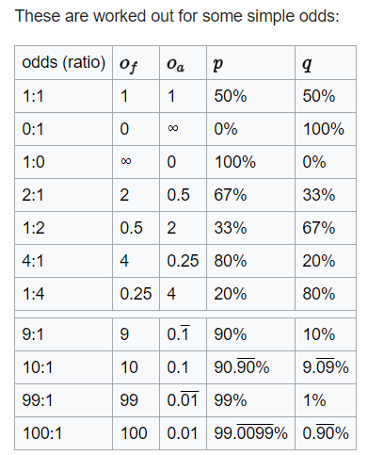
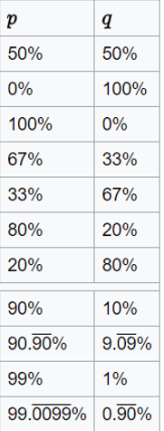
TRANSFORMING LINEAR REGRESSION
Odds represent the likelihood that an event will take place.
What would be the odds for an event will a p = 0.75?
What about the odds for something with a p = 0.40?

Slide 23
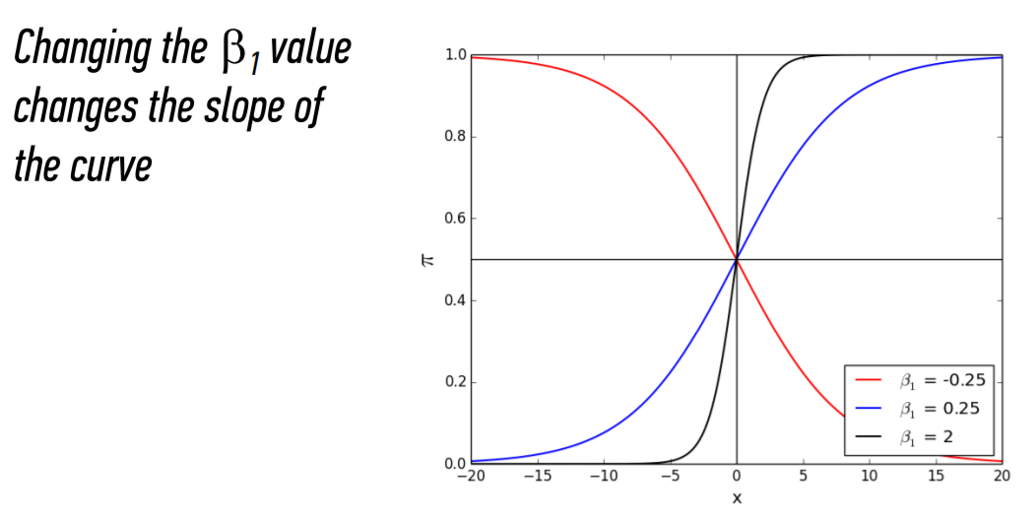


TRANSFORMING LINEAR REGRESSION
The bigger the
the steeper the curve
The smaller the more gradual the curve

Slide 24
GUIDED PRACTICE
NEVER
TELL ME THE ODDS

Slide 25
ACTIVITY: NEVER TELL ME THE ODDS
ANSWER THE FOLLOWING QUESTIONS
EXERCISE
Given a standard deck of cards, calculate the probability and odds of obtaining the following cards
The 2 of clubs
Any diamond card
A face card (any J, Q, K)
What do each of these measures tell you about how likelihood of each scenario?

Slide 26
INDEPENDENT PRACTICE
MULTICLASS
LOGISTIC REGRESSION

Slide 27
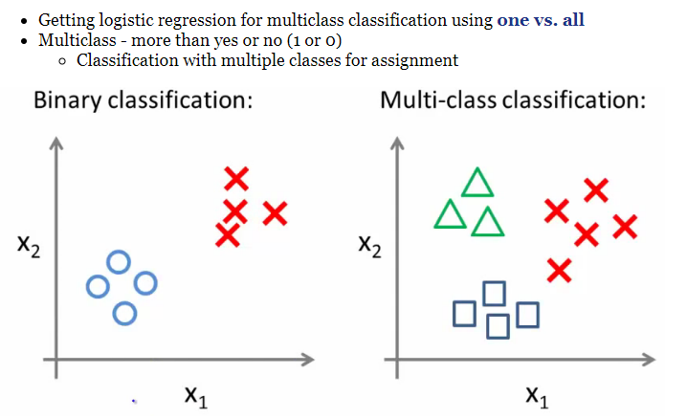
MULTICLASS LOGISTIC REGRESSION

Slide 28
MULTICLASS LOGISTIC REGRESSION
One vs. all classification
Split the training set into three separate binary classification problems
X2
X2
X2
X1
Circle vs. everything else (squares and triangles)
Squares vs. everything else (circles and triangles)
Squares vs. everything else (circles and triangles)

Slide 29
MULTICLASS LOGISTIC REGRESSION
Overall
Train a logistic regression classifier for each class, i.
Make predictions based on which ever model outputs the highest probability for y=1
X2
X1

Slide 30

KNOWLEDGE CHECK
DIRECTIONS (5 minutes)
Suppose we’re trying to predict whether a widget is defective based on its manufacturing time in hours, x₁ , and number of dongles, x₂. We run a Logistic Regression (where a “1” means the widget is defective and “0” means it is not defective) on a dataset and get the following sigmoid function:
What’s the probability of a defective dongle when the manufacturing time is 2 hours and there are 5 dongles?
What happens to the odds of a widget being defective as we increase the number of dongles by 1 unit?
What happens to the odds of a widget being defective as we increase the manufacturing time by 1 unit?
EXERCISE

Slide 31
INTRODUCTION
GRADIENT DESCENT

Slide 32
GRADIENT DESCENT
Intuition: how do we find the decision boundary that best separates our two classes?
AKA what are the coefficients for the linear boundary?
We want to build a decision boundary that best divides the two classes. There are two ways we can think of this:
We fit a line such that we minimize the sum of the residuals between the true label and the “strength” (aka probability) of our guess.
(2) We optimize the probabilities
We make our probabilities as large as possible when y = 1.
We make our probabilities as small as possible when y = 0.
Y
Y = -2.5x + 30
Y = -2.3x + 20
Y = -3x + 40
X

Slide 33
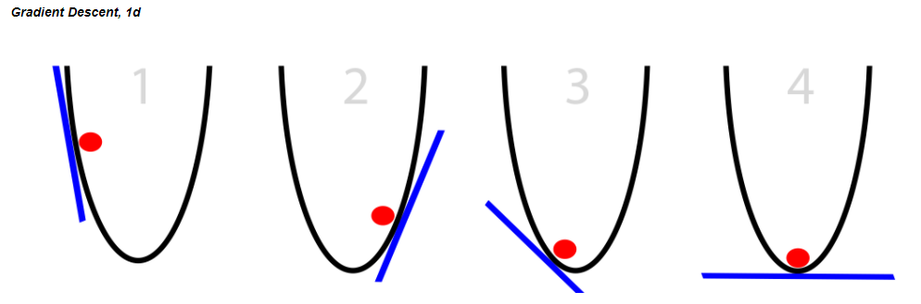
GRADIENT DESCENT
Gradient Descent is an iterative process that we use to pick our decision boundary
You can see it as almost a guess and check – do these sets of coefficients minimize the error between my guess and the true point? If no, then keep looking for better coefficients. If yes, then stop!
The y-axis represents the residuals AKA the cost function, and the x-axis represents our parameters for the decision boundary
Notice how there is only one point that minimizes the cost function

Slide 34
GRADIENT DESCENT
A random linear solution is provided as a starting point (usually a "flat" line or solution)
The solver then attempts to find a next step: we take a step in any direction and measure each performance.
If the solver finds a better solution (optimizing toward a metric such as mean squared error), this is the new starting point.
Repeat these steps until the performance is optimized and no "next steps" perform better. The size of the steps will shrink over time.
Because we’ve minimized the residuals at this point, the set of parameters we use to define our decision boundary are here!

Slide 35
LOGISTIC REGRESSION
Advantages of logistic regression
Highly interpretable (if you remember how)
Model training and prediction are fast
No tuning is required (excluding regularization)
Features don't need scaling
Can perform well with a small number of observations
Outputs well-calibrated predicted probabilities
Disadvantages of logistic regression
Presumes a linear relationship between the features and the log-odds of the response
Performance is (generally) not competitive with the best supervised learning methods
Can't automatically learn feature interactions

Slide 36
INTRODUCTION
QUESTIONS

Slide 37
INTRODUCTION
EXERCISE:
PREDICTING DEFAULT

Slide 38
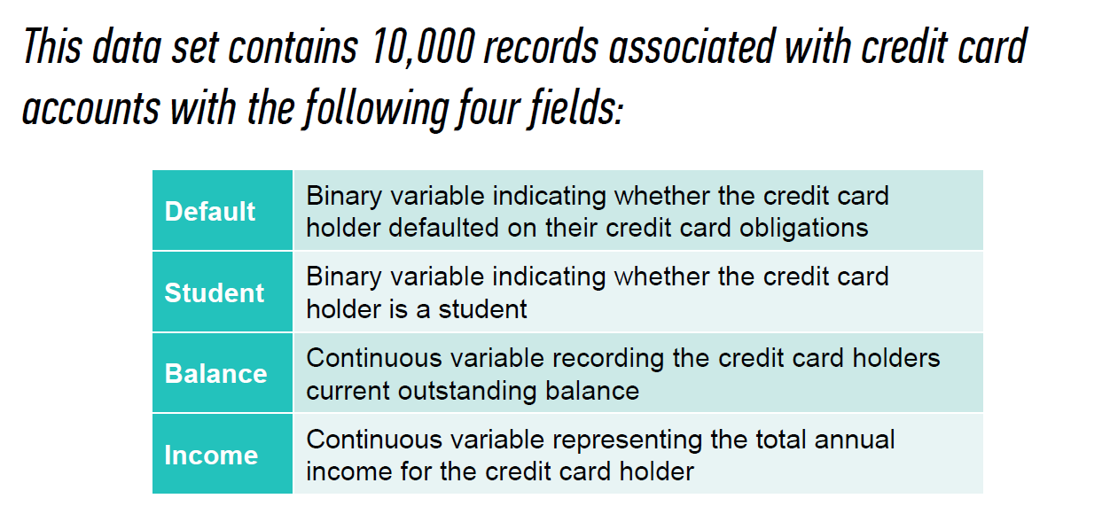
EXERCISE

Slide 39
EXERCISE
Part I: Exploration
Open the Spyder IDE on your computer
Read in Default.csv and convert all data to numeric
Create a histogram of all variables
Run the scatter plot of income vs. balance
Run the scatter plot of income vs. balance with the ‘default’ classes laid overtop. What can you infer from this plot?
Create a training and test set

Slide 40

EXERCISE
Part II: Partner-up
Run a logistic regression on just the balance variable (very similar syntax to Lin Reg and KNN)
What is the value associated with balance?
Predict the probability of default for someone with a balance of $1.2k and $1.5k
Run the plots to see what the sigmoid function looks like with the given parameters.
Create predictions using the test set and store them in a variable called ‘preds’
Create a list of the projected probabilities of each class and store them in a variable called ‘proba_preds’. How could you just get the predictions for the default class?

Slide 41
EXERCISE
Part III: Evaluating Model Fit
Compute the “accuracy” using metrics.accuracy_score. Is this a good score? Take a look at the actual numbers of default vs. non-default in the test set and reevaluate.
What do the predictions for ‘default’ look like? Plot a histogram of them. What do guesses look like when p > 0.8 or when p < 0.2?

Slide 42
INTRODUCTION
BREAK

Slide 43
INTRODUCTION
ADVANCED CLASSIFICATION METRICS

Slide 44
ADVANCED CLASSIFICATION METRICS
What if we wanted to know exactly how a classifier was performing (e.g. what is predicting correctly vs incorrectly)?

Slide 45
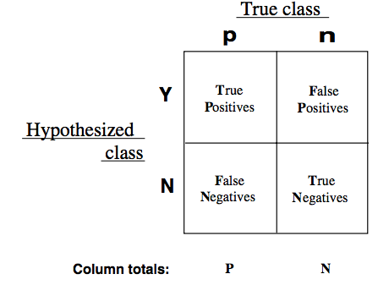
ADVANCED CLASSIFICATION METRICS
We can use a confusion matrix to obtain more granular accuracy ratings for of each class by using the true positive rate and the false positive rate.

Slide 46
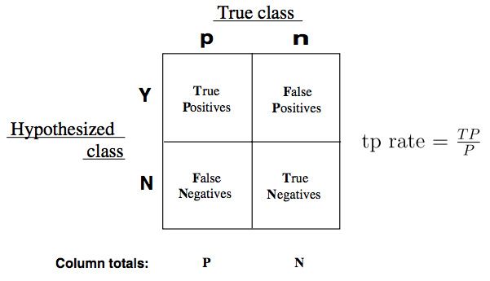
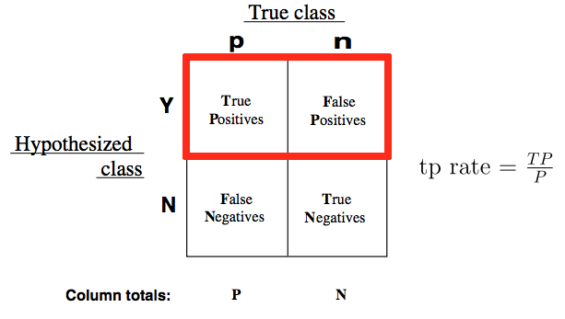
ADVANCED CLASSIFICATION METRICS
The true positive rate (TPR) asks, “Out of all of the target classes, how many were accurately predicted to belong to that class?”
Using our example, the TPR would be how often does our model correctly identify customer who will default on their credit card debt.

Slide 47
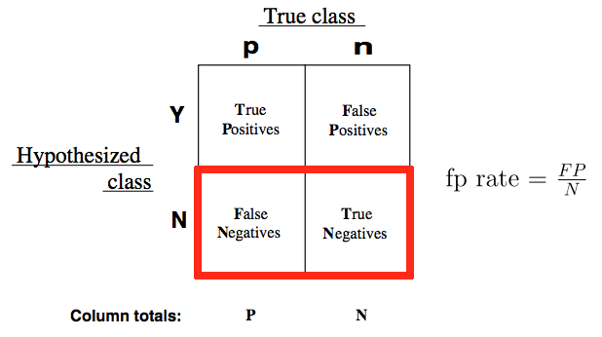
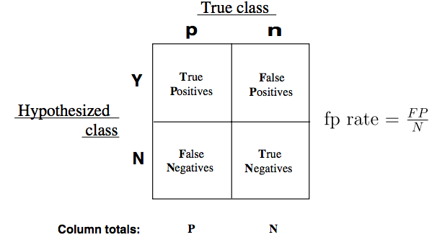
ADVANCED CLASSIFICATION METRICS
The false positive rate (FPR) asks, “Out of all items not belonging to a class, how many were predicted as belonging to that target class label?”
Using our example, the FPR would be how often the model predict that a customer will default when they end up not doing so.

Slide 48


ADVANCED CLASSIFICATION METRICS
We can also measure the inverse of TPR/FPR or the false negative rate (FNR) and the true negative rate (TNR).
True Negative Rate (TNR)
False Negative Rate (FNR)

Slide 49
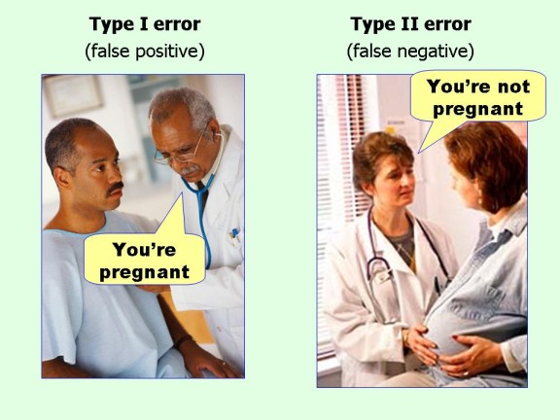
ADVANCED CLASSIFICATION METRICS

Slide 50
ADVANCED CLASSIFICATION METRICS
True Class
Not Pregnant
Pregnant
What are the number of true positives?
What are the number of false negatives?
What are the number of false positives?
What are the number of true negatives?
50 | 24
10 | 62
Not Pregnant
Predictions
Pregnant

Slide 51
ACTIVITY
For each of the example:
Write a confusion matrix: true positive, false positive, true negative, false negative. Then decide what each square represents for that specific example.
Define the benefit of a true positive and true negative and the cost of a false positive and false negative.
Examples:
A test is developed for determining if a patient has cancer or not.
A newspaper company is targeting a marketing campaign for "at risk" users that may stop paying for the product soon.
You build a spam classifier for your email system.
EXERCISE

Slide 52
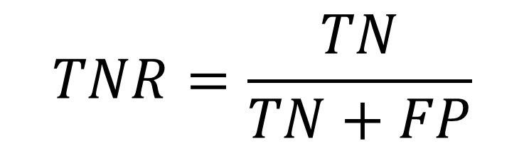


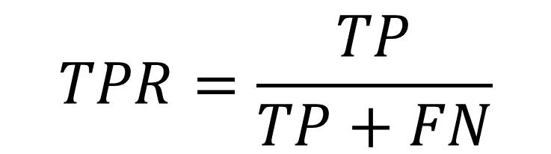


ADVANCED CLASSIFICATION METRICS
These rates gives us a much clearer pictures of where model predictions begin to fall apart and exactly what business cases are being mishandled.
This allows us to adjust our models accordingly and use metrics that best align to our business needs.

Slide 53
ADVANCED CLASSIFICATION METRICS
Ideally, our classifier would have a TPR approaching 1 and a FPR approaching 0. This would mean that our model is correctly predicting all customers who defaulted and not mistakenly predict that they wouldn’t default.
We can vary the classification threshold for our model to get different predictions, but how do we know if a model is better overall than other model?
Default threshold is p > 0.5
We can compare the FPR and TPR of the models, but it can often be difficult to optimize two numbers at once. Can you think of any ways to combine our two metrics?

Slide 54
THE ROC CURVE
This is where the Receiver Operation Characteristic (ROC) curve comes in handy.
The curve is created by plotting the TPR against the FPR at various probability thresholds.
This is where we toggle our threshold of p = 0.5
Area Under the Curve (AUC) summarizes the impact of TPR and FPR in a single value.

Slide 55
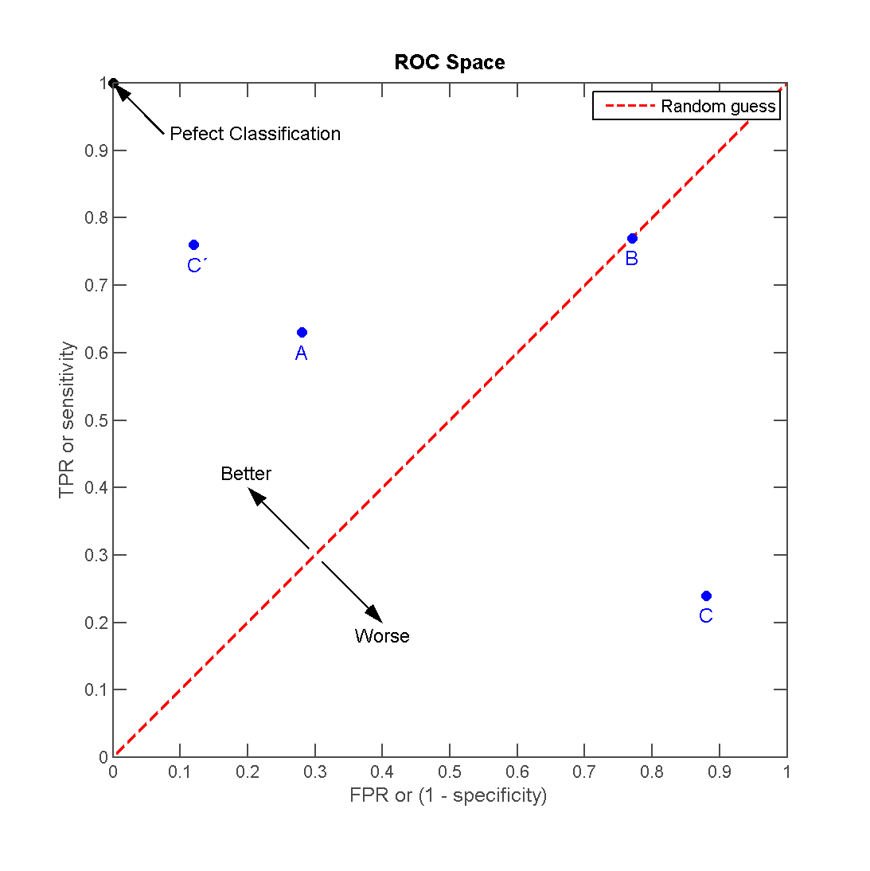
THE ROC CURVE
There can be a variety of points on an ROC curve.
Each point is determined by a unique probability threshold

Slide 56
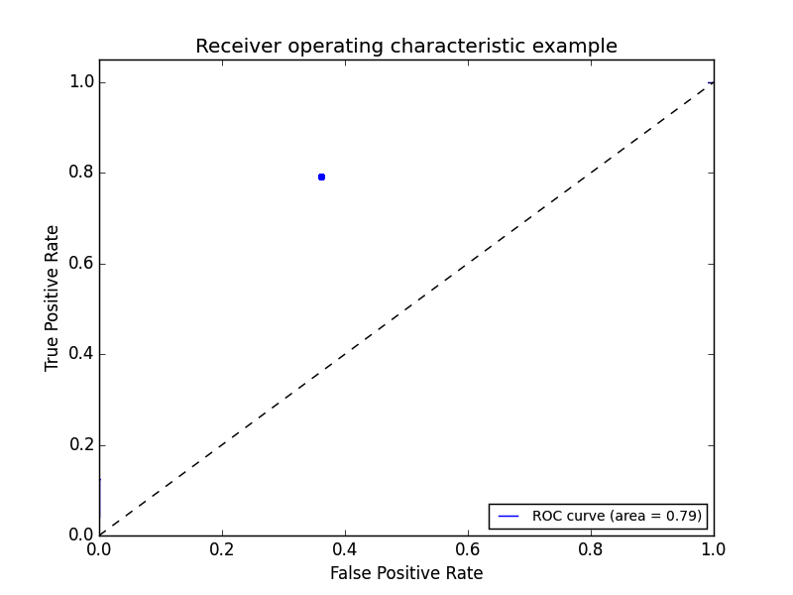
THE ROC CURVE
We can begin by plotting an individual TPR/FPR pair for one threshold.

Slide 57
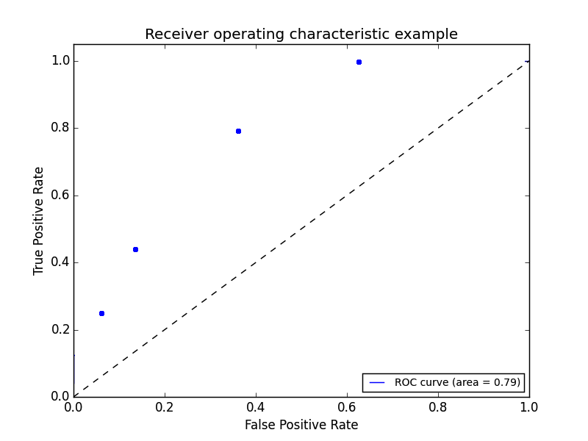
THE ROC CURVE
We can continue adding pairs for different thresholds.

Slide 58
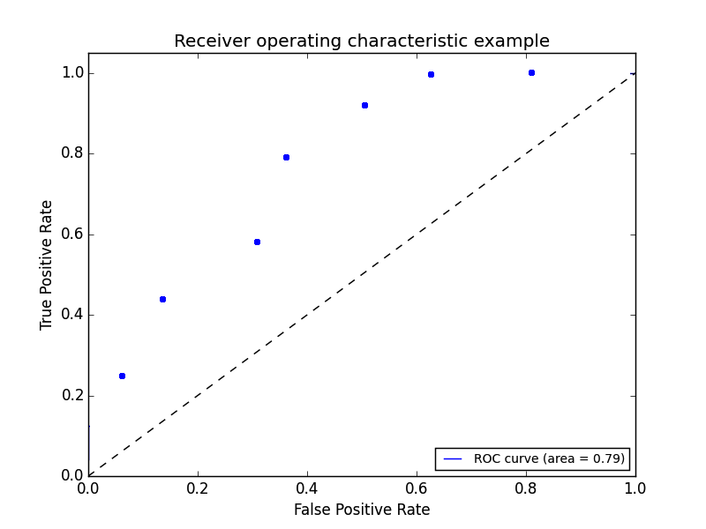
THE ROC CURVE
We can continue adding pairs for even more thresholds.

Slide 59
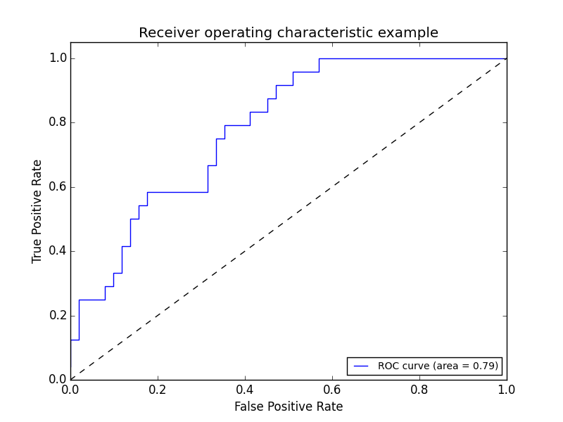
THE ROC CURVE
Finally, we create a full “curve” that is described by both TPR and FPR.

Slide 60
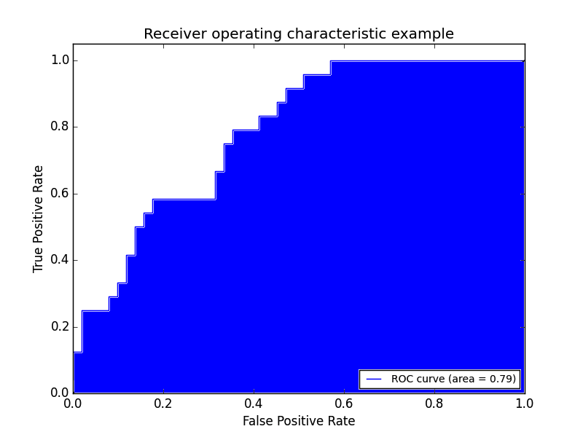
AREA UNDER THE CURVE
With this curve, we can find the Area Under the Curve (AUC).
As you increase your sensitivity (true positives) and can identify more cases with a certain condition, you also sacrifice accuracy on identifying those without the condition (specificity).

Slide 61
AREA UNDER THE CURVE
If we have a TPR of 1 (all positives are marked positive) and FPR of 0 (all negatives are not marked positive), we’d have an AUC of 1. This means everything was accurately predicted.
If we have a TPR of 0 (all positives are not marked positive) and an FPR of 1 (all negatives are marked positive), we’d have an AUC of 0. This means nothing was predicted accurately.
An AUC of 0.5 would suggest a model no better than random is an excellent benchmark to use for comparing predictions (e.g. is my AUC above 0.5?).

Slide 62
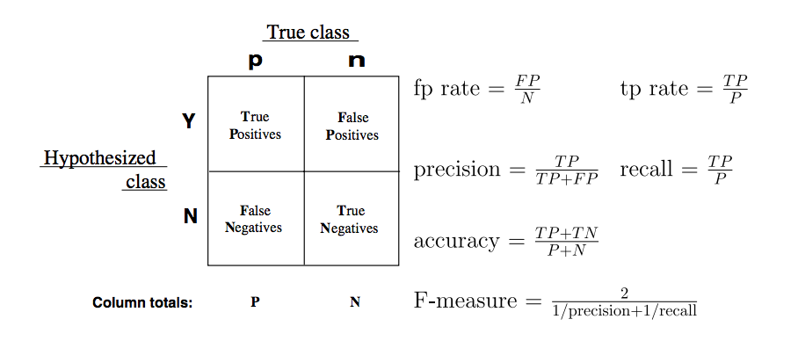
MORE CLASSIFICATION METRICS!
There are several other common metrics that are similar to TPR and FPR that can also be useful.
Sklearn has all of these metrics located on one convenient page.

Slide 63
KNOWLEDGE CHECK
What do all of the points on the ROC curve represent?
As we decrease our probability threshold, we (increase/decrease) our true positive rate
An AUC (Area under the curve) close to 0.5 means our model is (good/bad)?
An AUC (Area under the curve) close to 1 means our model is (good/bad)?
EXERCISE

Slide 64
CONCLUSION
TOPIC REVIEW

Slide 65
REVIEW QUESTIONS
What’s the link function is used in logistic regression?
What criteria do we use to create our decision boundary?
What do the coefficients in a logistic regression represent? How does the interpretation differ from ordinary least squares? How is it similar?
How do we implement a multivariate logistic regression?
How does True Positive Rate and False Positive Rate help explain accuracy?

Slide 66
LESSON
EXIT TICKET

