Slide 1
Review and Analysis of “A Microclimate Greenhouse Multivariable Control: A Guide to use Hardware in the Loop Simulation”
Aaron Rosenberg
ECE 763
4/19/2023
G. Cevallos, J. Pinzon, and O. Camacho, “A microclimate greenhouse multivariable control: A guide to use hardware in the Loop Simulation,” 2022 IEEE International Conference on Automation/XXV Congress of the Chilean Association of Automatic Control (ICA-ACCA), 2022.

Slide 2
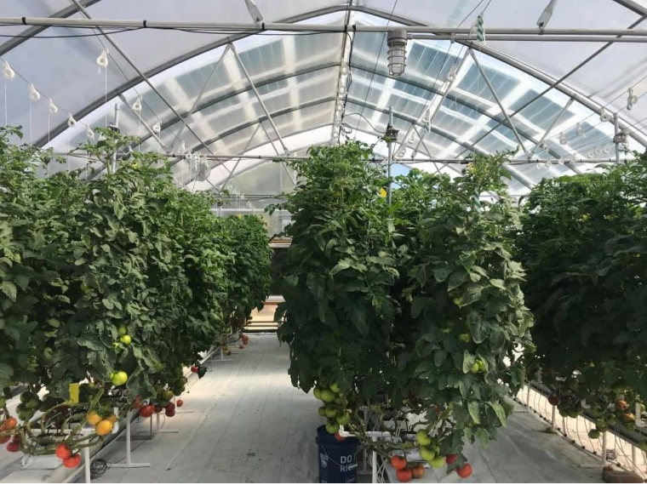
Statement of Interest
Groundwork for home project
Maintain growth of tropical plants
Goal is to eventually grow food plants
Benefits of greenhouses
Controlled environment (temperature/humidity)
Protected environment (weather/pests/animals)
Ability to grow out of season/conditions
Picture of inside of greenhouse [2]
Notes:
I chose to do this project because it helps lay the groundwork for a future home project of mine; my wife studies horticulture and wants to grow tropical plants here in Chesapeake + eventually food plants. All of the plants she likes are tropical or require high temperatures and humidities, so they don’t do well here.
Solution to this is greenhouse, see bullets. I thought it would be fun to do the controller myself + save money.
Also, my undergrad was mechanical engineering so revisiting the thermo stuff was kind of fun.

Slide 3
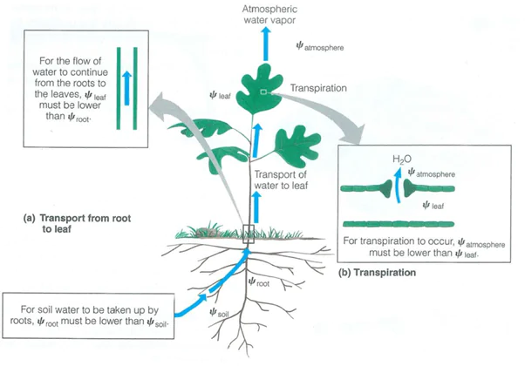
Background Information
How does Temperature affect plants? [4]
Plant vigor
Leaf size
Leaf expansion rate
Time to fruit development
How does Humidity affect plants? [4]
Transpiration
Calcium uptake
Hormonal Distribution
Diagram of plant transpiration process [3]
Notes:
Why do we care about Temp and Humidity?
Vigor is the ability of the plant to resist stress [5]
Transpiration is the loss of water through the foliage in the form of water vapor, which helps cool the leaf and draw up water through the stem [5]
Explain picture: plant draws water up from roots to leaves
During photosynthesis pores on leaf open and water evaporates, cools plant allows more water to come up and transfer nutrients from soil
Humidity too high: water doesn’t evaporate, plant overheats, mineral deficiencies because water can’t bring it up..also water deposition leads to mold and pathogens
Humidity too low: water evaporates too fast, plant dries out runs out of nutrients
Calcium: Calcium is not only an essential plant nutrient [6]
but is also used in correcting soil acidity so that other soil nutrient elements can be made
available to plants in appropriate amounts. It is absorbed as Ca2 ions by plants.
Calcium is important in cell growth and division, cell wall formation (calcium in the form of pectate), and nitrogen accumulation. The element also forms organic salts with organic acids
in plants. For example, in dumbcane (Dieffenbachia) calcium forms calcium oxalate,
which is irritating to the tongue and throat of humans when ingested.
When deficient, plant tissue formation is incomplete. The terminal bud may cease
to grow, leaving a blunt end. Deficiency symptoms for calcium are manifested frequently
as defective terminal bud development. The margins of young leaves may not form,
resulting in strap leaves. Slight chlorosis followed by brown or black scorching of new
leaf tips and die-back of growing points are also characteristic of this deficiency. Roots
grow poorly and are short and thickened.
People tend to think of humidity in terms of relative humidity, which is the ratio of the amount of water vapor in the air to the amount of water vapor the air could hold at that temperature, expressed as a percent. Plants, on the other hand, perceive humidity in terms of vapor pressure deficit (VPD). VPD is the difference between the vapor pressure in the air and the vapor pressure inside the leaf. Water moves by diffusion from the roots through the plant and out the leaves as transpired vapor, thereby being "pumped" up the plant as the vapor moves from the higher pressure inside the leaf to the lower pressure in the surrounding air. Low VPD (high humidity, greater than 90%) is often responsible for nutrient deficiency symptoms, such as blossom end rot (calcium deficiency) because the plant is not transpiring, therefore it is not drawing water, or nutrients, into the roots. High VPD (low humidity, less than 50%) can also lead to the same symptoms, because water and nutrients are pumped too quickly through the plants, depositing nutrient ions in the leaves rather than properly in the fruit. [4]

Slide 4
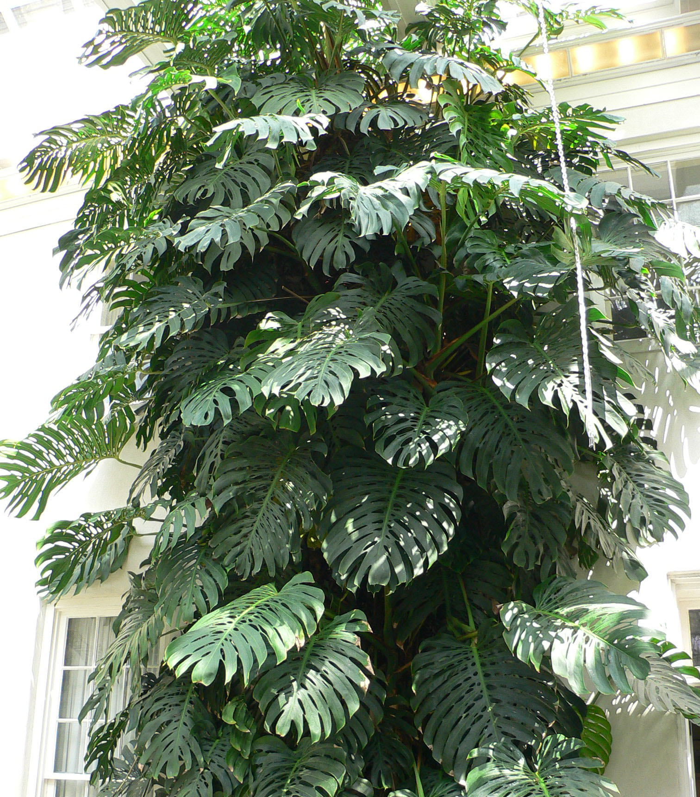
Temperature/humidity ranges for Plants
Rule of thumb for most horticultural crops [4]:
Temperature ranging from 70 °F - 79°F (21°C - 26°C) during the day, with temperatures ~10°F (5.5°C) lower at night.
Relative humidity between 55% and 95%
Monstera Deliciosa
https://commons.wikimedia.org/w/index.php?curid=7094
Plant | Ideal Temperature °F | Ideal Temperature °C | Ideal Relative Humidity
Monstera Deliciosa | 65 - 90 | 18.33 - 32.22 | 60% - 80%
Golden Pothos | 65 - 85 | 18.33 - 29.44 | 50% - 70%
Syngonium Wendlandii | 59 - 86 | 15 - 30 | 60% - 80%
Poblano | 70 - 85 | 21 - 29.44 | 70% - 80%
Serrano | 71 - 85 | 22 - 29.44 | 70% - 80%
Tomato | 70 - 79 | 21 - 26 | 80% - 90%
Notes:
Read slide
Mention:
Difficult to maintain in house, comfortable humidity for humans is 30%-50%
Tropical plants cannot handle temperatures <50degrees

Slide 5
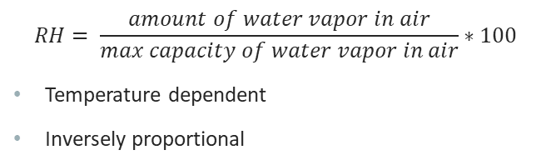
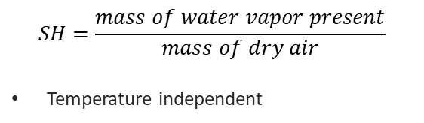
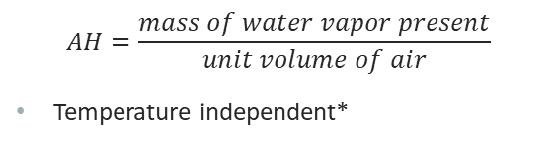
Temperature and Humidity
Relative Humidity
Absolute Humidity
Specific Humidity
$$RH= \frac{amount of water vapor in air}{max capacity of water vapor in air}∗100$$
Temperature dependent
Inversely proportional
$$AH=\frac{mass of water vapor present}{unit volume of air}$$
Temperature independent*
$$SH=\frac{mass of water vapor present}{mass of dry air}$$
Temperature independent
*As long as the volume is kept constant
Notes:
Humidity is commonly expressed in three different ways:
Relative humidity, absolute humidity, specific humidity
Relative humidity is the most common and is how the weather/news expresses humidity, because it best represents how the humidity will feel to a person.
It is expressed as a percentage of the amount of water vapor in the air versus the maximum capacity of water vapor in air (or the saturation pressure of water vapor)
RH is temperature dependent, because as the air temperature increases, the air can hold more water vapor, which decreases the RH. For this reason, I imagine that it is not a
Very useful parameter in control, because it is heavily dependent on the temperature, which is another state that we want to control.
The authors used absolute humidity to measure humidity. AH is the mass of water vapor present per unit volume of air. This parameter is temperature independent as long as the volume is constant,
Which is the case for the greenhouse system (because we are interested in the volume of air inside the greenhouse. The volume could change due to temperature because air expands – see ideal gas law
PV=nRT, volume is inversely proportional to temp, so AH is directly proportional to temp.
Specific humidity is the ratio of the mass of water vapor in the air to the mass of dry air and is temperature independent, because the mass does not change with temp. If the volume is kept constant, then this is the same as the absolute humidity. This parameter is shown on the psychrometric chart.

Slide 6
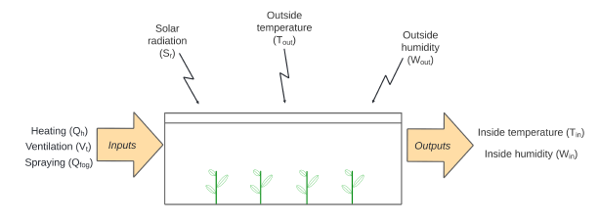
Description of Physical System
Maintain the inside temperature and inside humidity at desired set point
Non-linear, coupled system
MIMO system; 3 input, 2 output, 3 disturbance inputs
Implement controller on Arduino and simulate control of greenhouse microclimate
Greenhouse Model Inputs, Outputs, and Disturbances [1]

Slide 7
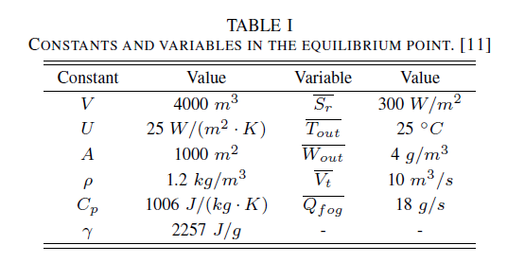
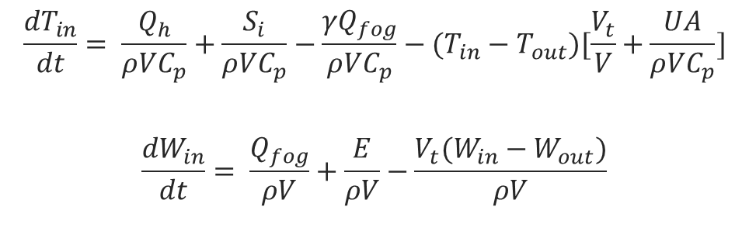
Mathematical Model
$$\frac{{dT}_{in}}{dt}= \frac{Q_{h}}{ρ{VC}_{p}}+\frac{S_{i}}{ρ{VC}_{p}}−\frac{{γQ}_{fog}}{ρ{VC}_{p}}−(T_{in}−T_{out})[\frac{V_{t}}{V}+\frac{UA}{ρ{VC}_{p}}]$$
$$\frac{{dW}_{in}}{dt}= \frac{Q_{fog}}{ρV}+\frac{E}{ρV}−\frac{V_{t}(W_{in}−W_{out})}{ρV}$$
(1)
(2)
Outputs
T_{in} = Inside Temperature (°C) = x₁
W_{in} = Inside Humidity (g/m³) = x₂
Inputs
V_{t} = Ventilation rate (m³/s) = u₁
Q_{fog} = Water capacity of fog system (g/s) = u₂
Q_{h} = Heat provided by heater (Watts) = u₃
Disturbances
T_{out} = Outside Temperature (°C) = d₁
W_{out} = Outside Humidity (g/m³) = d₂
S_{r} = Intercepted solar radiant energy (Watts/m²) = d₃

Slide 8

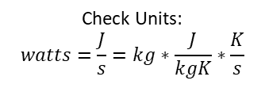

Derivation of Mathematical Model
Specific Heat Capacity – the amount of heat required to change the temperature of a mass by 1°C
$$Q=mCΔT$$
$\frac{d}{dt}$
$$\dot{Q}=mC\dot{T}$$
$$\dot{T}= \frac{\dot{Q}}{mC}$$
Check Units:
$$J=kg∗\frac{J}{kgK}∗K$$
Check Units:
$$watts=\frac{J}{s}=kg∗\frac{J}{kgK}∗\frac{K}{s}$$
(3)
Notes:
Specific heat = C
Metals/thermal conductors have low specific heat constants
Air ~1kj/kgK
Water ~4

Slide 9

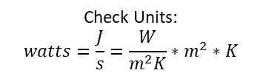
Derivation of Mathematical Model
Conduction – transfer of heat due to temperature gradient
$$\dot{Q}=−UA(T_{in}−T_{out})$$
$$mC\dot{T}=\dot{Q}=−UA(T_{in}−T_{out})$$
$$\dot{T}=\frac{−UA(T_{in}−T_{out})}{mC}$$
Check Units:
$$watts=\frac{J}{s}=\frac{W}{m^{2}K}∗m^{2}∗K$$
(4)

Slide 10
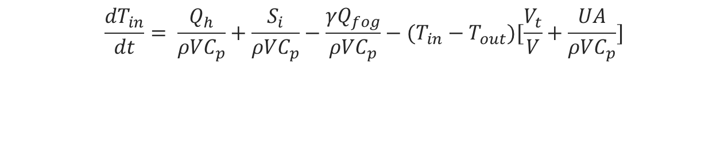
Equation (1) revisited
$$\frac{{dT}_{in}}{dt}= \frac{Q_{h}}{ρ{VC}_{p}}+\frac{S_{i}}{ρ{VC}_{p}}−\frac{{γQ}_{fog}}{ρ{VC}_{p}}−(T_{in}−T_{out})[\frac{V_{t}}{V}+\frac{UA}{ρ{VC}_{p}}]$$
Heater Term
Solar Term
Fog Term
Ventilation Term
Conduction Term
Additional Discussion:
Solar Term
Derived from Eq. (3)
Heat added to system through solar radiation, watts
Fog Term
Derived from Eq. (3)
Heat removed from system due to addition of water vapor
Ventilation Term
Temperature change due to venting out air

Slide 11
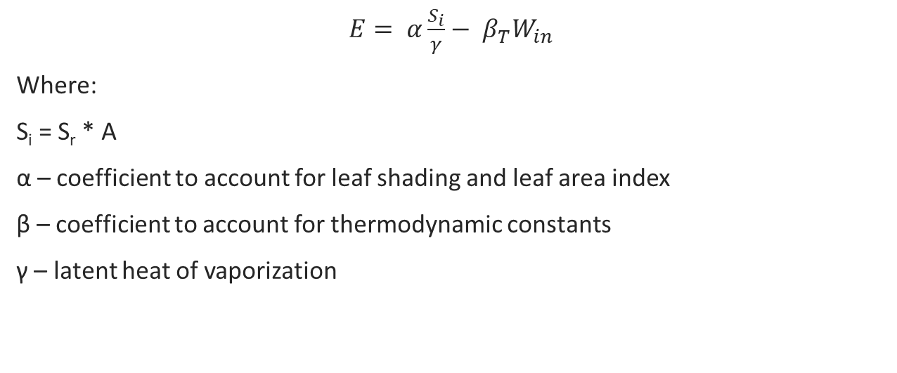

Evapotranspiration rate, E
Check Units:
$$\frac{g}{s}= \frac{\frac{W}{m^{2}}∗m^{2}}{\frac{J}{g}}− \frac{g}{s}$$
$E= α\frac{S_{i}}{γ}− β_{T}W_{in}$
Where:
S_{i} = S_{r} * A
α – coefficient to account for leaf shading and leaf area index
β – coefficient to account for thermodynamic constants
γ – latent heat of vaporization
(5)

Slide 12

Equation (2) Revisited
$$\frac{{dW}_{in}}{dt}= \frac{Q_{fog}}{ρV}+\frac{E}{ρV}−\frac{V_{t}(W_{in}−W_{out})}{ρV}$$
Fog Term
Transpiration Term
Venting Term
Additional Discussion:
Fog Term
Mass of water vapor added to system due to fogging
Transpiration Term
Mass of water vapor added to system through transpiration
Ventilation Term
Mass of water vapor removed from system through venting

Slide 13
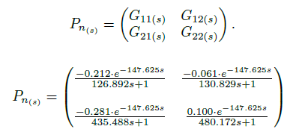
Linearized Model
Authors linearized non-linear model using non-linear system identification techniques
Delay calculated from average of delays from reference source
Delay added to account for sensor delay in real system
Transfer Functions:
G₁₁ is Temperature response due to ventilation
G₁₂ is Temperature response due to fogging
G₂₁ is Humidity response due to ventilation
G₂₂ is Humidity response due to fogging

Slide 14
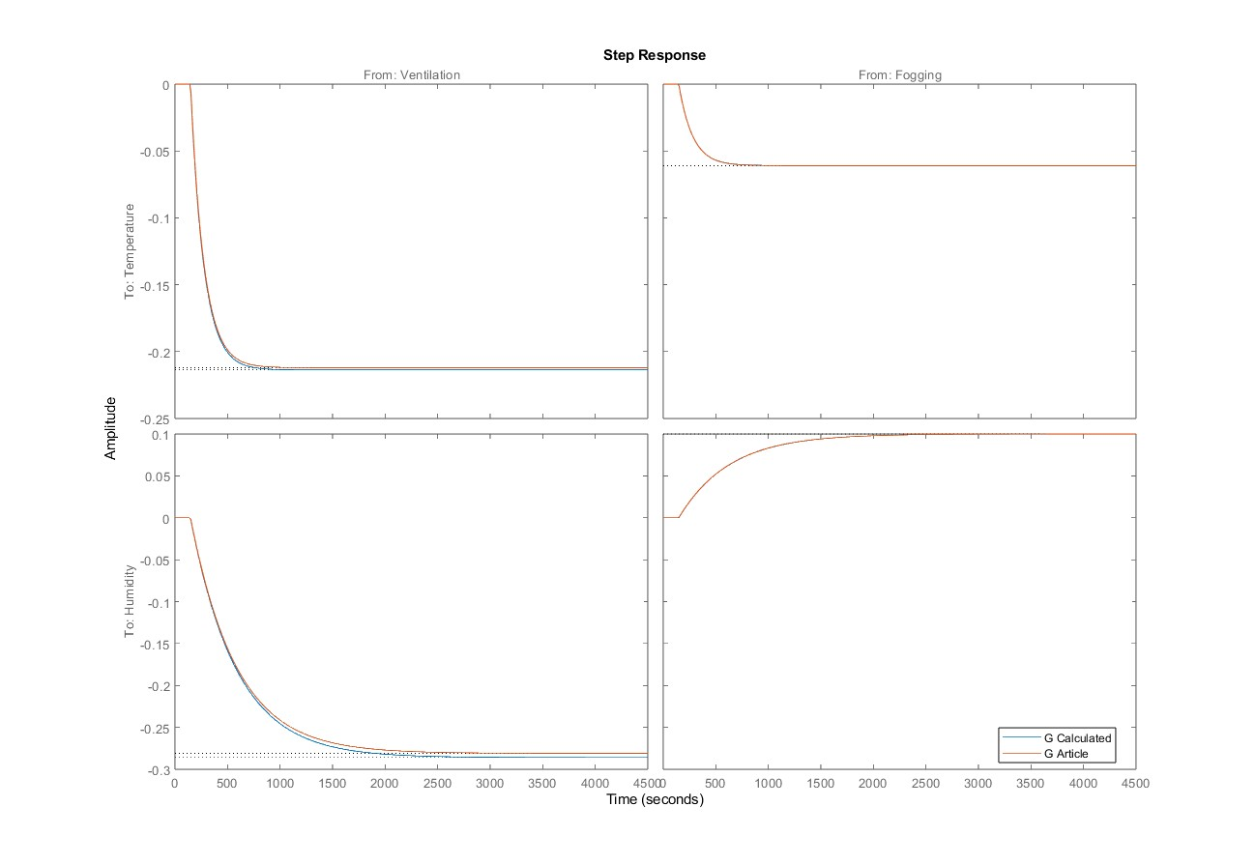
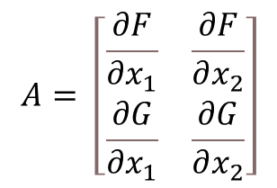

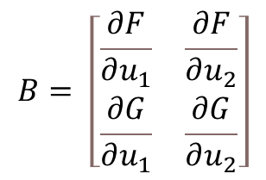
Comparison to ECE763 Linearization
$$A= \left[\begin{matrix}\frac{∂F}{∂x_{1}} & \frac{∂F}{∂x_{2}} \\ \frac{∂G}{∂x_{1}} & \frac{∂G}{∂x_{2}}\end{matrix}\right]$$
$$B= \left[\begin{matrix}\frac{∂F}{∂u_{1}} & \frac{∂F}{∂u_{2}} \\ \frac{∂G}{∂u_{1}} & \frac{∂G}{∂u_{2}}\end{matrix}\right]$$
$$C= \left[\begin{matrix}1 & 0 \\ 0 & 1\end{matrix}\right]$$
(6)

Slide 15
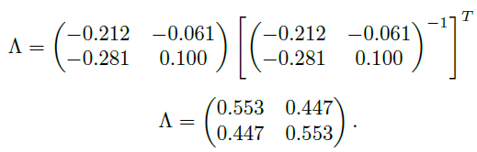
Relative Gain Array (RGA)
$$RGA\left(G\right)= Λ\left(G\right)≜G .∗{\left(G^{−1}\right)}^{T}$$
(7)
Ratio of the open loop gain to the closed loop gain for each transfer function, ∀ω [7]
“Measures” the amount of interaction between inputs and outputs
All columns in the RGA sum to 1, all rows in the RGA sum to 1
Entries ≈ 1 indicate strong interactions between input/output
Entries ≈ 0.5 indicate strong coupling in system between inputs and outputs
Negative entries indicate interactions in the opposite direction → instability
Notes:
Element by element multiplication

Slide 16
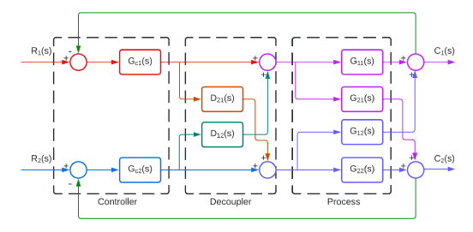
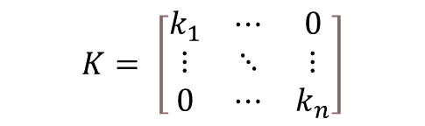
Decentralized Control
Simplest approach for multivariable controller design [7]
Diagonal controller
Design controllers separately, to control a single output
$$K= \left[\begin{matrix}k_{1} & ⋯ & 0 \\ ⋮ & ⋱ & ⋮ \\ 0 & ⋯ & k_{n}\end{matrix}\right]$$

Slide 17
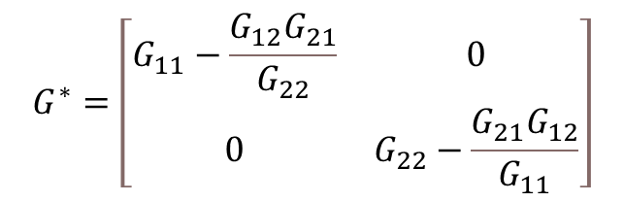
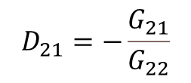
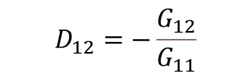


Decoupler Design
$$G^{∗}=GW_{1}= \left[\begin{matrix}G_{11} & G_{12} \\ G_{21} & G_{22}\end{matrix}\right]∗\left[\begin{matrix}1 & D_{12} \\ D_{21} & 1\end{matrix}\right]$$
$G^{∗}=\left[\begin{matrix}G_{11}+G_{12}D_{21} & G_{11}D_{12}+G_{12} \\ G_{21}+G_{22}D_{21} & G_{21}D_{12}+G_{22}\end{matrix}\right]$,
$$D_{12}=−\frac{G_{12}}{G_{11}}$$
$$D_{21}=−\frac{G_{21}}{G_{22}}$$
(8)
$$G^{∗}=\left[\begin{matrix}G_{11}−\frac{G_{12}G_{21}}{G_{22}} & 0 \\ 0 & G_{22}−\frac{G_{21}G_{12}}{G_{11}}\end{matrix}\right]$$
(9)

Slide 18
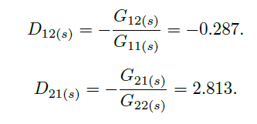
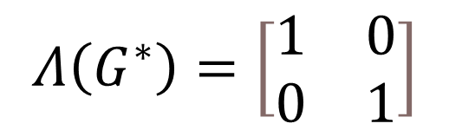
Decoupler design
$$Λ\left(G^{∗}\right)=\left[\begin{matrix}1 & 0 \\ 0 & 1\end{matrix}\right]$$

Slide 19

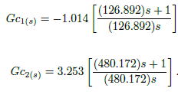
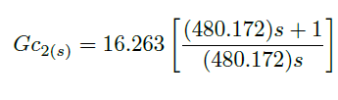
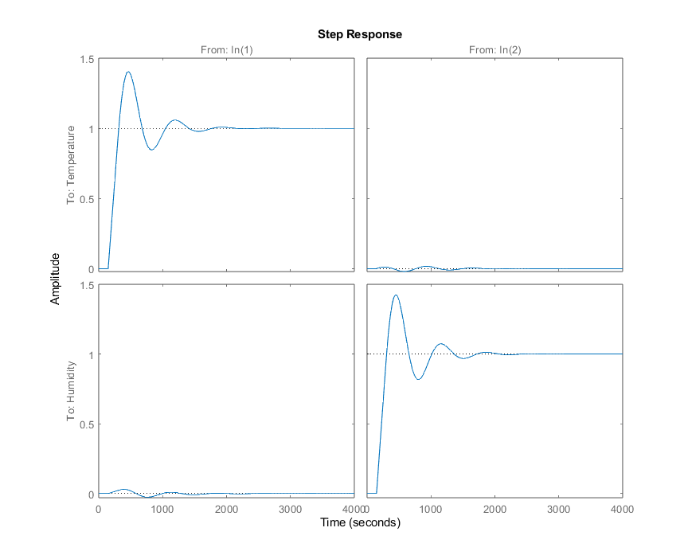
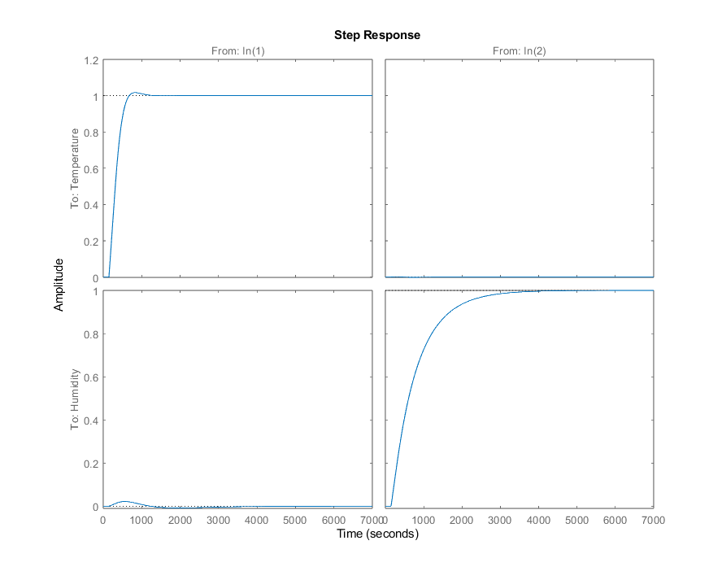
Controller Design
Reduce gain to improve control performance

Slide 20

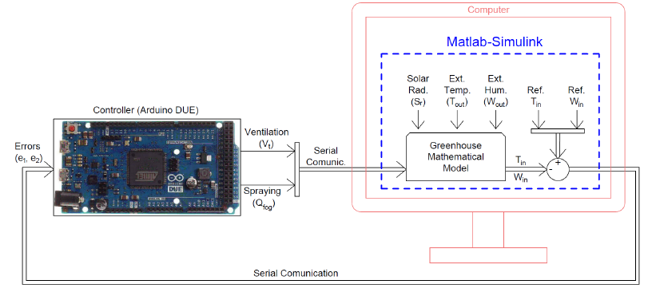

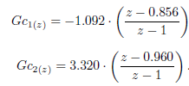

Conversion to Discrete time
“Tustin Approximation” [8]
(10)
(11)

Slide 21
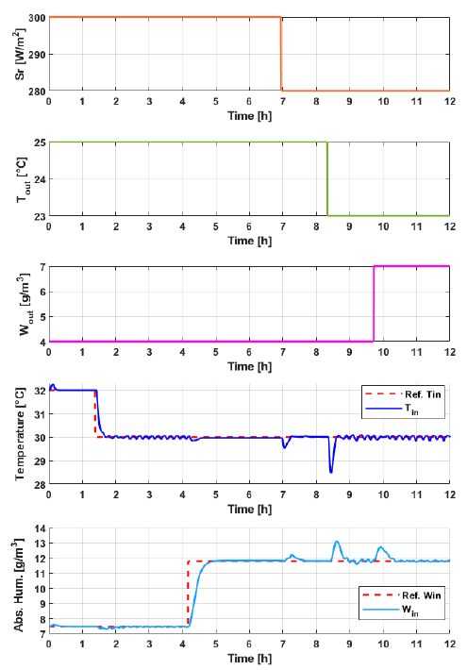
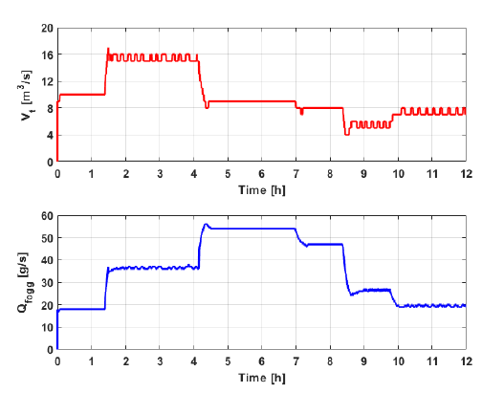
Article Results
Notes:
Tracking – good tracking performance, tracks reference changes within 15-30minutes
Reference changes would not be common occurrence (only two per day, one in morning one at night) so 30 minutes to track is good.
Can see that the system is decoupled well, reference changes minimally impact the other variable
Temperature controller has more oscillations, due to neglected dynamics?
Disturbance rejection – two controllers reject disturbances in 15mins, temp controller faster than humidity controller
Control actions – fogging is smooth, ventilation has more oscillations

Slide 22
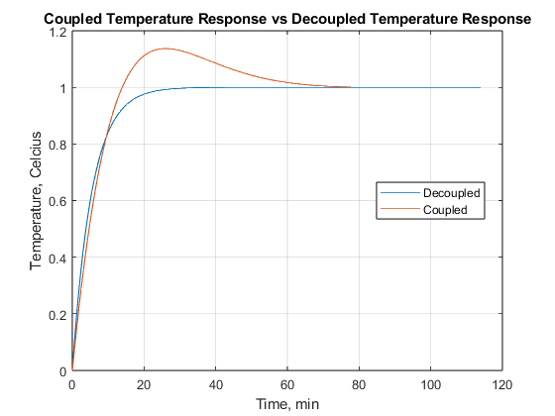
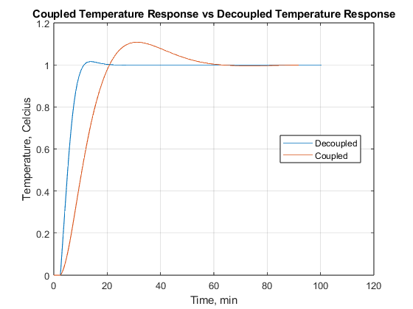
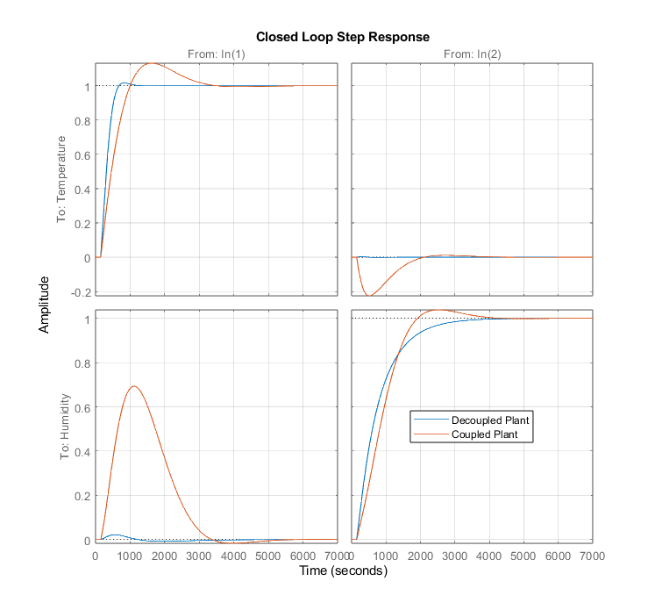
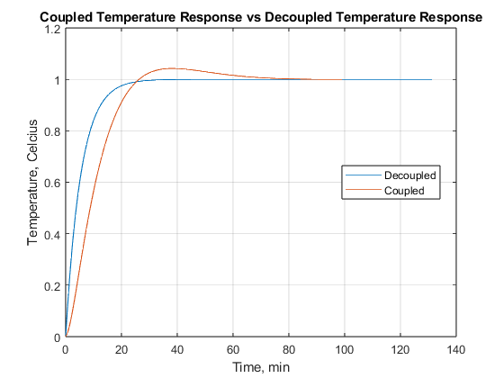
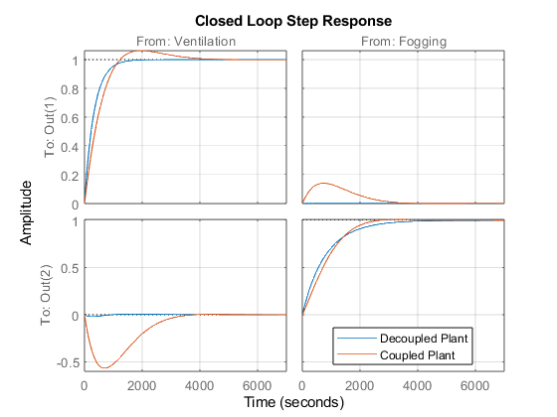
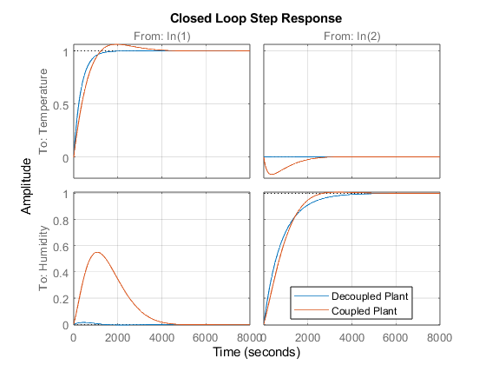
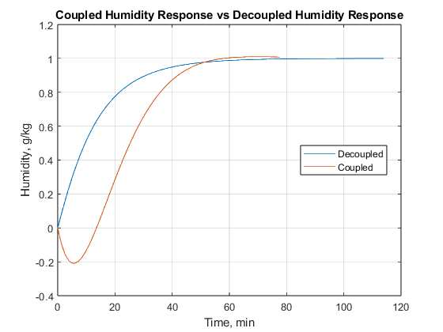
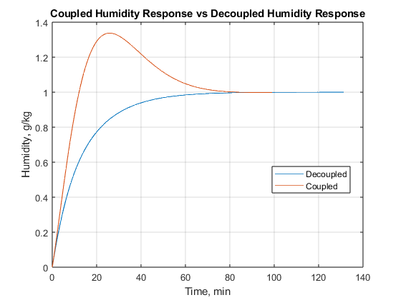
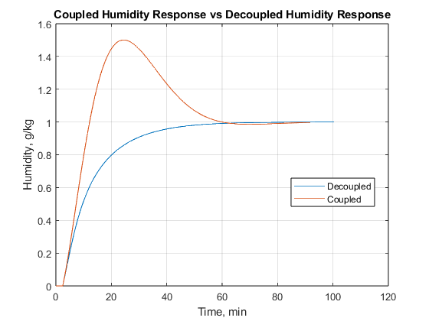
System Insights: Decoupling vs coupling
Notes:
Question to answer; what happens if you don’t decouple the outputs?
Interactions affect the output, worse results…more difficult to control?

Slide 23
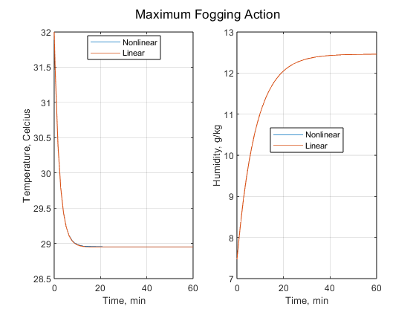
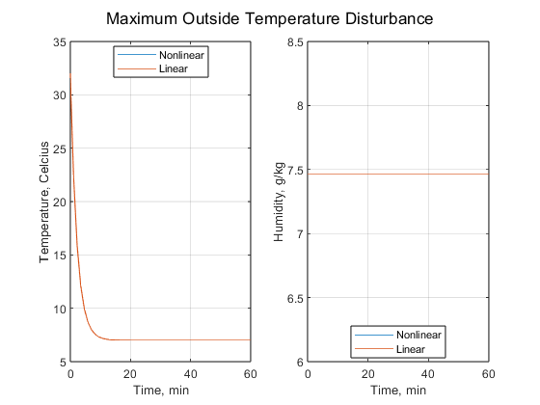
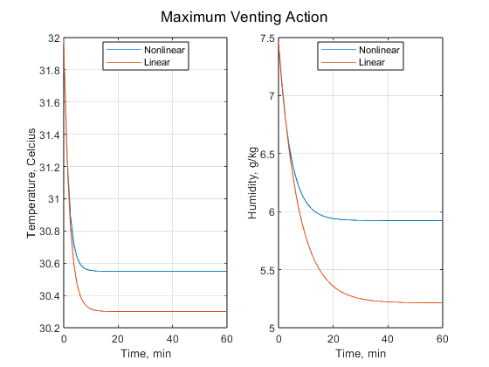


System insights: Validity of linear model
Linear model matches nonlinear system well for most variables over realistic ranges
Linear model breaks down under very little change in venting (±1m³/s)
Notes:
Question to answer; what ranges is the linear model valid?
Most inputs and disturbances are model the NL system very well over the possible range.
I’m not sure if this difference (which is <1 degree) poses a major issue. I wonder if there is a set of conditions where this would become an issue?
Ventilation breaks down almost immediately. I wonder if there’s a better physical model for it.

Slide 24



System insights: Disturbance Responses
Notes:
Question to answer; how much do the disturbances affect the plant?
Disturbance responses have much higher magnitude than input responses
Kind of expected.

Slide 25



System insights: S,T, and Sg_{d}
$$\overline{σ}\left(T\right)≈1 for ω<0.001 \frac{rad}{s}$$
Good tracking at steady state
Good noise rejection
$$\overline{σ}\left(SG_{d}\right)>3dB,\text{0.002<}\text{ω}\text{<0.012}$$
Bad disturbance rejection in this range

Slide 26




Disturbance Rejection
Outside Temperature Step Response ($\text{ω}$=0)
Outside Temperature Response($\text{ω}$=0.01)
Notes:
Steady state input – response goes to zero in ~16minutes
Frequency input minimally damps the response
Point of improvement – frequency is so close to the operating frequency

Slide 27
References
[1] G. Cevallos, J. Pinzon, and O. Camacho, “A microclimate greenhouse multivariable control: A guide to use hardware in the Loop Simulation,” 2022 IEEE International Conference on Automation/XXV Congress of the Chilean Association of Automatic Control (ICA-ACCA), 2022.
[2] Energy Producing Greenhouse: Organic Photovoltaics Integrated Greenhouse. 2023.
[3] S. Trimble. Transpiration in Plants: Its Importance and Applications. 2022.
[4] Environmental Control Systems. [Online]. Available: https://cals.arizona.edu/hydroponictomatoes/system.htm. [Accessed: 30-Mar-2023].
[5] S. J. Lilly, “Chapter 11: Plant Health Care,” in Arborists' Certification Study Guide, P. Currid, Ed. Atlanta, GA: International Society of Arboriculture, 2010, p. 180.
[6] G. Acquaah, Horticulture: Principles and Practices. Upper Saddle River, NJ: Pearson Education, Inc., 2009.
[7] S. Skogestad and I. Postlethwaite, Multivariable Feedback Control: Analysis and Design. Chichester: Wiley, 2005.
[8] “Continuous-Discrete Conversion Methods,” Continuous-Discrete Conversion Methods - MATLAB & Simulink. [Online]. Available: https://www.mathworks.com/help/ident/ug/continuous-discrete-conversion-methods.html#bs78nig-8. [Accessed: 15-Apr-2023].

