Slide 1
AI-Powered Job Matching & Resume Optimization System
Team Members:
Amadou Sarjo Jallow
Jones Omoyibo
Williams Afotey Botchway

Slide 2
Agenda
Objective & Target Audience
Application Overview
System Workflow & Orchestration ( Overall Image Representation )
Project Structure
Agents & Features
UI Demo Flow
Team Contributions
GitHub Repository
Conclusion & Reflection

Slide 3
Objective & Audience
Objective:
Build an AI-powered system that automatically matches users with relevant jobs and generates tailored resumes using a multi-agent architecture.
Target Audience:
Job seekers (students, entry-level, professionals)
Individuals applying to multiple jobs efficiently
Users needing resume optimization

Slide 4
Objective & Audience
Problem Solved:
Manual job searching is time-consuming
Generic resumes reduce interview chances
Lack of personalization in job applications

Slide 5
Application Overview
This application uses multiple AI agents to:
Parse a user’s resume into structured data
Fetch job listings from external APIs
Match jobs based on skills and experience
Rank jobs by relevance
Aggregate and clean results
Display results through a user interface
Generate tailored resumes for selected jobs

Slide 6
Application Overview
Key Idea:
A modular multi-agent system where each agent performs a specific task in the pipeline.

Slide 7
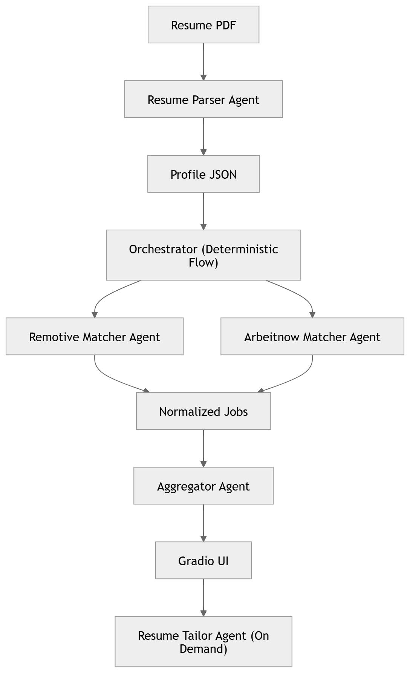
System Workflow & Orchestration
Pipeline Overview:

Slide 8
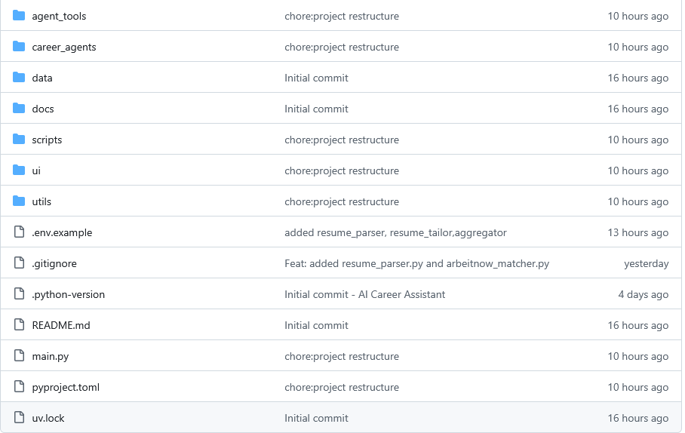
Project Structure (Screenshot Slide)

Slide 9
Project Structure
Description:
career_agents/ → Core AI agents (parser, remotive_matcher, arbeitnow_matcher, aggregator, resume generator)
agent_tools/ → Contains Function tools
utils/ → Helper functions (PDF parsing, scoring, etc)
scripts/ → pdf generation script etc
ui/ → Gradio interface
main.py → Entry point
career_agents/orchestrator.py → Controls Deterministic workflow
docs/ → docs

Slide 10
Agents & Features
1. Resume Parser Agent
Role:
Extract structured data from resume
Output:
Profile JSON:
Skills
Experience
Projects
Education etc

Slide 11
Agents & Features
2. Remotive Matcher Agent
Role:
Fetch jobs using fetch_remotive_jobs()
Match jobs against user profile
Assign match scores

Slide 12
Agents & Features
3. Arbeitnow Matcher Agent
Role:
Fetch jobs using fetch_arbeitnow_jobs()
Match jobs against user profile
Assign match scores

Slide 13
Agents & Features
Matcher Features
✔ Uses external APIs (tool-based integration)
✔ Performs filtering + ranking
✔ Outputs normalized job structure

Slide 14
Agents & Features
4. Aggregator Agent
Role:
Combine job results from both matchers
Remove duplicates
Sort jobs by match score
Return top results

Slide 15
Agents & Features
5. Resume Tailor Agent
Role:
Generate a job-specific resume
Highlight relevant skills and experience
Save resume locally

Slide 16
Agents & Features
6. Orchestrator (Non-Agent Component)
Role:
Controls system workflow
Calls agents in correct sequence
Ensures data flows correctly between components

Slide 17
Agents & Features
Key System Features
✔ Modular multi-agent design
✔ Tool-augmented agents (API integration)
✔ Parallel job matching
✔ Built-in ranking inside matchers
✔ Clean separation of responsibilities

Slide 18
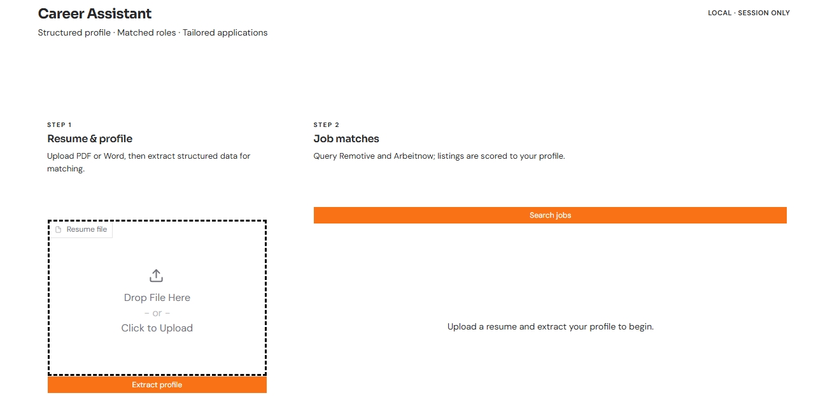
UI Demo Flow

Slide 19
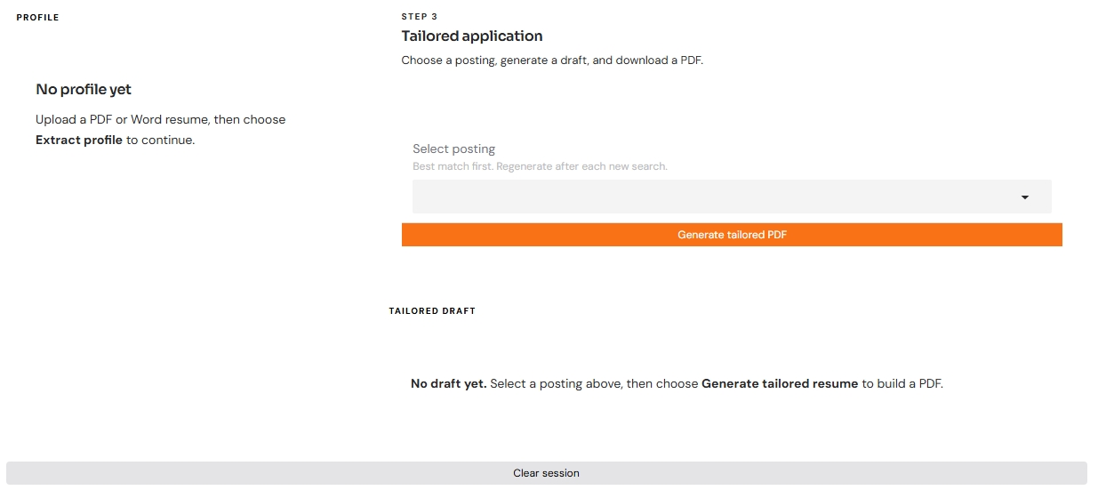
UI Demo Flow

Slide 20
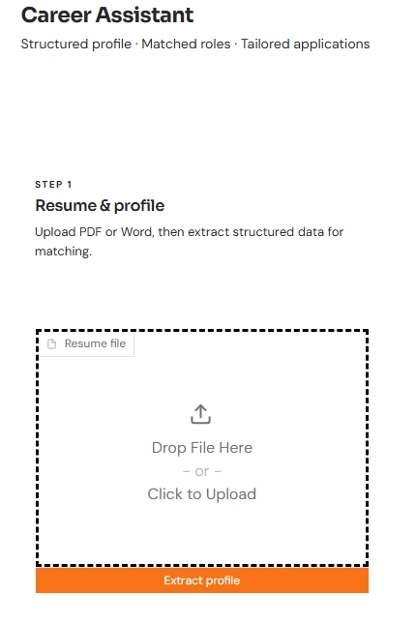
UI Demo Flow

Slide 21
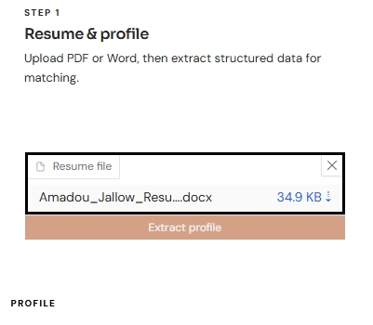
UI Demo Flow

Slide 22
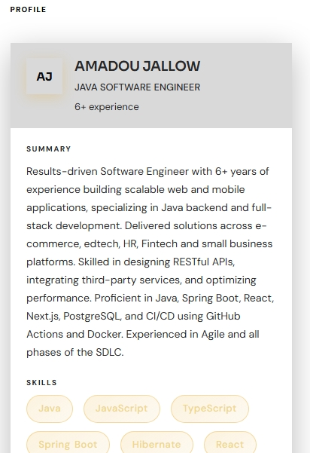
UI Demo Flow

Slide 23
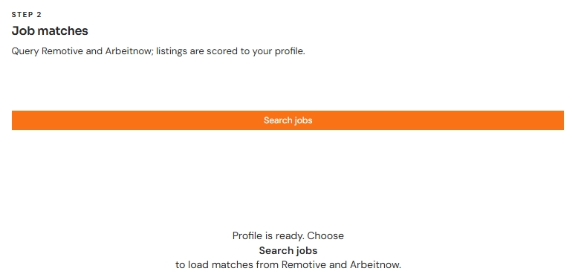
UI Demo Flow

Slide 24
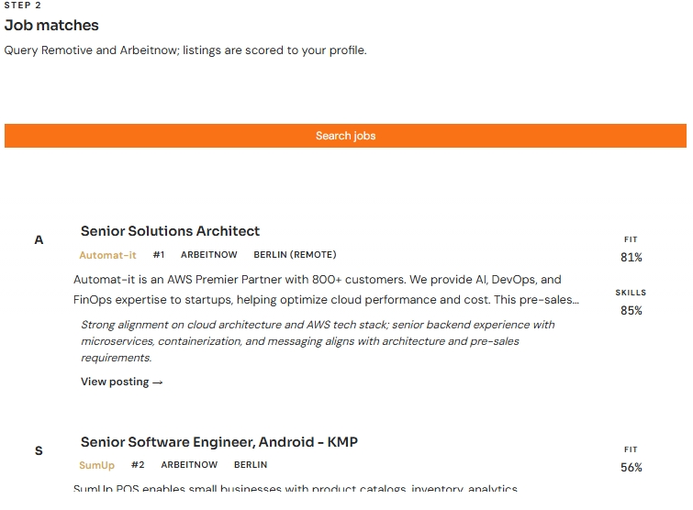
UI Demo Flow

Slide 25
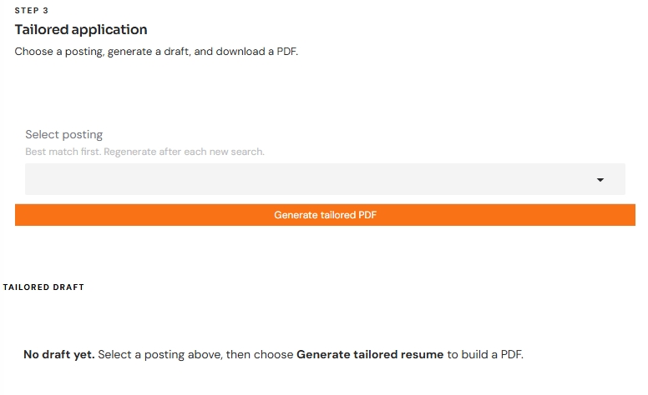
UI Demo Flow

Slide 26
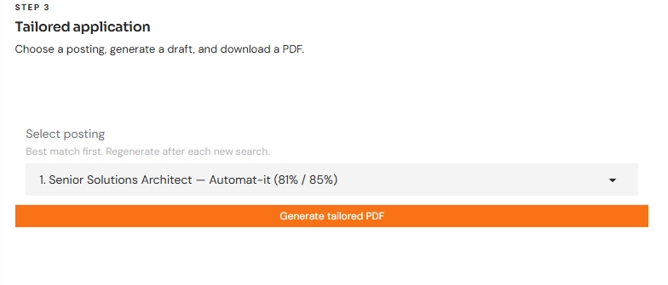
UI Demo Flow

Slide 27
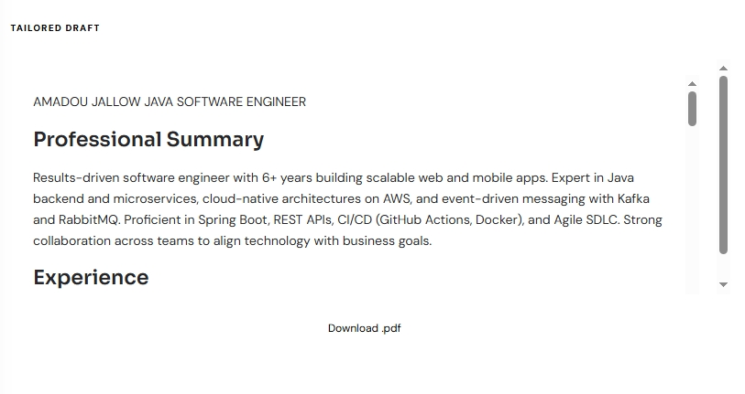
UI Demo Flow

Slide 28
Team Contributions
Amadou Sarjo Jallow
Designed overall system architecture
Implemented orchestrator and multi-agent workflow
Built and integrated the Gradio UI

Slide 29
Team Contributions
Jones Omoyibo
Developed Resume Parser Agent
Implemented Resume Tailor Agent
Built Aggregator Agent for result consolidation

Slide 30
Team Contributions
Williams Afotey Botchway
Developed Remotive Matcher Agent
Developed Arbeitnow Matcher Agent
Implemented API function tools for job fetching and integration

Slide 31
GitHub Repository
Repository Link:
https://github.com/AMS-JR/ai-career-assistant
Includes:
Full source code
Agent implementations
API integrations
UI (Gradio)
GitHub Repository

Slide 32
Conclusion & SCI Reflection
Conclusion:
Successfully built a scalable AI-driven job matching system
Demonstrated the power of multi-agent architectures
Improved efficiency of job searching and resume customization

Slide 33
Conclusion & SCI Reflection
SCI Reflection (Systems & Computational Intelligence):
The Orchestrator represents a form of centralized control, similar to principles in control systems, where a central mechanism coordinates all components to achieve a goal.
This aligns with SCI’s idea that a unified intelligence coordinates different parts of a system to function harmoniou

Slide 34
Conclusion & SCI Reflection
The use of multiple agents demonstrates distributed intelligence, where each agent performs a specialized role.
This reflects the SCI concept that intelligence is expressed through different components, but originates from a deeper unified structure.

