Slide 1

Fox Plus Mechanical
Topic: Routing Cables Using Autodesk Inventor Cable and Harness
Andrew Robinson
KA3WDW
1Sept2025

Slide 2
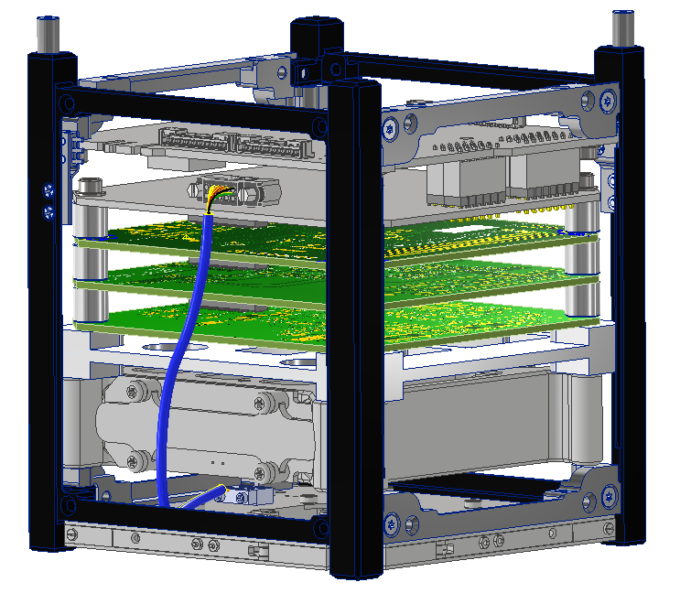
Model Screenshot
Harwin M80-5301042 Connector on Power-Signal Adapter
Harwin M80-4611042 Connector
9 wires in user-defined “Segments” to route as desired
Omnetics A29100-009 Connector on AntS
Omnetics A28000-009 Connector
Note: Model currently Work In Progress (WIP)

Slide 3
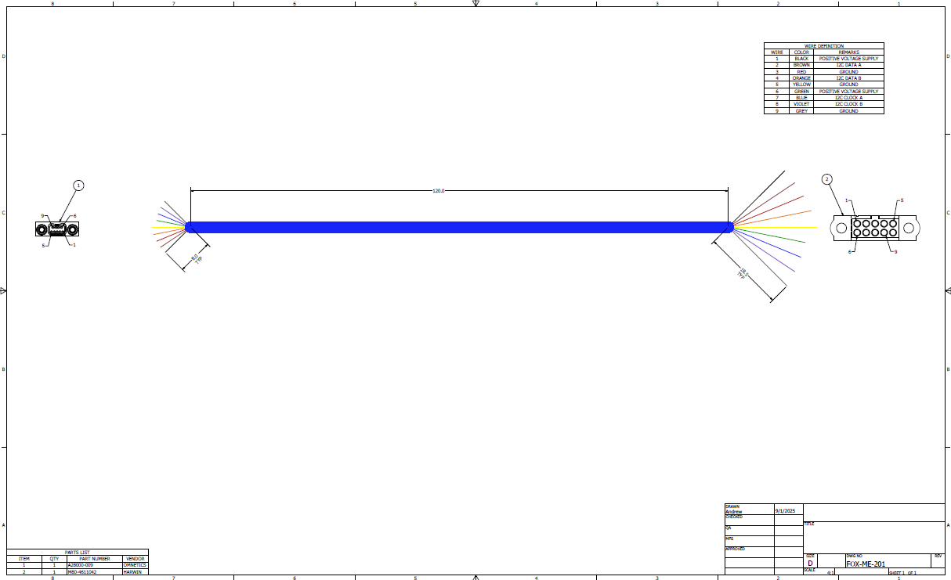
Cable Drawing
First cut at a drawing from cable layout
Wire details
Cable lengths
Connector
details
Connector
details
Model-driven BOM

