Slide 1
Fox+ Mechanical
Andrew Robinson
KA3WDW
11Dec2024

Slide 2
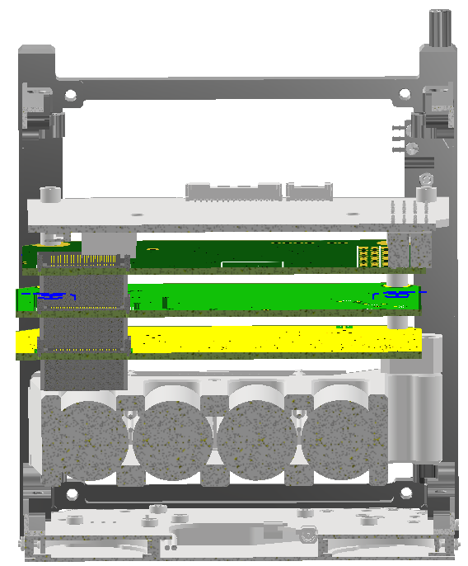
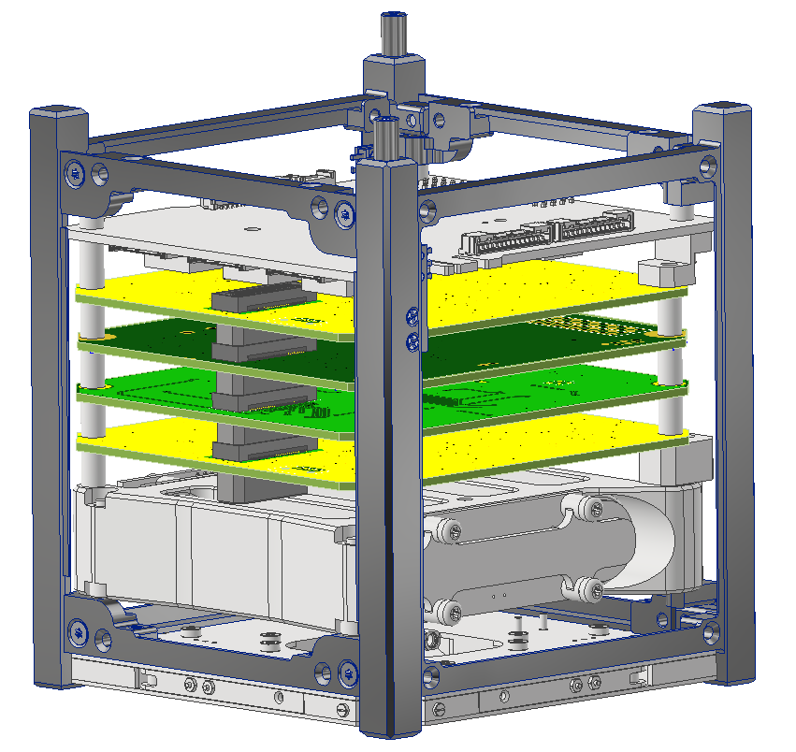
Motivation
CSKB
PC-104
ISISpace PIU
Mate via PC-104 and CSKB
Unfavorable Alignment
REMOVED
LIHU
X-Section

Slide 3
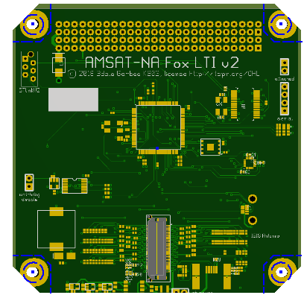
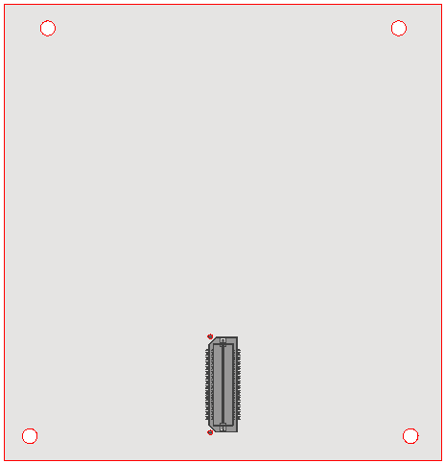
Idea
Is this correct?
Reposition PC-104 to mate with ISISpace EPS CSKB
95 mm
92 mm
95 mm
TBD Modifications
96 mm
Maintain QxH location
ME-113 PCB
ISISpace PCB
Mounting thru holes (x4)

