Slide 1
Fox+ Space Vehicle Mechanical Plan
FP-PN-001

Slide 2
Space Vehicle Coordinate System
In model space, where is the origin (0,0,0)?
Top
Y
y
x
z
X
Right
Z
Front

Slide 3
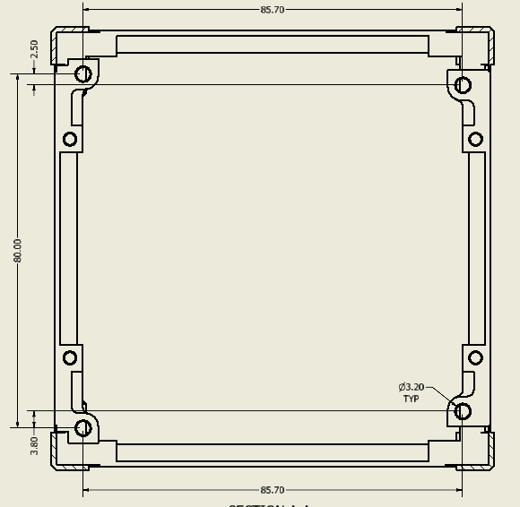
Frame Layout
Top Looking Bottom
Right
Front

Slide 4
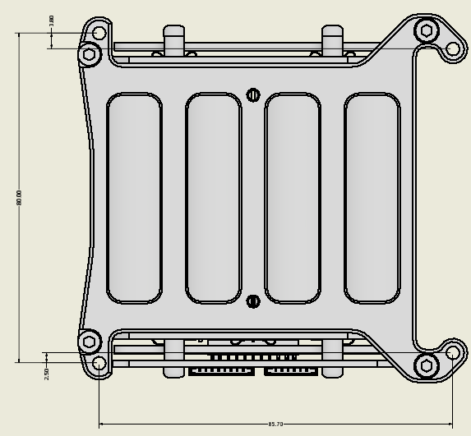
Battery Layout

Slide 5
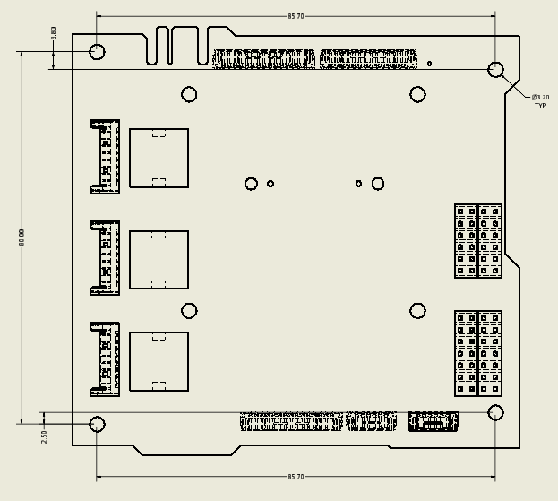
PIU Layout

Slide 6
Refence Documents
SBC = Satellite Body Coordinates
CDS = Cubesat Design Specification

Slide 7
Model Naming Convention
FP-AB-###
Types (AB):
ME: Mechanical Drawings
AN: Analysis
PN: Plans
ML: Parts Lists (MEL, BOM, etc.)

Slide 8
SV Decomposition
Fox+ SV
Structure
Antenna
EPS
RT-IHU
RXTX
ICR
Frame
PIU
Hardware
PBP
Solar Panels
Level 1
Level 2
Level 3

