Slide 1

Fox Plus Mechanical
Topic: Umbilical Connector
Andrew Robinson
KA3WDW
18Feb2026

Slide 2
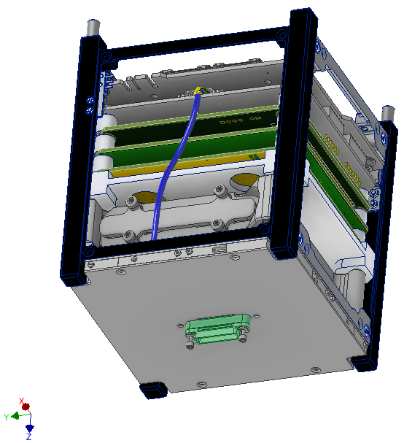
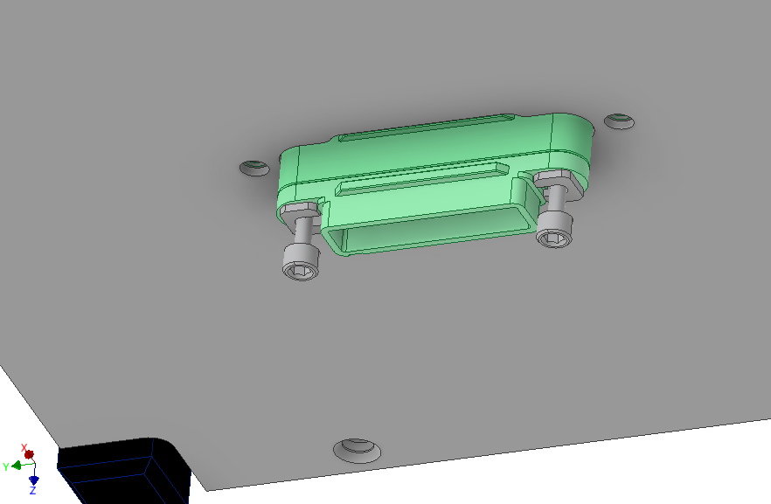
FoxPlus-A Umbilical Concept
Harwin G125-3242696M5
Harwin G125-2242696F1

Slide 3
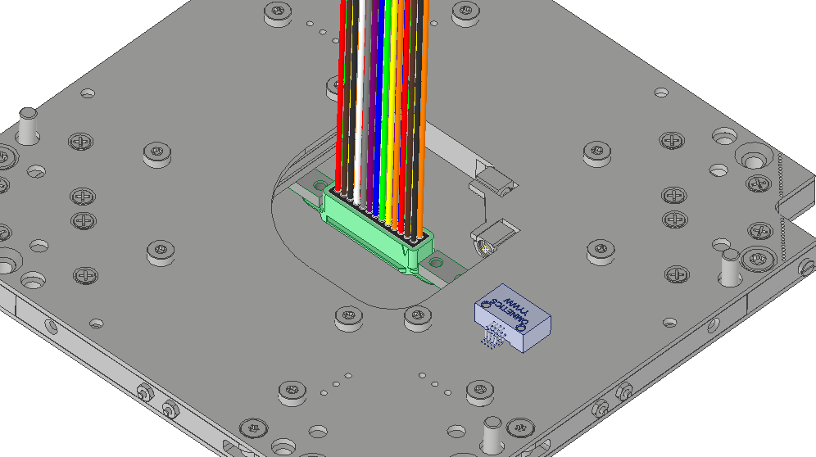
FoxPlus-A Umbilical Concept
ISISpace AntS

Slide 4
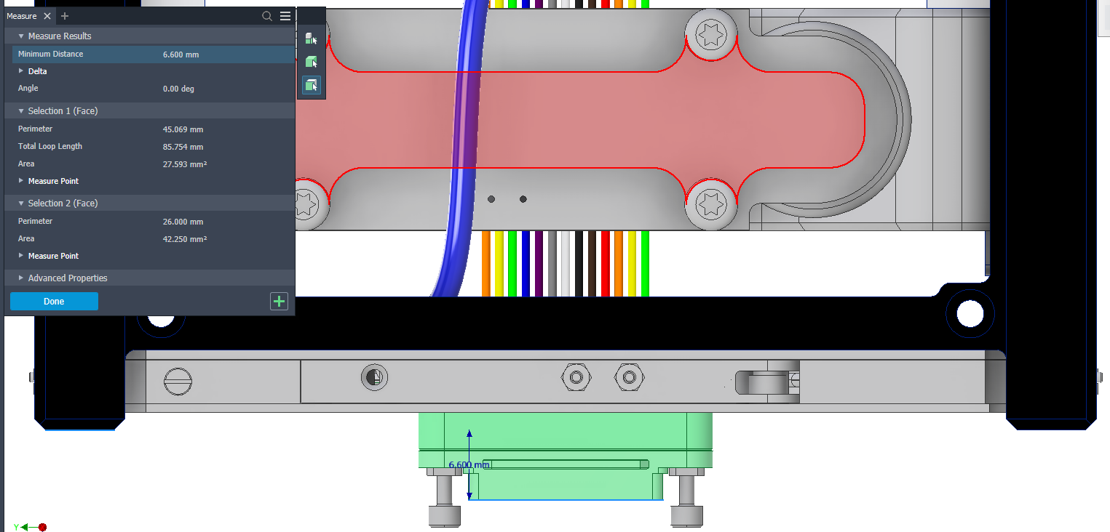
Umbilical Connector +Z-Face Protrusion
6.600 mm

Slide 5
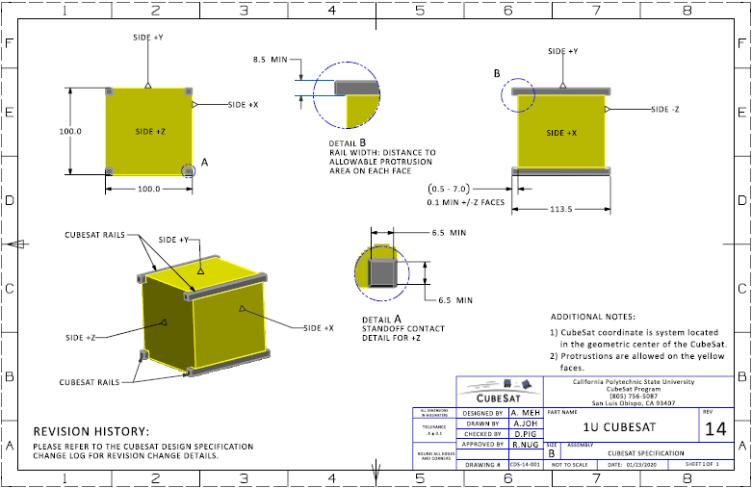
CubeSat Design Specification Rev. 14

Slide 6

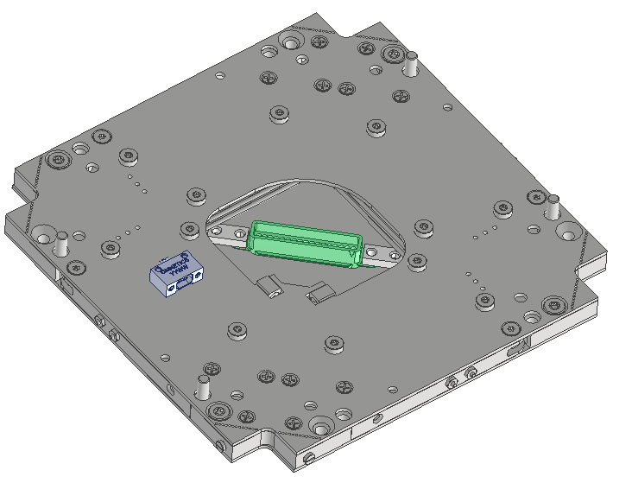
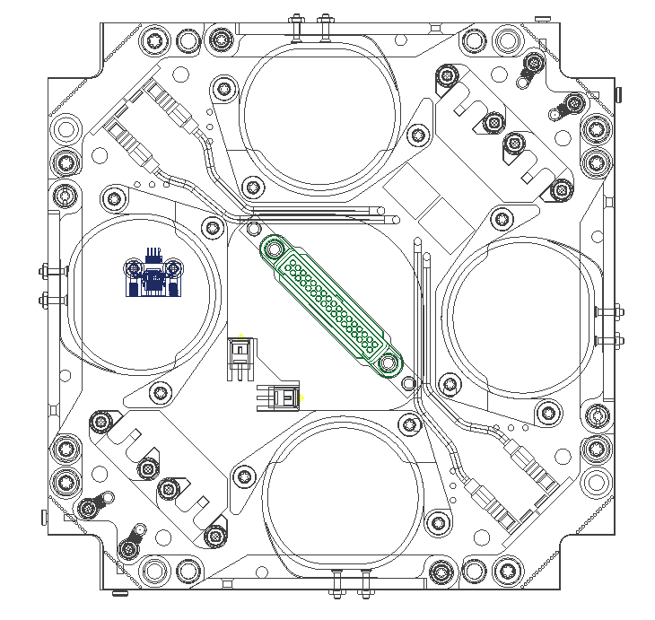
Optional Connector – 34 Pin
Minor interference
PINS
Harwin G125-3243496M5

