Slide 1
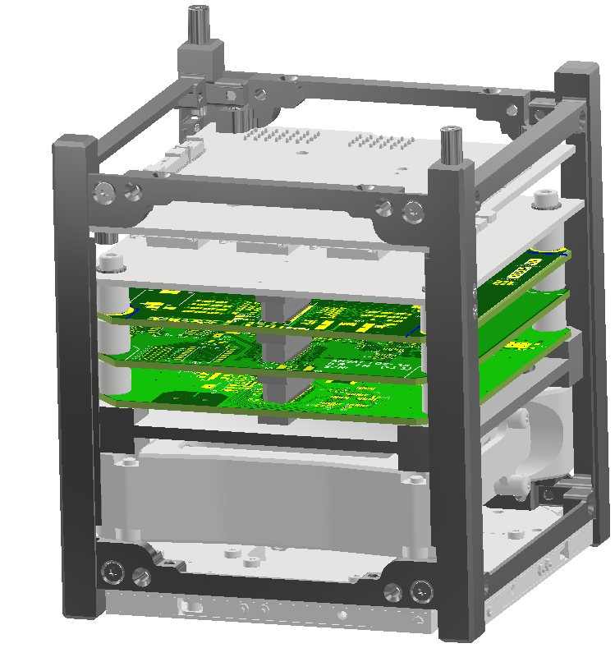
Space Vehicle Coordinate System
Back
Zenith
Right
Top
Inventor
Views
(0,0,0)
x
y
z
Y
X
Nadir
Z

Slide 2
Refence Documents
SBC = Satellite Body Coordinates
CDS = Cubesat Design Specification

Slide 3
Model Naming Convention

