Slide 1
Fox+ Mechanical
Andrew Robinson
KA3WDW
18Dec2024

Slide 2
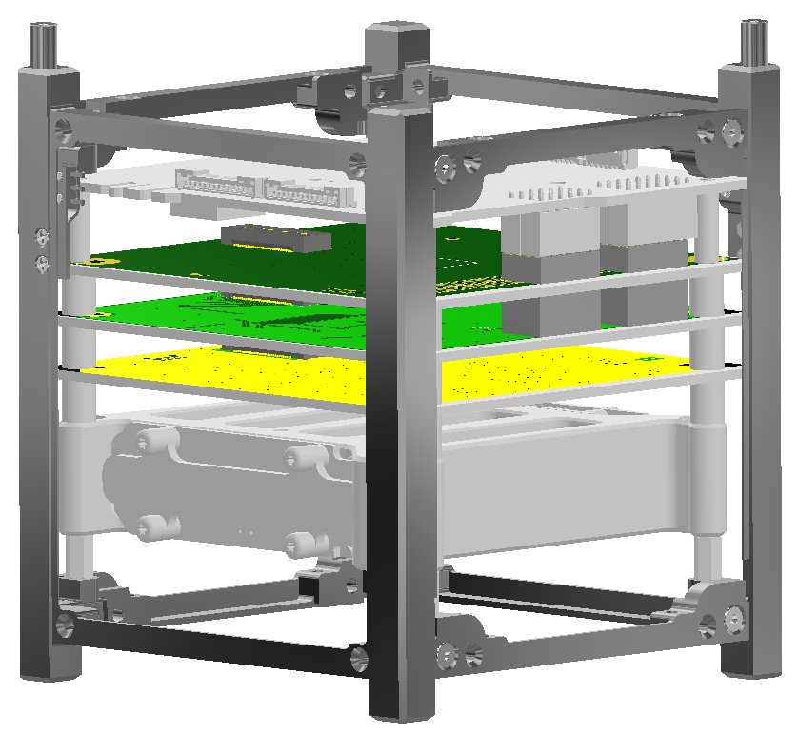
ISISpace PIU
LIHU
ICR
RXTX
ISISpace Battery

Slide 3
(4) Samtec ESQ-106-12-G-D
To be completely honest, not sure how these PC-104 type connectors install. The solid model for this part (from Mouser) had these two pieces, so I put one on the “bottom” of the board and one on the “top.”

Slide 4
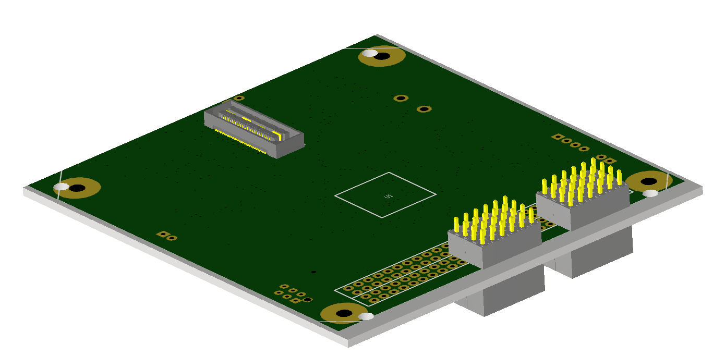
LIHU Details
92mm
96mm
(4) Thru holes align to the ISISpace hole pattern
LIHU board with the (4) ESQ-106-12-G-D connectors. The two on the right should be ESQ-107-12-G-D but that STEP model wasn’t available (easily) through Mouser. This position aligns with the ISISpace PIU CSKB-Lite connector in the assembly model.

Slide 5
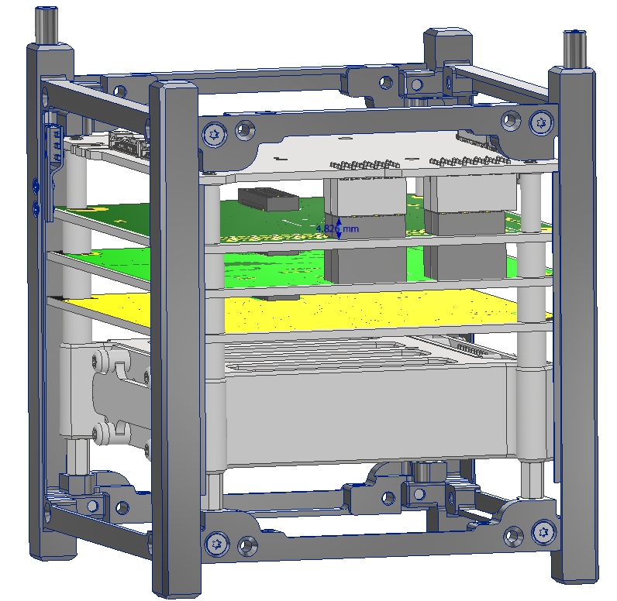
That piece on the top (is it needed?) is 4.826mm, so could save some space if it isn’t required.

Slide 6
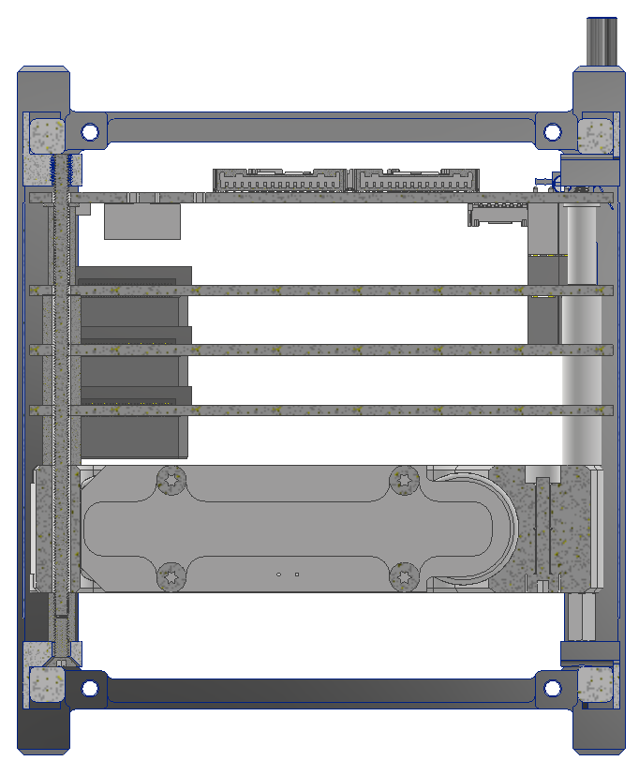
Stack Up Hardware
ISISpace Frame
Washer/Shim (COTS)
13mm Spacer (COTS)
FOX-ME-117-01 Spacers
M2.5 Threaded Rod (COTS, will need machined down)
M2.5 Female Threaded Standoff (COTS)
M2.5 C’sunk Fastener (COTS)
ISISpace Frame
X-Section View

Slide 7
Potential Re-Arranging
Small gap here; will need to put a washer/shim/spacer there (easy)
Originally wanted to not have this threaded spacer here and have the ISISpace battery sit on the frame. I would then move this threaded spacer to the “top” of the battery (in place of the FOX-ME-117-01 spacer) and run a long M2.5 c’sunk thread from the frame through the battery to the threaded spacer. Couldn’t seem to located a good reliable M2.5 c’sunk fastener long enough. If we hear back from ISISpace and M2.5 isn’t the right size (from the model, seems small) then we might be able to re-configure. With this layout there is some dead space under the battery.
X-Section View
This mounting scheme shown matches the stack up on the 1U frame that I have

Slide 8
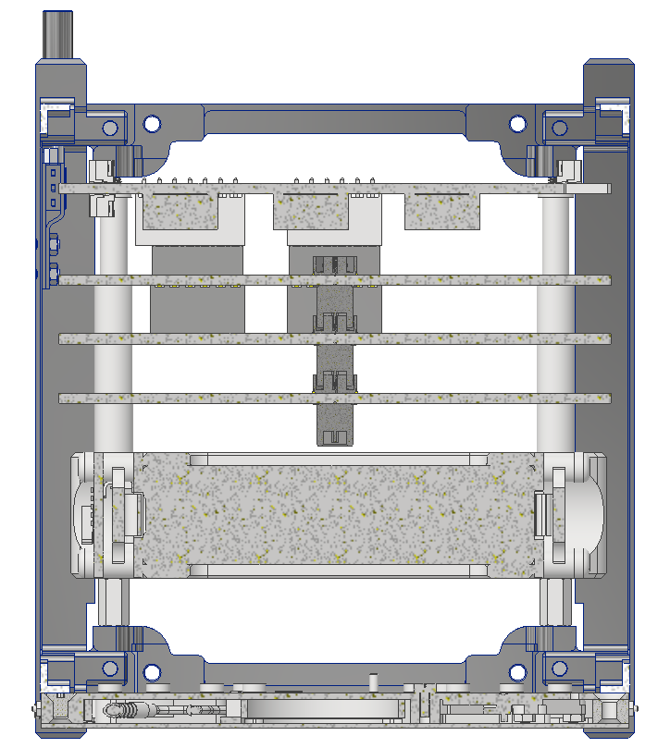
QxH Engagement
QxH engagement maintained by using heritage FOX-ME-117 spacers between boards
X-Section View

