Slide 1
Fox+ Mechanical
Andrew Robinson
KA3WDW
19Dec2024

Slide 2
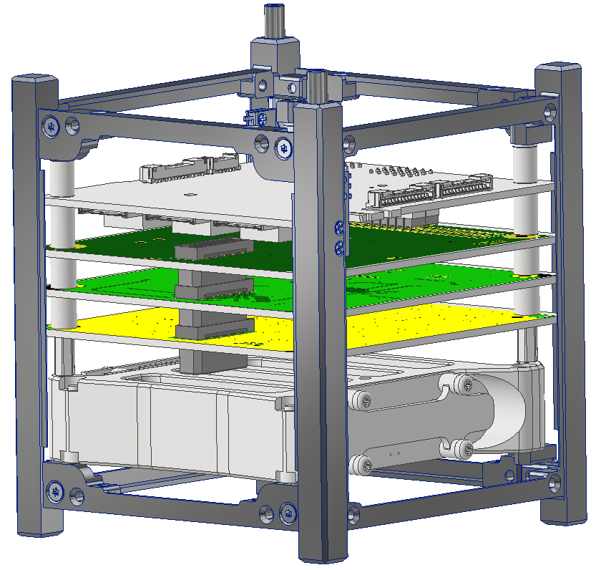

Slide 3
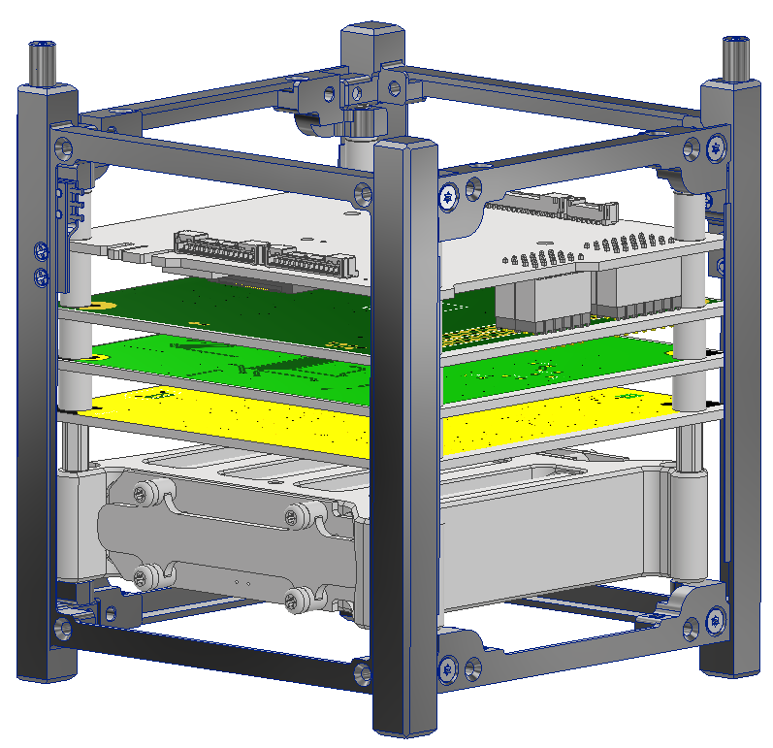
Only 9.761mm
(2) MTSW-107-08-L-D
(2) MTSW-106-08-L-D

Slide 4
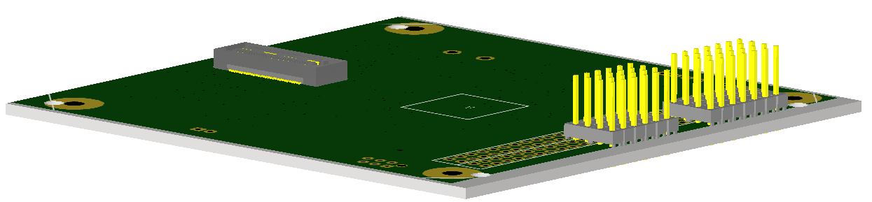
LIHU w/Header Pins

Slide 5
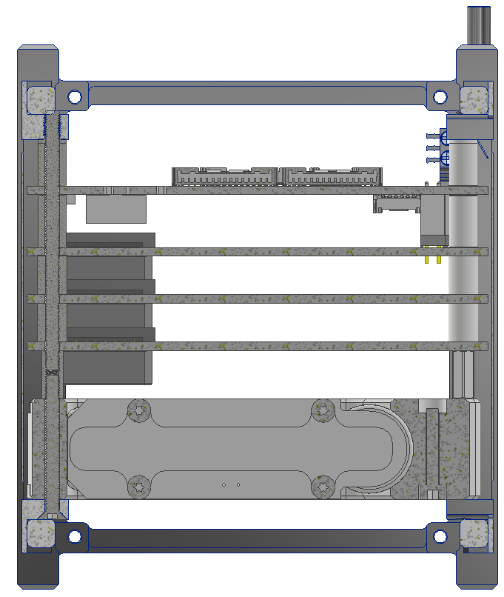
Stack Up Hardware
9mm Spacer + Shim (COTS)
11mm Spacer (COTS)
M3 Threaded Rod (COTS + Machined to Length)
FOX-ME-117-01 Spacers
M3x10mm Threaded Standoff (COTS)
(Made this 10mm instead of 8mm to enable sufficient thread engagement for M3x30 c’sunk and threaded rod)
M3x30mm C’Sunk Fastener (COTS)
X-Section View

