Slide 1

Fox+ Mechanical
Topic: ISISpace EPS CSKB and LIHU PC-104 Alignment
Andrew Robinson
KA3WDW
21Dec2024

Slide 2
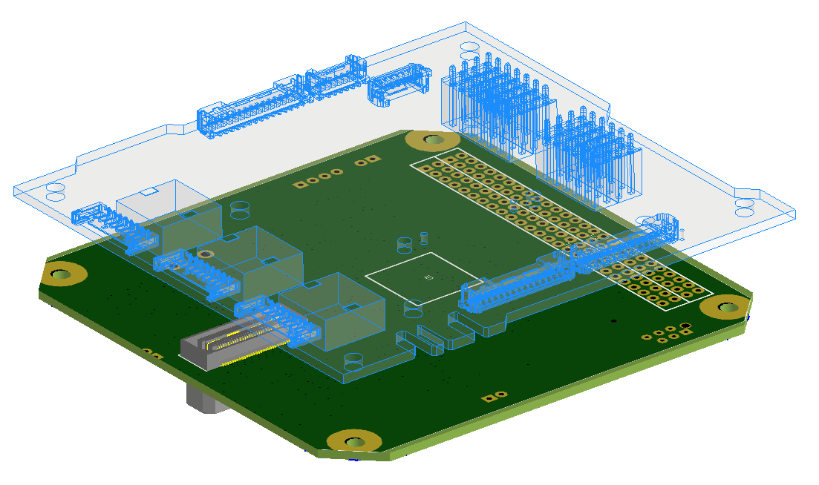
ISISpace EPS Board
(Transparent w/ outline)
LIHU

Slide 3
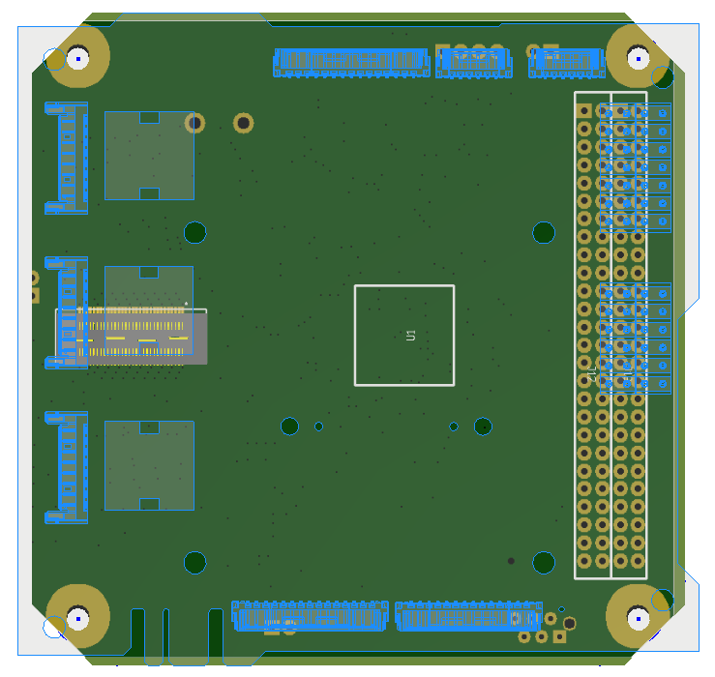
ISISpace EPS Board
(Transparent w/ outline)
LIHU

Slide 4
Centered
92mm
The ISISpace EPS bolt holes must stay fixed (to align with the ISISpace frame) but the LIHU can slide to the left and to the right (by 2mm in each direction).
92mm
2mm
2mm
96mm

Slide 5
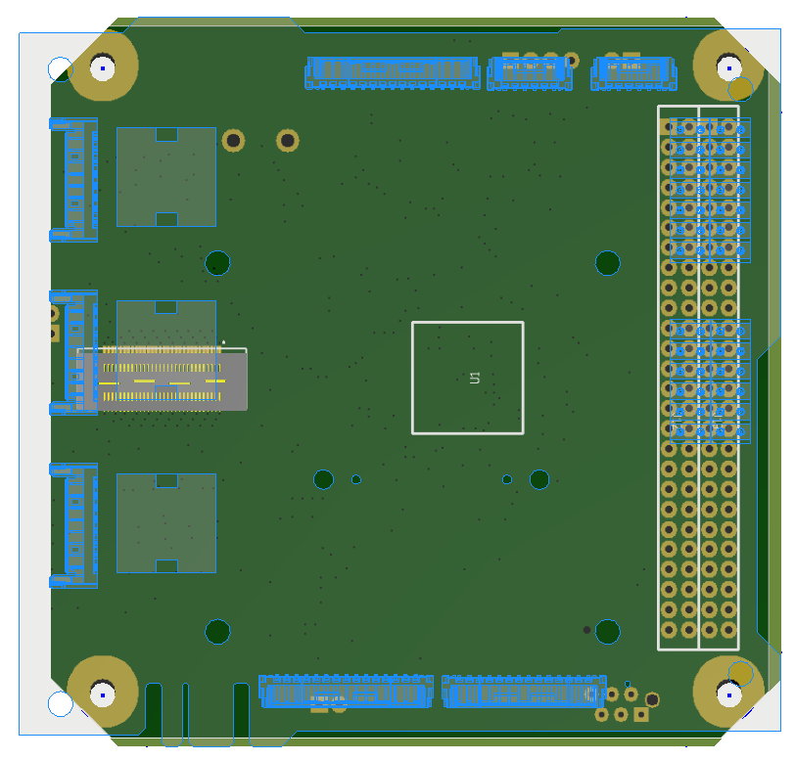
LIHU Slid Right
4mm

Slide 6
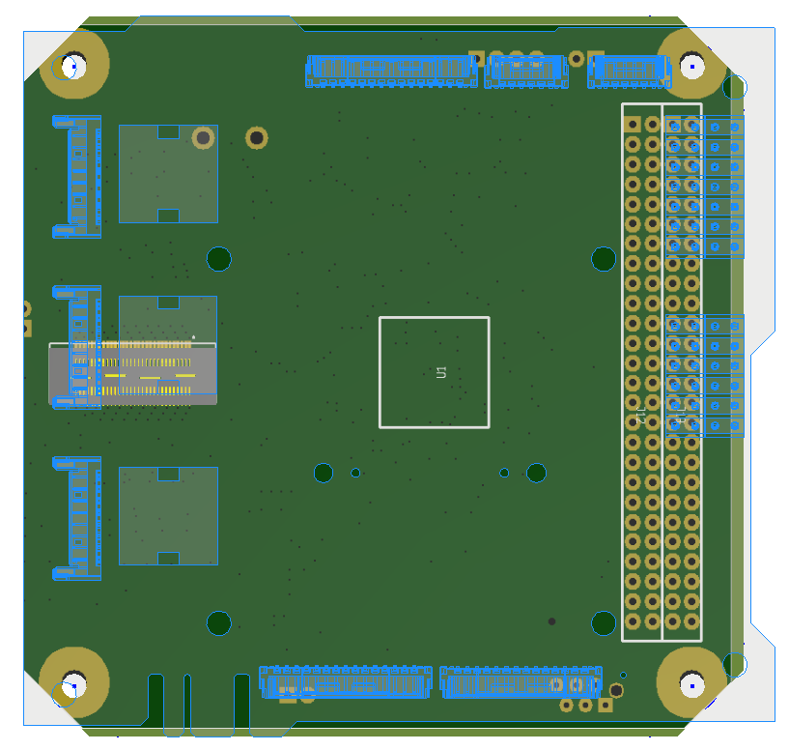
LIHU Slid Left
4mm

