Slide 1

Fox-Plus Mechanical
Topics: Mechanical Assumptions and Constraints
FOX-ME-203 Adapter PCB Overview
Andrew Robinson
KA3WDW
5Jan2025

Slide 2
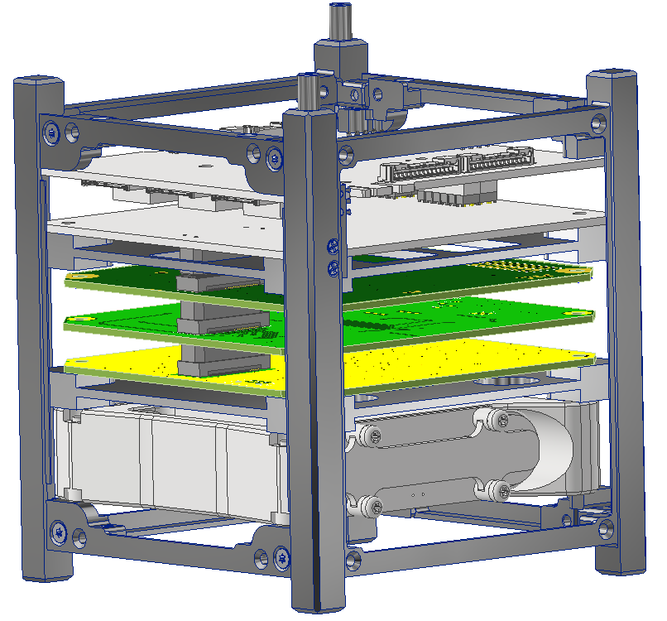
Assumptions and Constraints
Top hole pattern on ISISpace frame is fixed
Top holes on ISISpace frame are M3 helicoil inserts (female)
ISISpace EPS hole pattern is fixed
ISISpace EPS hole pattern per ISISpace ICD (same as frame)
ISISpace frame oriented as shown to have ISISpace EPS board oriented with CSKB sockets pointing down
Adapter PCB needed with QTH on bottom and CSKB on top
Hole pattern not fixed
TBD adapter needed to go between PCB hole pattern and ISISpace hole pattern
Will need to be roughly 8mm to have proper QxH engagement with IHU
RXTX, ICR, and LIHU board hole patterns are fixed
Possible minor hole adjustments (slots?)
Hole patterns are per GOLF/FOX-ME-113
Spacing between boards set by FOX-ME-117 spacers (roughly 8mm)
Boards can move in x/y direction by a small amount (<5mm)
TBD adapter needed to go between ISISpace hole pattern and PCB hole pattern
ISISpace battery hole pattern is fixed
ISISpace battery must be oriented as shown in this stack configuration
Bottom hole pattern on ISISpace frame is fixed
Bottom holes on ISISpace frame are M3 countersunk holes
Note: Model currently Work In Progress (WIP)

Slide 3
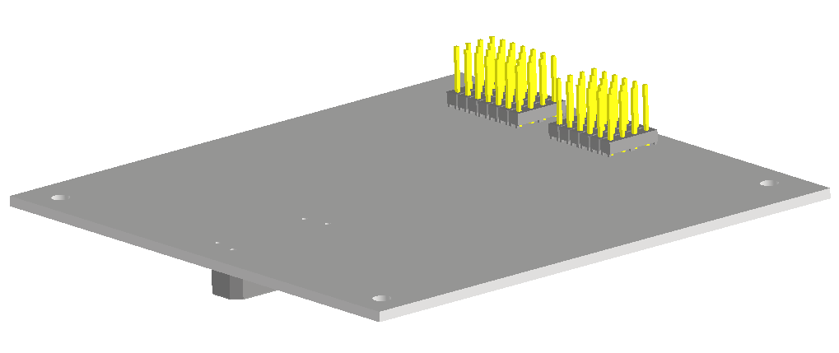
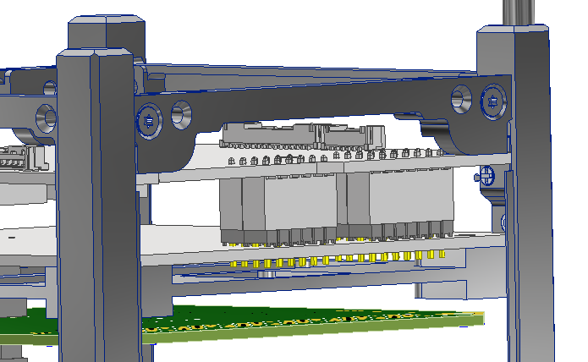
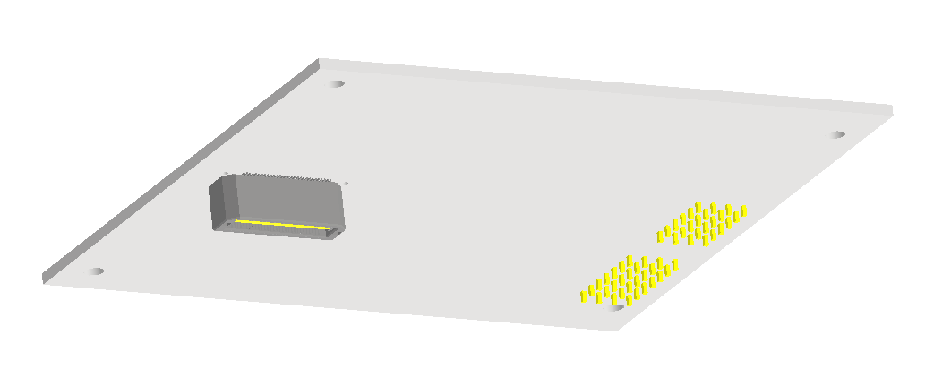
FOX-ME-203 Adapter PCB Images
(2) MTSW-107-08-L-D-300
(2) MTSW-106-08-L-D-300
Currently ISISpace bolt hole pattern to match ISISpace EPS board
Top
96mm
92mm
Bottom
(2) MTSW-107-08-L-D and (2) MTSW-106-08-L-D headers mate with ISISpace EPS socket
Samtec QTH-030-02-L-D-A

Slide 4
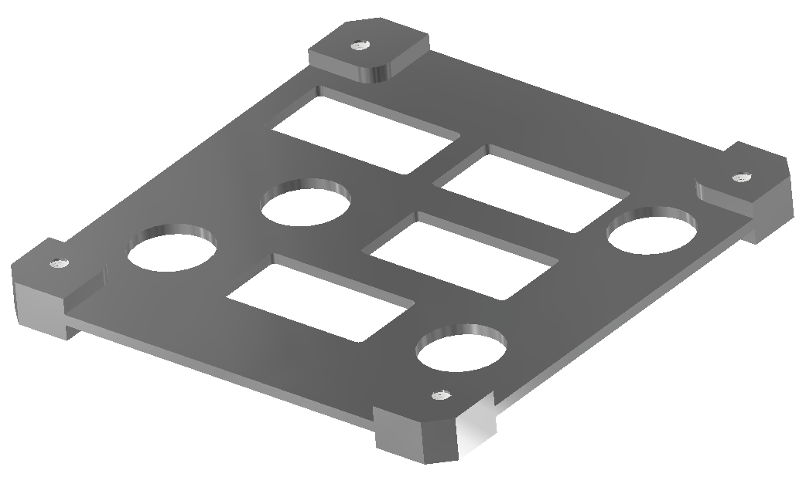
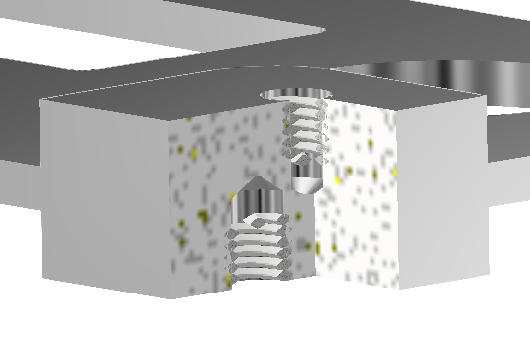
Adapter Concept
GOLF/FOX-ME-113 hole pattern on top (mate with RXTX/ICR/IHU stack)
(8) M3 Helicoils
Minimal (yet significant) difference between hole patterns makes this challenging
ISISpace hole pattern on bottom (mate with battery)
Note: Similar concept for “top” adapter, just reversed
¾-X Section

