Slide 1
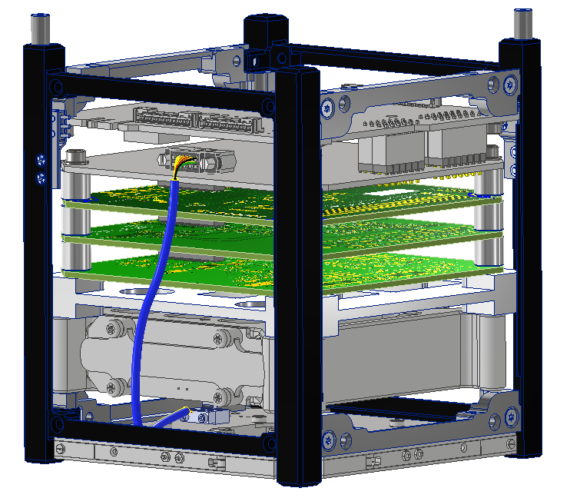
ISISpace 1U Frame
ISISpace Power Integration Unit (PIU)
FOX-ME-204 Power Signal Adapter (PSA)
LIHU
ICR
RXTX
FOX-ME-203 Mechanical Adapter
ISISpace Power Battery Pack (PBP)
ISISpace AntS

Slide 2
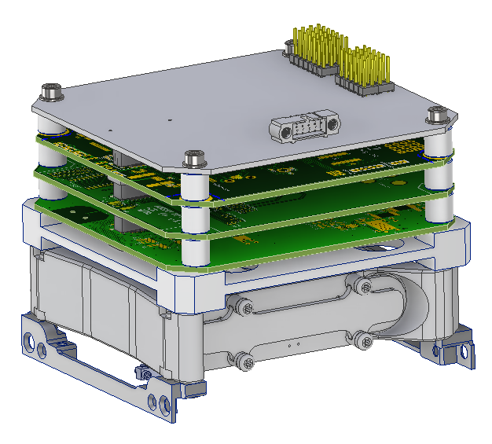
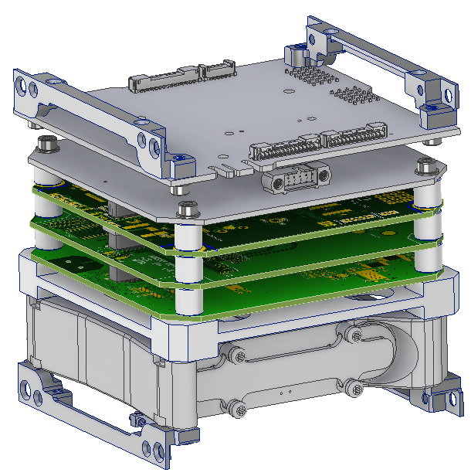
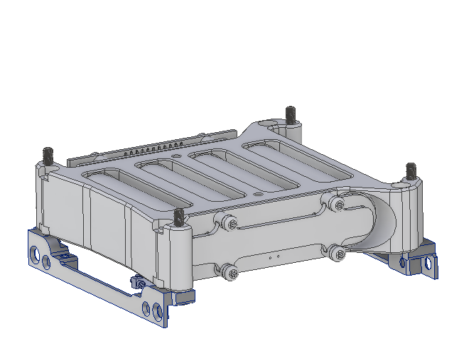
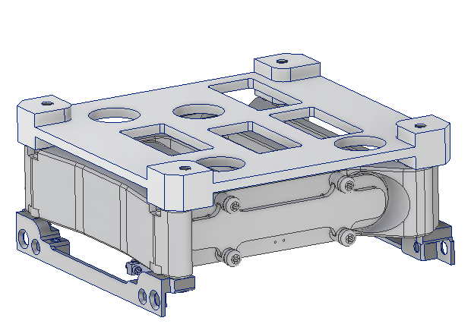

Slide 3
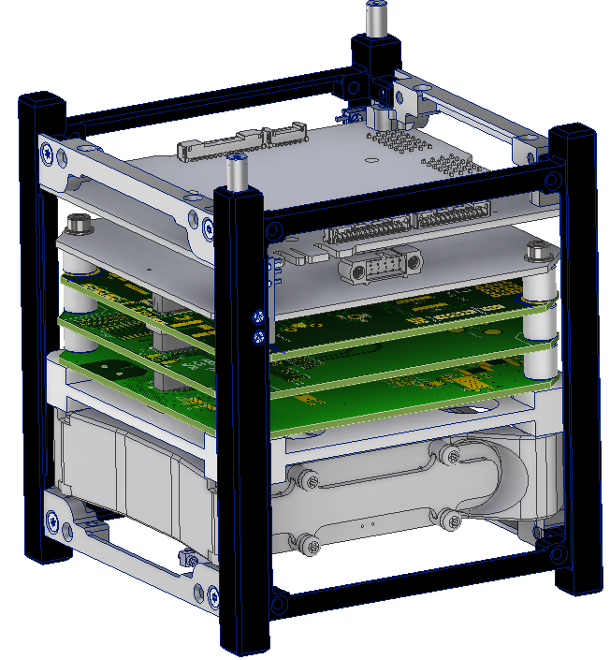
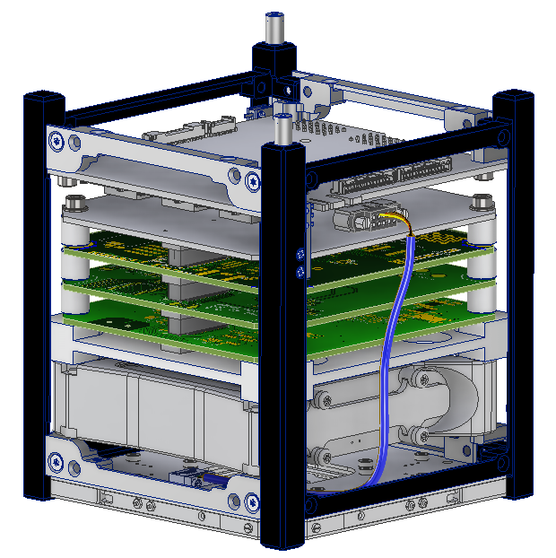

Slide 4
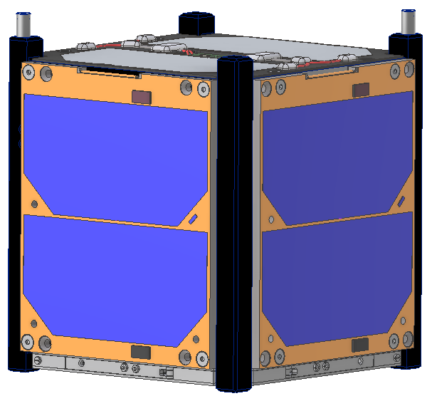

Slide 5
