Slide 1
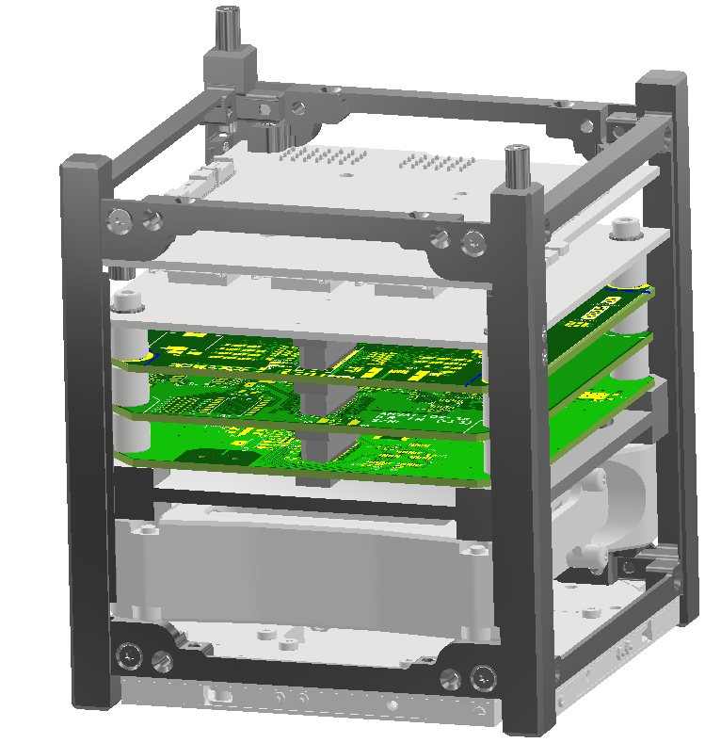
Space Vehicle Coordinate System
Top
Zenith
Right
Front
Inventor
Views
(0,0,0)
Y
y
x
z
X
Z
Nadir

Slide 2
Refence Documents
SBC = Satellite Body Coordinates
CDS = Cubesat Design Specification

Slide 3
Model Naming Convention

