Slide 1

AMSTer : SAR & InSAR Automated Mass processing Software for Multidimensional Time series
Nicolas d’Oreye^{1,2}, Dominique Derauw^{3,4}, Sergey Samsonov⁵,
Delphine Smittarello¹, Maxime Jaspard¹, Gilles Celli¹
ndo@ecgs.lu
amster@ecgs.lu
1 European Centre for Geodynamics and Seismology (ECGS), 19 rue Josy Welter, L-7256 Walferdange, Luxembourg
2 National Museum of Natural History (NMNH), 19 rue Josy Welter, L-7256 Walferdange, Luxembourg
3 Centre Spatial de Liège (CSL), Avenue du Pré Aily, B-4031 Angleur, Belgium
4 SAREOS, 1 Rue des Violettes, 4557 Fraiture, Belgium
5 Canada Centre for Mapping and Earth Observation, Natural Resources Canada (NRCAN), 560 Rochester Street, Ottawa, ON K1A 0E4, Canada

Slide 2
Summer School in InSAR, time series processing and deformation modelling
Data manipulation with QGIS
Nicolas d’Oreye

Slide 3
Data manipulation with QGIS
Plan:
Pixel coordinates
PlotTS.sh from QGIS
Rasters manipulation
Create a map of deformation masked by coherence on a Google Earth background

Slide 4
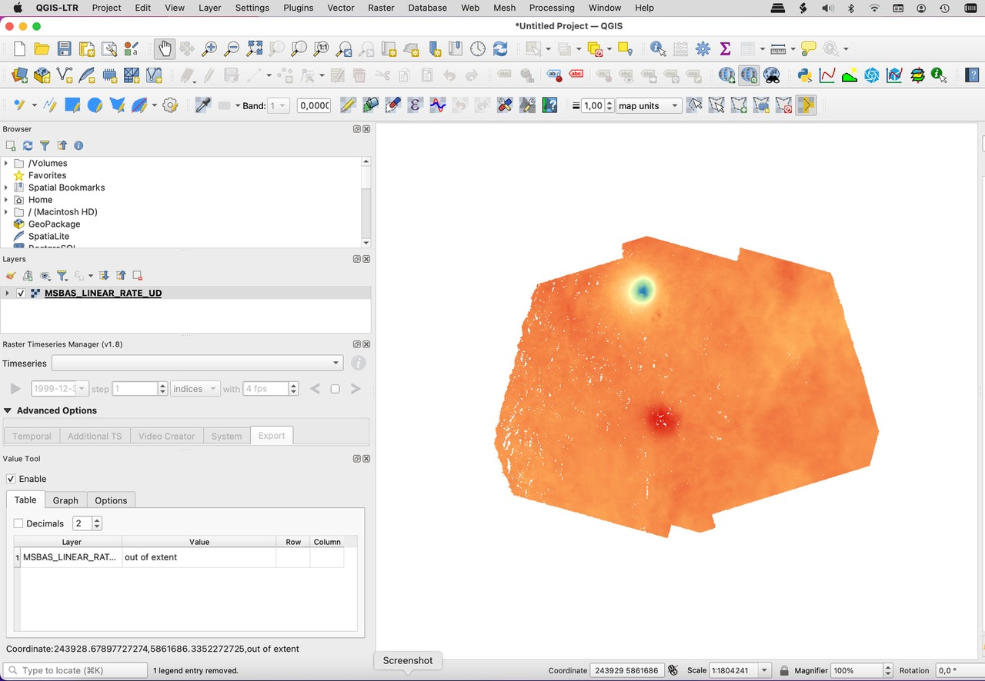
Data manipulation with QGIS
Pixel coordinates
Drag & drop e.g. the MSBAS_LINEAR_RATE_UD.bin In QGIS
[Double click on layer ➔ change Render type; transparency etc…]
Value Tool plugin: watch
“Value”
“Row” & “column”
“UTM values”
0.1803949
1471
2368
363431.842803030, 6006489.223484, 0.1803949177
363431 6006489

Slide 5
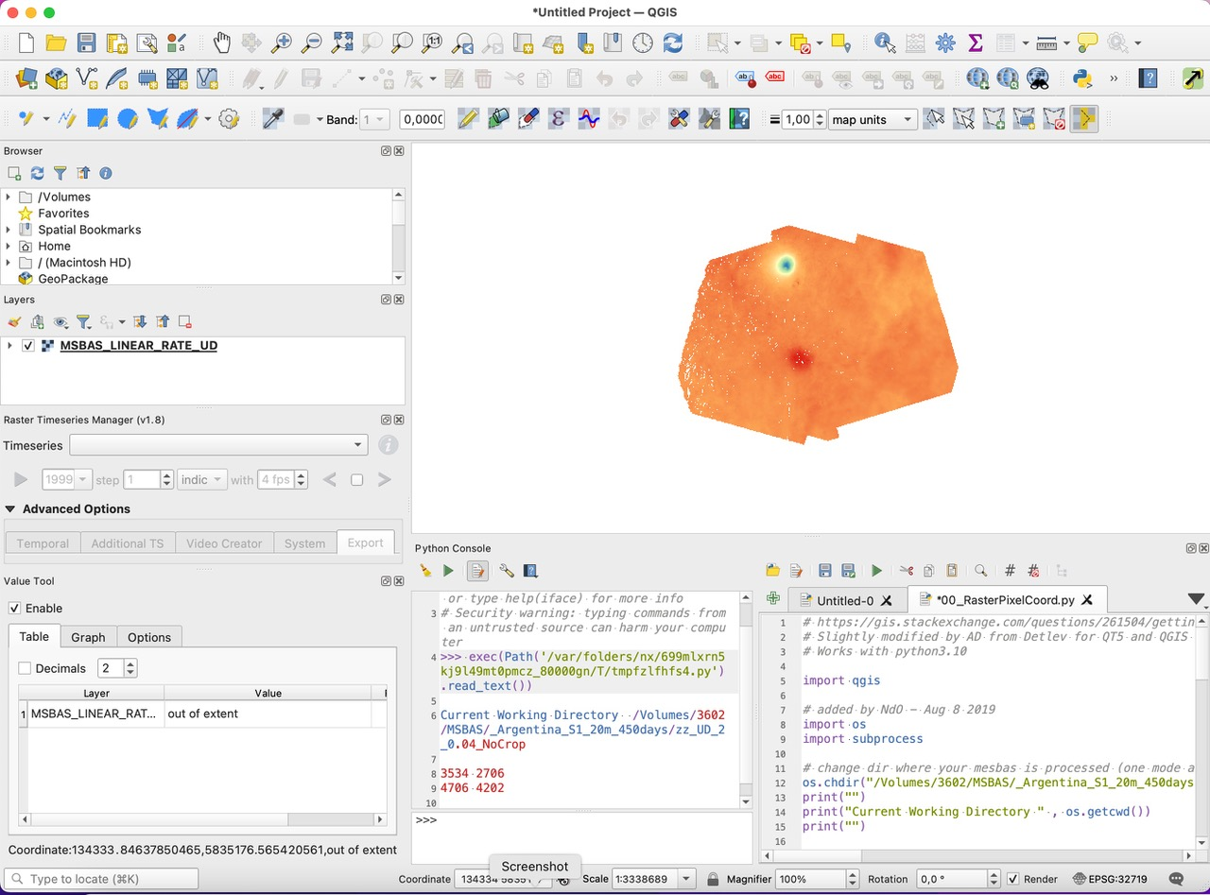
Data manipulation with QGIS
Pixel coordinates
PlotTS.sh from QGIS
Click on Plugins > Python Console
Open 00_RasterPixelCoord.py (in …/SAR/AMSTer/SCRIPTS_MT)
In line 12 of 00_RasterPixelCoord.py, change path to dir where msbas defo maps are stored, e.g. …/MSBAS/YourRegion/zz_Comp_...
Run it (click on )
Click on the defo map on the pixel where you want to plot the time series.
The coordinates of the pixel appear in the Console in red, and the plot is computed in …/MSBAS/YourRegion/zz_Comp_...

Slide 6
Data manipulation with QGIS
Pixel coordinates
PlotTS.sh from QGIS
Rasters manipulation
Click on Raster > Raster Calculator
Perform the computation you want, e.g.
Create mask based on a coherence threshold
Multiply a defo by a mask (1 everywhere, 0 where to mask)
Create a differential deformation map by substracting the deformation between two dates (= create a deformation map even between different satellites or acquisition mode !)
Etc…
Plus several other classical features from GIS software: create profiles etc…

Slide 7
Data manipulation with QGIS
Pixel coordinates
PlotTS.sh from QGIS
Rasters manipulation
Create a map of deformation masked by coherence on a Google Earth background
Try it – have fun !

Slide 8
Data manipulation with QGIS
Plan:
Pixel coordinates
PlotTS.sh from QGIS
Rasters manipulation
Create a map of deformation masked by coherence on a Google Earth background
- DONE ! -

