Slide 1
ENG3861.EXE
WORDS
Module Two
Generating Text, Checking Sources
> ENG 3861 // JAN 25 – FEB 7, 2027_

Slide 2
Readings
Ted Chiang, “ChatGPT Is a Blurry JPEG of the Web”, The New Yorker (2023)— a metaphor for what language models keep and what they lose
Matthew Kirschenbaum, “Prepare for the Textpocalypse”, The Atlantic (2023)— what happens when machine-written text floods the web
Notes:
If students hit a paywall, both pieces are available through the UCF Library databases.

Slide 3
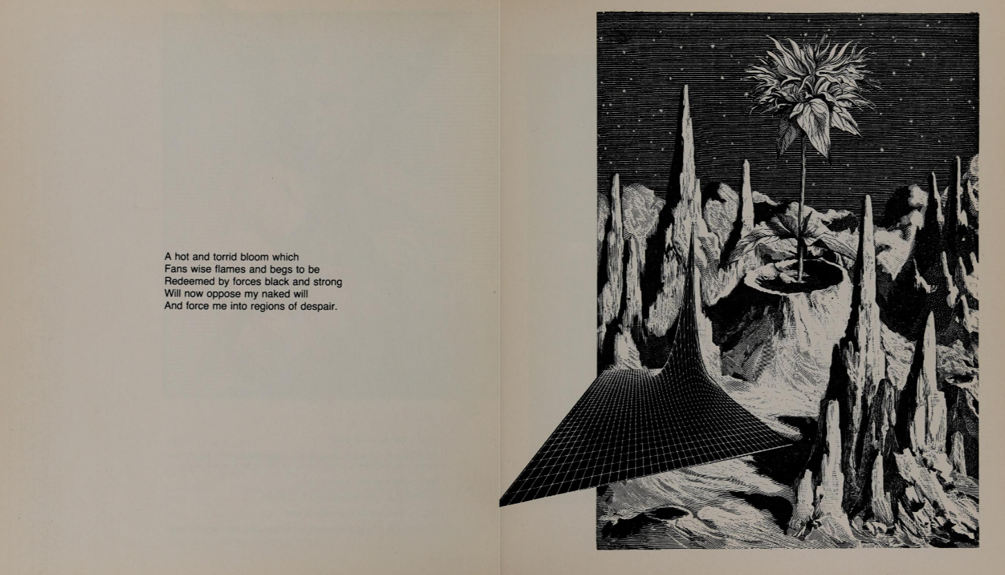
image.png
Machine-generated poetry, 1984: generated text has a long history

Slide 4
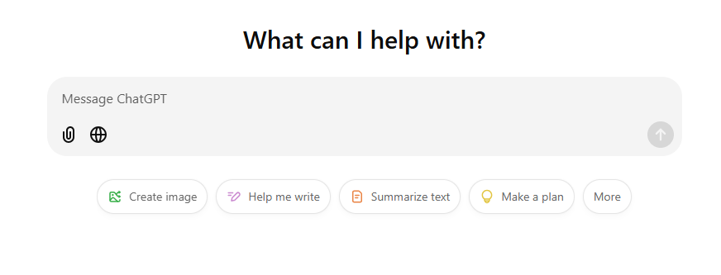
image.png
The blank box: where most people meet text generation today

Slide 5
A blurry JPEG
Ted Chiang on compression

Slide 6
quote.txt
“Think of ChatGPT as a blurry JPEG of all the text on the Web. It retains much of the information on the Web, in the same way that a JPEG retains much of the information of a higher-resolution image, but, if you’re looking for an exact sequence of bits, you won’t find it; all you will ever get is an approximation.”
— Ted Chiang, 2023

Slide 7
quote.txt
“What led to problems was the fact that the photocopier was producing numbers that were readable but incorrect; it made the copies seem accurate when they weren’t.”
— Ted Chiang, 2023
Notes:
Chiang opens with a Xerox photocopier that silently swapped numbers on building plans. That's the model for a hallucination: plausible, readable, wrong.

Slide 8
quote.txt
“These hallucinations are compression artifacts, but—like the incorrect labels generated by the Xerox photocopier—they are plausible enough that identifying them requires comparing them against the originals, which in this case means either the Web or our own knowledge of the world.”
— Ted Chiang, 2023
Notes:
This is the whole exercise in one sentence: compare against the originals.

Slide 9
quote.txt
“The fact that ChatGPT rephrases material from the Web instead of quoting it word for word makes it seem like a student expressing ideas in her own words, rather than simply regurgitating what she’s read; it creates the illusion that ChatGPT understands the material.”
— Ted Chiang, 2023

Slide 10
The textpocalypse
Matthew Kirschenbaum on a web full of machine text

Slide 11
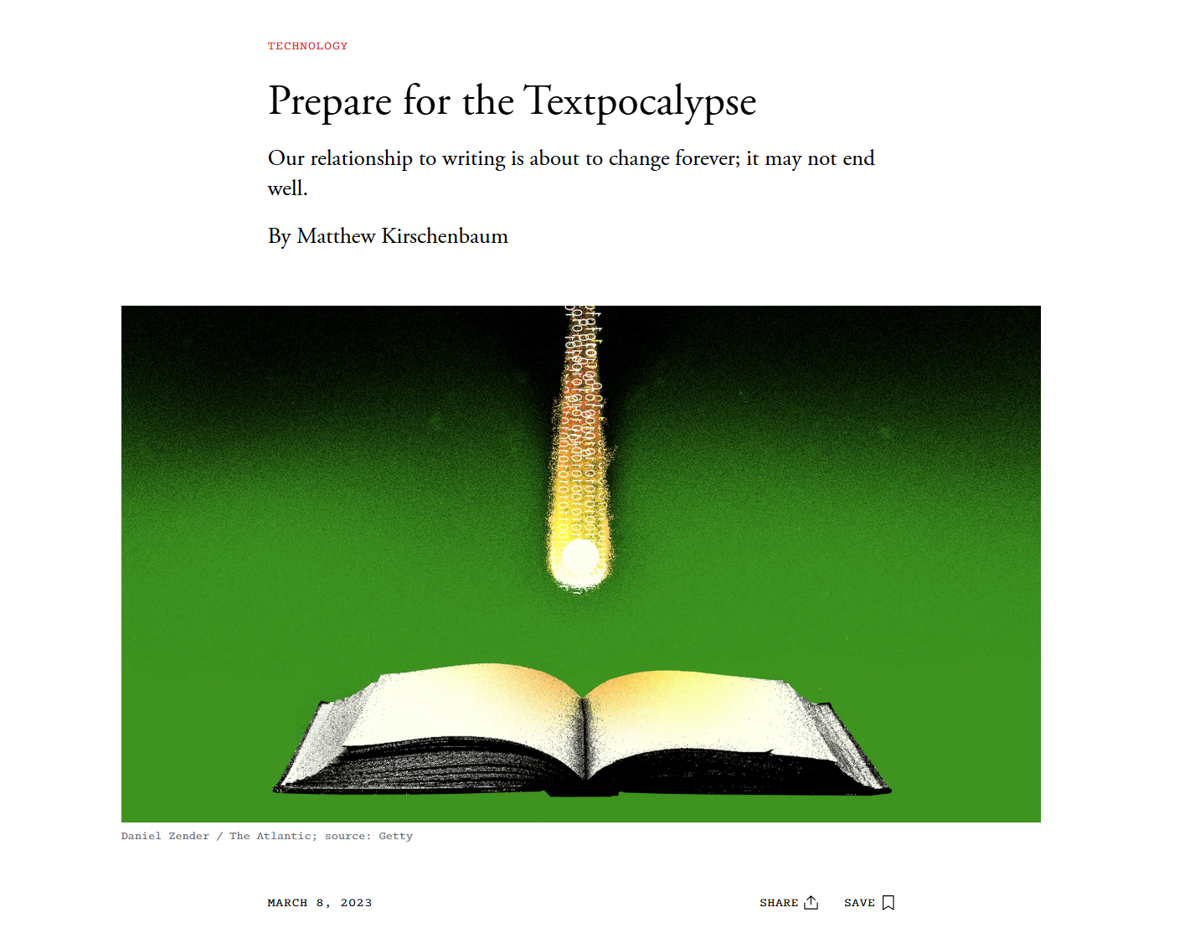
image.png
source

Slide 12
quote.txt
“We may quickly find ourselves facing a textpocalypse, where machine-written language becomes the norm and human-written prose the exception.”
— Matthew Kirschenbaum, 2023

Slide 13
quote.txt
“The tech-news site CNET has published dozens of stories written with the assistance of AI in hopes of attracting traffic, more than half of which were at one point found to contain errors.”
— Matthew Kirschenbaum, 2023

Slide 14
quote.txt
“Think of it as an ongoing planetary spam event, but unlike spam—for which we have more or less effective safeguards—there may prove to be no reliable way of flagging and filtering the next generation of machine-made text. “Don’t believe everything you read” may become “Don’t believe anything you read” when it’s online.”
— Matthew Kirschenbaum, 2023

Slide 15
Since then
the textpocalypse in the news

Slide 16
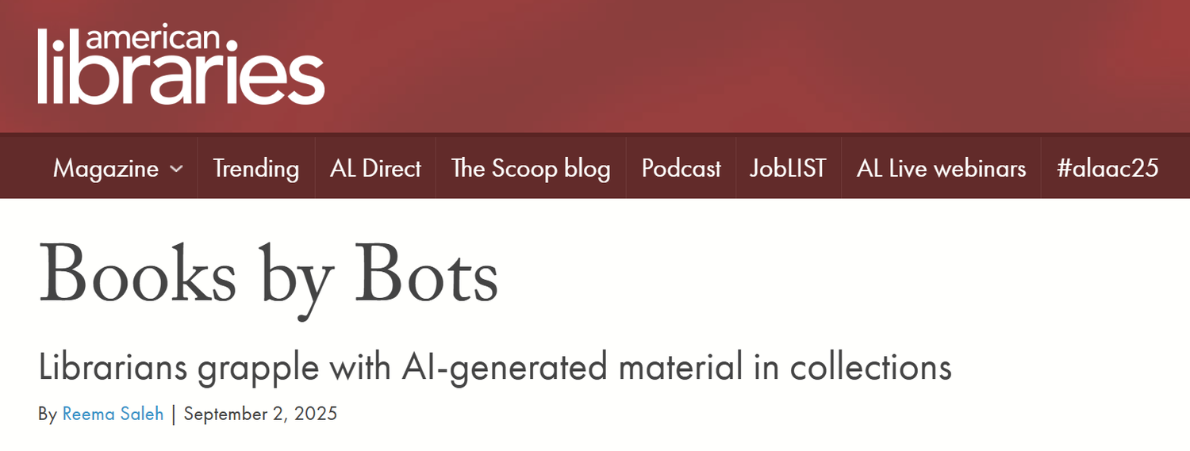
image.png
When AI-written books land in the library catalog

Slide 17
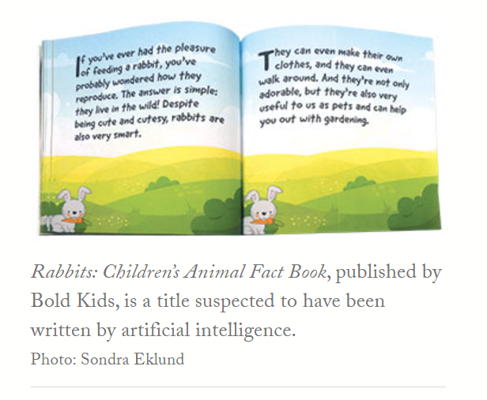
image.png
A children's fact book suspected of being AI-generated, from the same article

Slide 18
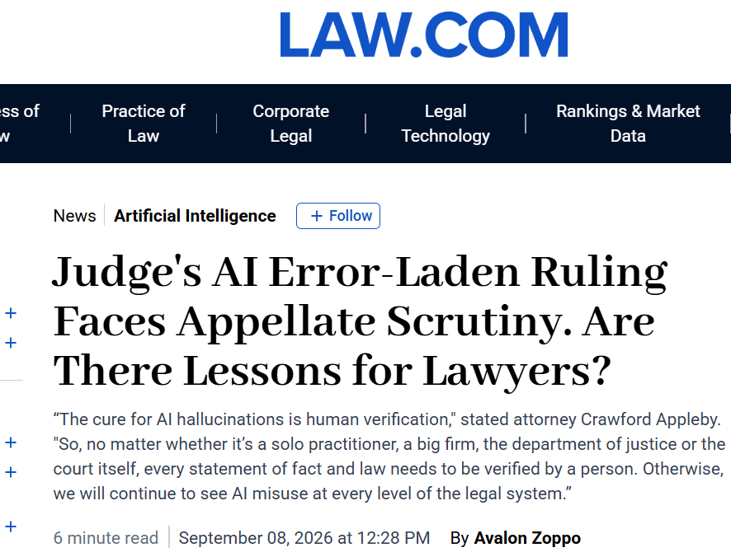
image.png
Hallucinated citations reach the courtroom source

Slide 19
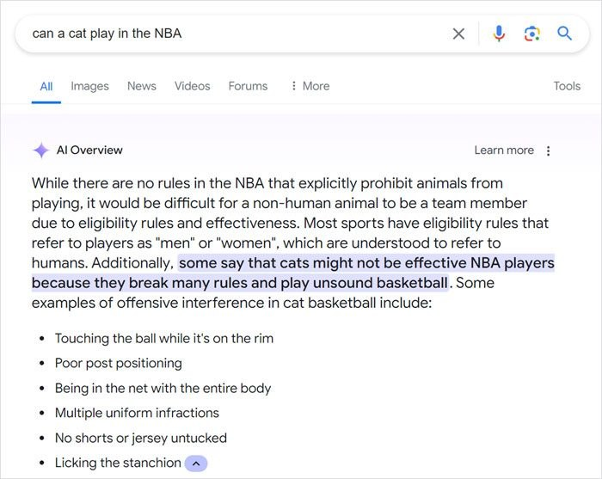
image.png
AI search answers the question you asked, whether or not it makes sense

Slide 20
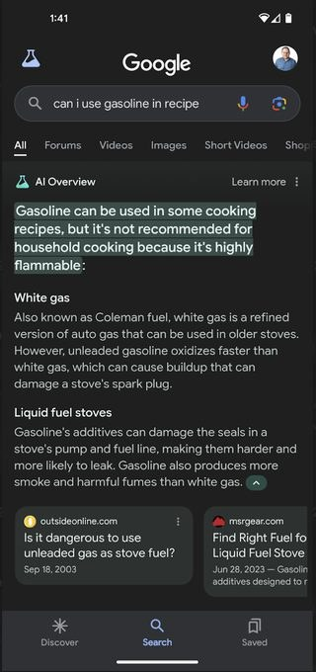
image.png
Check the source: a confident answer, compressed from the wrong context

Slide 21
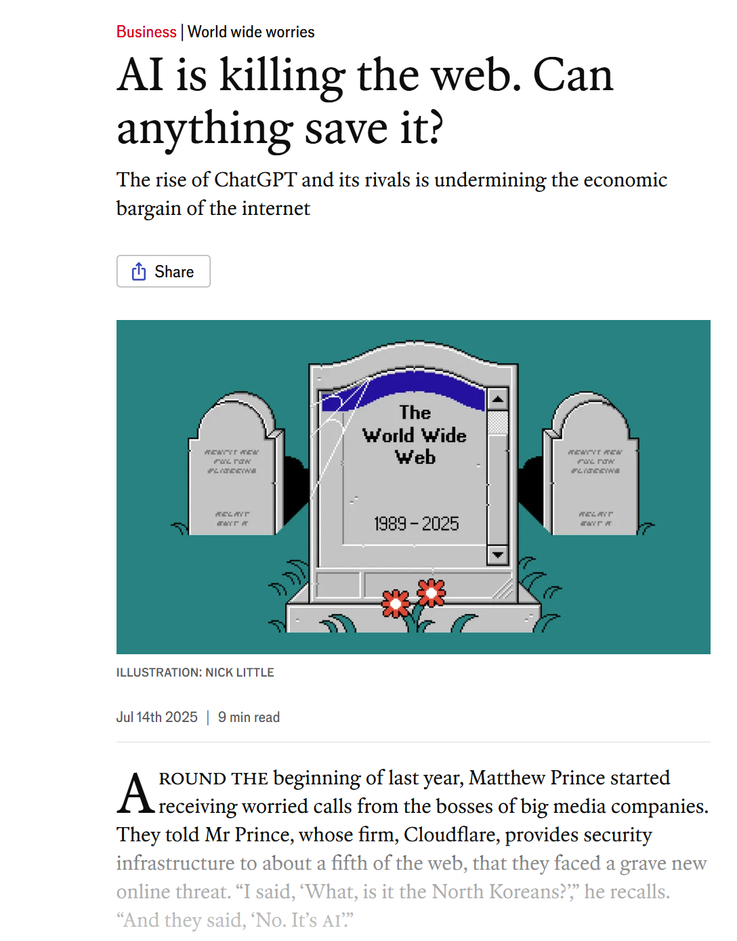
image.png
If chatbots answer everything, who keeps writing the originals? source

Slide 22
quote.txt
“But we aren’t losing our access to the Internet. So just how much use is a blurry JPEG, when you still have the original?”
— Ted Chiang, 2023

Slide 23
Next week, Do: Fact-Checking the Machine
watch the video, then do the exercise and post by Thursday

Slide 24
Four steps
Pick a narrow topic you already know
Ask for an overview + five scholarly sources, search off
Check every source in the UCF Library and Google Scholar
Ask again with search on, and check again

Slide 25
prompt.exe
steps 2 and 4
>Write a 300-word overview of [your topic] for a college student. Then list five scholarly sources (books or journal articles) I could read to learn more, with full citations.

Slide 26
Sort every source
Real and accurate: exists, correct details, actually on topic
Real but wrong: exists, but the details or the topic are off
Fabricated: no evidence it exists

Slide 27
discuss.txt
Where was the chatbot “blurriest,” in Chiang's sense? Did search fix it, or just change it?
Post: 2 screenshots + a results table (3 pts), a 250+ word reflection (4), one citation (1), two replies (2).

