Slide 1
Module Five: Archives and Collections
ENG3861.EXE
IMAGES
Module Five
Archives and Collections
> ENG 3861 // MAR 8 – MAR 28, 2027_

Slide 2
Readings
Readings
Kate Crawford and Trevor Paglen, “Excavating AI” (2019) — the labels inside an image-training dataset
“The Santa Barbara Statement on Collections as Data” (2017-2018) — librarians and archivists on opening collections responsibly
Notes:
This module spans spring break (March 15-21). Nothing is due over the break; the module closes March 28.

Slide 3
Collections become data
Collections become data

Slide 4
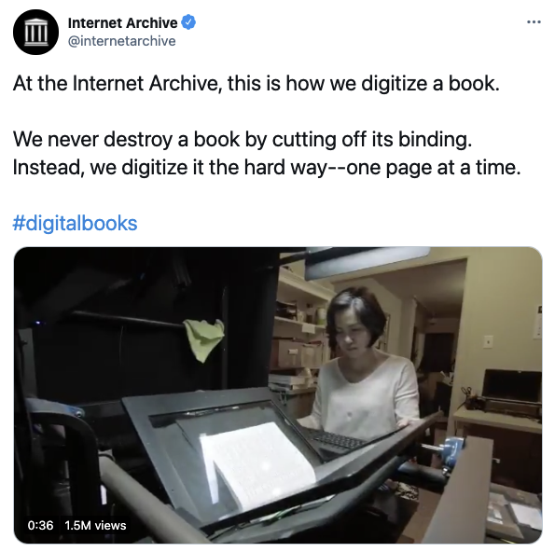
Building a digital collection, one page at a time
image.png
Building a digital collection, one page at a time

Slide 5
Quote: The Santa Barbara Statement on Collections as Data
quote.txt
“Data as well as the data that describe those data are considered in scope. For example, images and the metadata, finding aids, and/or catalogs that describe them are equally in scope.”
— The Santa Barbara Statement on Collections as Data
Notes:
Metadata is part of the collection. That's what students will compare the AI's descriptions against.

Slide 6
Quote: The Santa Barbara Statement on Collections as Data
quote.txt
“Collections as data designed for everyone serve no one. Specific needs inform collections as data development.”
— The Santa Barbara Statement on Collections as Data

Slide 7
Images do not describe themselves
Images do not describe themselves
Crawford and Paglen dig into ImageNet

Slide 8
Quote: Kate Crawford and Trevor Paglen, 2019
quote.txt
“Images do not describe themselves. This is a feature that artists have explored for centuries. Agnes Martin creates a grid-like painting and dubs it “White Flower,” Magritte paints a picture of an apple with the words “This is not an apple.” We see those images differently when we see how they’re labeled.”
— Kate Crawford and Trevor Paglen, 2019

Slide 9
Quote: Kate Crawford and Trevor Paglen, 2019
quote.txt
“There’s a kind of sorcery that goes into the creation of categories. To create a category or to name things is to divide an almost infinitely complex universe into separate phenomena.”
— Kate Crawford and Trevor Paglen, 2019

Slide 10
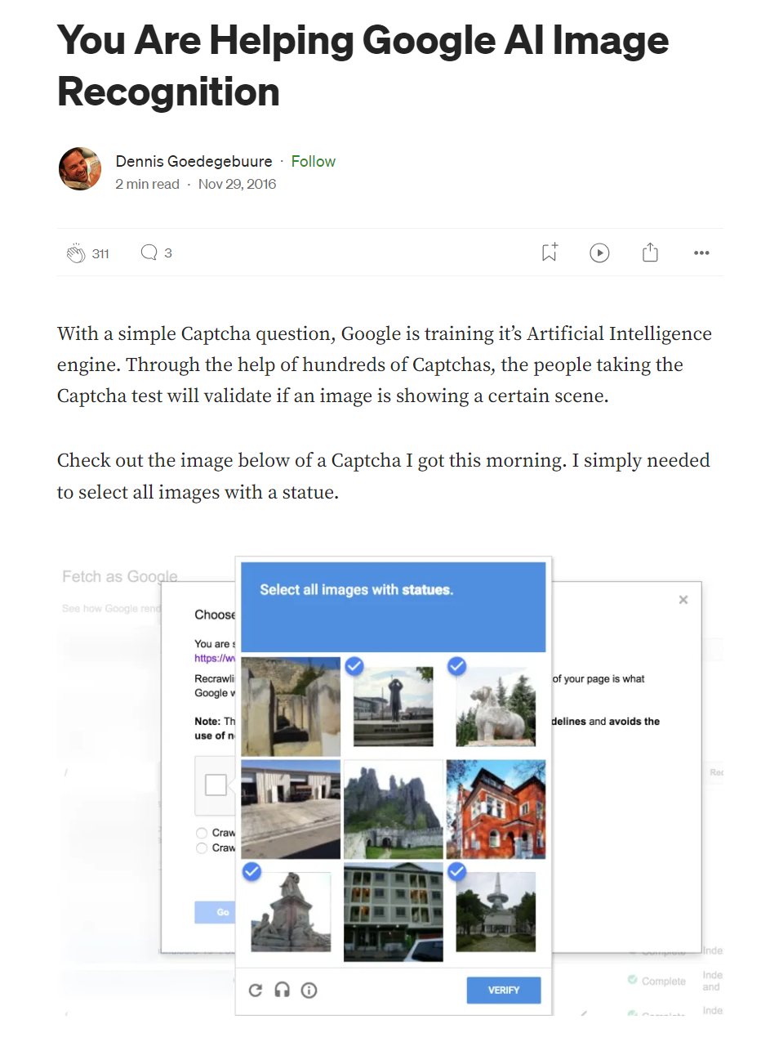
Every captcha is a labeling job: you classify images for AI training
image.png
Every captcha is a labeling job: you classify images for AI training source

Slide 11

The human labor behind labeled training data
image.png
The human labor behind labeled training data source

Slide 12
Quote: Kate Crawford and Trevor Paglen, 2019
quote.txt
“These gradients have been erased in the logic of ImageNet. Everything is flattened out and pinned to a label, like taxidermy butterflies in a display case.”
— Kate Crawford and Trevor Paglen, 2019

Slide 13
Quote: Kate Crawford and Trevor Paglen, 2019
quote.txt
“Regardless of the supposed neutrality of any particular category, the selection of images skews the meaning in ways that are gendered, racialized, ableist, and ageist. ImageNet is an object lesson, if you will, in what happens when people are categorized like objects.”
— Kate Crawford and Trevor Paglen, 2019

Slide 14
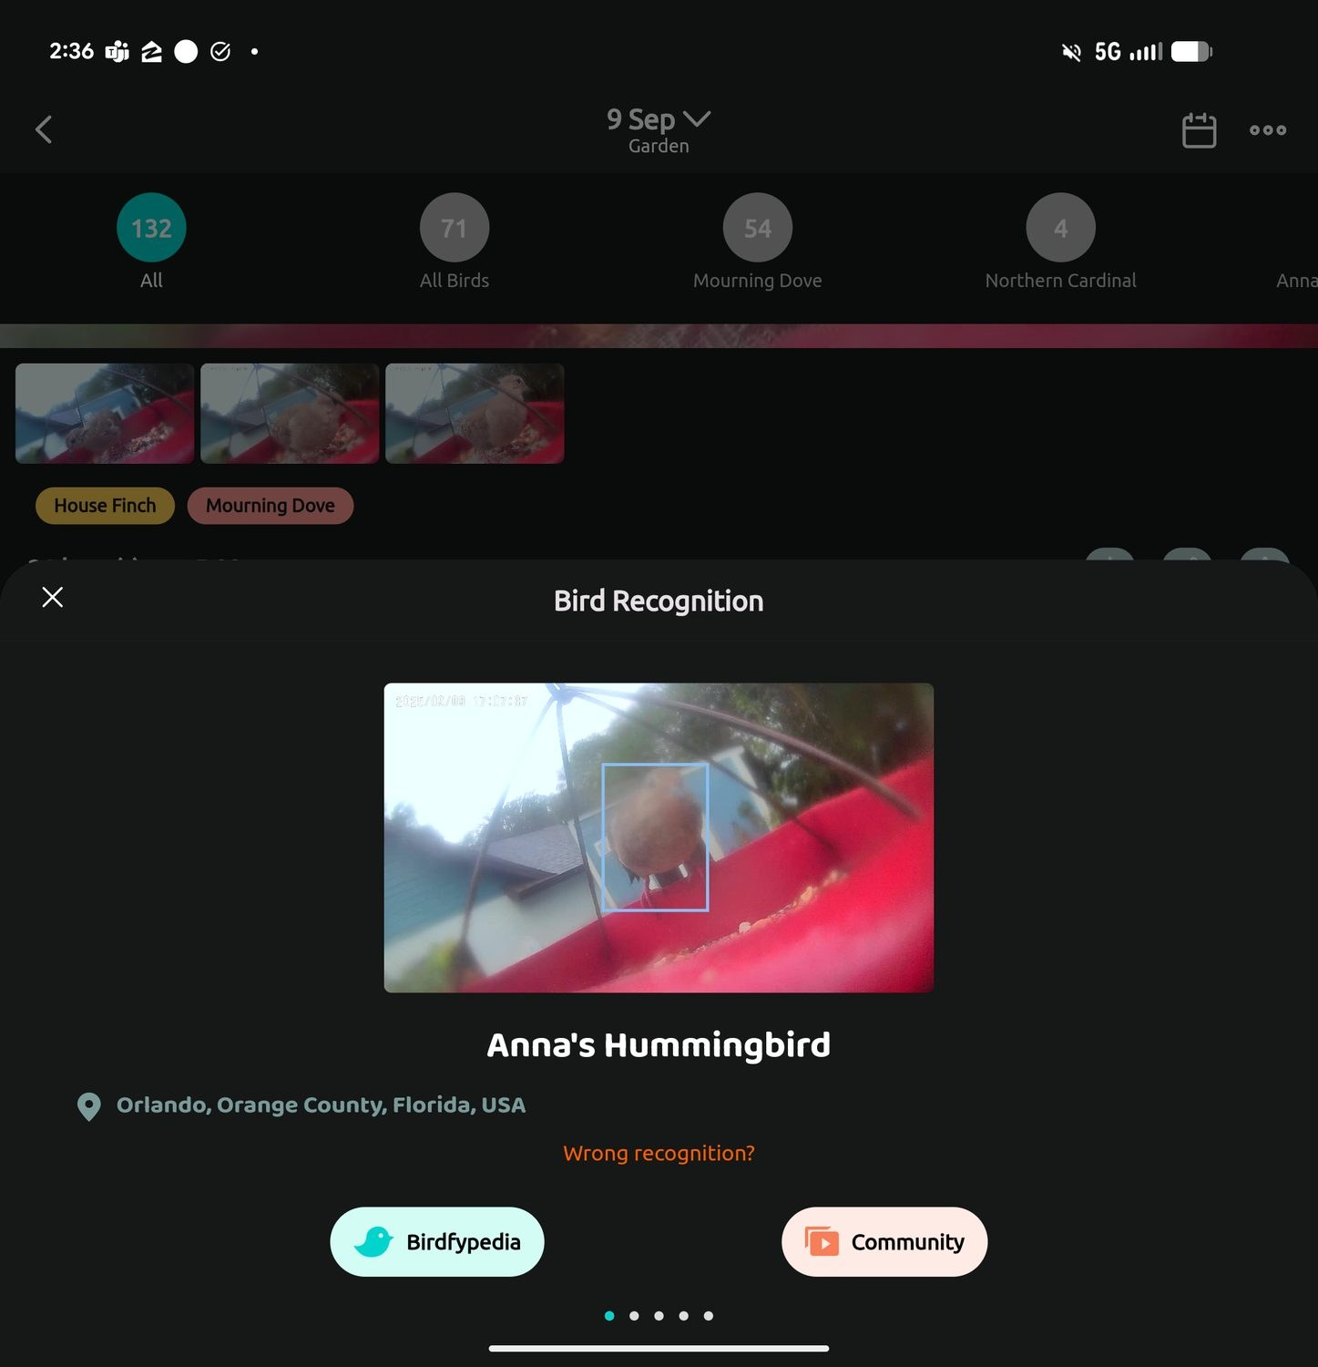
AI classification in an Orlando backyard. Is that really a hummingbird?
image.png
AI classification in an Orlando backyard. Is that really a hummingbird?

Slide 15
Archives, art, and AI
Archives, art, and AI

Slide 16
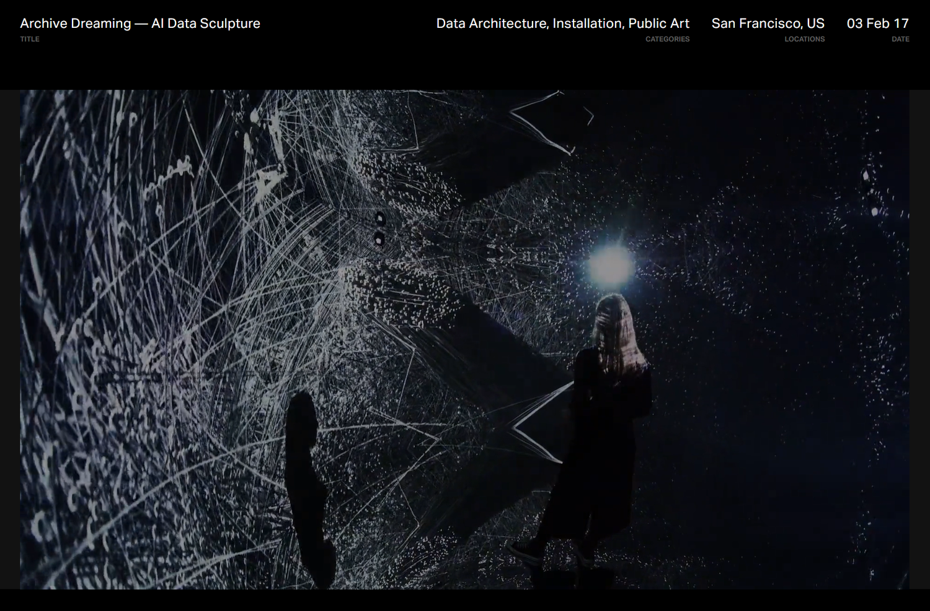
Refik Anadol's Archive Dreaming (2017): an archive turned into an AI installation
image.png
Refik Anadol's Archive Dreaming (2017): an archive turned into an AI installation source

Slide 17
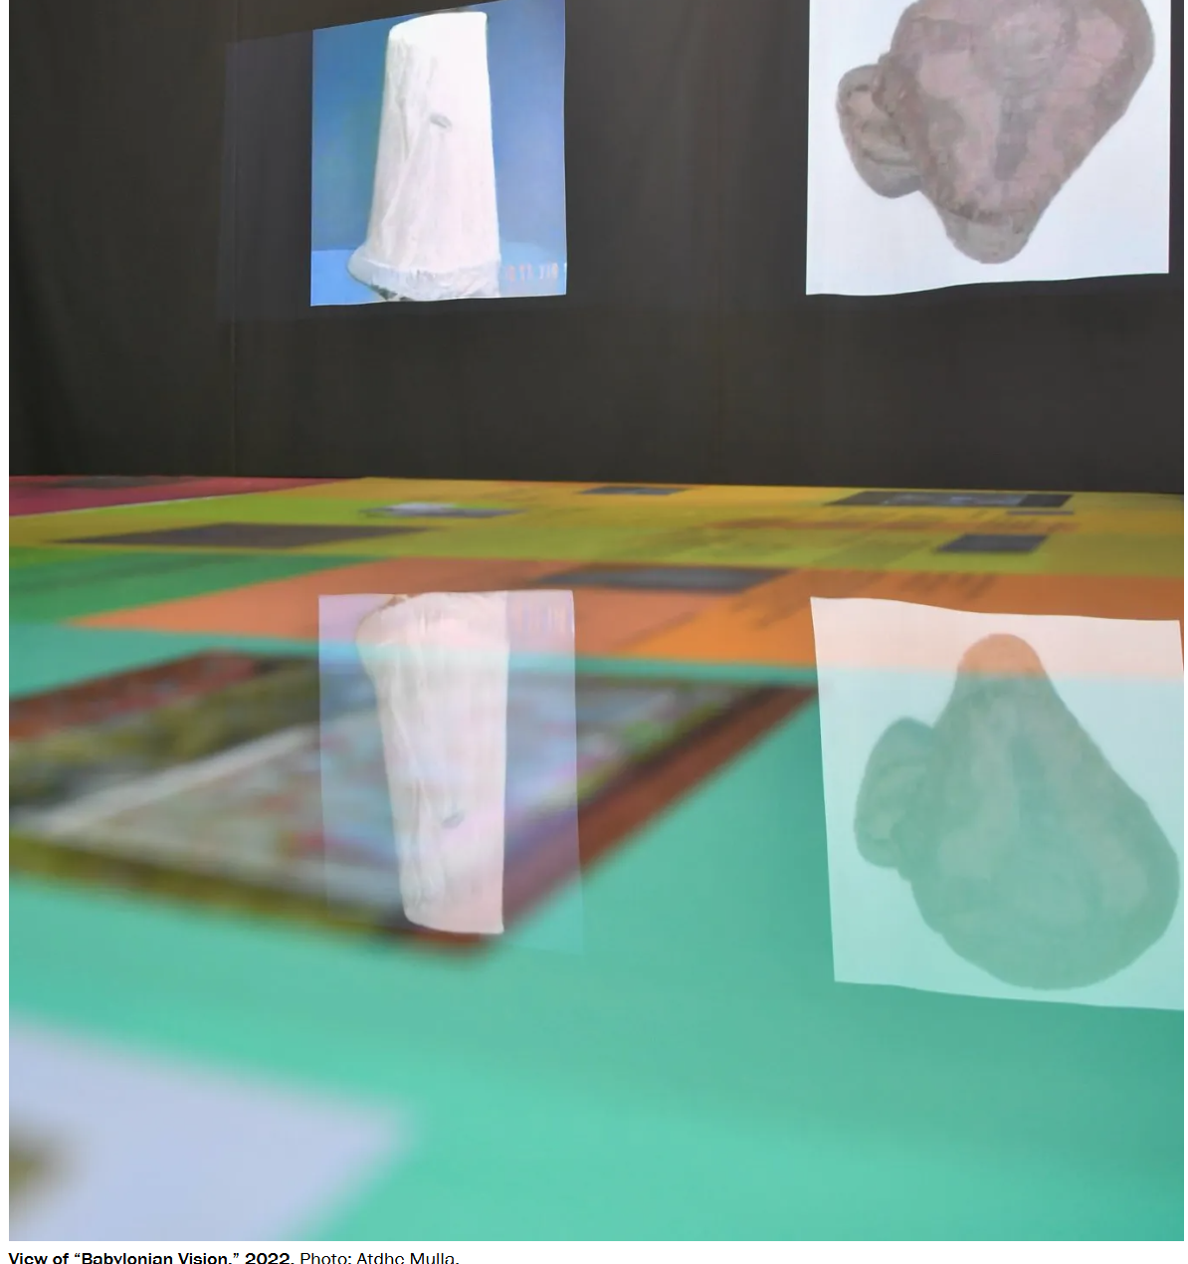
Nora Al-Badri's Babylonian Vision: a model trained on museum collections
image.png
Nora Al-Badri's Babylonian Vision: a model trained on museum collections source

Slide 18
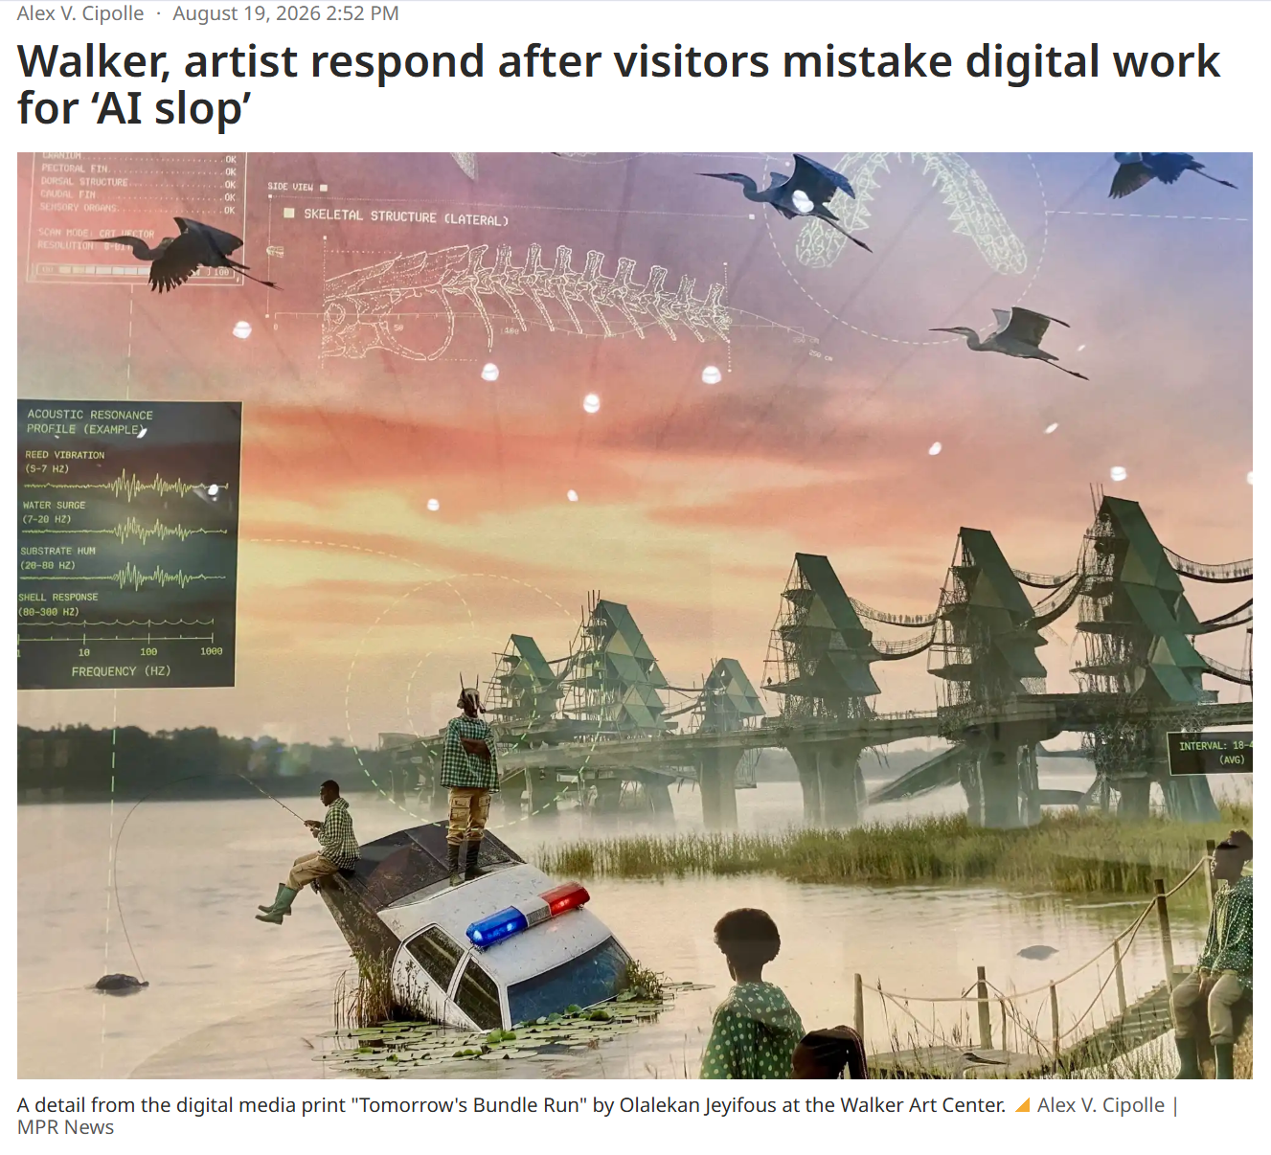
At the museum: real digital art mistaken for AI
image.png
At the museum: real digital art mistaken for AI source

Slide 19
Altering the record
Altering the record

Slide 20
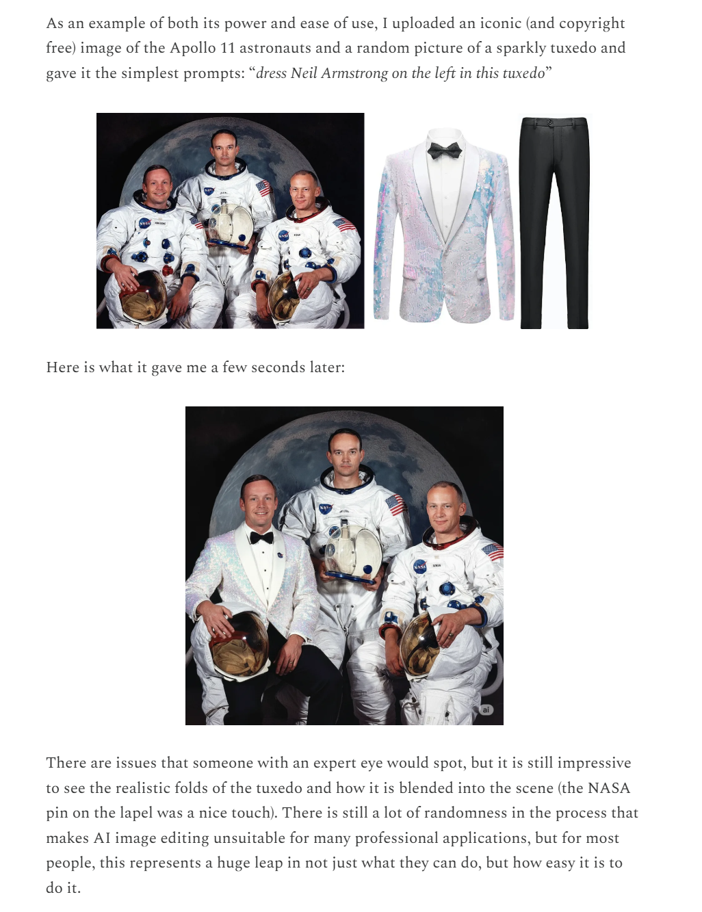
One prompt, and a historical photograph is altered
image.png
One prompt, and a historical photograph is altered

Slide 21
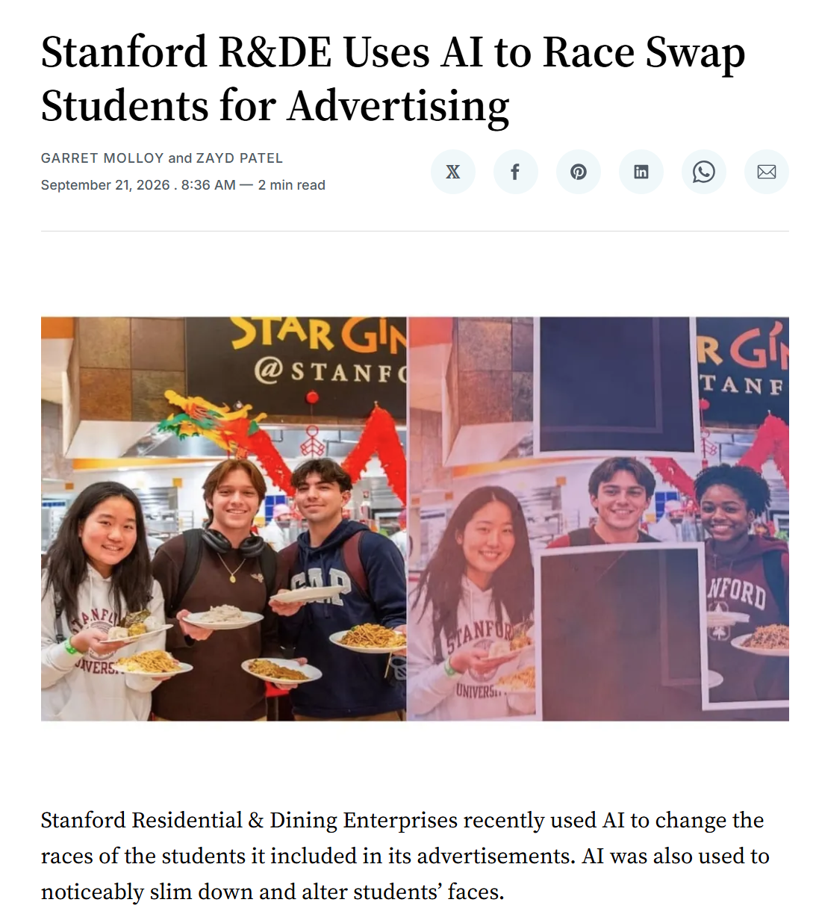
Real photo, altered ad: AI rewrites who appears in the record
image.png
Real photo, altered ad: AI rewrites who appears in the record source

Slide 22
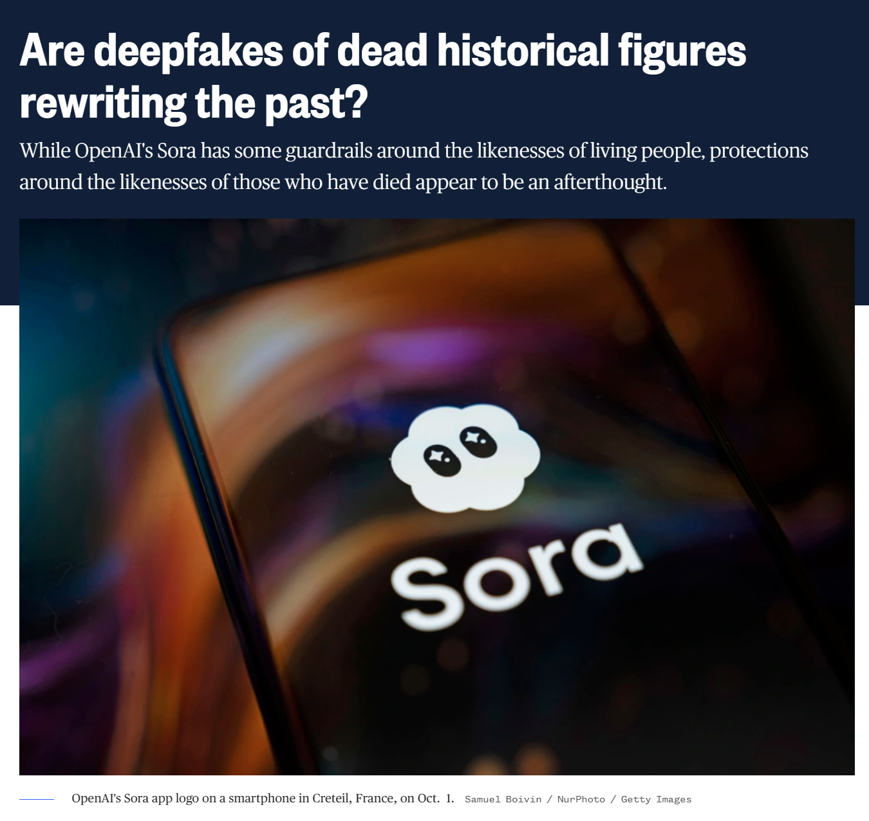
Deepfaked history: generated video of people who have died
image.png
Deepfaked history: generated video of people who have died

Slide 23
Quote: Kate Crawford and Trevor Paglen, 2019
quote.txt
“The whole endeavor of collecting images, categorizing them, and labeling them is itself a form of politics, filled with questions about who gets to decide what images mean and what kinds of social and political work those representations perform.”
— Kate Crawford and Trevor Paglen, 2019

Slide 24
Quote: The Santa Barbara Statement on Collections as Data
quote.txt
“The scale of some collections may also obfuscate what is hidden or missing in the histories they are perceived to represent. Cultural heritage institutions must be mindful of these absences and plan to work against their repetition.”
— The Santa Barbara Statement on Collections as Data

Slide 25
Next week, Do: Describing the Archive
Next week, Do:
Describing the Archive
watch the video, then do the exercise and post by Thursday

Slide 26
Four steps
Four steps
Build a set of 5-8 related images from the Library of Congress, Smithsonian, or Internet Archive
Save each item's catalog record
Ask an AI to describe and catalog each image, without the record
Compare, then ask it to sort the whole set

Slide 27
Prompt: step 2, one image at a time
prompt.exe
step 2, one image at a time
> Describe this image in detail. Then write alt text for it (under 150 characters), and suggest a title, an approximate date, and five subject keywords as if you were cataloging it for a library.

Slide 28
Compare with the catalog
Compare with the catalog
What did the AI get right?
What did it get wrong (dates, places, people)?
What did it assume or invent?
What does the catalog know that the image can't show?

Slide 29
Discussion question
discuss.txt
Would you trust this AI's alt text if you depended on a screen reader?
Post: 3 AI descriptions + catalog links (3 pts), a 250+ word reflection (4), one citation (1), two replies (2).

Slide 30
Quote: The Santa Barbara Statement on Collections as Data
quote.txt
“Documentation must also attest to the history of how the collection has been treated over time. While no documentation can be fully comprehensive, incomplete or in-progress documentation is better than no documentation.”
— The Santa Barbara Statement on Collections as Data

